Slide 1

INSTANT MESSAGING

Slide 2
Introduction
Instant Messaging Service will provide an online messaging system to the college staff in order to send information to students concerned instantly. We have added various features to this application so that the all information activities can be managed. The prime objective of this application is to send messages to a selected group consisting of students in order to send information altogether instantly.

Slide 3
Market Potential
As this is a general purpose project the market potential for it is limited. There are no financial motivations behind building this project. The main motivation is experimentation and developing a world class piece of software.
On the flip side the popularity of this project is expected to rise gradually. We expect that the number of downloads of this project would be 300 in a year. Then with more addition in functionality the popularity of this project is expected to raise more.

Slide 4
Software & Hardware Requirements
Processors: Intel Pentium 4(FAMILY)
RAM: 512MB
Operating System: Microsoft windows XP Professional
Web Server: IIS (Internet Information Server)
Language: C#
Database: SQL SERVER 2005
Browser: Internet Explorer, Firefox
Development Software: Visual Studio 2008

Slide 5
What is ASP.net?
ASP.NET is a server side scripting technology that enables scripts (embedded in web pages) to be executed by an Internet server.
ASP.NET is a Microsoft Technology
ASP stands for Active Server Pages
ASP.NET is a program that runs inside IIS
IIS (Internet Information Services) is Microsoft's Internet server
IIS comes as a free component with Windows servers
IIS is also a part of Windows 2000 and XP Professional

Slide 6
Advantages of using .net framework
Reduced amount of code
Declarative programming model
Richer server control hierarchy with events
Larger class library
Better support for development tools
Easier and quicker programming

Slide 7
IIS
IIS (Internet Information Server) is a group of Internet servers (including a Web or Hypertext Transfer Protocol server and a File Transfer Protocol server) with additional capabilities for Microsoft's Windows NT and Windows 2000 Server operating systems. IIS is Microsoft's entry to compete in the Internet server market that is also addressed by Apache, Sun Microsystems, O'Reilly, and others. With IIS, Microsoft includes a set of programs for building and administering Web sites, a search engine, and support for writing Web-based applications that access databases. Microsoft points out that IIS is tightly integrated with the Windows NT and 2000 Servers in a number of ways, resulting in faster Web page serving.

Slide 8
What is SQL?
SQL is a special-purpose language used to define, access, and manipulate data. SQL is nonprocedural, meaning that it describes the necessary components (i.e., tables) and desired results without dictating exactly how those results should be computed. Every SQL implementation sits atop a database engine, whose job it is to interpret SQL statements and determine how the various data structures in the database should be accessed to accurately and efficiently produces the desired outcome.

Slide 9
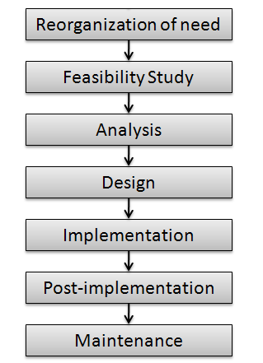
System Development Life Cycle

Slide 10
Software Process Development Model
Agile Software Development Process:
Agile methodology is an approach to project management, typically used in software development. It helps teams respond to the unpredictability of building software through incremental, iterative work cadences, known as sprints. But before discussing agile methodologies further, it’s best to first turn to the methodology that inspired it: waterfall, or traditional sequential development.

Slide 11
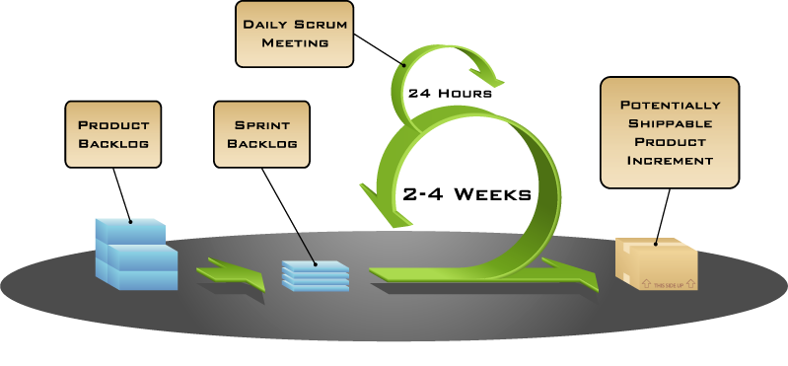

Slide 12
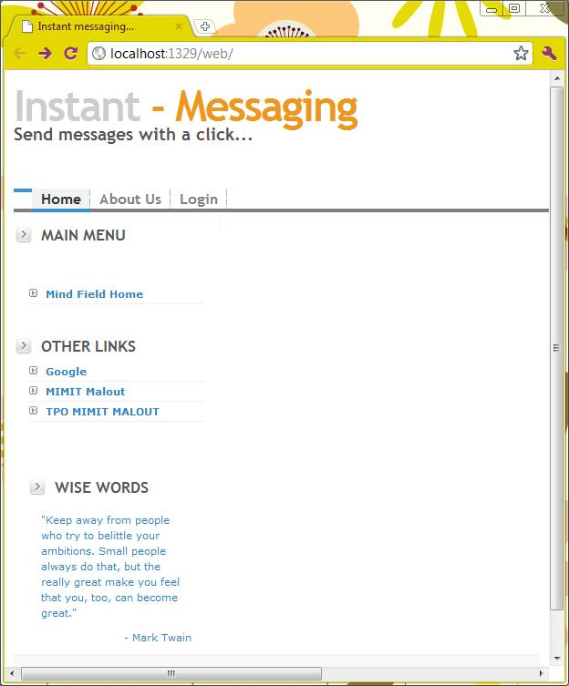
HOME PAGE…

Slide 13
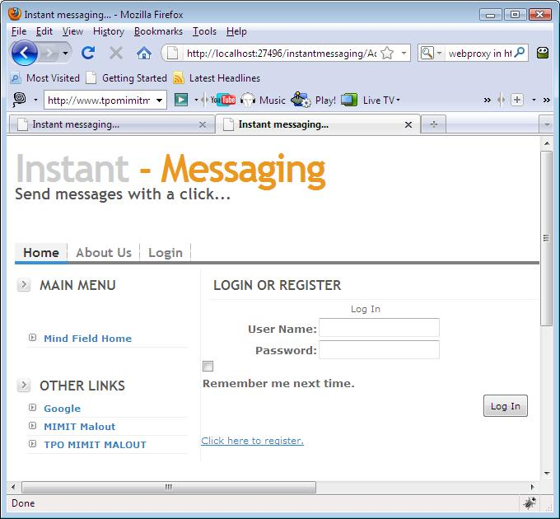
LOGIN PAGE….

Slide 14
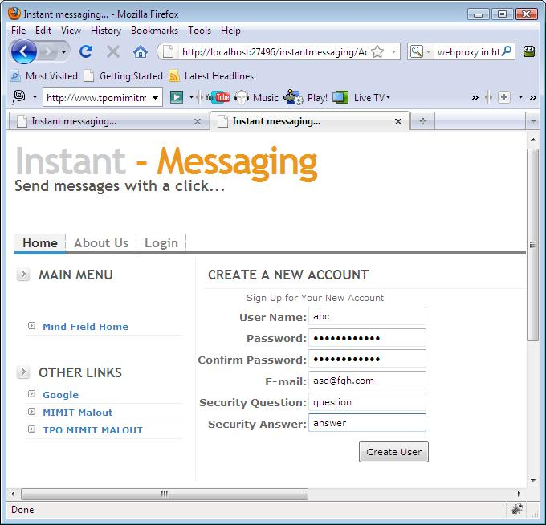
REGISTRATION FORM….

Slide 15
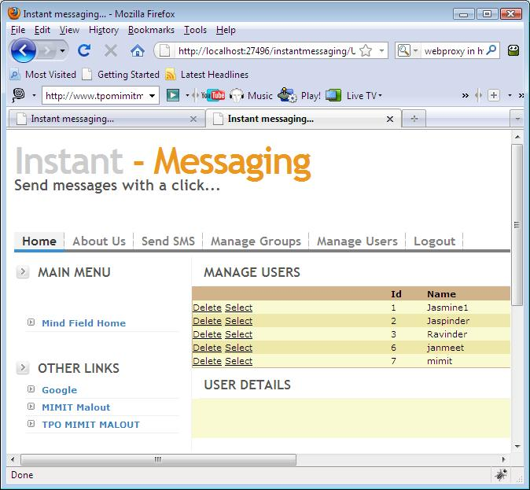
MANAGING USERS…

Slide 16
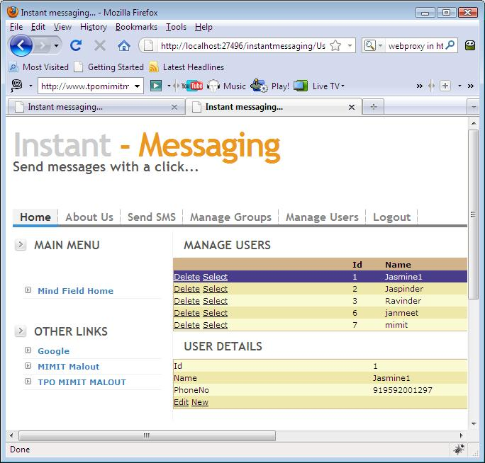
USER DETAILS…

Slide 17
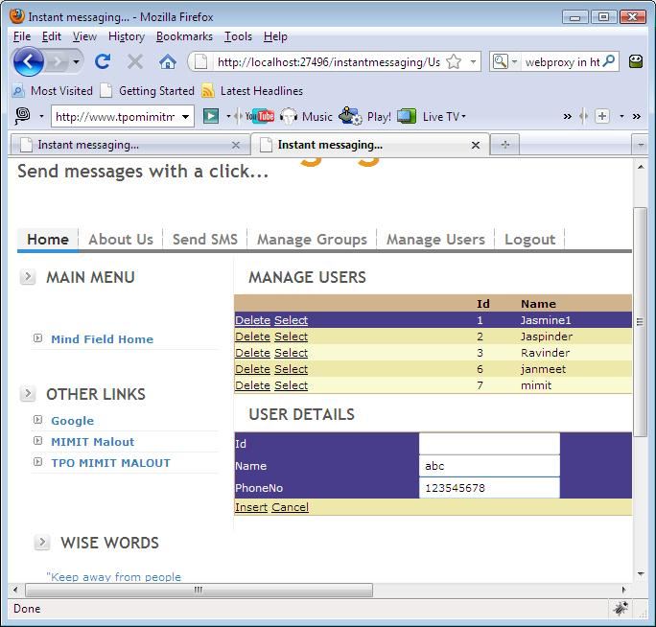
INSERT NEW USER…

Slide 18
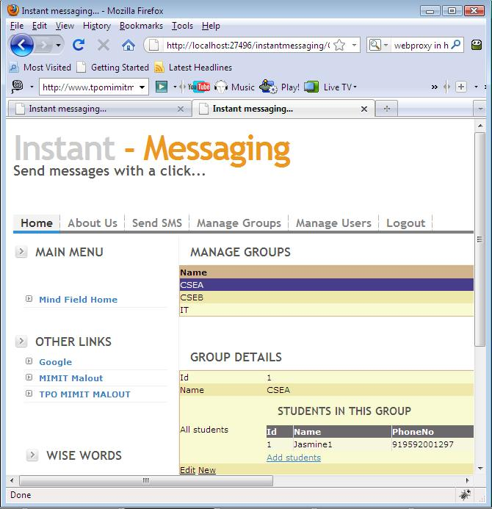
MANAGING USERS…

Slide 19
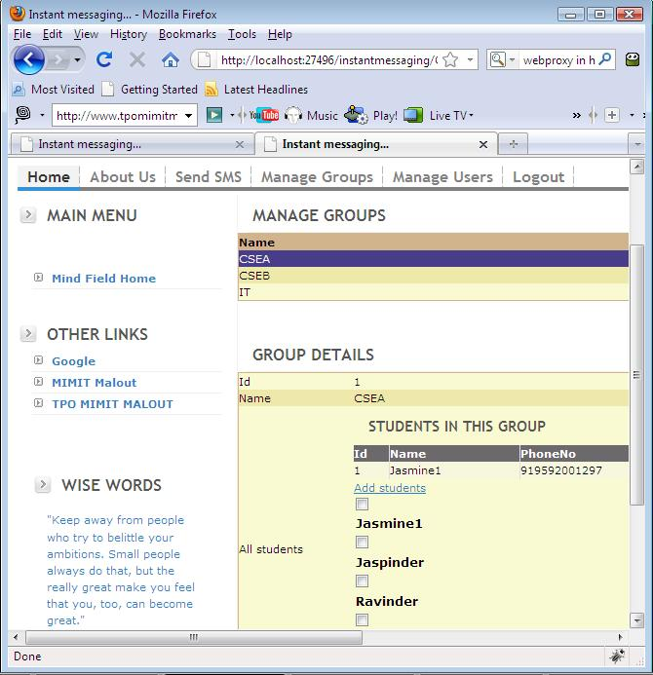
ADDING STUDENTS TO GROUP…

Slide 20
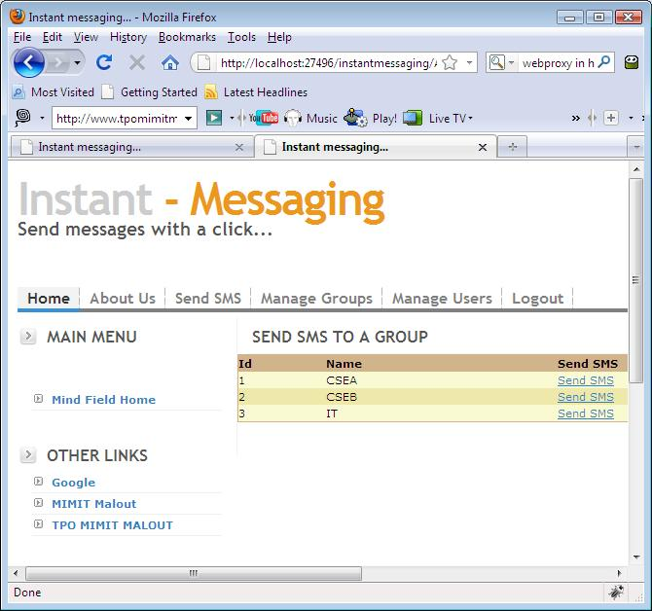
SEND SMS…

Slide 21
SENDING SMS TO GROUP…

Slide 22
Thank You

