Slide 1
Single-Sign Authentication
Kerberos
With Mail Server

Slide 2
PROJECT OVERVIEW
This project provide high security of user’s authentication and application server’s (Mail Server) authentication that users and application server is genuine or not.
In this project users can be login without password to application server. This project provides last level security of authentication.

Slide 3

What is Kerberos?
Developed by MIT
Shared secret-based strong 3rd party authentication
Provides single sign-on capability
Passwords never sent across network

Slide 4
Some Kerberos benefits
Standards based strong authentication system
Wide support in various operating systems
Make strong authentication readily available for use with campus computer systems
Prevents transmission of passwords over the network
Provides “single-sign-on” capability
  Only 1 password to remember
  Only need to enter it once per day (typically)

Slide 5
XYZ Service
Key
Distribution
Center
Ticket
Granting
Service
“Kerberos Server”
Authen-
Tication
Service
Harry
Desktop
Computer
Harry

Slide 6
XYZ Service
Key
Distribution
Center
Ticket
Granting
Service
Represents something requiring Kerberos authentication (web server, ftp server, ssh server, Mail Server etc…)
Authen-
Tication
Service
Harry
Desktop
Computer
Harry

Slide 7
XYZ Service
Key
Distribution
Center
Ticket
Granting
Service
“I’d like to be allowed to get tickets from the Ticket Granting Server, please.
Authen-
Tication
Service
Harry
Desktop
Computer
Harry
Trusted Third-Party

Slide 8

XYZ Service
Key
Distribution
Center
Ticket
Granting
Service
“Okay. I locked this box with your secret password. If you can unlock it, you can use its contents to access my Ticket Granting Service.”
Authen-
Tication
Service
Harry
Desktop
Computer
Harry

Slide 9

XYZ Service
Key
Distribution
Center
Ticket
Granting
Service
Authen-
Tication
Service
Harry
Desktop
Computer
TGT
myPassword
Harry

Slide 10
Because Client was able to open the box (decrypt a message) from the Authentication Service, she is now the owner of a shiny “Ticket-Granting Ticket”.
The Ticket-Granting Ticket (TGT) must be presented to the Ticket Granting Service in order to acquire “service tickets” for use with services requiring Kerberos authentication.
The TGT contains no password information.
TGT

Slide 11
XYZ Service
“Let me prove I am Client to XYZ Service.
Here’s a copy of my TGT!”
Key
Distribution
Center
Ticket
Granting
Service
TGT
Authen-
Tication
Service
TGT
Harry
Desktop
Computer
use XYZ
Harry

Slide 12
XYZ Service
Hey XYZ:
Harry is Harry.
CONFIRMED: TGS
Key
Distribution
Center
Ticket
Granting
Service
You’re Harry.
Here, take this.
Authen-
Tication
Service
TGT
Harry
Desktop
Computer
Harry

Slide 13
XYZ Service
Key
Distribution
Center
Ticket
Granting
Service
I’m Harry. I’ll prove it. Here’s a copy of my legit service ticket for XYZ.
Authen-
Tication
Service
Hey XYZ:
Harry is Harry .
CONFIRMED: TGS
TGT
Hey XYZ:
Harry is Harry.
CONFIRMED: TGS
Harry
Desktop
Computer
Harry

Slide 14
XYZ Service
That’s Harry alright. Let me determine if he is authorized to use me.
Key
Distribution
Center
Ticket
Granting
Service
Hey XYZ:
Harry is Harry.
CONFIRMED: TGS
Authen-
Tication
Service
Hey XYZ:
Harry is Harry.
CONFIRMED: TGS
TGT
Harry
Desktop
Computer
Harry

Slide 15
Authorization checks are performed by the XYZ service…
Just because Client has authenticated herself does not inherently mean he is authorized to make use of the XYZ service.

Slide 16
One remaining note:
Tickets (your TGT as well as service-specific tickets) have expiration dates configured by your local system administrator(s). An expired ticket is unusable.
Until a ticket’s expiration, it may be used repeatedly.

Slide 17
XYZ Service
Key
Distribution
Center
Ticket
Granting
Service
ME AGAIN! I’ll prove it. Here’s another copy of my legit service ticket for XYZ.
Authen-
Tication
Service
Hey XYZ:
Harry is Harry.
CONFIRMED: TGS
Hey XYZ:
Harry is Harry.
CONFIRMED: TGS
TGT
Harry
Desktop
Computer
use XYZ
Harry

Slide 18
XYZ Service
That’s Harry… again. Let me determine if she is authorized to use me.
Key
Distribution
Center
Ticket
Granting
Service
Hey XYZ:
Harry is Harry.
CONFIRMED: TGS
Authen-
Tication
Service
Hey XYZ:
Harry is Harry.
CONFIRMED: TGS
TGT
Harry
Desktop
Computer
Harry

Slide 19
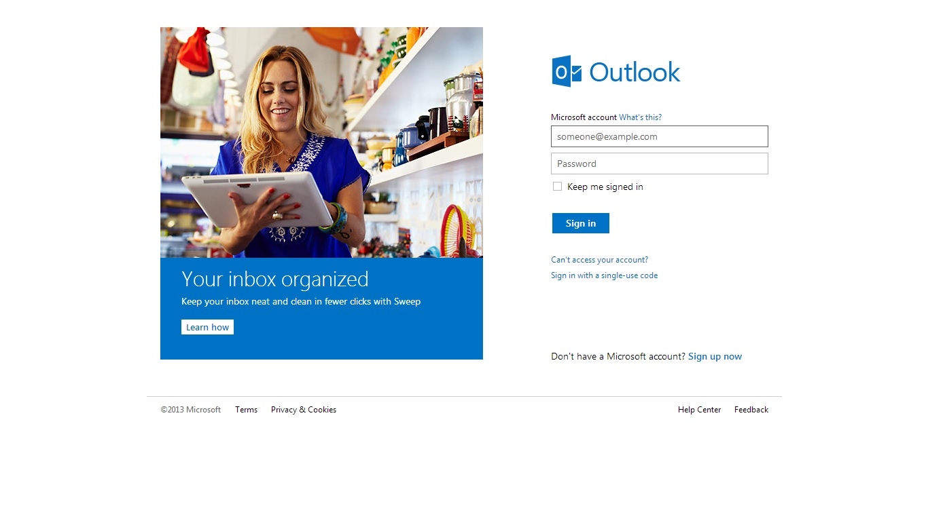
MAIL Web Page

Slide 20
PHP MySQL CONNECT TO A DATABASE
Before access data in database must create a connection to the database.
In PHP this is done width the MySQL-connect() function.
SYNTAX
MySQL-connects(servername,username,password);
EXAMPLE
<?php
$con=MySQL-connect(“localhost”,peter”);
If(!$con)
{
Die(‘could not connect:mysql-error());
}
//some code
?>

Slide 21
THANK YOU

