Slide 1
Weighted Graph Algorithms
Weighted shortest path problem
Dijkstra’s algorithm (single-source, non-negative edge weight)
All pairs shortest path
Warshall’s algorithm

Slide 2
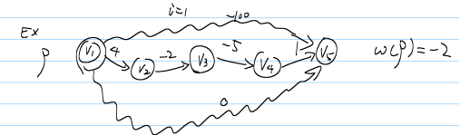
Definition of a path
Consider a directed graph G=(V, E) with edge-weight function w: E➔R.
Weight of edge v₁→v_{2:} w(v₁,v₂)
The weight of a path p=v₁→v₂→… →v_{k} is defined to be w(p)= sum w(v_{i}, v_{i+1}), i=1..k-1

Slide 3
Shortest path
A shortest path from u to v is a path of minimum weight from u to v
There might be multiple paths from u to v
The shortest path weight from u to v is defined as

Slide 4
Single source shortest path
Problem: from a given source vertex s, find the shortest path weights from s to all vertices in V.
If all edge weights w(u,v) are non-negative, all shortest path weights must exist
Idea: greedy
Maintain a set S of vertices whose shortest path weights from s are known.
At each step, add to S the vertex v, whose distance estimate from s is minimal
Update the distance estimates of all vertices adjacent to v.

Slide 5
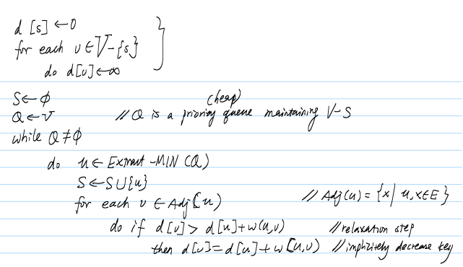
Dijkstra’s algorithm

Slide 6
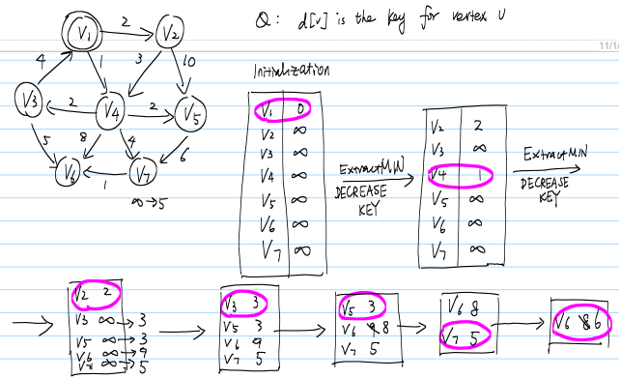

Slide 7
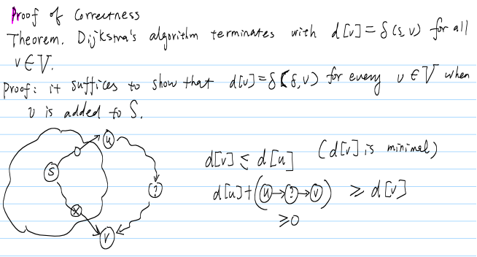

Slide 8
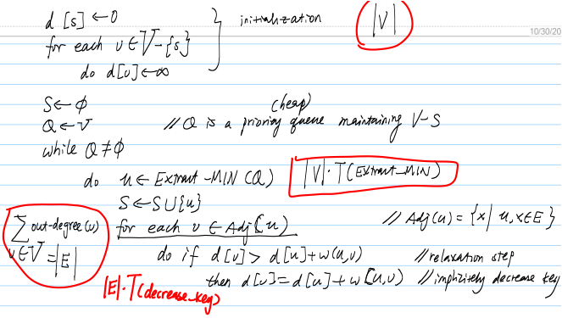
Running time analysis

Slide 9
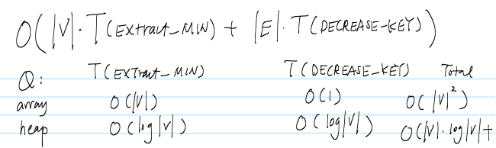

Running time analysis

Slide 10
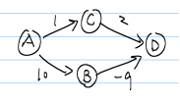
Unweighted shortest path problem
Dijkstra with negative weights

