Slide 1

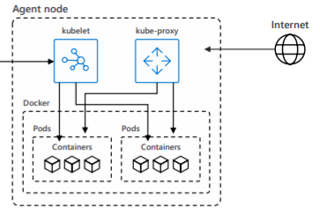
User
Microservice Platform
Workload (Container)
Cross
Functionality
(Provisioning etc.)
Orchestration (Kubernetes)
Extensions
(Infra/ App)
Controller Mgr
API-Server
Scheduler
etcd
Cluster admin

Slide 2






User
Microservice Platform
Workload (Container)
Cross
Functionality
(Provisioning etc.)
Orchestration (AKS)
Extensions
(Infra/ App)
Controller Mgr
API-Server
Scheduler
etcd
Cluster admin

