Slide 1

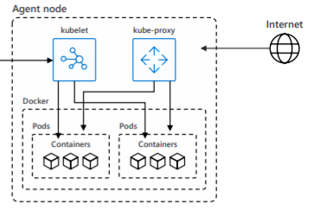
User
Microservice Platform
Workload (Container)
Cross
Functionality
(Provisioning etc.)
Orchestration (Kubernetes)
Extensions
(Infra/ App)
Controller Mgr
API-Server
Scheduler
etcd
Cluster admin

Slide 2



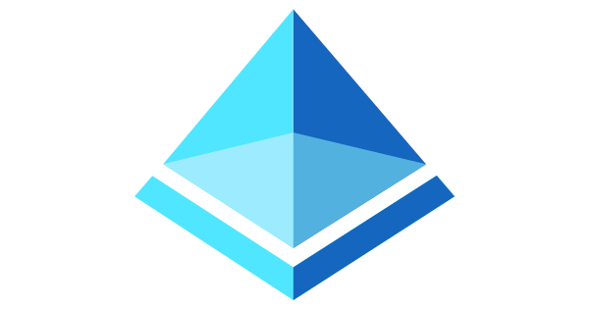
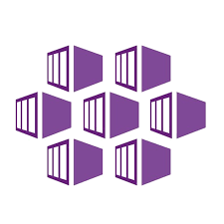

User
Microservice Platform
Workload (Container)
Cross
Functionality
(Provisioning etc.)
Orchestration (AKS)
Extensions
(Infra/ App)
Controller Mgr
API-Server
Scheduler
etcd
Cluster admin

Slide 3
User
Microservice Platform
Workload (Container)
Cross
Functionality
(Provisioning etc.)
Orchestration (AKS)
Extensions
(Infra/ App)
Controller Mgr
API-Server
Scheduler
Azure provides integration of AKS with other cross functionality services such as Azure Active Directory and with ACR its own registry option
etcd
Azure provides hosted Kubernetes (=AKS) and specialized hosted versions such as Red Hat OpenShift
Cluster admin

