Slide 1
Bayesian missing value imputation for mass spec proteomics (3-29)

Slide 2
Motivation
Using mass spectrometry, proteins are broken up into peptides and measured as individual peptide ions (features)
We can use these features to infer the underlying protein intensity in a sample
Any given feature can be missing due to MAR or MNAR reasons
With few measured features the inferred protein intensity can be biased towards those that were measured
Can we use these missing features to more accurately infer the underlying protein intensity

Slide 3
Reasons for missingness
A feature can be MAR or MNAR (dependent on acquisition method)
MNAR => missing due to low abundance
MAR => some low probability a feature will be missed at any given time
We can encode these relationships in a graphical model

Slide 4
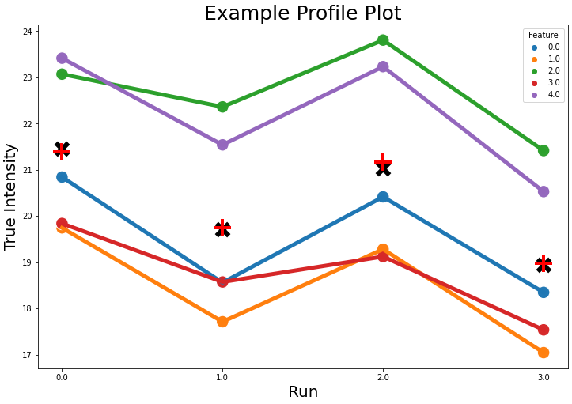
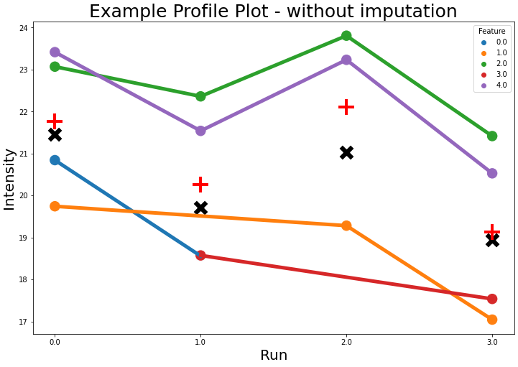
Example

Slide 5
Graphical setup
Protein-Independent model
Current main imputation strategy in proteomics
Each protein is conditionally independent of each other
Missing values are unrecoverable based on graphical topology
Build constraints into the model to overcome unrecoverability
Correlation model
A common imputation method is KNN
Can we leverage correlated proteins, rather than a full causal graph
Causal model
Leverage a PKN and specify causal graph over observed proteins
Missing values can be recoverable based on topology

Slide 6
Protein-Independent model – Single Protein
Protein mean
Protein Std
Feature
0
Run
Intensity
MNAR
Is Missing
MCAR
Intensity*
N
3
Observation 1
2

Slide 7
Protein-Independent model – Multiple Proteins
3
2
Protein mean
Protein Std
Protein 1
Feature
0
Run
Intensity
MNAR
Is Missing
MCAR
Intensity*
N
3
Observation 1
2

Slide 8
Protein-Independent model – Multiple Proteins
3
2
Protein mean
Protein Std
Protein 1
Feature
0
Run
Intensity
MNAR
Is Missing
MCAR
Intensity*
N
3
Observation 1
2

Slide 9
How to model missing values when they are not recoverable?

Slide 10
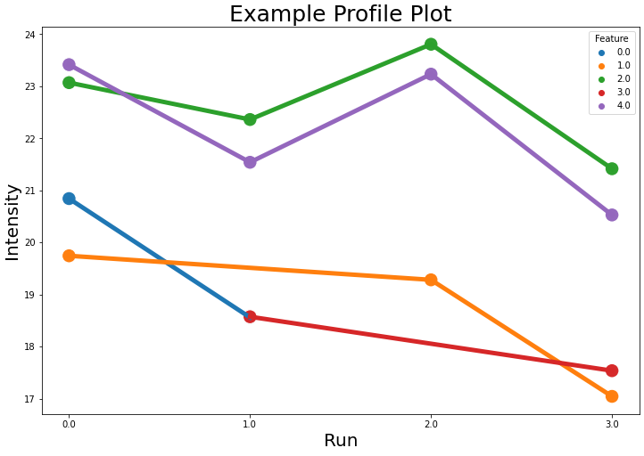
Leverage known information using Bayesian regression

Slide 11
Leverage known information using Bayesian regression

Slide 12
Leverage known information using Bayesian regression

Slide 13
Leverage known information using Bayesian regression

Slide 14
Leverage known information using Bayesian regression

Slide 15
Leverage known information using Bayesian regression

Slide 16
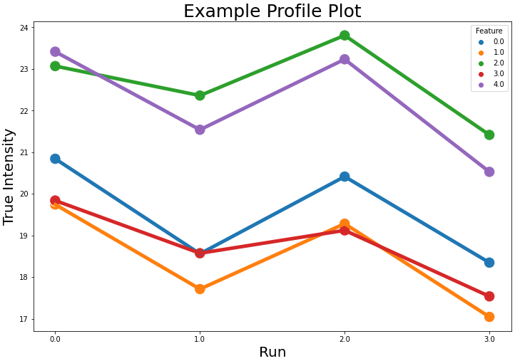
Leverage known information using Bayesian regression

Slide 17
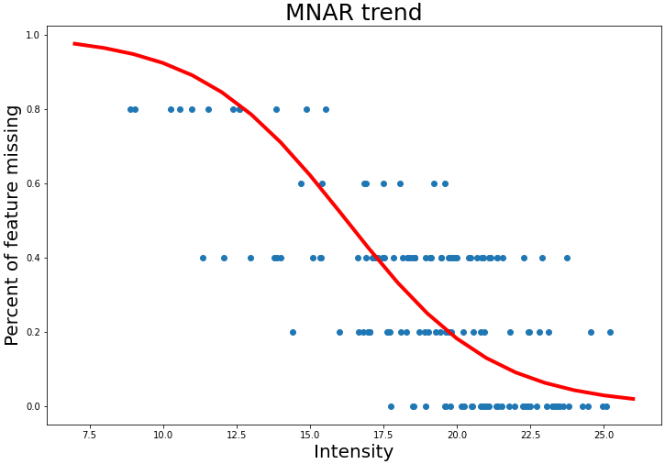
Leverage MNAR information

Slide 18
Leverage MNAR information

Slide 19
Leverage MNAR information

Slide 20
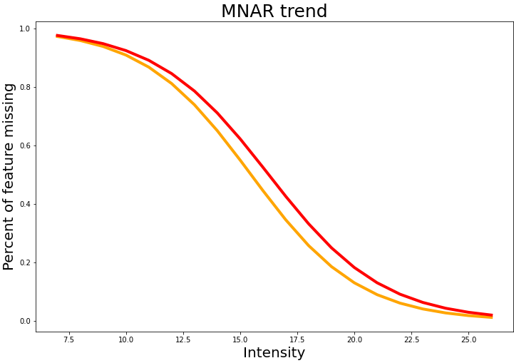
Leverage MNAR information

Slide 21
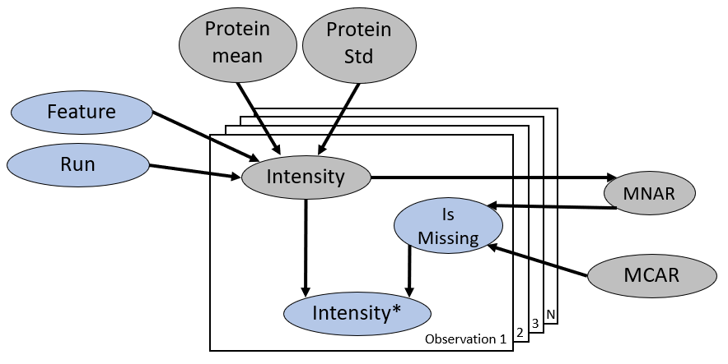
Correlation model

Slide 22
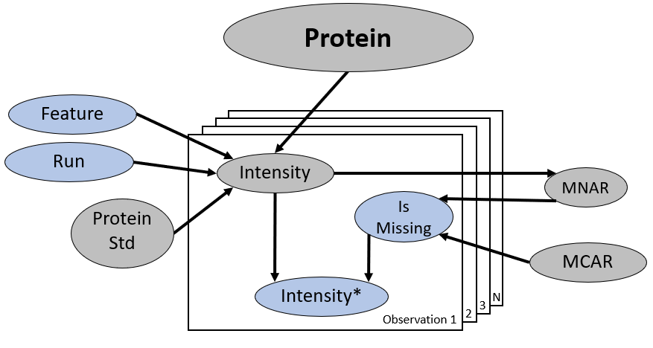
Causal Model

