Slide 1
Missing value imputation in Mass Spec proteomics (4-19)

Slide 2
Overview of model
Implemented in numpyro
Latent parameters
MAR
MNAR – B0, B1
Run effect
Feature effect
Error
Missing values

Slide 3
Overview of model
3
Implemented in numpyro
Learned latent parameters
MAR
MNAR – B0, B1
Run effect
Feature effect
Error
Missing values
2
Protein 1
Feature
0
Run
Intensity
MNAR
Error
Is Missing
MCAR
Intensity*
N
3
Feature 1
2

Slide 4

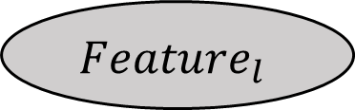
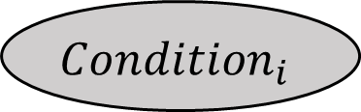


For a single feature
$$Condition_{i}$$
$$BioReplicate_{ij}$$
$$Y_{ijkl}$$
$$Run_{ijk}$$
$$Feature_{l}$$

Slide 5
Simulated data
6 Proteins
20 runs
20 features per protein
Simulated with underlying causal structure and effect, but not added to model

Slide 6
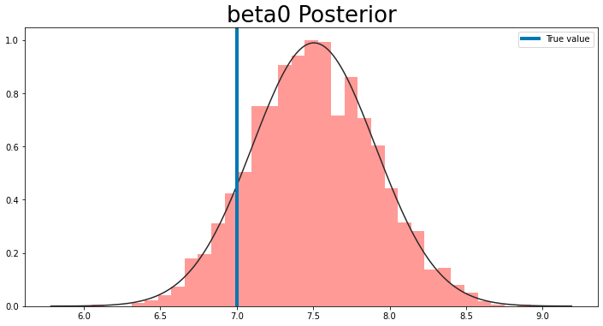
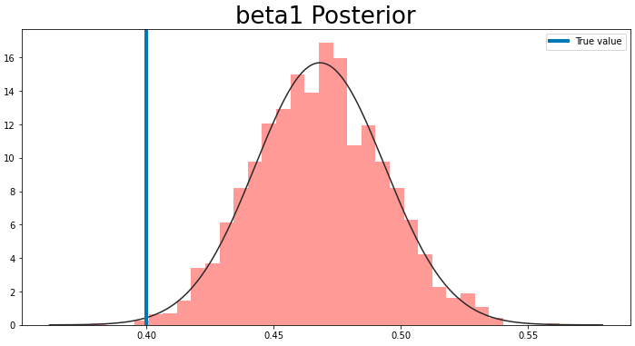
MNAR posterior

Slide 7
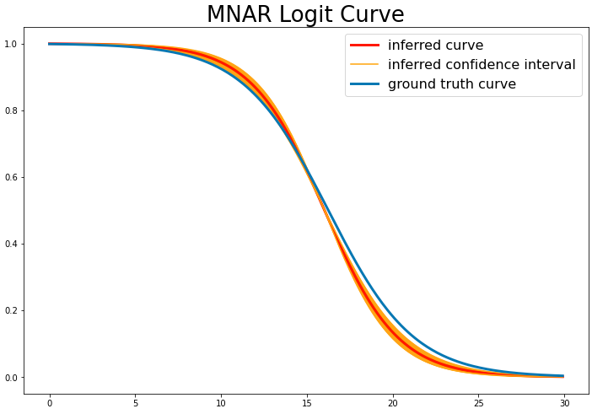
MNAR logit function

Slide 8
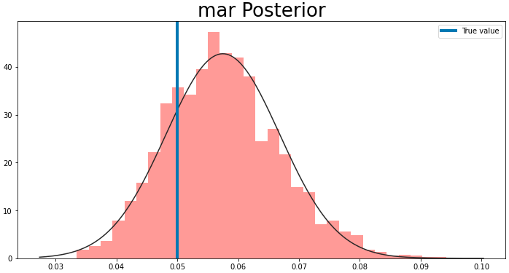
MAR Posterior

Slide 9
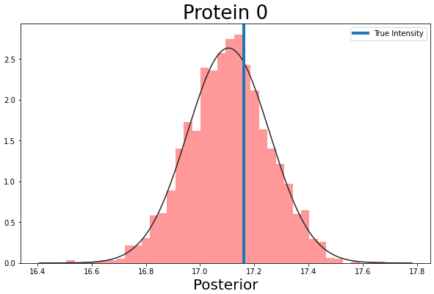
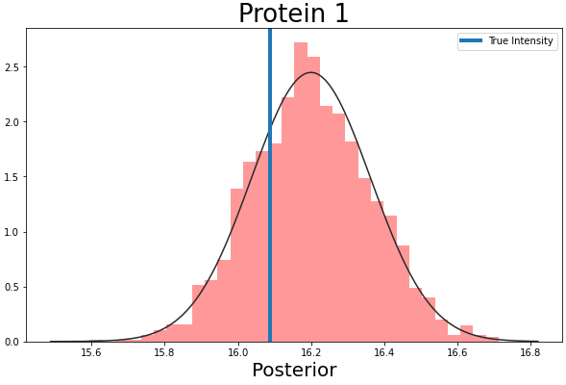
Imputed missing values

Slide 10
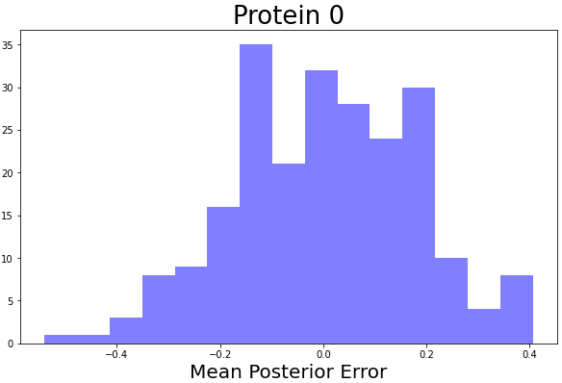
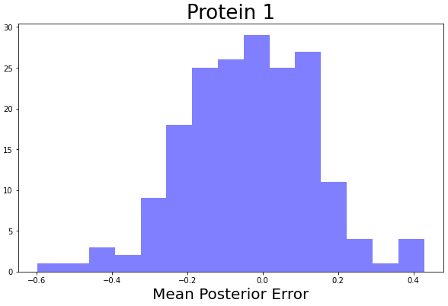
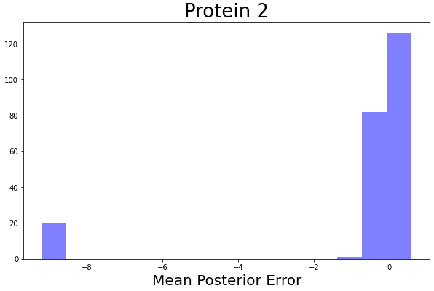
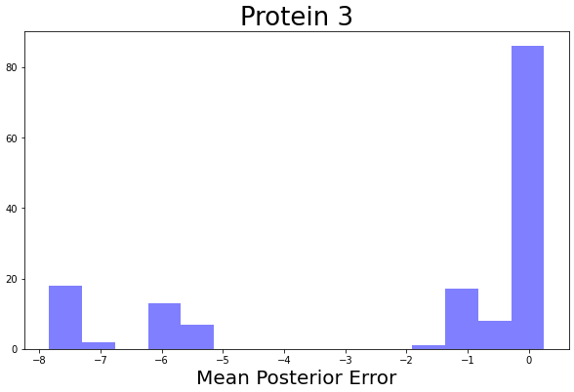
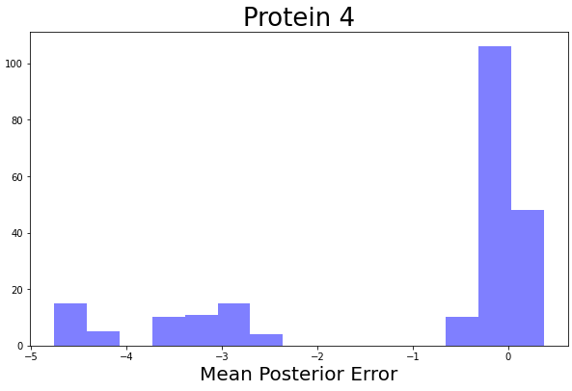
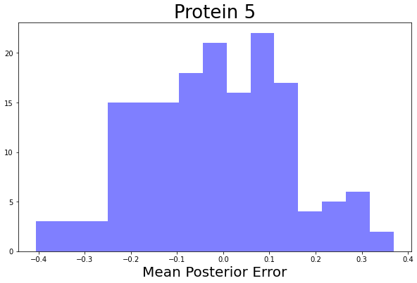
Imputation error

Slide 11
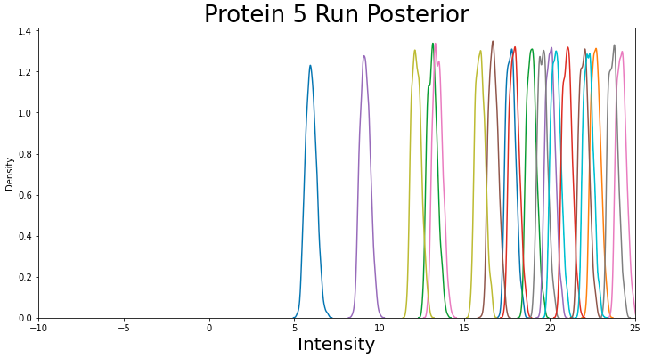
Run Posterior

Slide 12
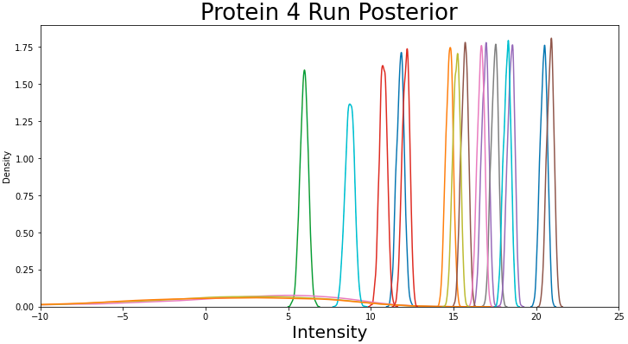
Run Posterior

Slide 13
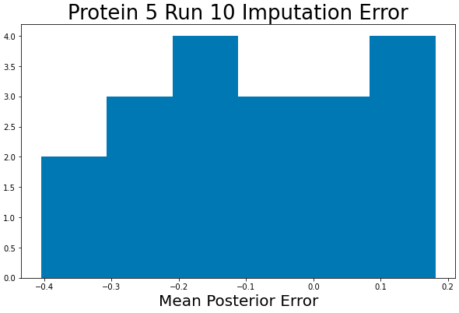
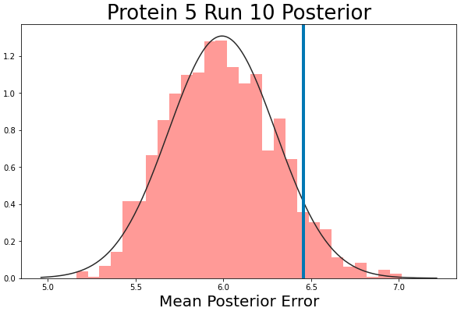
Protein 5, Run 10
Only one observation that is not missing
Still can estimate posterior of Run

Slide 14
Causal Model
Latent parameters (same as before)
MAR
MNAR – B0, B1
Run effect
Feature effect
Error
Missing values
Plus, causal coefficients (i.e., Bayes Net)

Slide 15
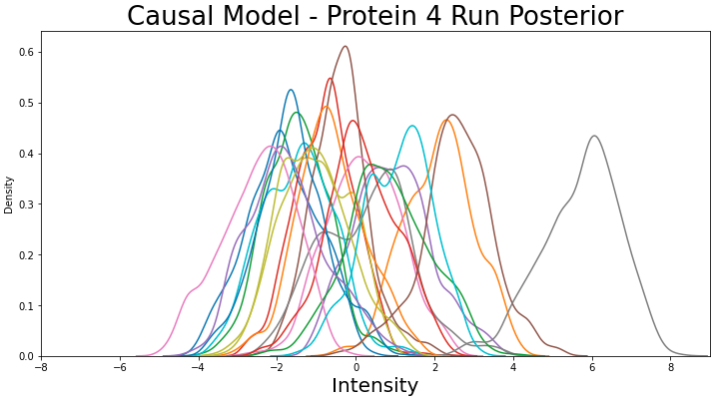
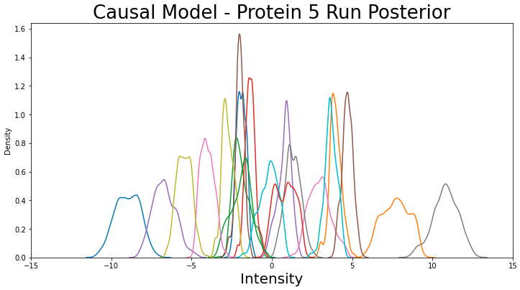
Causal model

