Slide 1
Bayesian missing value imputation in Mass Spec proteomics

Slide 2
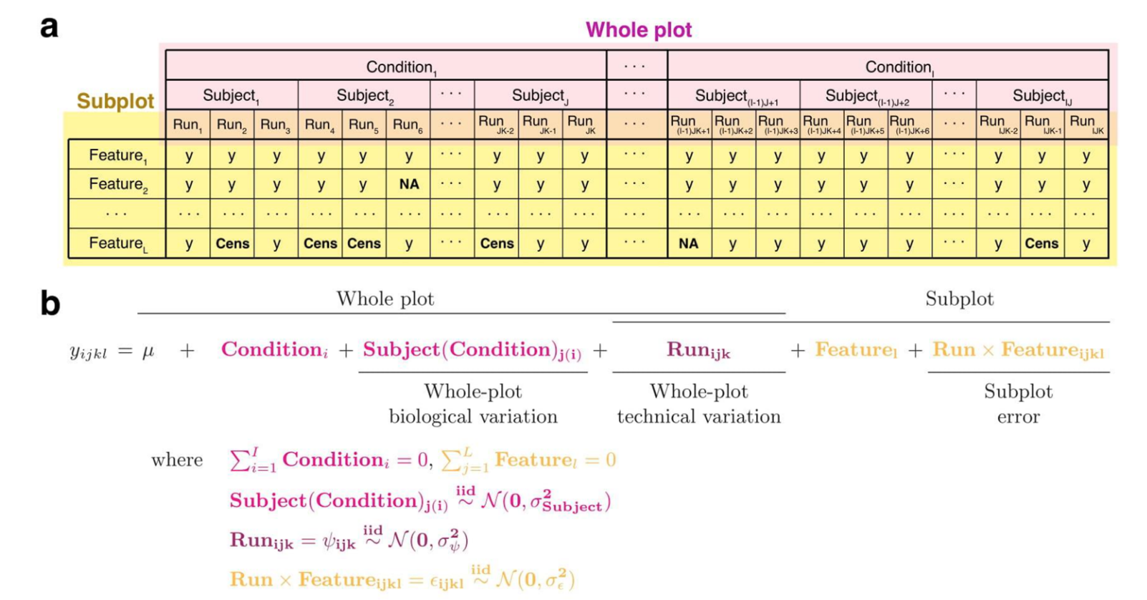
Classic LF MS data structure

Slide 3
Reformulate above model in a Bayesian/graphical setting
Quantify uncertainty with probabilistic measurements
Specify informed priors over variables
Where is this helpful? (missing value imputation)

Slide 4

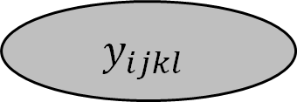

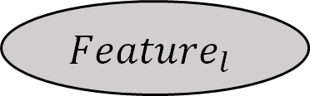
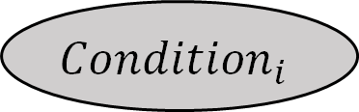




For a single feature
$$Condition_{i}$$
$$∑Condition_{i}=0$$
$$BioReplicate_{ij}$$
$$BioReplicate_{ij}∼N(μ_{ij}, σ_{ij}^{2})$$
$$y_{ijkl}$$
$$Run_{ijk}∼N(μ_{ijk}, σ_{ijk}^{2})$$
$$Run_{ijk}$$
$$∑Feature_{l}=0$$
$$Feature_{l}$$

Slide 5


For a single feature
$$Condition_{i}$$
$$Condition_{i}∼N(μ_{i}, σ_{i}^{2})$$
$$BioReplicate_{ij}$$
$$BioReplicate_{ij}∼N(μ_{ij}, σ_{ij}^{2})$$
$$y_{ijkl}$$
$$Run_{ijk}∼N(μ_{ijk}, σ_{ijk}^{2})$$
$$Run_{ijk}$$
$$Feature_{l}∼N(μ_{l}, σ_{l}^{2})$$
$$Feature_{l}$$

Slide 6

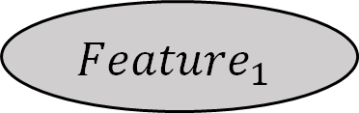

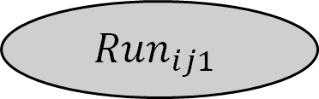
For a single protein
$$Condition_{i}$$
$$Feature_{1}$$
$$BioReplicate_{ij}$$
$$y_{ij11}$$
$$Run_{ij1}$$
Feature 1
2
L
Run 1
…
2
…
K

Slide 7
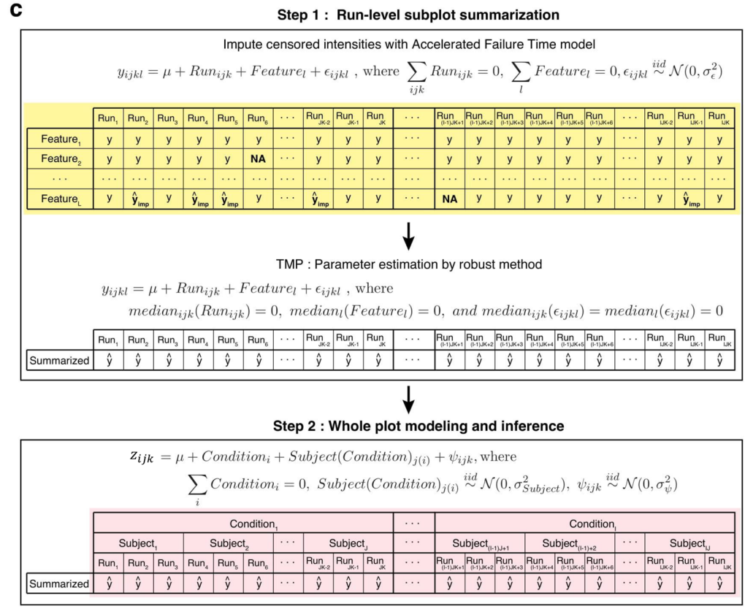
Two-step model

Slide 8



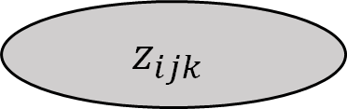
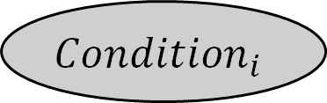
Whole-Plot
$$Condition_{i}$$
$$BioReplicate_{ij}$$
Sub-Plot
$$z_{ijk}$$
$$Feature_{1}$$
$$Run_{ijk}$$
$$y_{ijk1}$$
Feature 1
2
…
L

Slide 9
Missing value problem
Features in classical Mass Spectrometry-based proteomic experiments can be missing for two main reasons
Missing completely at random (MCAR)
Missingness is statistically independent of a features intensity and the intensity of other features
Missing not at random (MNAR)
Missingness can be due to intensities being below the threshold limit of detection (i.e. the values are too low for the instrument to measure)
Missingness is dependent on the features intensity
Imputation strategies exist to address one or both of these problems
MAR - KNN
MNAR - AFT model
Both - mbImpute

Slide 10
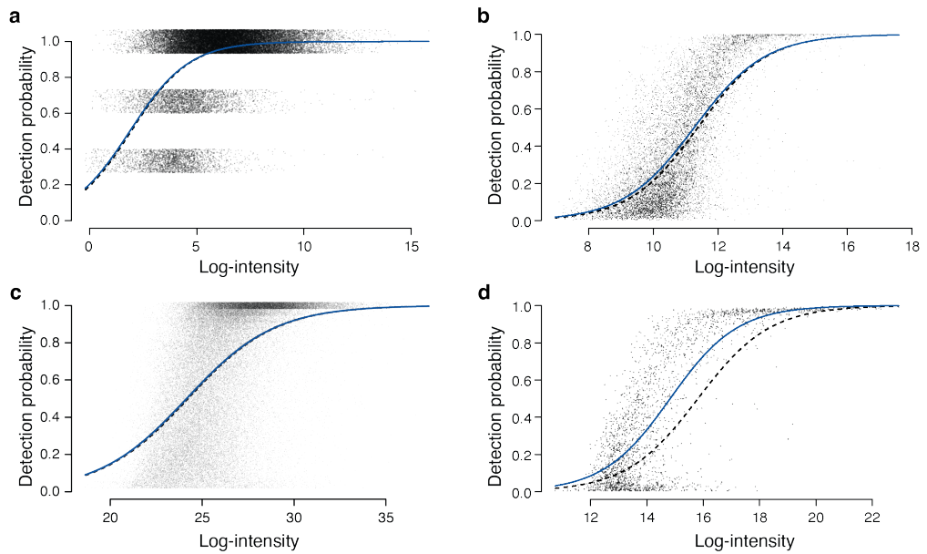
Li and Smyth, Bioinformatics. 2023.

Slide 11
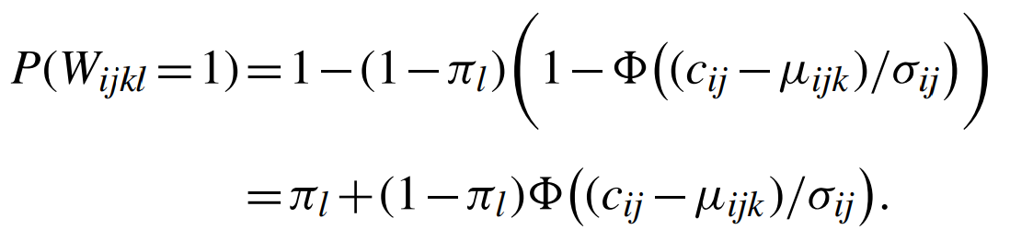
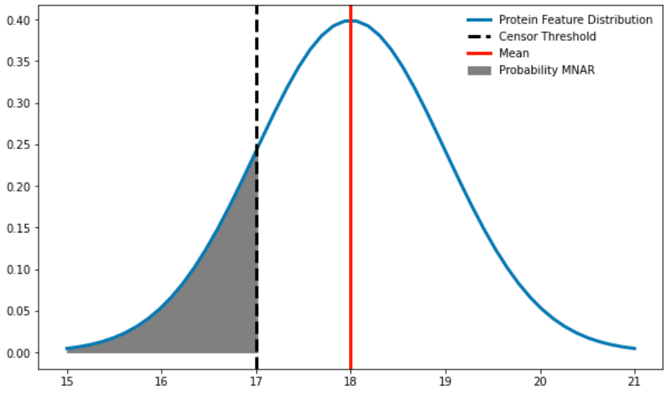
Karpievitch et al.
MAR Probability
MNAR Probability

Slide 12
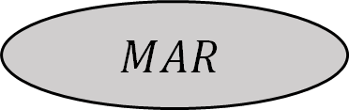

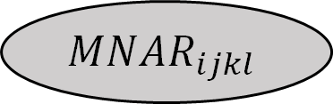

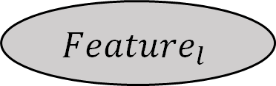
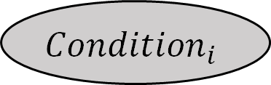




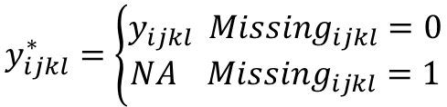
$$MN{AR}_{ijkl}∼logit(β_{0}+β_{1}y_{ijkl})$$
Model variables
$$MAR∼N(μ_{mar}, σ_{mar}^{2})$$
$$Missing_{ijkl }=B(MAR+\left(1−MAR\right)∗MNAR)$$
$$Condition_{i}$$
$$y_{ijkl}^{∗}=\left\{\begin{aligned}y_{ijkl} Missing_{ijkl}=0 \\ NA Missing_{ijkl}=1\end{aligned}\right.$$
$$BioReplicate_{ij}$$
Missing mechanism
$$Run_{ijk}$$
$$y_{ijkl}$$
$$MNAR_{ijkl}$$
$$Feature_{l}$$
$$Missing_{ijkl}$$
$$MAR$$
$$y_{ijkl}^{∗}$$

Slide 13
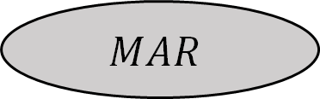

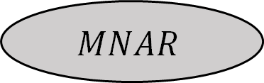
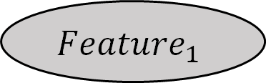




$$BioReplicate_{ij}$$
$$Condition_{i}$$
$$Feature_{1}$$
$$Run_{ij1}$$
$$y_{ij11}$$
$$MNAR$$
$$Missing_{ij11}$$
$$y_{ij11}^{∗}$$
$$MAR$$
Feature 1
2
…
L
Run 1
2
…
K

Slide 14
Results – using simulated data
We can recover the missing mechanisms
Accurately impute missing features
Accurately learn the run posterior
However, this falls apart when the protein is entirely missing in a run

Slide 15
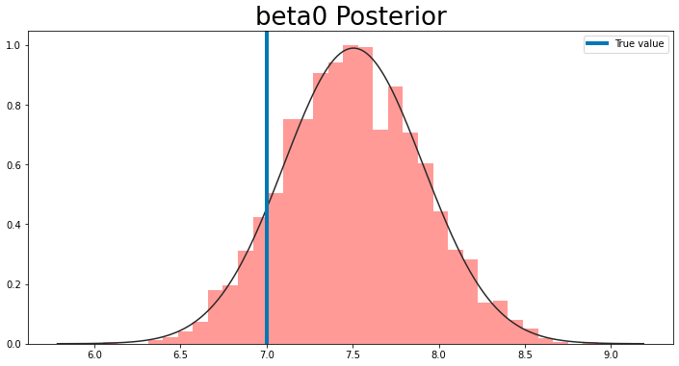
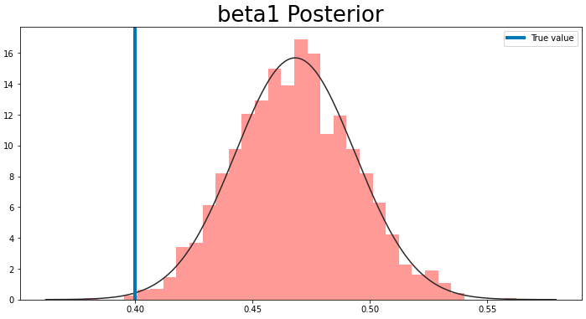
MNAR posterior

Slide 16
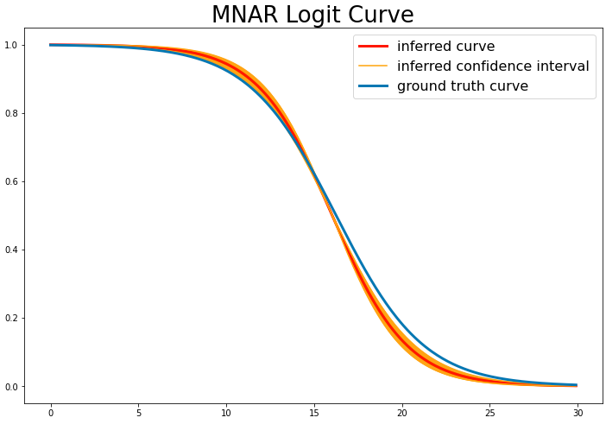
MNAR logit function

Slide 17
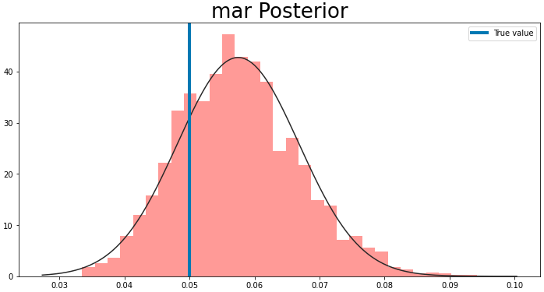
MAR Posterior

Slide 18
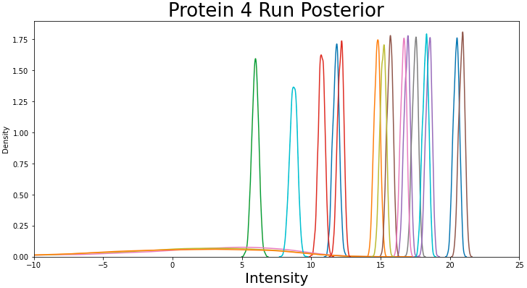
Run Posterior

Slide 19
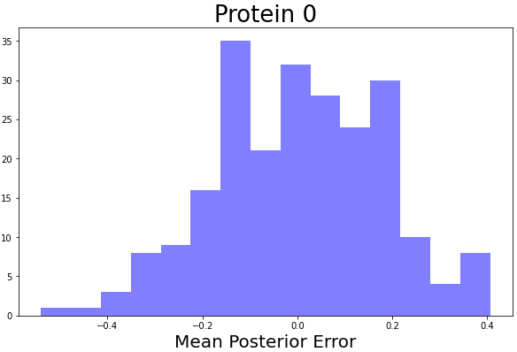
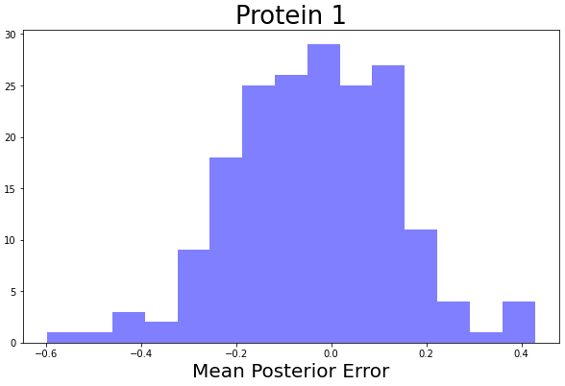
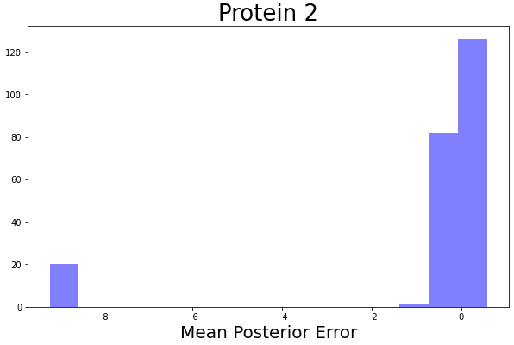
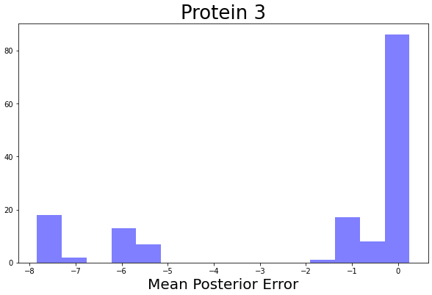
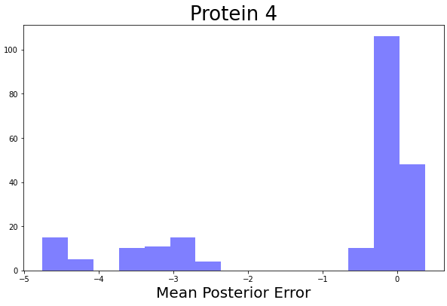
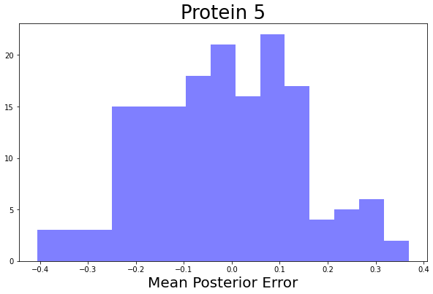
Imputation error

Slide 20
Solution
We have already formulated these results in a graphical setting
Causal theory states we can only recover self-censored values in a causal setting
This is less of a problem when we have some values in a run, but if it is completely missing, we need to leverage causal structure

Slide 21
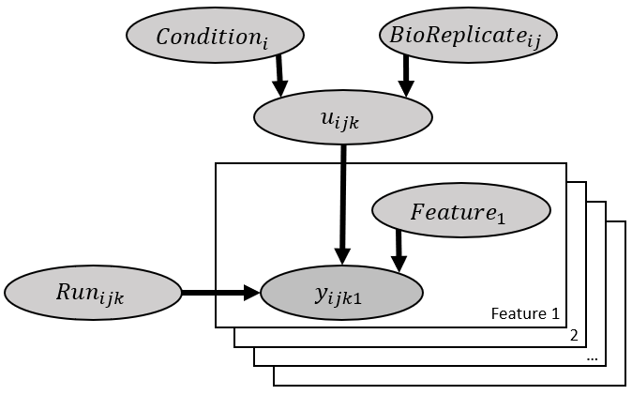
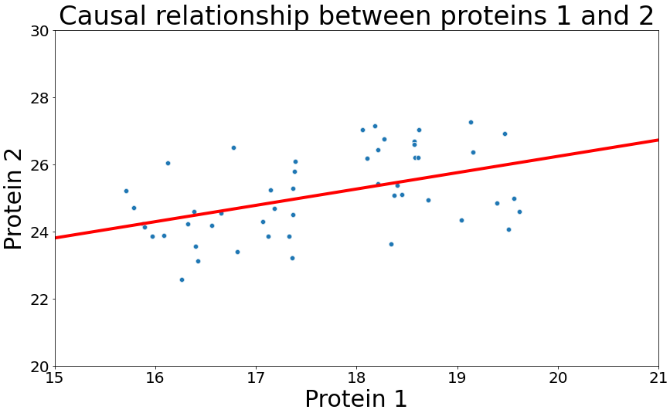
Protein 1
Protein 2

Slide 22
Whole-Plot
$$Condition_{i}$$
$$BioReplicate_{ij}$$
Sub-Plot
$$z_{ijk}$$
$$Feature_{1}$$
$$Run_{ijk}$$
$$y_{ijk1}$$
Feature 1
2
…
L

Slide 23
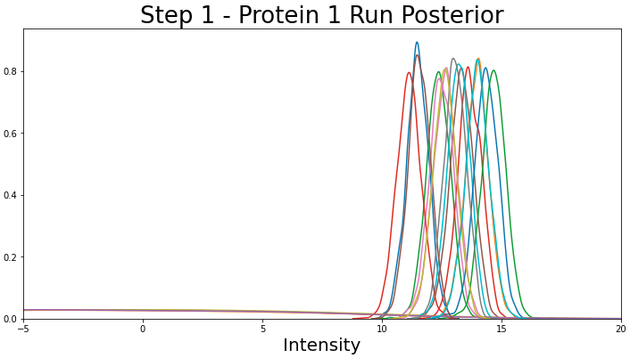
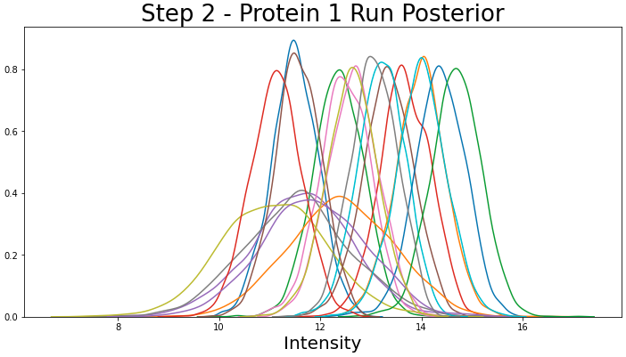
Two step Run Posterior

Slide 24
References
Smyth missing values - https://academic.oup.com/bioinformatics/advance-article/doi/10.1093/bioinformatics/btad200/7126416
Karpievitch - https://academic.oup.com/bioinformatics/article/25/16/2028/205083
Bayesian analysis - https://www.ncbi.nlm.nih.gov/pmc/articles/PMC6249692/
More Bayesian - https://pubs.acs.org/doi/10.1021/acs.jproteome.1c00859

