Slide 1
Missing values in Mass spec proteomics
What is the goal
Impute values?
Summarize features?
Can we impute self censored mechanism?
Do we want to include a full causal graph?

Slide 2
For one protein
Protein mean
Protein Std
Feature
0
Run
Intensity
MNAR
Is Missing
MCAR
Intensity*
N
3
Observation 1
2

Slide 3
Multiple proteins
3
2
Protein mean
Protein Std
Protein 1
Feature
0
Run
Intensity
MNAR
Is Missing
MCAR
Intensity*
N
3
Observation 1
2

Slide 4
Multiple proteins
3
2
Protein mean
Protein Std
Protein 1
Feature
0
Run
Intensity
MNAR
Is Missing
MCAR
Intensity*
N
3
Observation 1
2

Slide 5
Multiple proteins
Protein mean
Protein Std
Feature
0
Run
Intensity
MNAR
Is Missing
Intensity*
MCAR

Slide 6
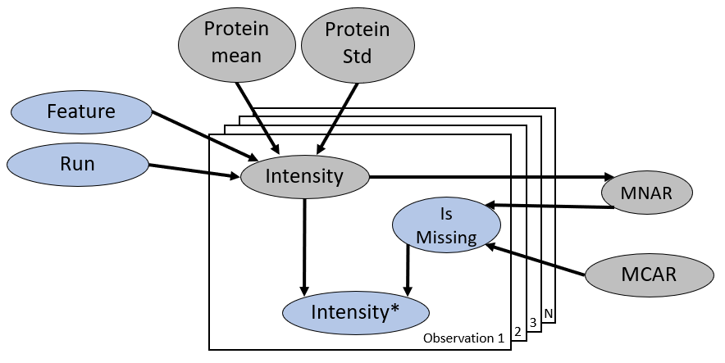
Build correlation into graph

Slide 7
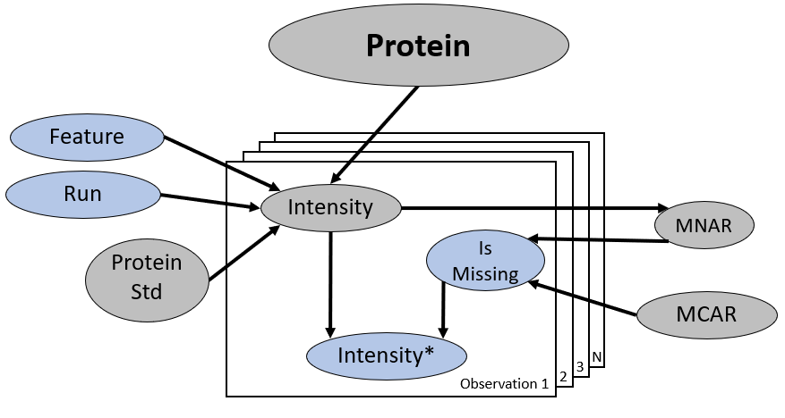
Build missing mechanism into causal graph

Slide 8
Protein A
Protein B
Protein
Abundance
Protein Abundance
Run
Run
Feature
Intensity
Feature
Intensity
Is Missing
Is Missing
Intensity*
Intensity*

Slide 9
Protein A
Protein B
Normal, sigma
Normal
U_1, U_2
Protein
Abundance
B_C
Protein
Abundance

Slide 10
Protein A
Replicate
Protein B
Normal
Normal
Protein
Abundance
Protein
Abundance
Feature
Intensity*
Feature
Intensity
MCAR
Is Missing
Feature
Is Missing
MNAR
Feature
Intensity
Intensity*

Slide 11
Protein A
Protein B
Replicate
Normal
Normal
0
Protein
Abundance
Protein
Abundance
Feature
Feature
Feature
Intensity
Feature
Intensity

Slide 12
Protein A
Protein B
Replicate
Normal
Normal
0
Protein
Abundance
Protein
Abundance
Feature
Feature

