Slide 1
 | Q
 |  |  | Q
Q
 |  | Q
n = 4

Slide 2
 | 1
 |  |  | 1
1
 |  | 1
n = 4

Slide 3
0 | 1 | 0 | 0
0 | 0 | 0 | 1
1 | 0 | 0 | 0
0 | 0 | 1 | 0
BINARY ??!??!!!!!!

Slide 4
0 | 1 | 0 | 0
0 | 0 | 0 | 1
1 | 0 | 0 | 0
0 | 0 | 1 | 0
4
1
8
2
binary
decimal

Slide 5
0 | 1 | 0 | 0
0 | 0 | 0 | 1
1 | 0 | 0 | 0
0 | 0 | 1 | 0
4
1
8
2
2²
2⁰
2³
2¹
Working solution
binary
decimal
base 2

Slide 6
forget about the 1s and 0s
rowPossibilities = [4, 1, 8, 2];
0
1
2
3
4
1
8
2
2²
2⁰
2³
2¹
array indices
0 | 1 | 2 | 3
Working solution
array index
decimal
base 2

Slide 7
Failing solutions?

Slide 8
0 | 1 | 0 | 0
0 | 0 | 0 | 1
1 | 0 | 0 | 0
0 | 0 | 1 | 0
4
1
8
2
2²
2⁰
2³
2¹
Working solution
binary
decimal
base 2

Slide 9
red = primary concept
yellow = secondary

Slide 10
1 | 1 | 0 | 0
0 | 0 | 0 | 1
1 | 0 | 0 | 0
0 | 0 | 1 | 0
12
1
8
2
2?
2⁰
2³
2¹
failing solution: row conflict
binary
decimal
base 2

Slide 11
1 | 1 | 0 | 0
0 | 0 | 0 | 1
0 | 0 | 0 | 0
0 | 0 | 1 | 0
12
1
0
2
2?
2⁰
2?
2¹
failing solution: row conflict
binary
decimal
base 2

Slide 12
1 | 0 | 0 | 0
0 | 0 | 0 | 1
1 | 0 | 0 | 0
0 | 0 | 1 | 0
8
1
8
2
2³
2⁰
2³
2¹
failing solution: column conflict
binary
decimal
base 2

Slide 13
1 | 0 | 0 | 0
0 | 0 | 0 | 1
0 | 1 | 0 | 0
0 | 0 | 1 | 0
8
1
4
2
2³
2⁰
2²
2¹
failing solution: diagonal conflict v1.1
binary
decimal
base 2

Slide 14
0
1
2
3
8
1
4
2
2³
2⁰
2²
2¹
abs( 2 – 3 ) === abs( 2 -1 )
abs( -1 ) === abs( 1 )
1 === 1
failing solution: diagonal conflict v1.1
array index
decimal
base 2

Slide 15
1 | 0 | 0 | 0
0 | 1 | 0 | 0
0 | 0 | 0 | 1
0 | 0 | 1 | 0
8
4
1
2
2³
2²
2⁰
2¹
failing solution: diagonal conflict v1.2
binary
decimal
base 2

Slide 16
0 | 1 | 0 | 0
1 | 0 | 0 | 0
0 | 0 | 0 | 1
0 | 0 | 1 | 0
4
8
1
2
2²
2³
2⁰
2¹
failing solution: diagonal conflict v2.1
binary
decimal
base 2

Slide 17
0
1
2
3
4
8
1
2
2²
2³
2²
2¹
abs( 1 – 3 ) === abs( 3 – 1 )
abs( -2 ) === abs( 2 )
2 === 2
failing solution: diagonal conflict v1.1
array index
decimal
base 2

Slide 18
0 | 0 | 0 | 1
0 | 1 | 0 | 0
0 | 0 | 1 | 0
1 | 0 | 0 | 0
1
4
2
8
2⁰
2²
2¹
2³
failing solution: diagonal conflict v2.2
binary
decimal
base 2

Slide 19
0
1
2
3
1
4
2
8
2⁰
2²
2¹
2³
abs( 0 – 3 ) === abs( 0 – 3 )
abs( -3 ) === abs( 3 )
3 === 3
failing solution: diagonal conflict v1.1
array index
decimal
base 2

Slide 20
conflicts recap:
row numbers must be base 2, else row conflict
can’t be 12 because in binary 12 is 1100 and contains more than one 1
no identical numbers, else column conflict
can’t have 8 and 8 because 1000 and 1000 stack 1s
if the absolute value of the difference in array indices = the absolute value of the difference in base 2 exponents, there exists a diagonal conflict
if n = 2 and board = [4, 2] = [2^{2,} 2¹], abs(base 2 diff) === abs(index diff) → abs( 2 – 1 ) === abs( 0 – 1 )

Slide 21
“coding is not fast;
it’s 10% typing and 90% thinking.
getting a solution is a process, not a binary light switch.”
-Marcus Phillips

Slide 22
Bitwise Operators
let’s jump into the chrome console…

Slide 23
input: n, a number, representing an n by n board with n non-conflicting queens
0. declare a solution counter variable equal to 0.
1. get an array of potential rows for an n x n board.
n = 5 → [1, 2, 4, 8, 16]
2. declare recursive function expression that searches and potentially appends new rows.
2.0 base case – if board length = n, add to solutionCounter
2.1 initialization - iterate over the list and begin a board search using an array containing each.
search([1]), search([2]), search([4]) . . .
2.2 recursion -using our row, column, and diagonal conditions, check to see if we can append from our potential rows array. If all tests pass:
2.2.0 append potential row to board and call recursive search on new board
3. invoke recursive search function on empty array
4. return solutionCounter
output: number of solutions for n queens
let’s not worry about time/space complexity on this one ;)

Slide 24
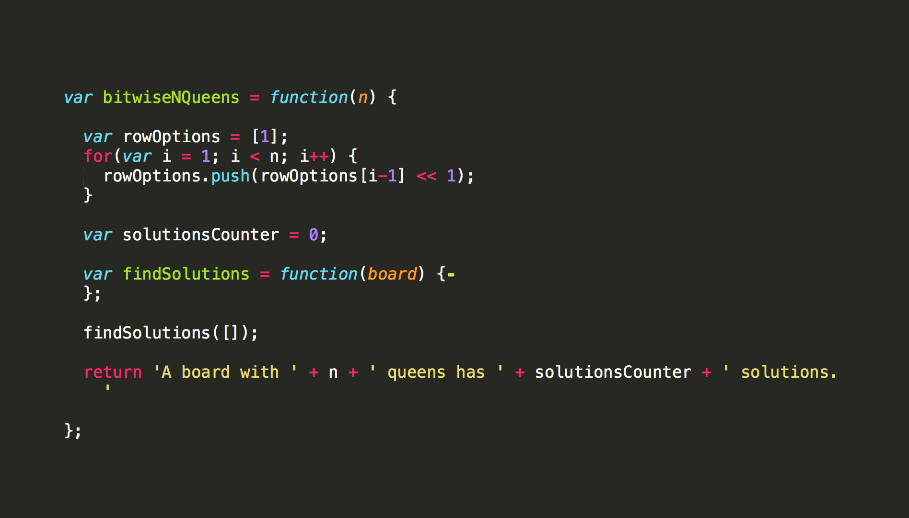
just an outline!
0) creating row of base 2 options
1) declaring counter variable
2) recursive function expression
recursive function invocation
return # of solutions
let’s jump into findSolutions() . . .

Slide 25
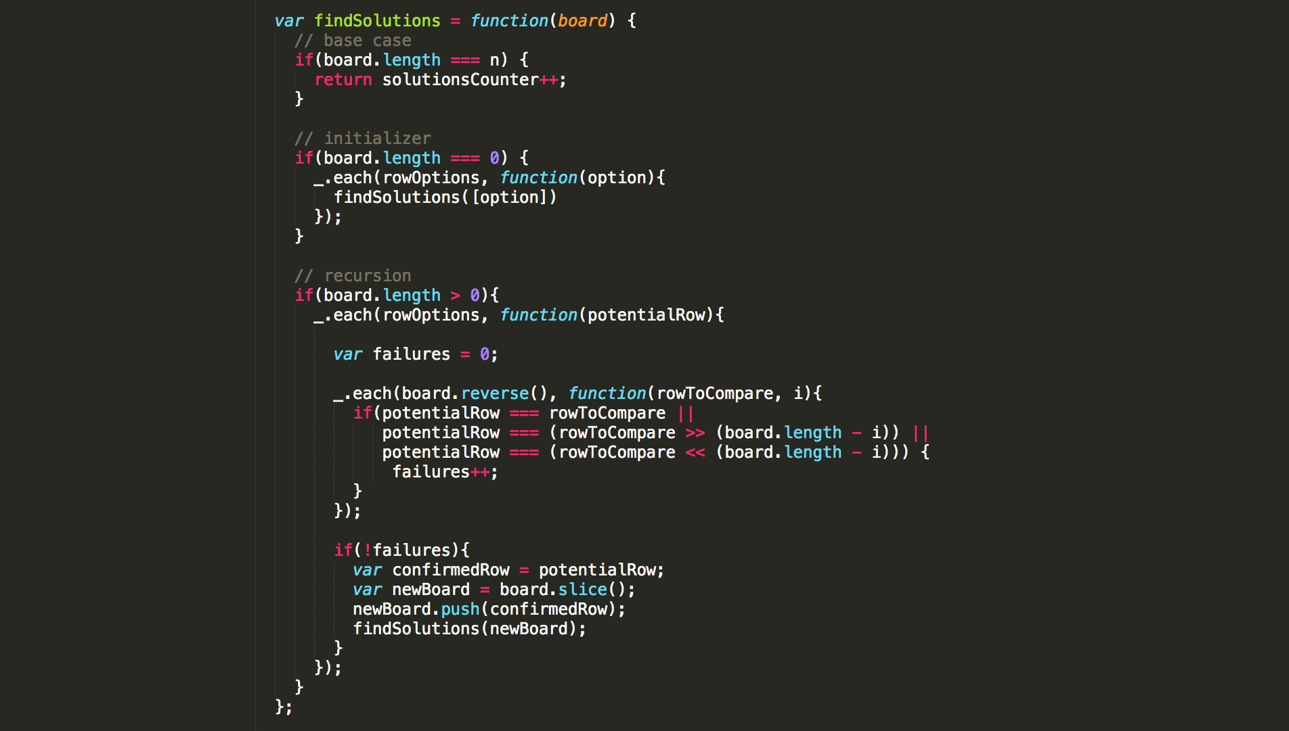

2.0) base case
updating solutionCounter if full board n x n board exists
2.1) dealing with initial ‘[]’ argument
recurses on singly populated array
2.2) iterating over potential next row options
2.3) keeping track of failures
2.4) checking: iterating over current board, backwards
2.4.0) checking column conflicts
2.4.1) checking both diagonal conflicts
while accounting for absolute
changes in:
1) base 2 exponent
2) indices
2.5) if the potential row passed all the tests
set potentialRow to confirmedRow for readability
slice our current board to avoid modification conflict
add our newly tested row to the board
test it!
underscore!

