Slide 1
Beer Consumption in Brazil
General Assembly Data Science final Project

Slide 2
Problem Statement
Beer is the most consumed alcoholic beverage in Brazil.
Brazil is the third largest beer producer in the world.
Brazil is also the third largest consumer of beer in the world, after China and the United States.
Brazil entered a recession in 2014. The country started to recover in 2017, but corruption, the lack of public policies, and the economic crisis have led to an increase in poverty.
Beer sales may help to drive the economy. On the other end, the lack of sales may hurt the economy.
The main goal of this exercise is to predict the consumption of beer in one of the country's most populous cities, Sao Paulo.

Slide 3
hypothesis
Beer consumption can be affected by many factors:
Temperature
Precipitation
Day of the week
Month
Season

Slide 4
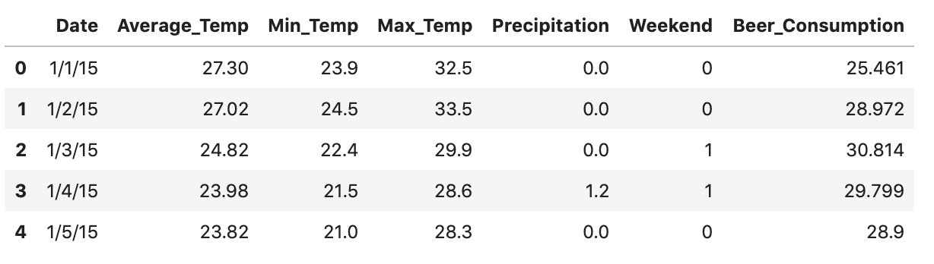
The data
The data contains conditions for each day in a calendar year.

Slide 5
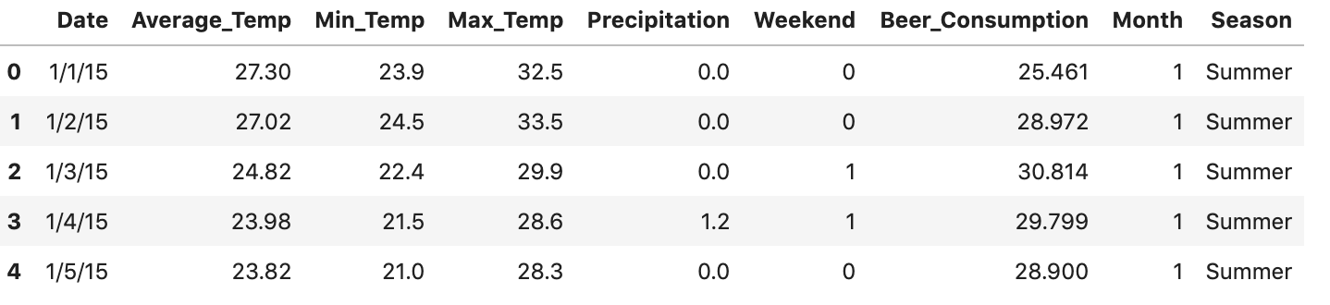
The data
More columns can be created by parsing the “Date” column.

Slide 6
Metrics and Limitations
The success metric is limited to the ability to predict the amount of beer consumed in Sao Paulo and whether there is a trend in the data based on the feature columns.
Look at R-squared test set values and RMSE values.
The data is only based on one year (2015).
The dataset focuses on an area in the city, rather than the whole city.

Slide 7
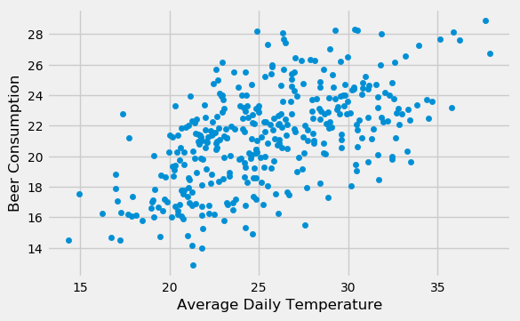
Data Exploration
Investigate relationship between beer consumption and feature columns.
Beer consumption increases with temperature.

Slide 8
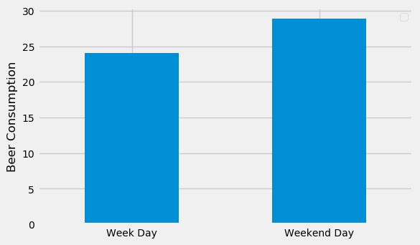
Data Exploration
Average beer consumption is higher on weekend days than on week days.

Slide 9
Approach
I tried out three different models to see which would best work with my dataset:
Linear Regression
Decision Tree Regressor
Random Forest Regressor

Slide 10
Model evaluation
Linear regression:
R-squared test value: 0.724
RMSE test value: 2.28
Decision tree:
R-squared test value: 0.553
RMSE test value: 2.90
Random forest:
R-squared test value: 0.700
RMSE test value: 2.38

Slide 11
Model evaluation
The model performs the best with linear regression.
Feature engineering helped a little but not much.
More data is needed for a better score.

Slide 12
Impact
This model can help the Brazilian government predict beer consumption with an R-squared value of 0.724.
This model can be used to forecast the economic trends based on the time of year and the weather.

Slide 13
conclusion
Recommendations
This model can be incorporated but with warning.
More data should be researched and added to the dataset for better results.
Next Steps
Incorporate time of day into the dataset.
Expand to more areas in the metropolitan area and eventually to other cities and rural areas in the country.
Look at data from other years- how does weather change and how does this affect beer consumption?

