Slide 1

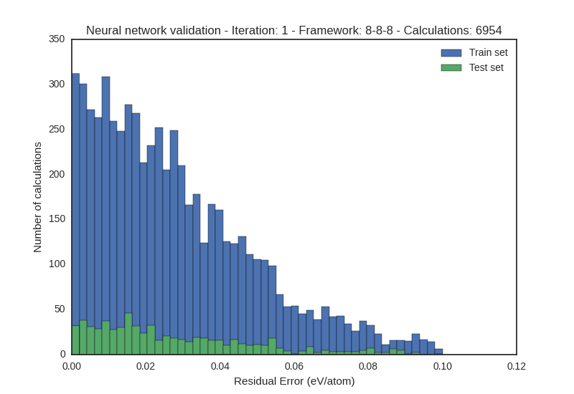
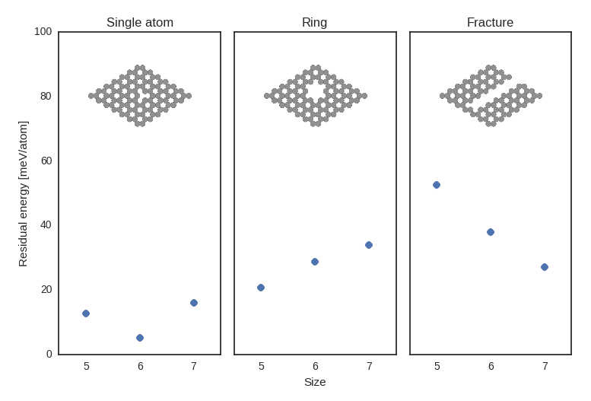
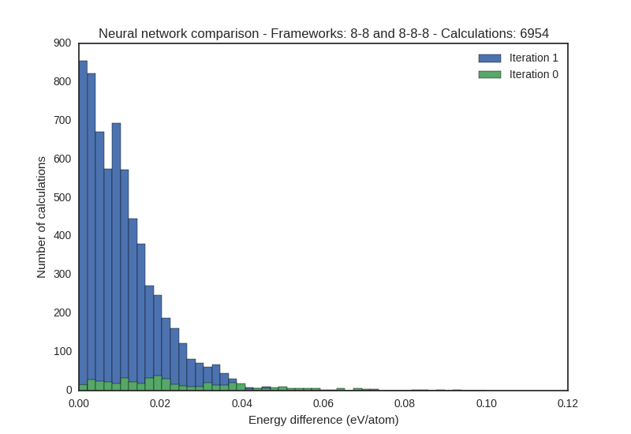
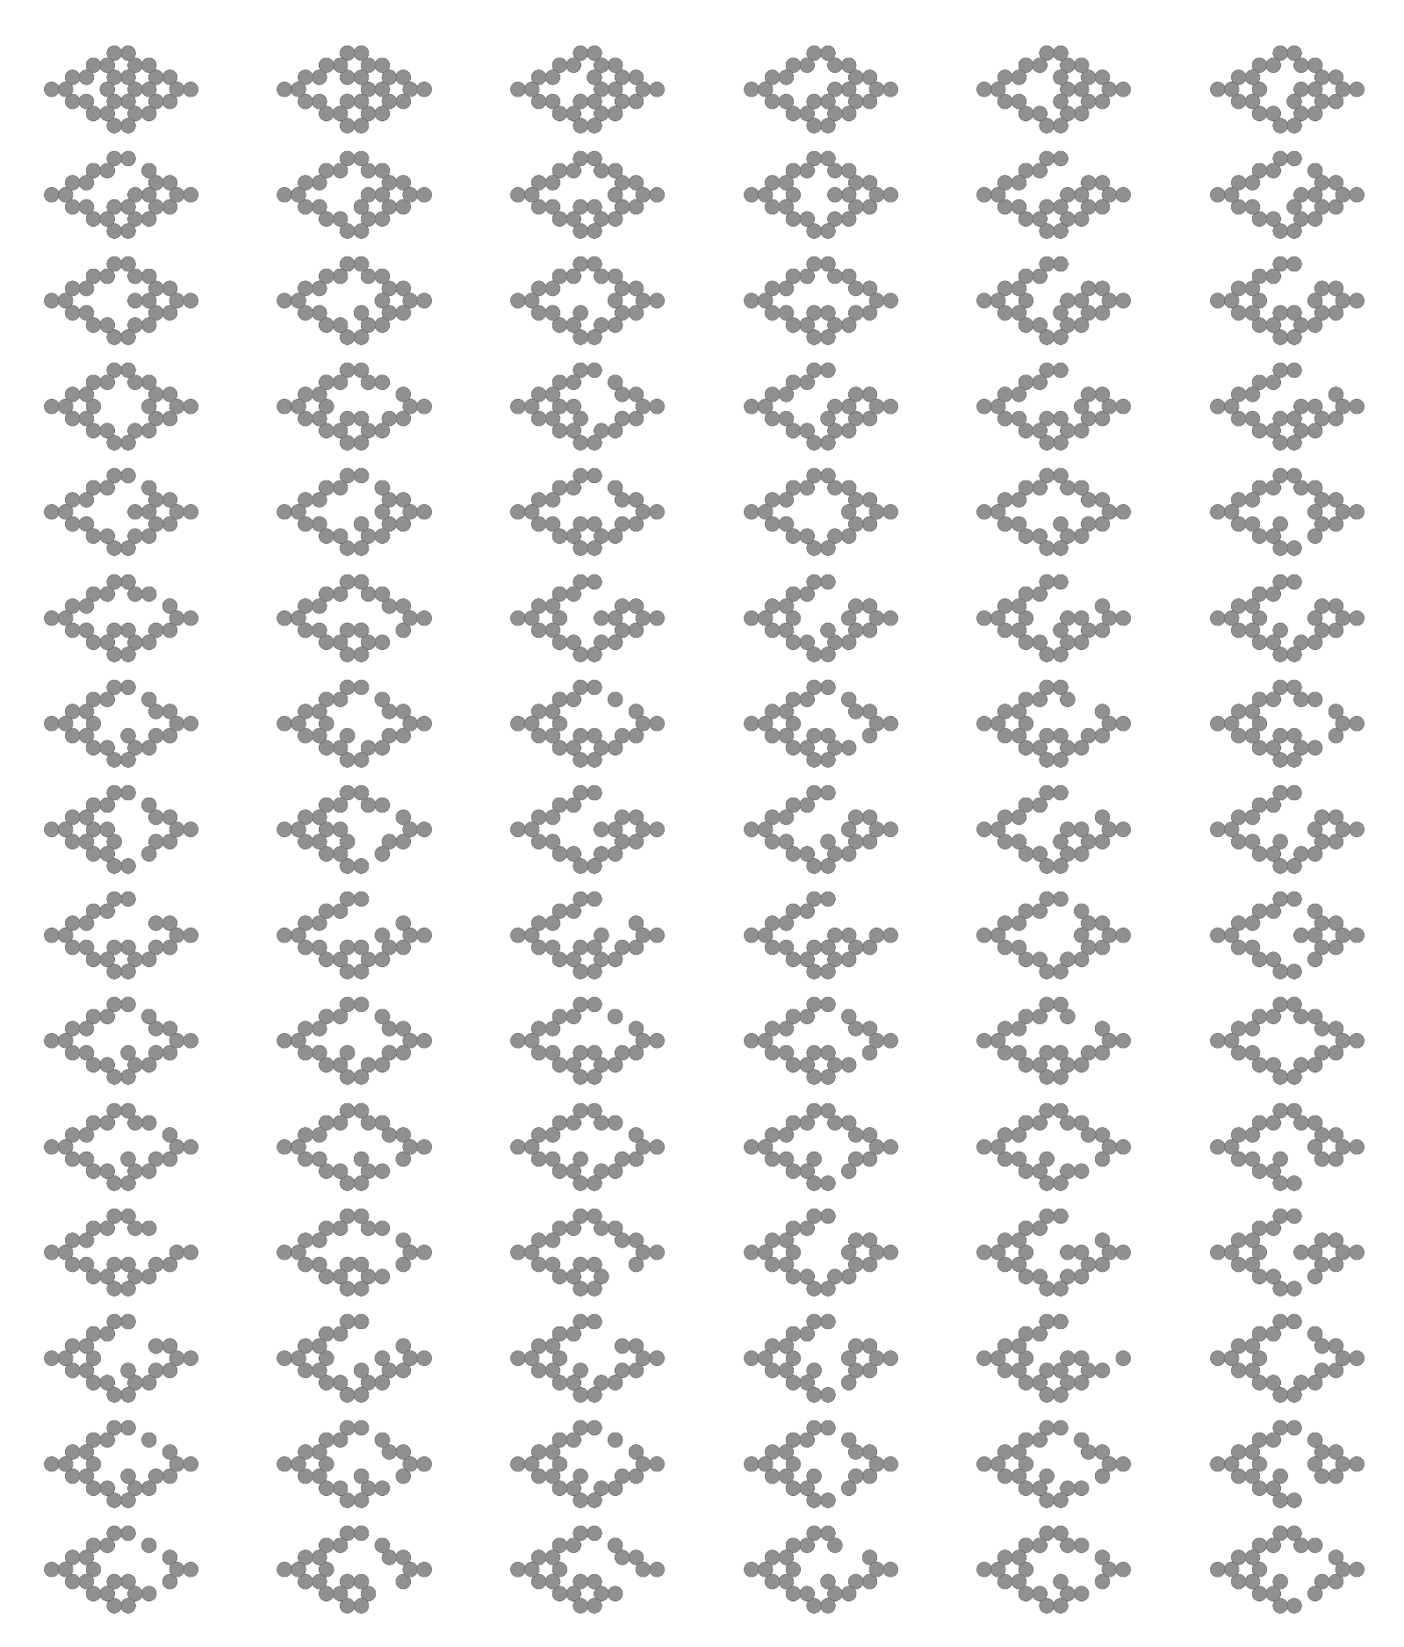
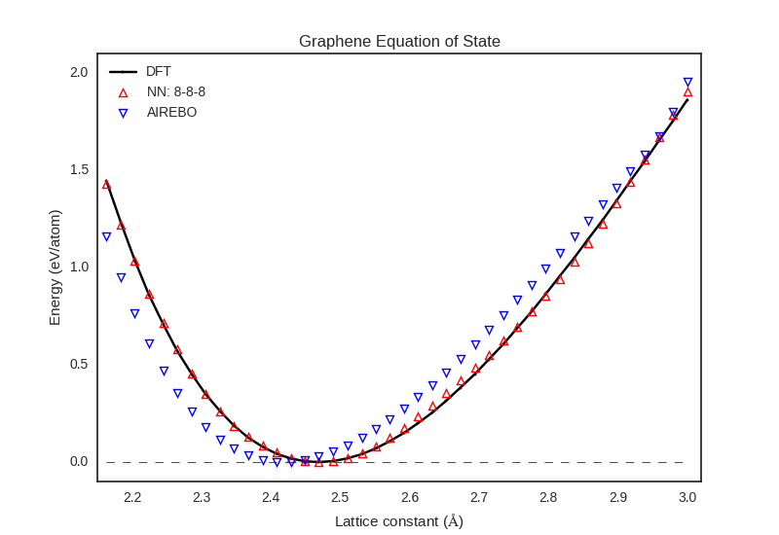



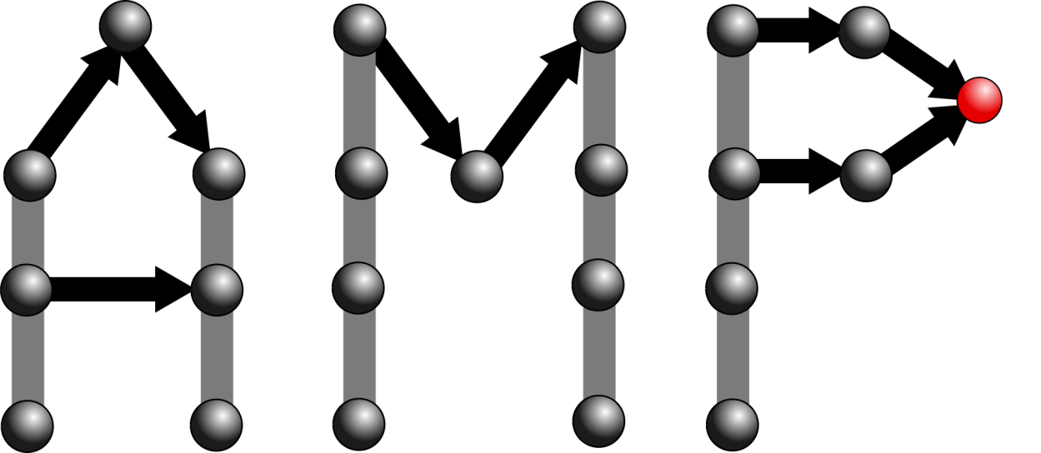
Minimum energy search over graphene defect structures using a neural network potential
Devon Walker* and John Kitchin
Motivation
Neural network training
Structure size extrapolation
Graphene is a 2D carbon material that is impermeable to all gases ^{[1]}.
Engineering pores into graphene can adjust its transport properties, but current methods of creating pores can leave unintentional vacancies ^{[2]}.
Predicting the rearrangement of pores would be too computationally costly with density functional theory (DFT).
A neural network potential (NNP) can offer similar accuracies but with greatly increased computational speed ^{[3]}.
Training a NNP that is capable of predicting energies over a variety of structures requires a diverse training set. Approximately 7k unique DFT calculations are divided between the training set (90%) and the test set (10%).
DFT quickly reaches computational limits as the number of atoms in the system increases beyond approximately 100 atoms. We would like the NNP to be useful for systems that are larger than those used to train it. Here we see a comparison between DFT and the NNP for system sizes approaching the upper limit of practical DFT calculation times.
We compare energy calculations between the NNP and the DFT training set to examine convergence. We also compare between two NNPs trained on the same data set to check for agreement and potential overfitting.
Limitations
The NNP is only trained for carbon and cannot be used for functionalized pores.
Currently, the NNP does not handle forces well enough to drive nudged-elastic band (NEB) calculations. We will correct this by including DFT calculations for NEB in the training set.
Equation of state
The NNP follows very closely to the equation of state predicted by DFT and outperforms the AIREBO potential at predicting the lattice constant of a pristine graphene monolayer. It is worth noting that equation of state calculations were included in the NNP training set.
Conclusions
A NNP has been developed that can accurately predict the energies for porous structures of graphene.
The NNP is able to be extrapolated to larger structures that would be too computationally expensive for a DFT calculation.
By increasing the size and scope of the DFT training set, we can achieve greater accuracy with the NNP.
Energy-unique pore search
In order to train the neural network, a set of energy-unique pore structures was needed for calculating DFT energies for the training and test sets. The image above represents approximately 1.3% of the total structure set.
References
J. S. Bunch et al., Nano Letters 8, 2458-2462 (2008).
L. Huang et al., J. Phys. Chem. Letters 6, 2806-2815 (2015).
3. J. Behler, Phys. Chem. Chem. Phys. 13, 17930-17955 (2011).

