Slide 1


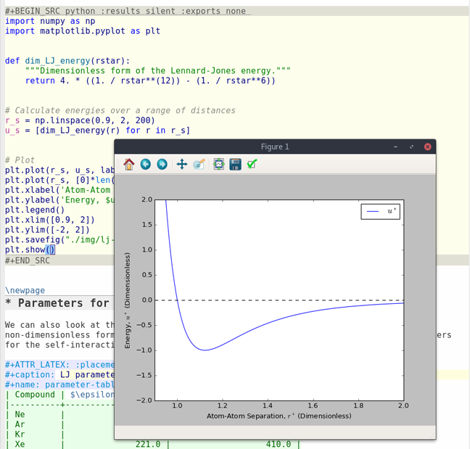
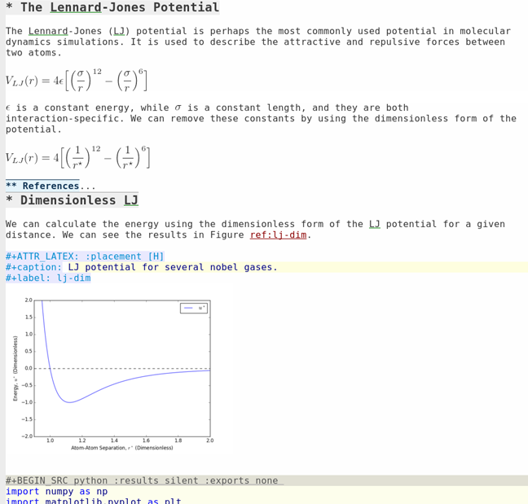
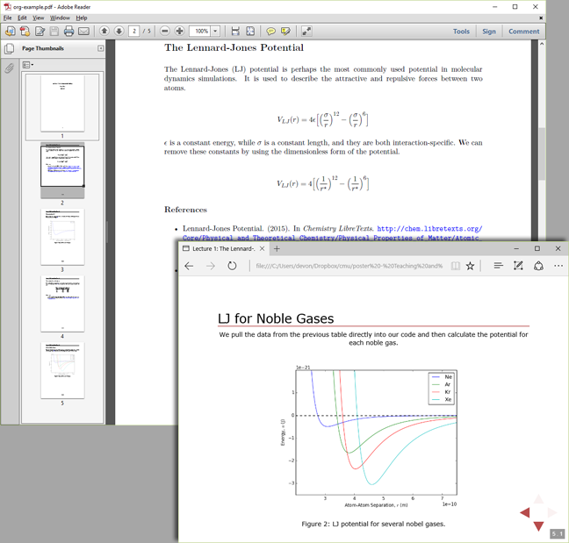




Devon Walker
Master’s student Chemical Engineering
Hands-on learning in the classroom with Org-mode
Creating and presenting a lesson plan using tools that
allow engineering students to manipulate and execute
code directly inside of their notes.
Project Design
Abstract: Learning engineering concepts without hands-on examples can be a difficult task for some students. Traditionally in the classroom, concepts are taught and examples are given, but working with them is left as a homework exercise. This method misses out on the opportunity to use programming in the classroom as a supplemental teaching tool for hands-on learning. Org-mode in Emacs solves this problem by allowing an instructor to contain lecture material and executable code inside a single document that they can give to their students. This poster shows how it is possible to use an Org-mode file to develop a lesson plan that makes the most out of having students working with code inside the same document as lecture notes.
A lesson plan in an org-mode file on a simple topic that allows manipulation of a code example
The same document exported to both a PDF and a slideshow for instructor presentation
Lessons Learned
Org-mode files naturally organize lesson materials into headings and subheadings
Students can take notes directly in the org-mode file, so that all information pertaining to the lesson is stored in one place
In the future, it is far simpler to work entirely in org-mode files than it is to export them
Using an org-mode file as a lesson plan works flawlessly, and keeping everything inside of one file makes it easier to get a clear picture of the lesson’s progression. I was unable to use the same file for exporting to a PDF and a slideshow simultaneously and resorted to using two separate org-mode files. Getting PDFs and slideshows to look the way you want requires optional arguments (the PDF is generated with LaTeX) and more time would be needed to make these optional arguments work correctly for both cases in the same org-mode file.
Project Demonstration
Figure 1. The lesson can be organized into topics and subtopics with the use of built-in headers. Emacs can support inline LaTeX, so equations appear cleaner than they would written on the blackboard. Any image can also be displayed inline with text, including plots generated from code inside the same file.
Figure 2. Code can be executed directly inside of a notebook, similar to working within a development environment. If the code updates an image displayed elsewhere in the notebook, it will be updated there as well. In this figure, the code spawned a new window showing the updated plot.
Figure 3. The lesson can be exported to PDF or a slideshow, depending on the instructor’s lecturing style. Students may take their own notes in the org-mode file to include in their own exports as well.
More information
(Lesson plan, slideshow,
and additional resources)

