Slide 1

Notes:
Zakat.
Welcome the audience. This session is about understanding Zakat, not announcing that a particular fundraising campaign is Zakat-eligible. The tree is a visual metaphor: wealth can support lives when it reaches the people entitled to it. Explain that this is a concise introduction, and individual calculations and disputed applications should be discussed with a qualified scholar. Allow a short pause before moving on.

Slide 2

Notes:
A pillar of faith. A responsibility in wealth.
Introduce the five pillars without implying they are interchangeable. Highlight Zakat as the pillar that concerns qualifying wealth and its rightful distribution. The hadith in Sahih al-Bukhari 8 identifies paying Zakat among the five. Avoid presenting this short deck as a full list of every condition for every person or asset; detailed rules differ between schools of law.

Slide 3
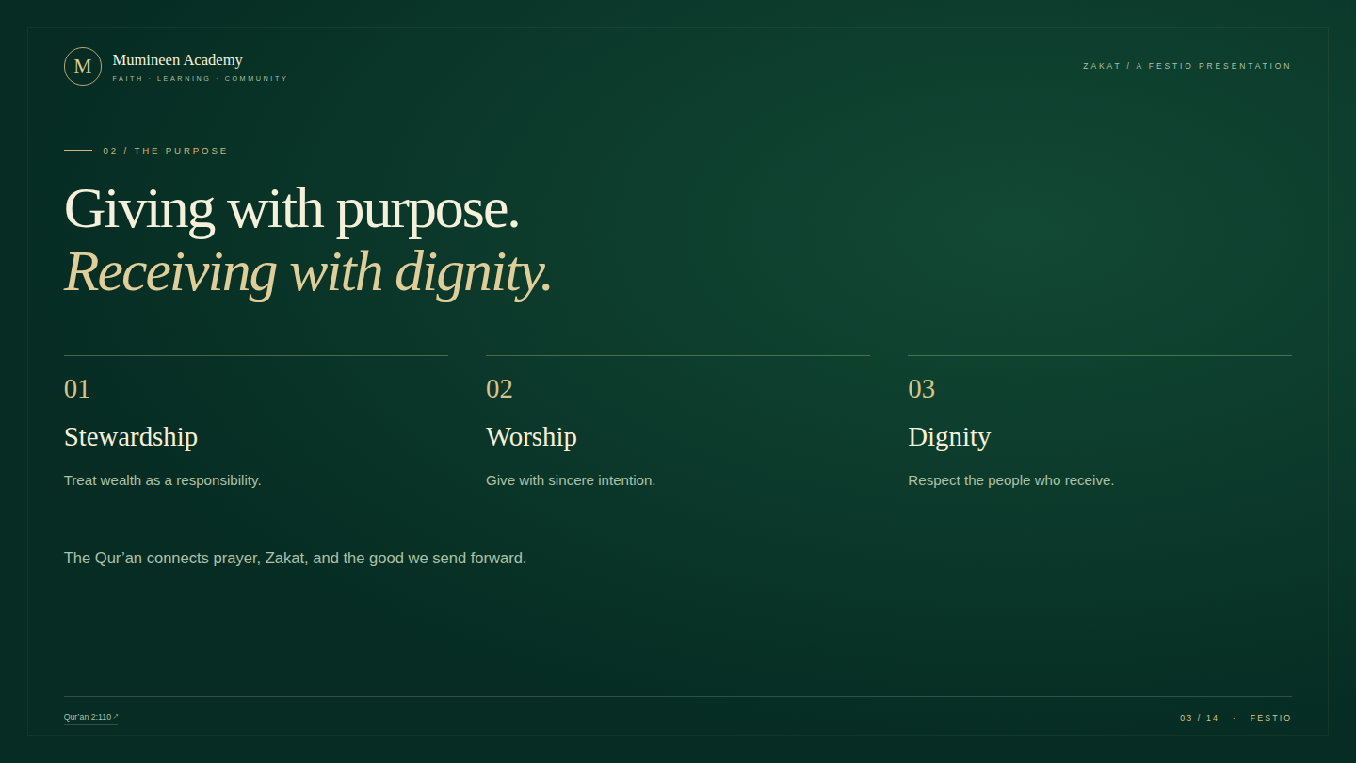
Notes:
Giving with purpose. Receiving with dignity.
This slide offers an ethical reflection, not a promise that every donation will produce a specific return. Paraphrase the message of Qur’an 2:110: establish prayer, give Zakat, and remember that good actions matter before Allah. Discuss dignity in practical terms: no humiliating photographs, pressure to share a story, or public display of a recipient’s circumstances.

Slide 4
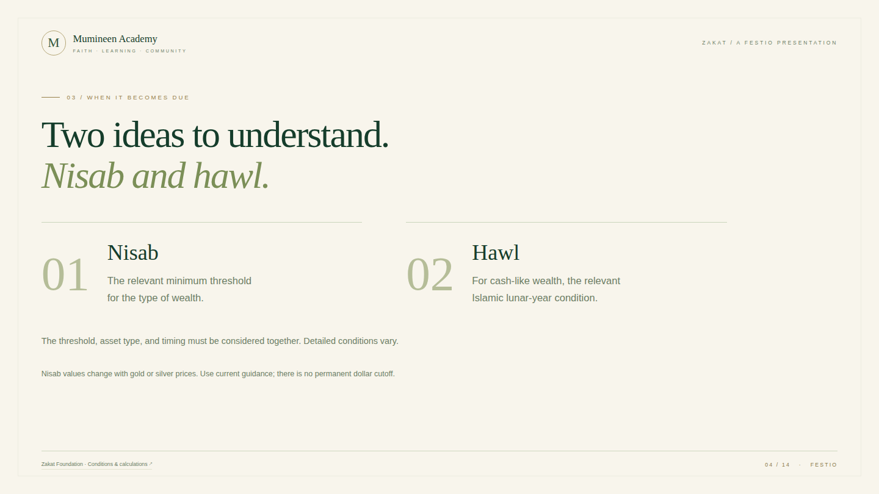
Notes:
Two ideas to understand. Nisab and hawl.
Nisab is a threshold, not the amount of Zakat itself. Hawl refers to the lunar-year condition applicable to common monetary wealth. Other assets have different rules. The treatment of fluctuations in wealth, debts, children’s wealth, gold and silver benchmarks, and other details varies. Do not announce a live dollar threshold from memory. Recommend a qualified scholar or a trusted, current calculator following the relevant methodology.

Slide 5
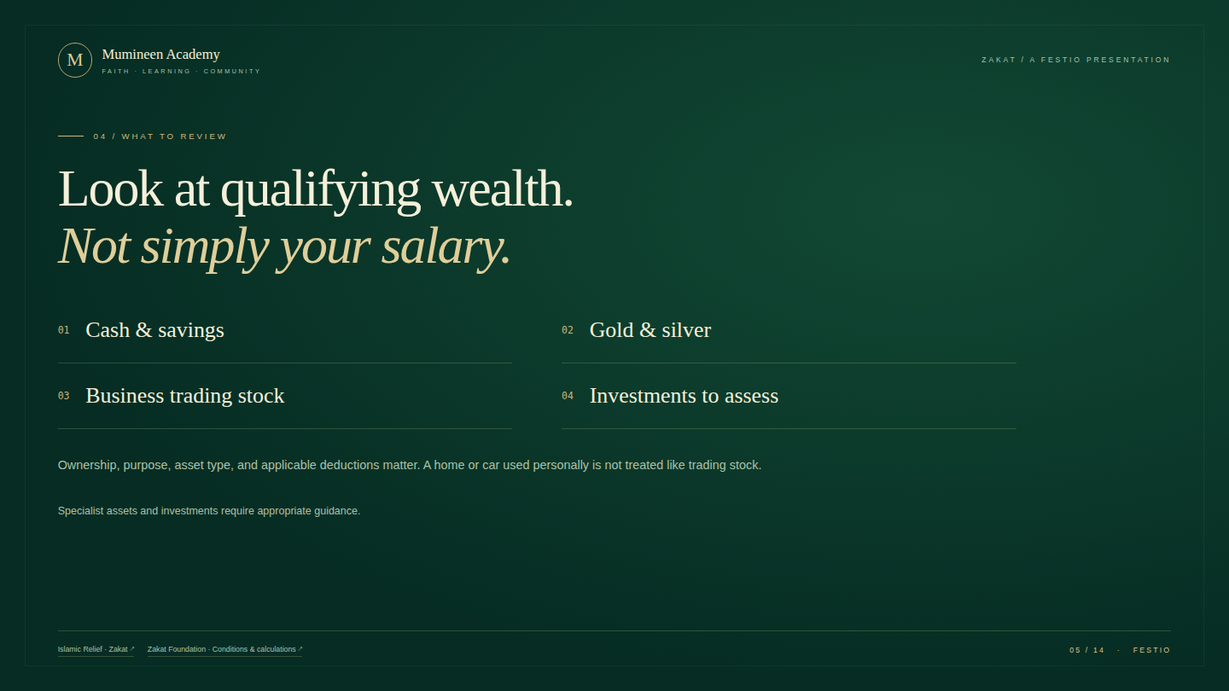
Notes:
Look at qualifying wealth. Not simply your salary.
The list is a starting point, not a personal Zakat assessment. Separate cash and savings from earnings spent on ordinary living costs. Ask the audience to consider the purpose for which an asset is held: personal use, resale, business operations, or investment. Do not treat all investments alike or deduct every debt automatically. Detailed treatment of jewelry, pensions, shares, business assets, and liabilities should be checked with qualified guidance.

Slide 6
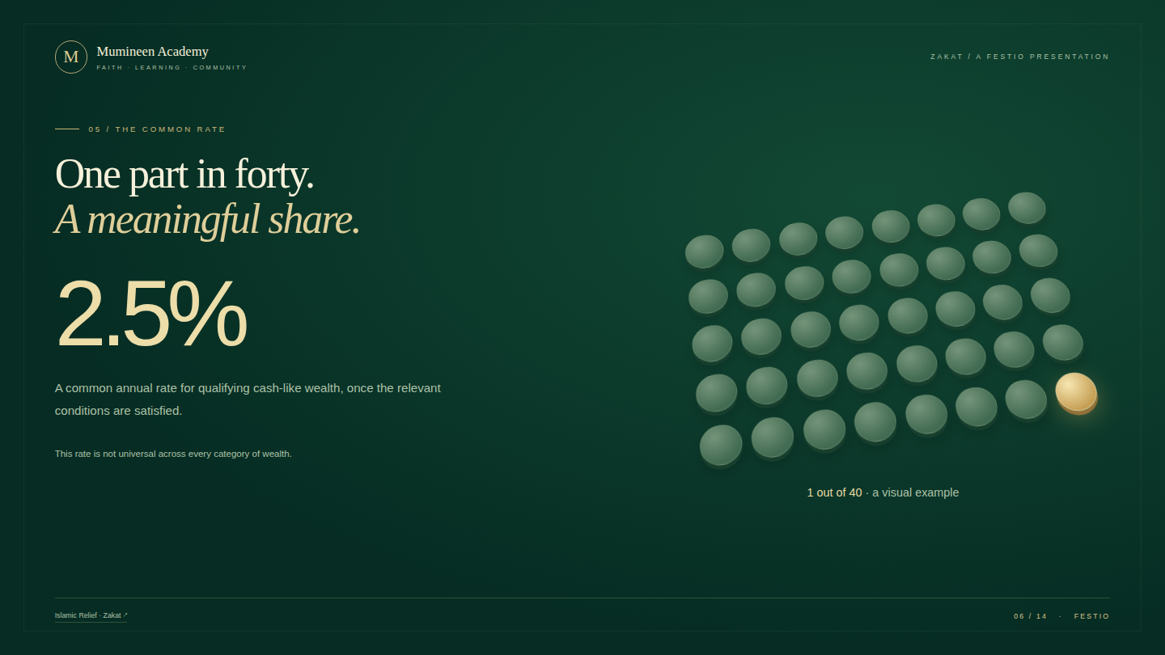
Notes:
One part in forty. A meaningful share.
Use the forty tokens to make the fraction tangible. One of forty equals 2.5 percent. Ask the audience to predict the number of highlighted tokens before revealing the visual. Make clear that the diagram illustrates a common rate for cash-like qualifying wealth. Agricultural produce, livestock, and other forms of wealth have their own rules. It is not 2.5 percent of everyone’s gross salary, and it is not a complete eligibility test.

Slide 7
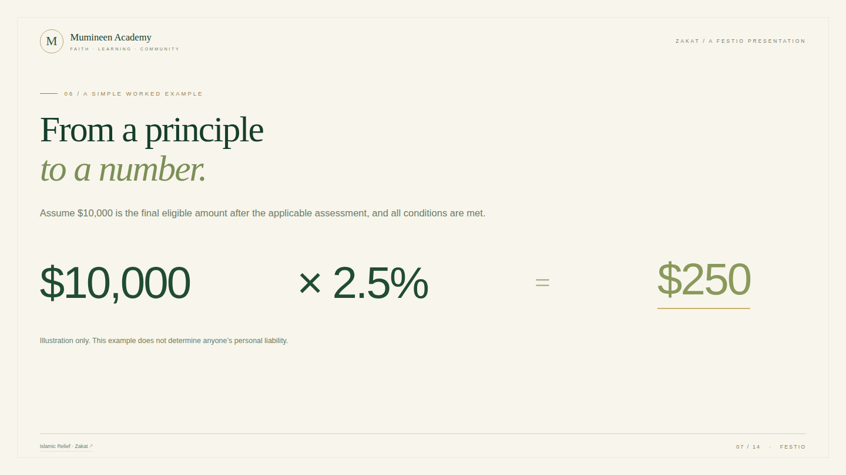
Notes:
From a principle to a number.
State the assumptions first. We are not deciding whether the person has reached nisab, whether a year has elapsed, or what deductions apply; those checks have already been completed for the example. Ten thousand multiplied by 0.025 equals two hundred and fifty. Invite the audience to check the arithmetic. Reveal the result after a brief pause. No live financial details are requested or stored.

Slide 8
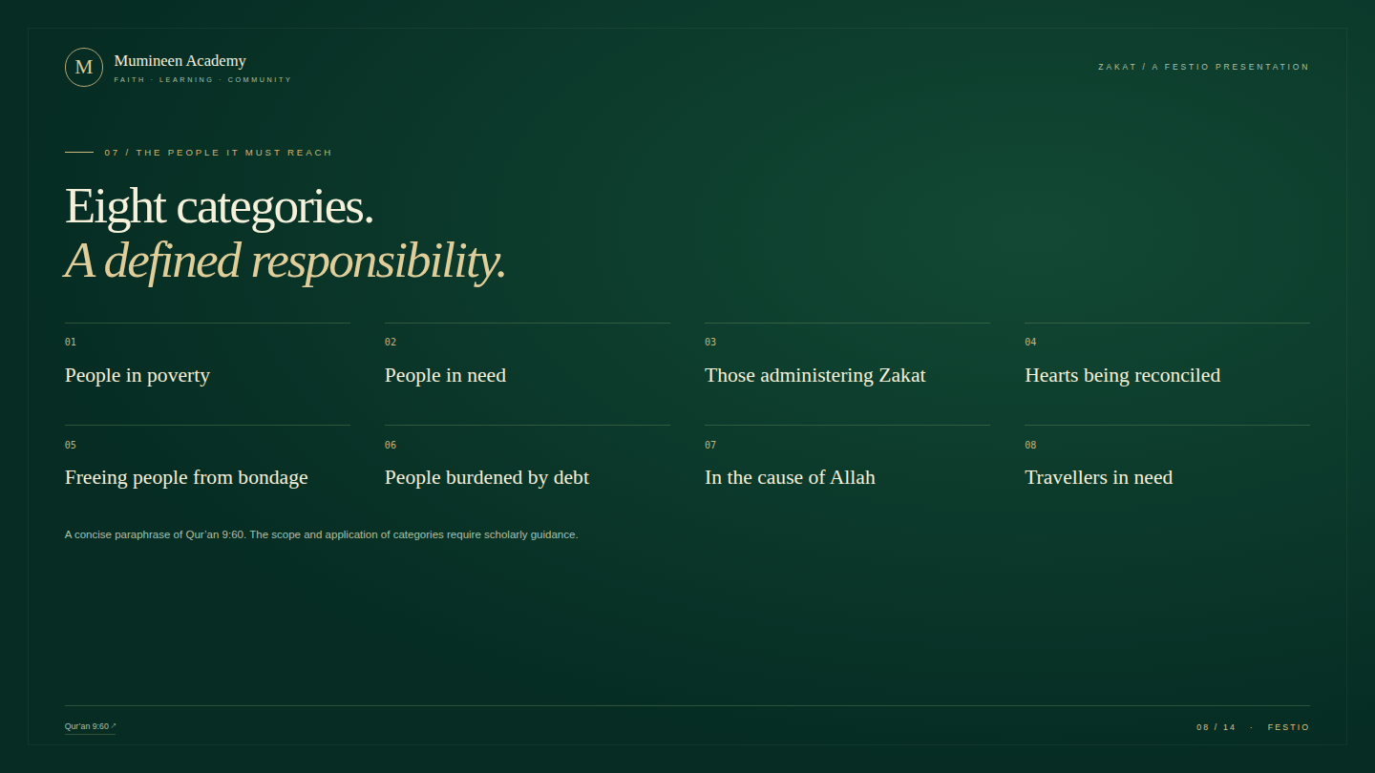
Notes:
Eight categories. A defined responsibility.
Read the categories with care. These are concise English paraphrases of the categories in Qur’an 9:60, not a replacement for the verse or its interpretation. Discuss why Zakat is not simply a general-purpose charity budget. The scope of categories such as those administering Zakat and in the cause of Allah is subject to conditions and scholarly interpretation; do not imply that any organization’s administrative costs or any worthy cause automatically qualifies.

Slide 9
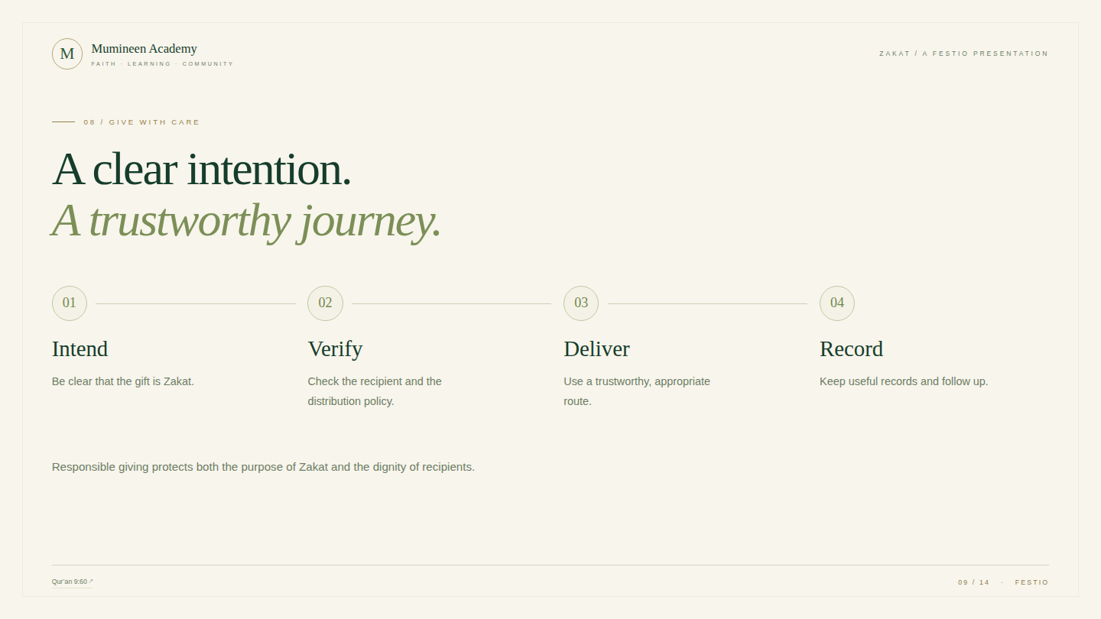
Notes:
A clear intention. A trustworthy journey.
Present this as a practical checklist. For an intermediary or organization, ask how eligibility is assessed, how funds are separated, and how the donor’s Zakat intention is carried through to distribution. A tax receipt, attractive website, or well-known name alone is not proof of religious eligibility. Keep records discreet and respect the recipient’s privacy. This process does not authorize the presenter to certify a particular organization.

Slide 10
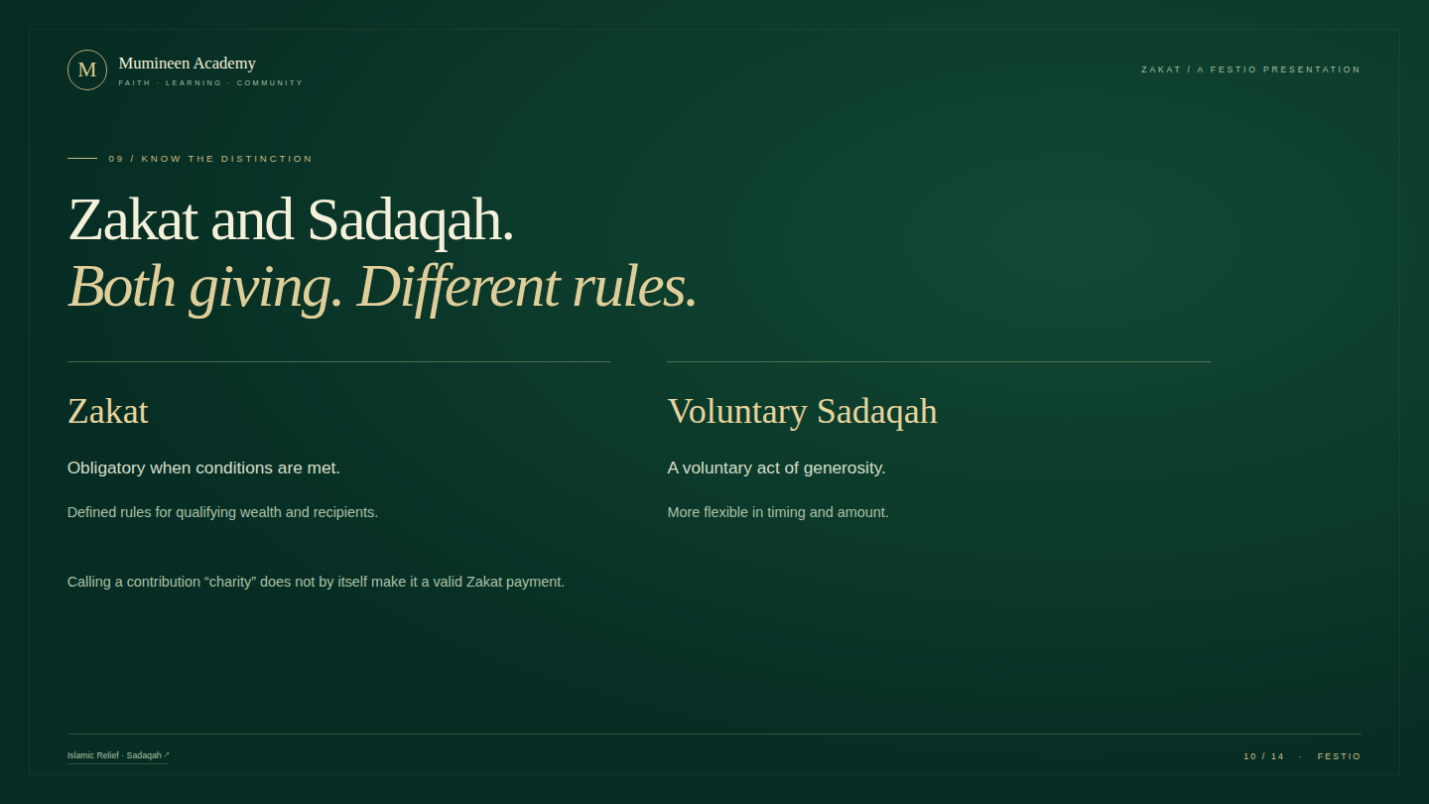
Notes:
Zakat and Sadaqah. Both giving. Different rules.
Explain the distinction without diminishing voluntary giving. Zakat is an obligation when applicable conditions are met, with rules governing calculation and distribution. Voluntary Sadaqah is broader and flexible. The Qur’anic word sadaqat can include obligatory alms in context, as in 9:60; the comparison here specifically concerns voluntary Sadaqah. A donor should not relabel an unrestricted contribution as Zakat without checking that the intended use and distribution meet the relevant requirements.

Slide 11
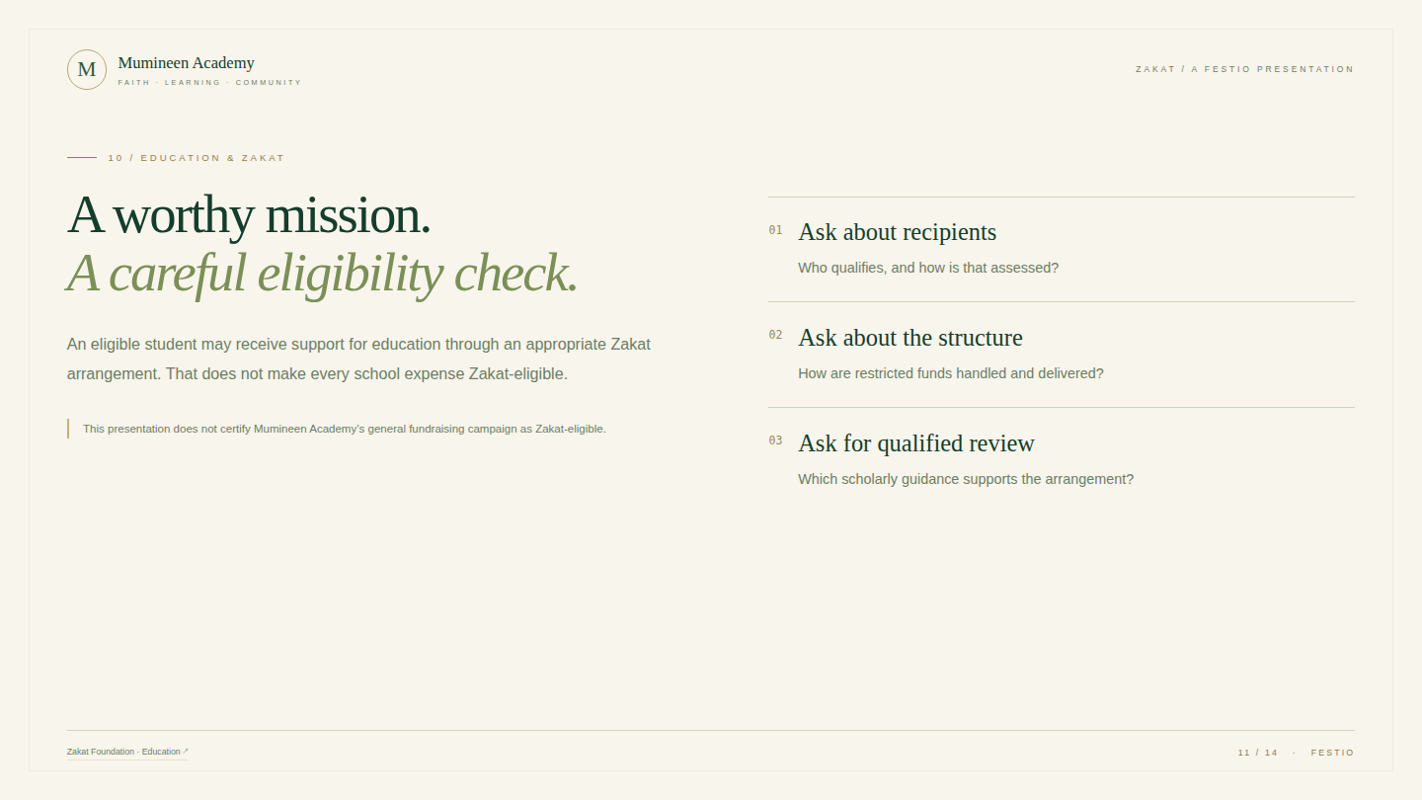
Notes:
A worthy mission. A careful eligibility check.
This is particularly relevant to a school community. Zakat Foundation’s education discussion centers on eligibility of people and the conditions of distribution; institutional uses and wider interpretations require careful scholarly consideration. Separate support for an eligible student from blanket claims about school buildings, fees, salaries, or all educational projects. Do not ask the audience to pay Zakat into the academy’s general appeal on the authority of this presentation. The academy would need a properly reviewed arrangement before making such a claim.

Slide 12
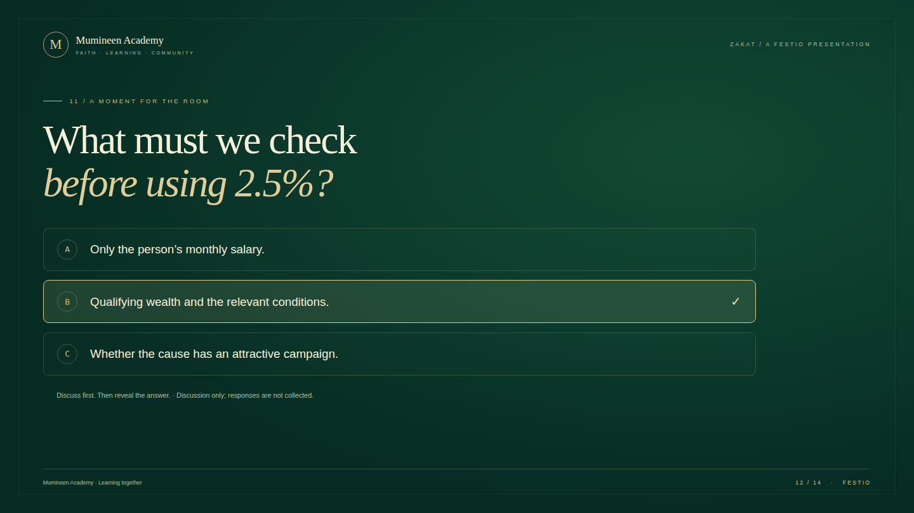
Notes:
What must we check before using 2.5%?
Pause and invite a show of hands or a short discussion. This is a local presenter interaction, not a live audience poll and no responses are collected. Reveal B: the rate is applied only after understanding qualifying wealth and the applicable conditions. A good cause or a beautiful campaign does not replace eligibility checks. If time allows, ask which slide changed the audience’s understanding most.

Slide 13
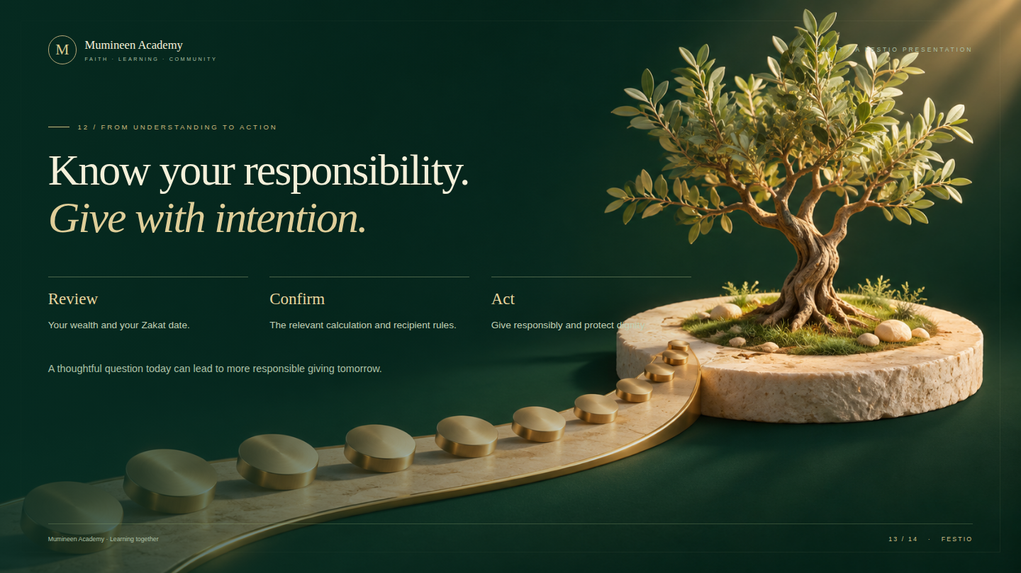
Notes:
Know your responsibility. Give with intention.
Close with three memorable actions: review, confirm, act. Encourage participants to write down their Zakat date and one question for a qualified scholar or knowledgeable advisor. Thank the audience. Offer questions and discussion without turning the educational session into an automatic payment request. No personal financial information should be announced publicly.

Slide 14
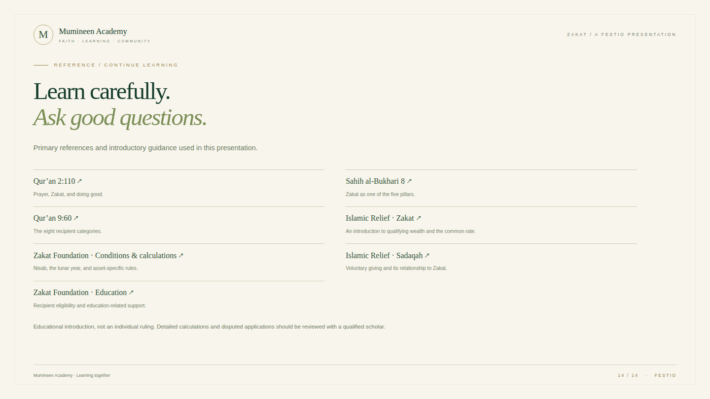
Notes:
Learn carefully. Ask good questions.
Keep this slide available during questions. The Qur’an and hadith references anchor the discussion; charitable organizations provide introductory summaries and practical explanations. A short presentation cannot resolve all differences between schools of law. The links are included so the presenter and audience can read in context. Speaker content and examples were prepared for this event and should be reviewed by the event’s chosen religious educator before teaching complex or disputed cases.

