Slide 1
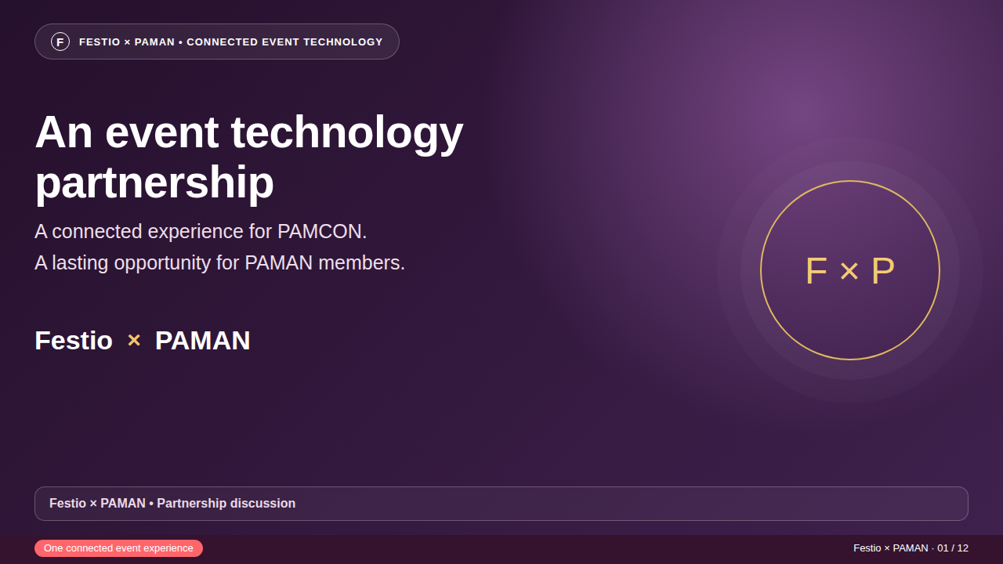
Notes:
Introduce Festio as event technology supporting PAMAN members. Suggested presentation: 10–12 minutes, followed by a five-minute demonstration and discussion. This is a proposed partnership, not an announced agreement.

Slide 2
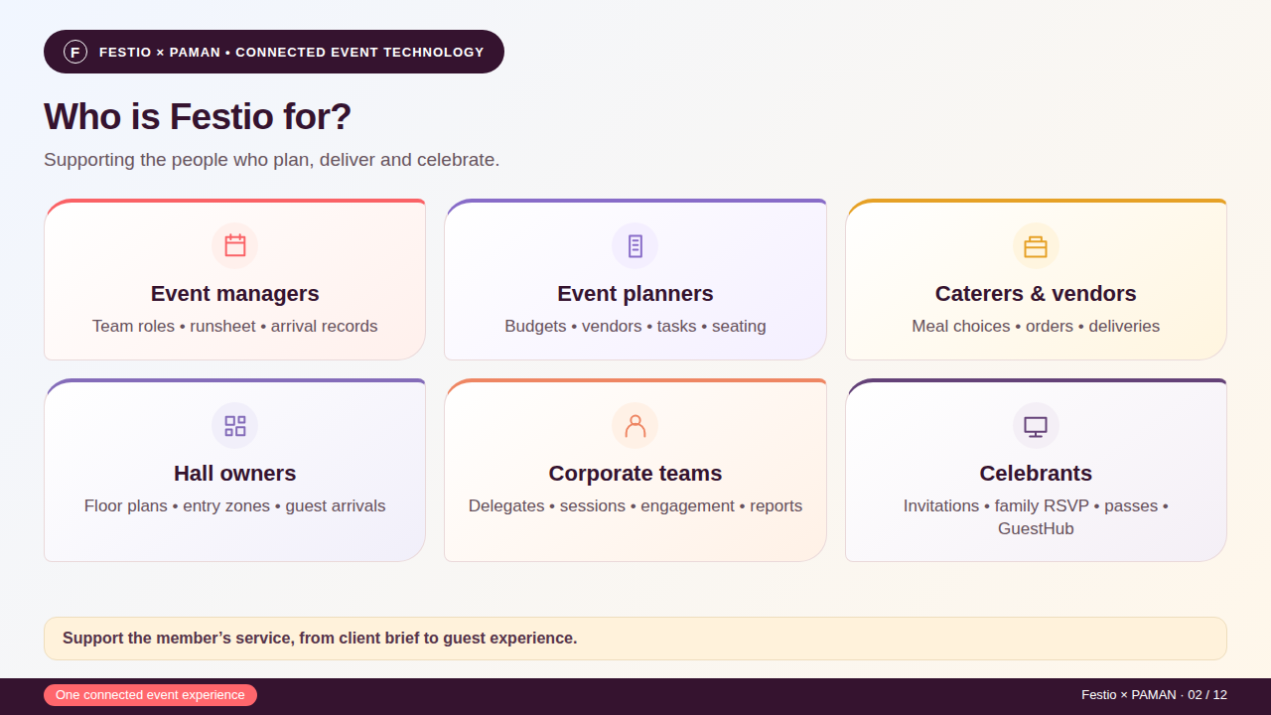
Notes:
Based on the same audience infographic approach used for NCNMO. These roles can overlap. Explain what each stakeholder can do with appropriately granted access; this is not six separate vendor portals.

Slide 3
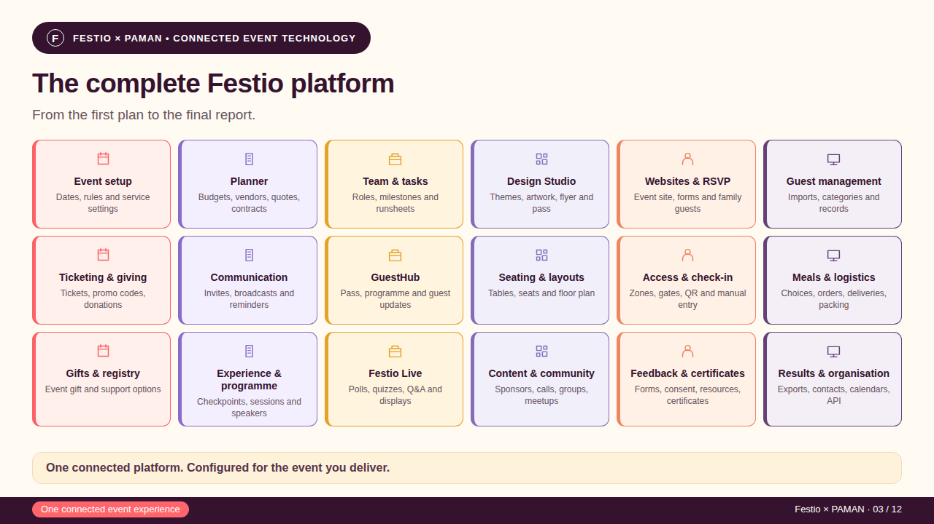
Notes:
This is the compressed equivalent of the NCNMO platform infographic. Features depend on event configuration, access, add-ons and integrations. Procurement records are not an automatic payment/e-signature engine. Reporting uses captured records.

Slide 4
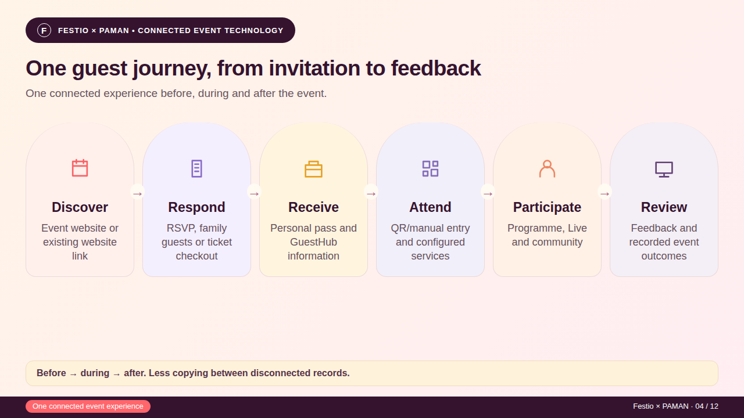
Notes:
Trace a rehearsal attendee through these stages. A successful admission does not prove service collection or session participation. Personal links must not be shared as public demo links.

Slide 5
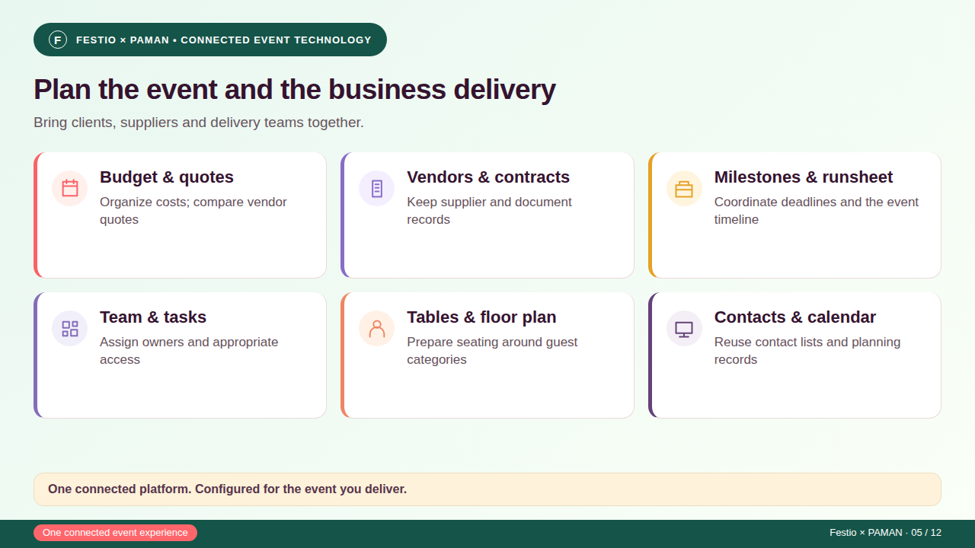
Notes:
Example: a planner preparing a wedding alongside a corporate dinner, with distinct branding and guest records for each event. Documents and budget entries do not imply bank reconciliation, e-signatures or vendor settlements.

Slide 6
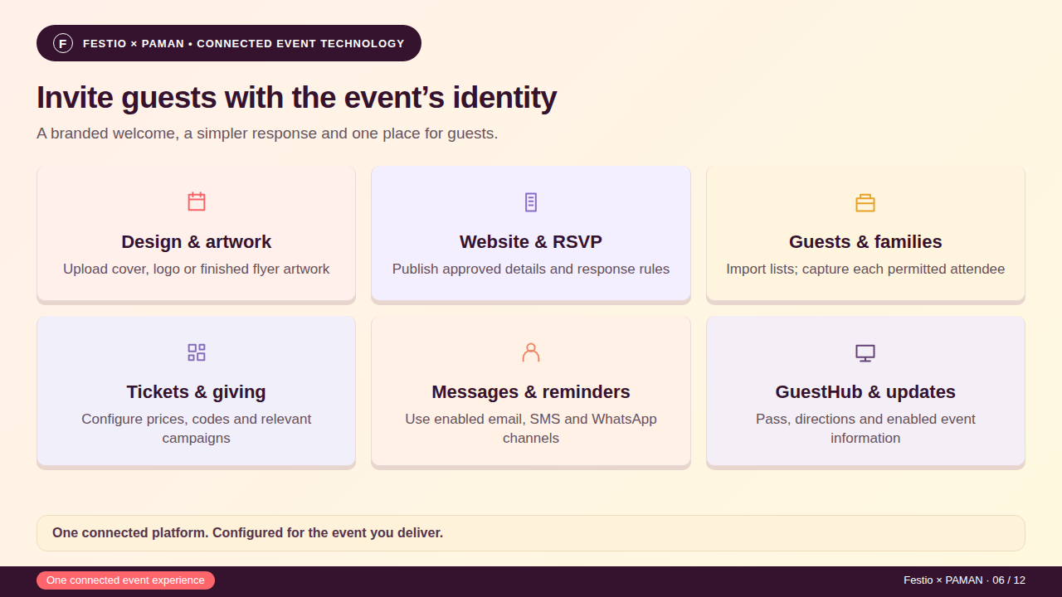
Notes:
Demonstrate actual Design Studio surfaces. Flyer controls appear after choosing Flyer. Messages need integrations, consent and credits. Real payment readiness must be checked with the configured provider; no payment success is asserted in this deck.

Slide 7
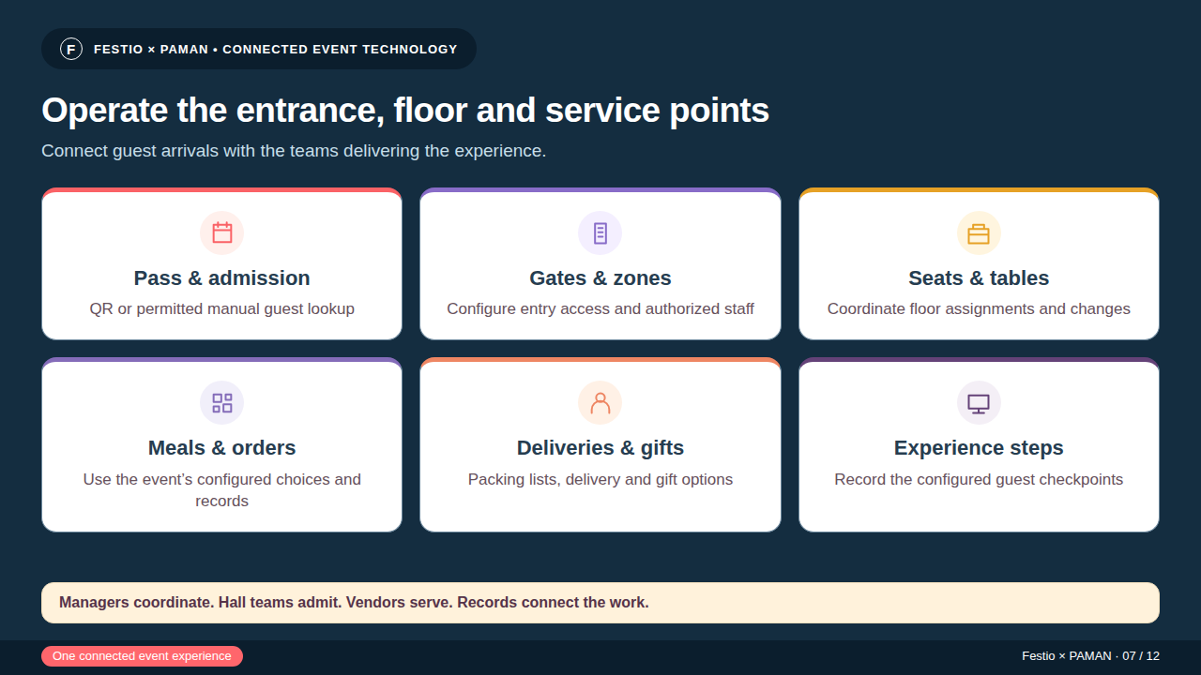
Notes:
Use a rehearsal guest to show both success and an exception. Do not equate arrivals with current building occupancy or claim a full stock/POS system. Offline admission requires prepared devices and reconciliation; not all operations support offline use.

Slide 8
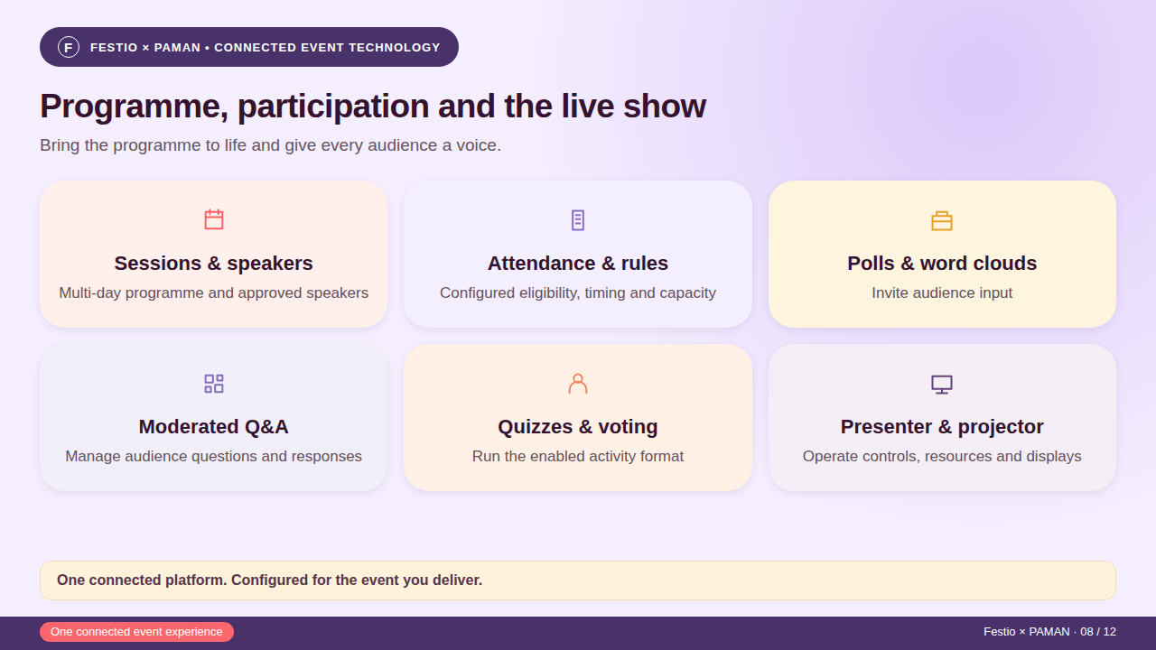
Notes:
Use a configured activity and separate moderator, guest and projector views. Timing and Guided Show behavior need their actual configuration. Appropriate feature entitlements apply. This is not a promise of autonomous or fully offline show operation.

Slide 9
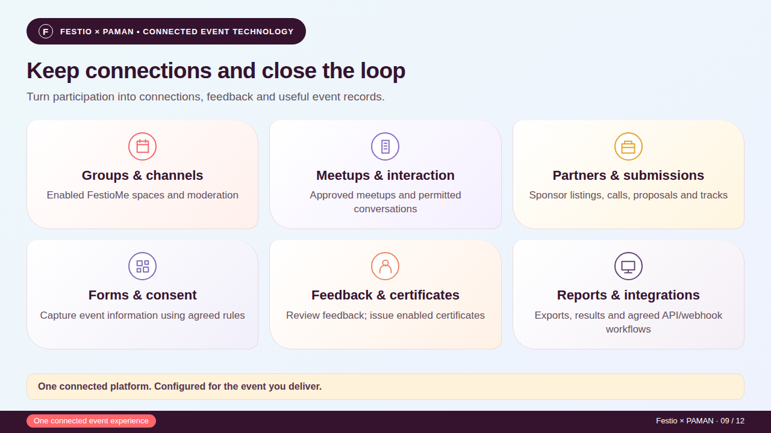
Notes:
Community permissions apply. Certificates are not automatically accredited. Inspect date/filter context and reconcile the specific export before quoting totals. Integrations are individually configured; no blanket third-party parity claim.

Slide 10
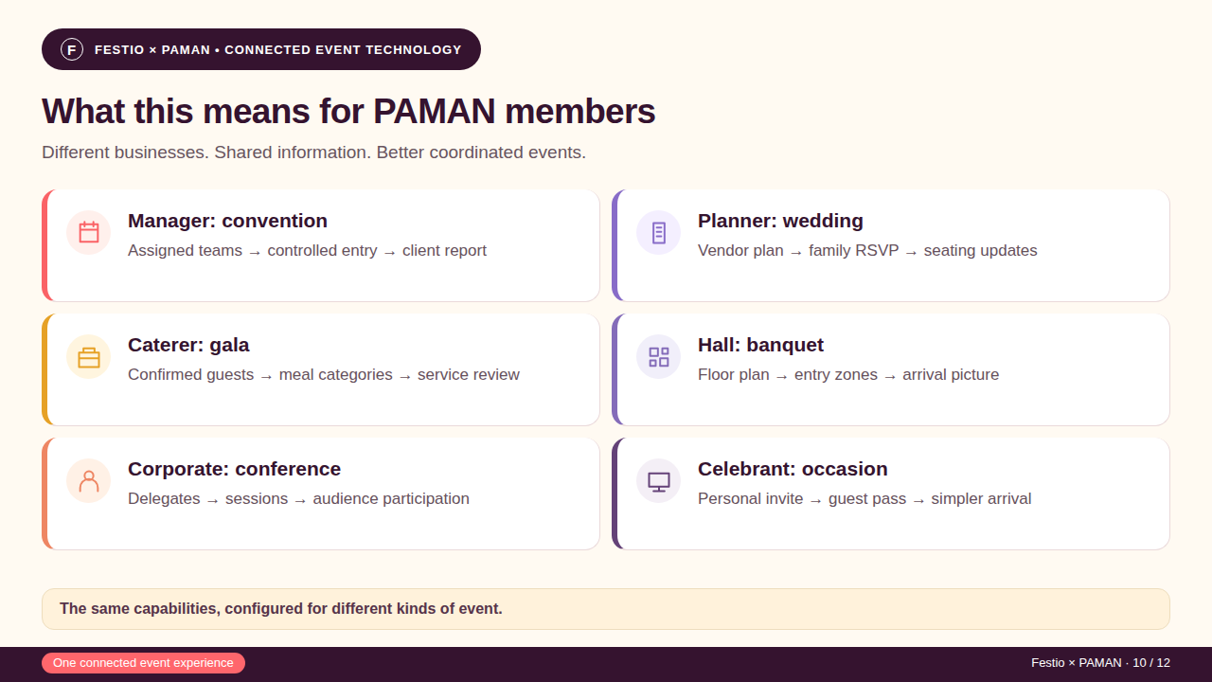
Notes:
These are illustrative scenarios, not claimed savings or completed PAMAN case studies. Ask which workflow is most valuable to each member group. Vendor and venue users need appropriate access.

Slide 11
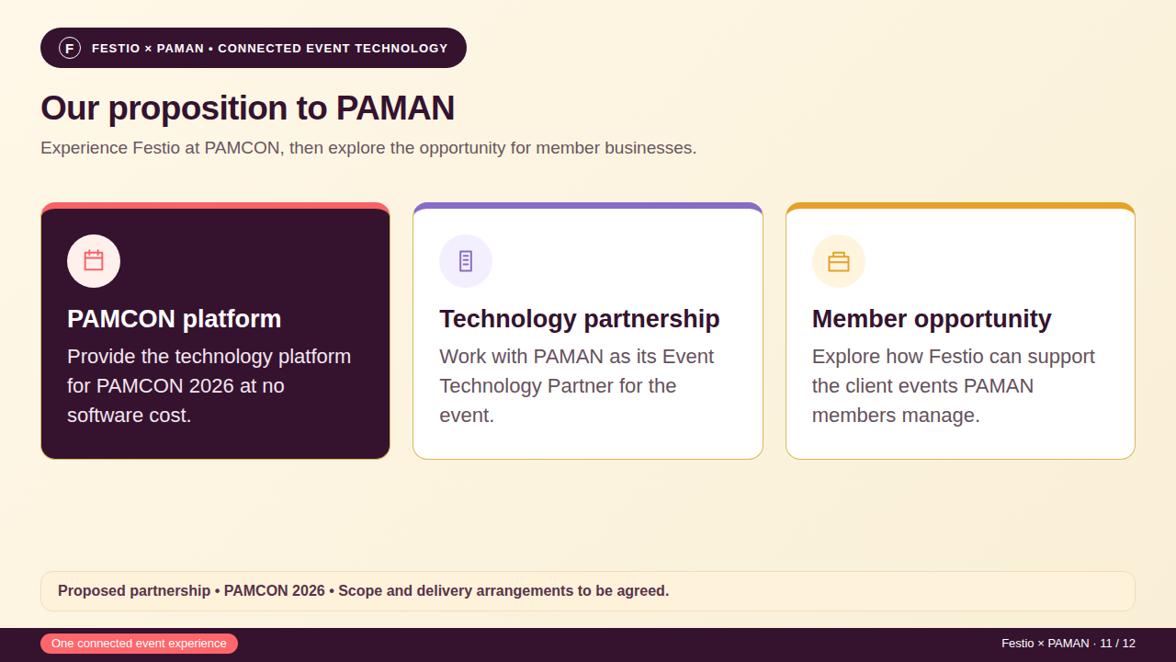
Notes:
This restates the proposition in the September one-pager. It is an offer for discussion, not a signed agreement. Confirm inclusions, messaging/provider fees, equipment, staffing, support and relevant add-ons separately. Demonstrate a prepared rehearsal event if requested; do not publish changes or send messages to real guests without an agreed plan.

Slide 12
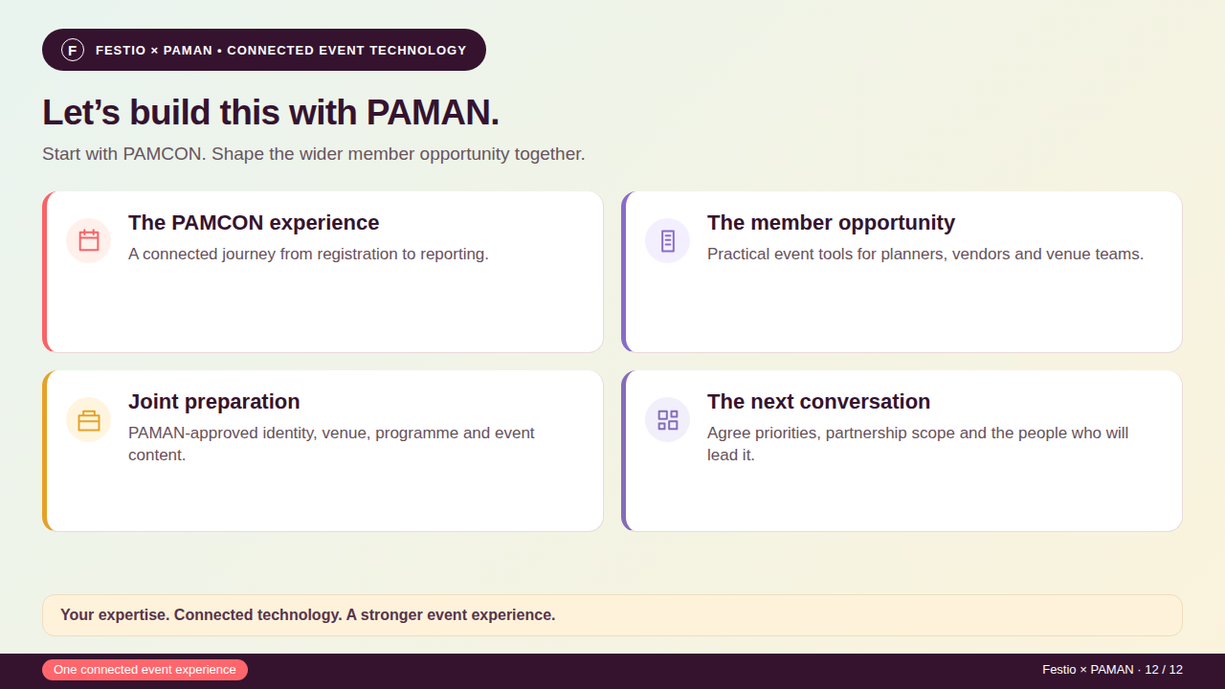
Notes:
The September one-pager proposes no software cost for PAMCON. Agree inclusions, message/provider fees, equipment, staffing, support and add-ons separately. Discounts, referral commissions and exclusivity are not agreed. Sources: shared PAMAN one-pager, Festio illustrated guide and the NCNMO decks. All scenarios remain subject to configuration and rehearsal.

