Slide 1
Personal Goals:
Task:
Collect some meteorology information using API from https://www.metaweather.com/api/
The data about air temperature, max and min temperature and humidity for yesterday and that date in a year ago on St. Petersburg.
Back-end (collects data) must:
Retrieve a portion of data from API and store it in a database
Update data on demand
Update DB schema if needed on app’s update
Front-end (outputs data) must:
Display any portion of the data stored in the DB
Provide a method to trigger data update process
Database:
Choose Database type and data scheme in a suitable manner.
Data must be stored in a persistent way
It’s better to use cloud native DB solutions like an RDS/AzureSQL/CloudSQL.
Cheap
Serverless
Cloud-native
Use MS tools and Azure DevOps service

Slide 2
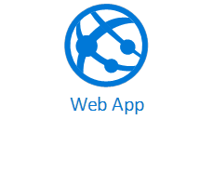



Slide 3
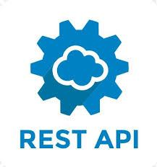





https://www.metaweather.com/api/location/2123260/YYYY/MM/DD/
Azure Service Bus

Slide 4
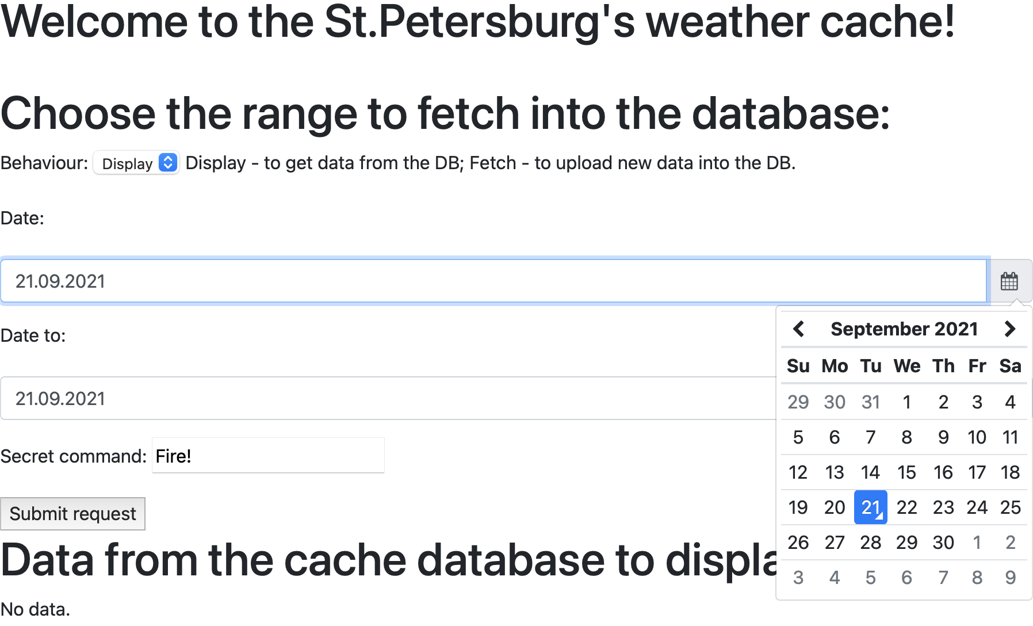
Cloud-native
Scalable
Simple
https://github.com/users/devops-ci-cd/projects/1

Slide 5
Estimate of the costs for Azure resources Azure Kubernetes Service
Microsoft Azure Estimate
Kubernetes solution
Service type | Region | Description | Estimated monthly cost
Azure Kubernetes Service (AKS) | West Europe | 1 F1 (1 vCPU, 2 GB RAM) x 730 Hours (Pay as you go), Linux; 0 managed OS disks – S4, 0 clusters | €34.97
IP Addresses | West Europe | 0 Dynamic IP Addresses, 1 Static IP Addresses, 0 Remaps | €2.22
Service Bus | West Europe | Basic tier: 1 million messaging operations/mo | €0.04
Azure Functions | West Europe | Consumption tier, 128 MB memory, 100 milliseconds execution time, 31 executions/mo | €0.00
Azure SQL Database | West Europe | Single Database, vCore, {1}, General Purpose, Serverless, Gen 5, Local Redundancy, 0.75 Billed vCores, 5 GB Storage, 0 GB Backup Storage | €11.83
Support |  | Support | €0.00
 |  | Licensing Program | Microsoft Online Services Agreement
 |  | Total | €49.05

Slide 6
Estimate of the costs for Azure resources Azure Web App no auto-scale
Microsoft Azure Estimate
Azure Web App no auto-scale
Service type | Region | Description | Estimated monthly cost
App Service | West Europe | Basic Tier; 1 B1 (1 Core(s), 1.75 GB RAM, 10 GB Storage) x 730 Hours; Linux OS | €11.08
Azure Functions | West Europe | Consumption tier, 128 MB memory, 100 milliseconds execution time, 31 executions/mo | €0.00
Service Bus | West Europe | Basic tier: 1 million messaging operations/mo | €0.04
Azure SQL Database | West Europe | Single Database, vCore, {1}, General Purpose, Serverless, Gen 5, Local Redundancy, 0.75 Billed vCores, 5 GB Storage, 0 GB Backup Storage | €11.83
Support |  | Support | €0.00
 |  | Licensing Program | Microsoft Online Services Agreement
 |  | Total | €22.95
Notes:
IP, DNS, TLS, Gunicorn provided out of the box

Slide 7
Estimate of the costs for Azure resources Azure Web App auto-scale
Microsoft Azure Estimate
Azure Web App auto-scale
Service type | Region | Description | Estimated monthly cost
App Service | West Europe | Standard Tier; 2 S1 (1 Core(s), 1.75 GB RAM, 50 GB Storage) x 730 Hours; Linux OS | €116.97
Azure Functions | West Europe | Consumption tier, 128 MB memory, 100 milliseconds execution time, 31 executions/mo | €0.00
Service Bus | West Europe | Basic tier: 1 million messaging operations/mo | €0.04
Azure SQL Database | West Europe | Single Database, vCore, {1}, General Purpose, Serverless, Gen 5, Local Redundancy, 0.75 Billed vCores, 5 GB Storage, 0 GB Backup Storage | €11.83
Support |  | Support | €0.00
 |  | Licensing Program | Microsoft Online Services Agreement
 |  | Total | €128.84

Slide 8
Summary on per month estimate

Slide 9
The DevOps workflow
Based on Azure DevOps CI/CD portal
GitHub instead of built-in Azure DevOps Repos
Individual repo for each team (Infrastructure, Frontend, Backend)
Two separate pipelines: Infrastructure and Application
A GitHub commit triggers building pipeline, new build triggers release pipeline
Yaml pipeline for Builds, classic pipelines for Releases
Infrastructure resource names are always unique, so the Release can be reused

Slide 10
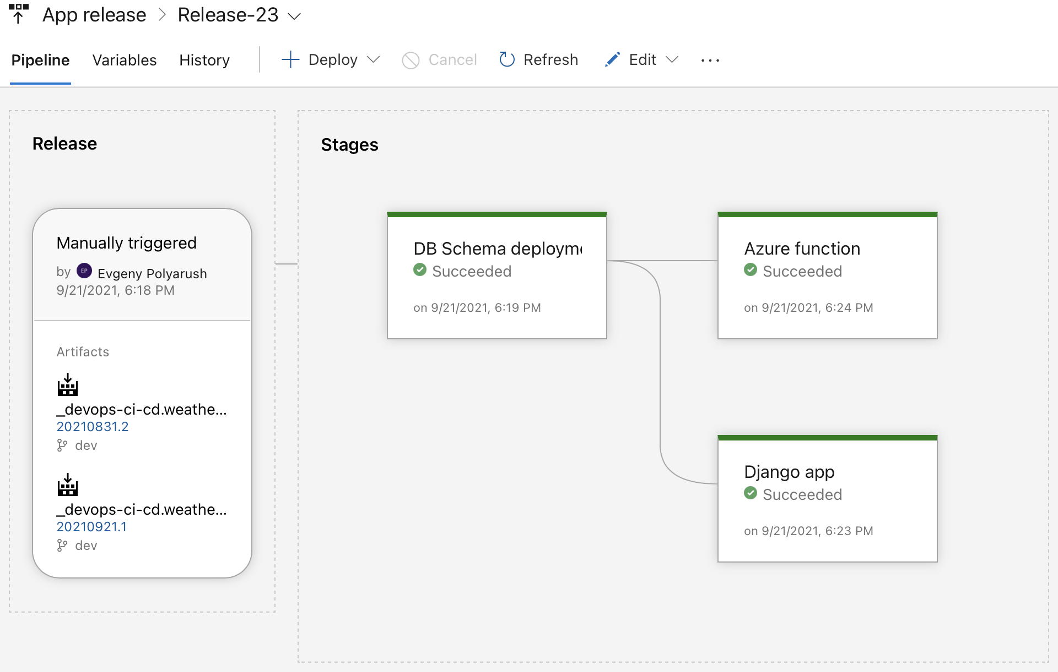
The DevOps workflow

Slide 11
Issues
A Release retains snapshot of global variables, so depended releases must be recreated to use new values
Error: "Requested feature is not available in resource group EPM-RDSP. Please try using a different resource group or create a new one.” It is not possible to create Linux Azure App Service if another App Service already exists in rg https://docs.microsoft.com/en-us/azure/app-service/overview#limitations
Python Azure function requires specific app config (env variables) to be deployed correctly

