Slide 1


by Evi Nikolaidou
CRUD application with Eurovision Favourite Entries

Slide 2
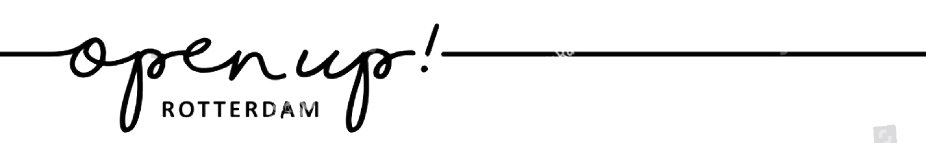
PRESENTATION OVERVIEW
About this project
Project Tracking
Entity Relationship Diagram
Deployment
Demonstration
Testing
Future Updates
Wrap Up

Slide 3
About
Objective:
To create a CRUD application with utilisation of supporting tools, methodologies and technologies that encapsulate all core modules covered during training
My solution:
Create an application where users can log in and create a post with their favourite entry of the Eurovision Song Contest. The users should be able to read other user’s favourites, update and delete their posts.

Slide 4
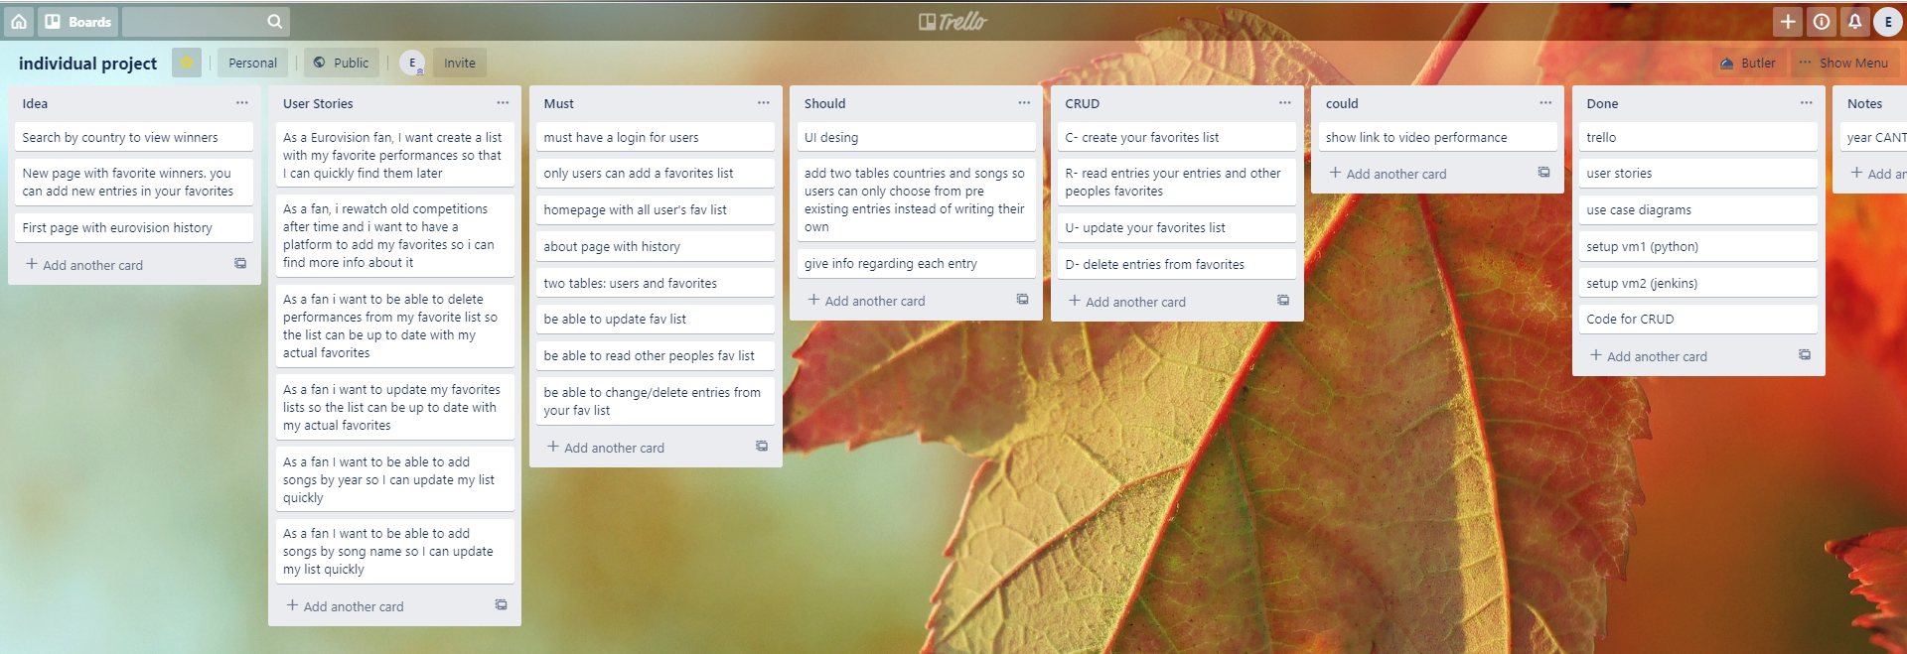
Project Tracking -Trello

Slide 5
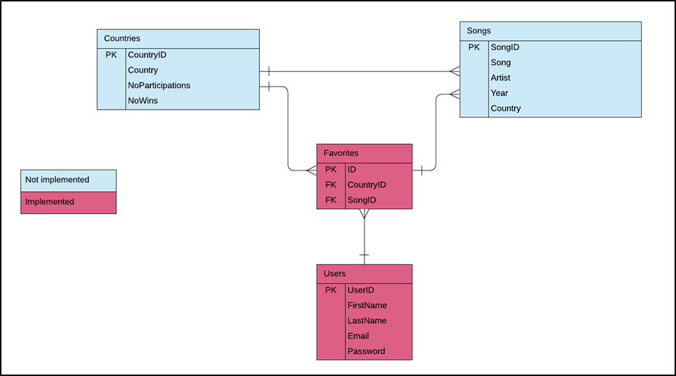
ERD

Slide 6
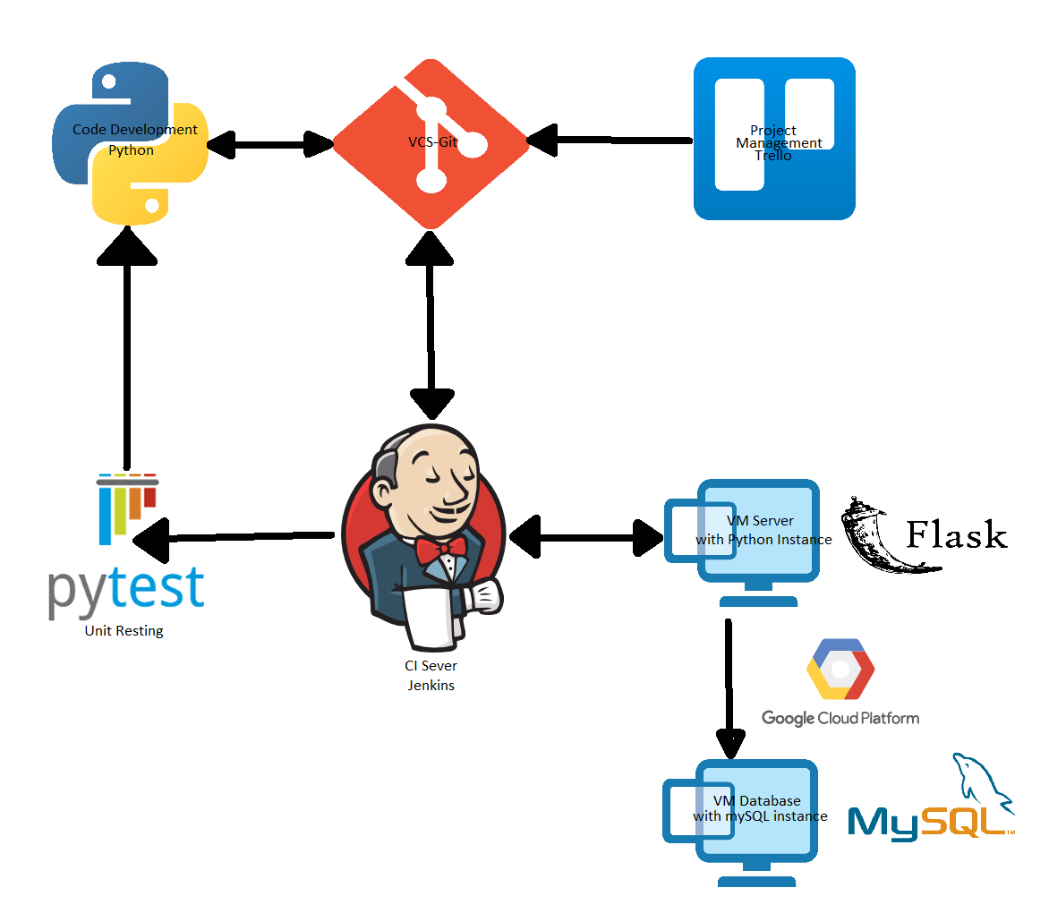
Deployment

Slide 7
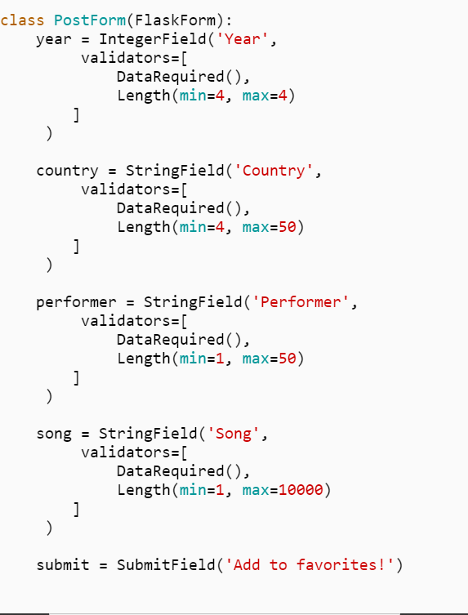
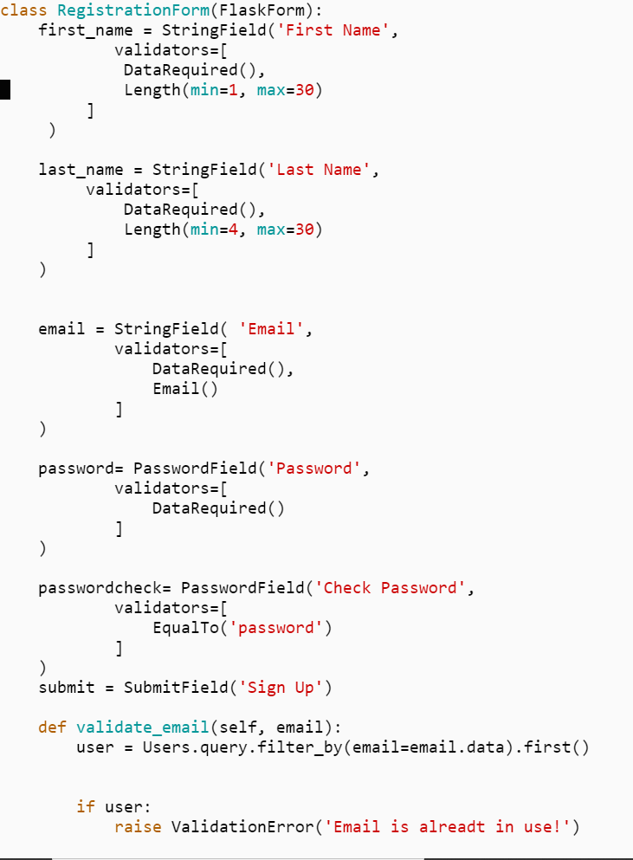
Create

Slide 8
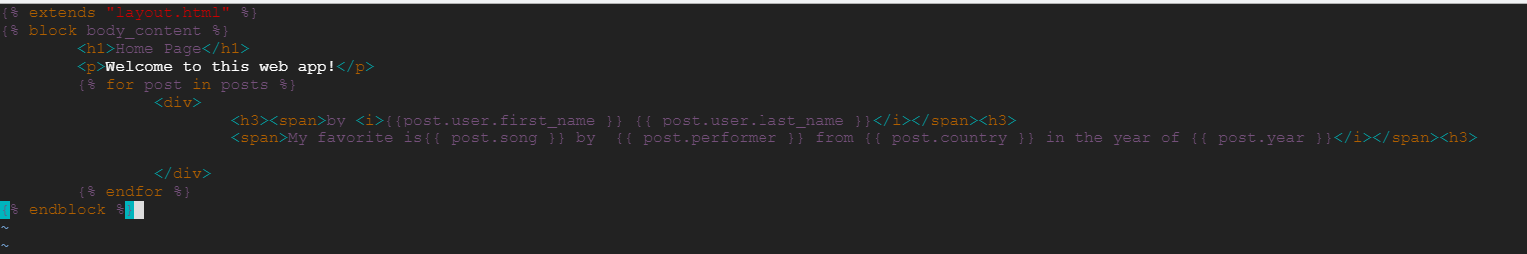
Read

Slide 9
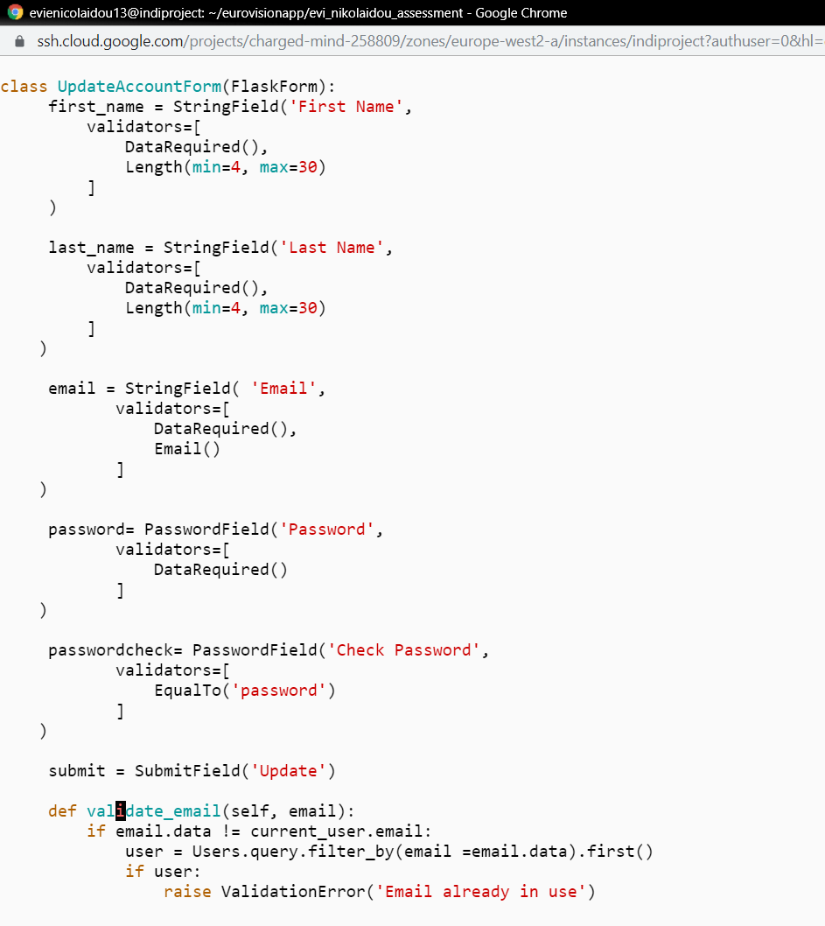
Update
Update your account information.
Class inside forms.py
and the frond-end is account.html

Slide 10
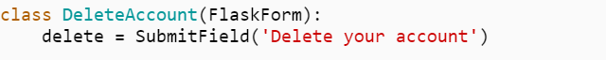
Delete
Delete your account
Class inside forms.py
and the frond-end is account.html

Slide 11
Demonstration

Slide 12
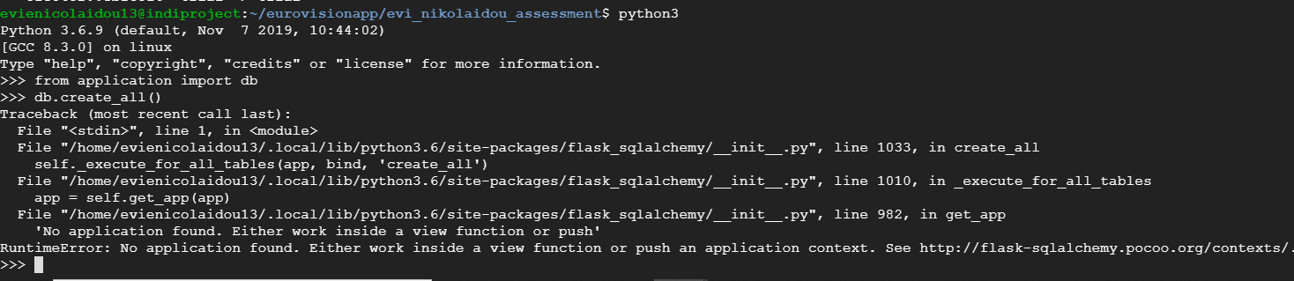
So, why it’s not working?
in Python 3:
from application import app
from application import db
db.init_app(app)
with app.app_context():
db.create_all()

Slide 13
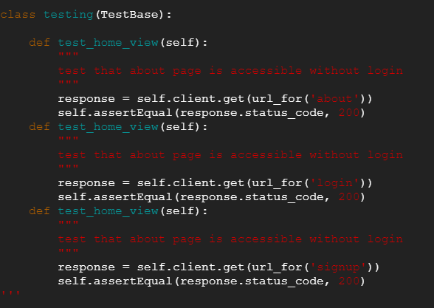
Testing

Slide 14
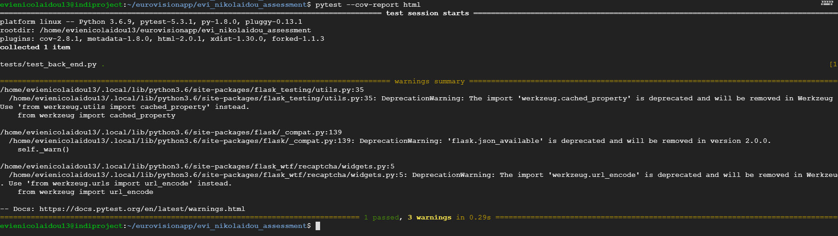
Testing

Slide 15
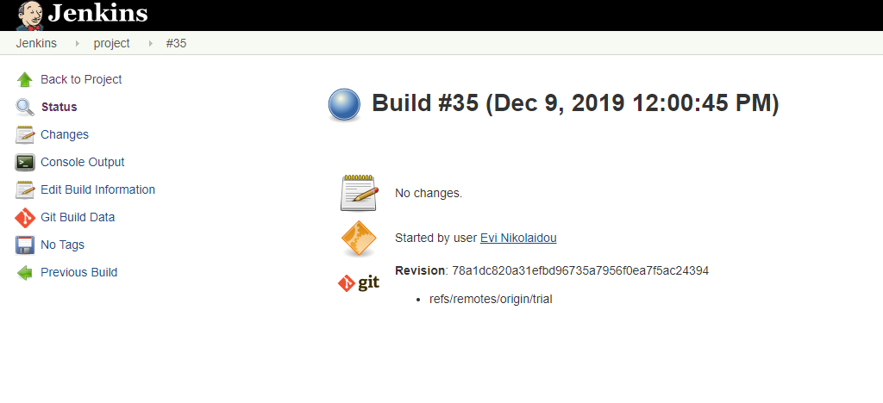
Testing

Slide 16
Future Updates
Find a way to fix the database issue
Continue debugging all functions
Create more tests
Modifications of User Interface
Create more tables and more features

Slide 17
Wrap Up
What is this project about?
Project Tracking
Entity Relationship Diagram
Deployment
Demonstration
Testing
Future Updates

Slide 18
Thank you for listening

