Slide 1
Individual project
By Ife Fayanju

Slide 2
Contents
Brief
Solution
Design
Development
CI
Testing
Demo
Summary

Slide 3
Brief
A functioning CRUD Application
Methodologies and Technologies
Relational Database
A Kanban Board

Slide 4
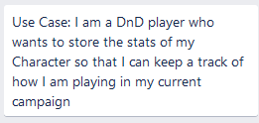
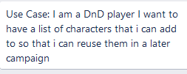

Solution
A Dungeons and Dragons Helper App
Manage Characters and Campaigns

Slide 5
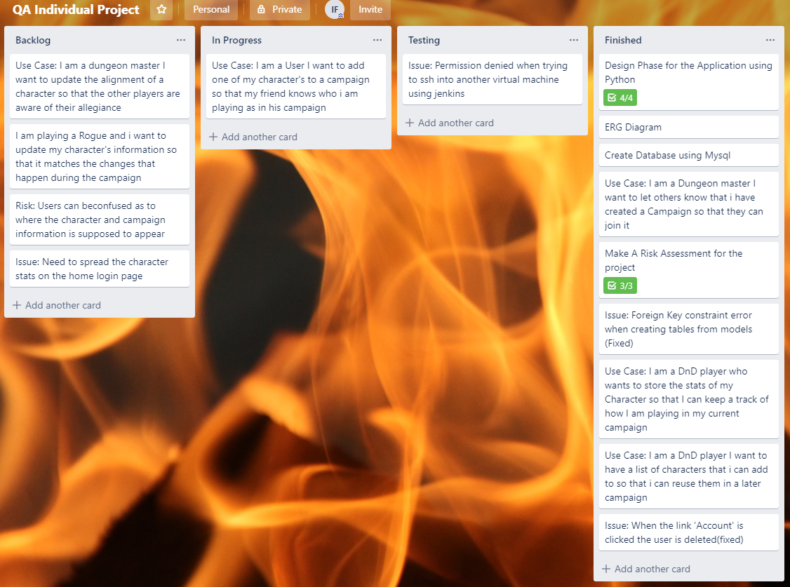
Solution

Slide 6
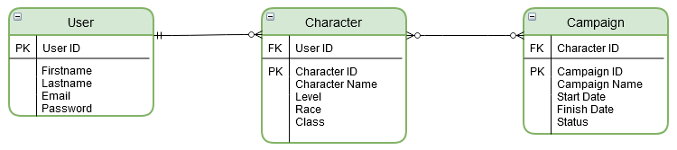
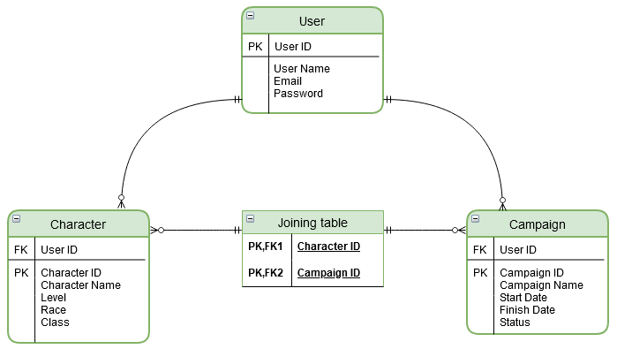
Design
Entity Relationship Diagram (ERD)

Slide 7
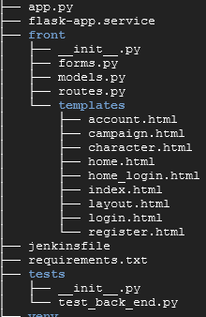
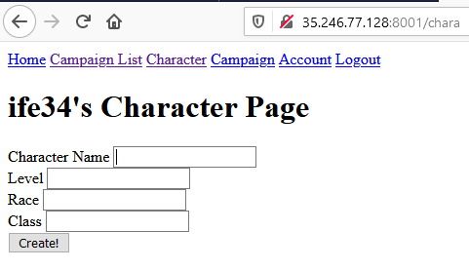
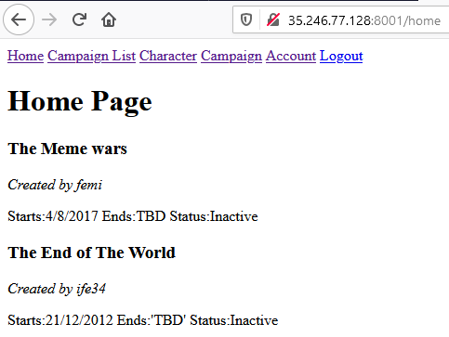
Development
API → Flask

Slide 8
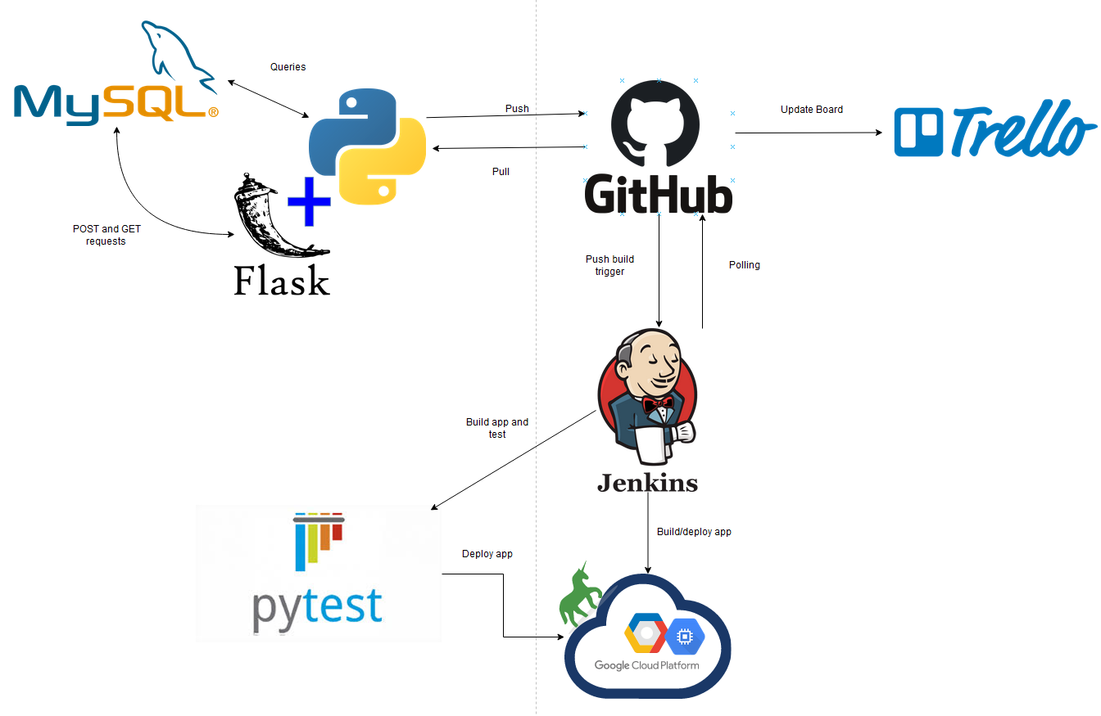
CI(Continuous Integration)

Slide 9
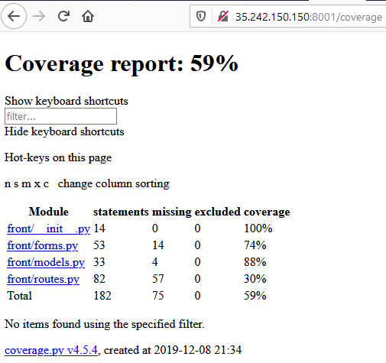
Testing
Static Testing
Dynamic testing

Slide 10
Summary
What went well:
Using GitHub to manage the development of my app
Creating the app with the flask API
What didn’t go so well:
Jenkins setup
Code writing relating to best practice
Project Management

Slide 11
Demonstration

Slide 12
Questions?

