Slide 1
A Simple Music App
By Rodion Brand
Contents
About
Planning
Tables
Front End
Testing
CI Pipeline
Summary
Demonstration/Feedback

Slide 2
What is this about?
Demonstrate web app creation
Flask, Python, Cloud VM, Jenkins, Git, Trello, SQL
Implementation of CI pipeline
CRUD Implementation

Slide 3
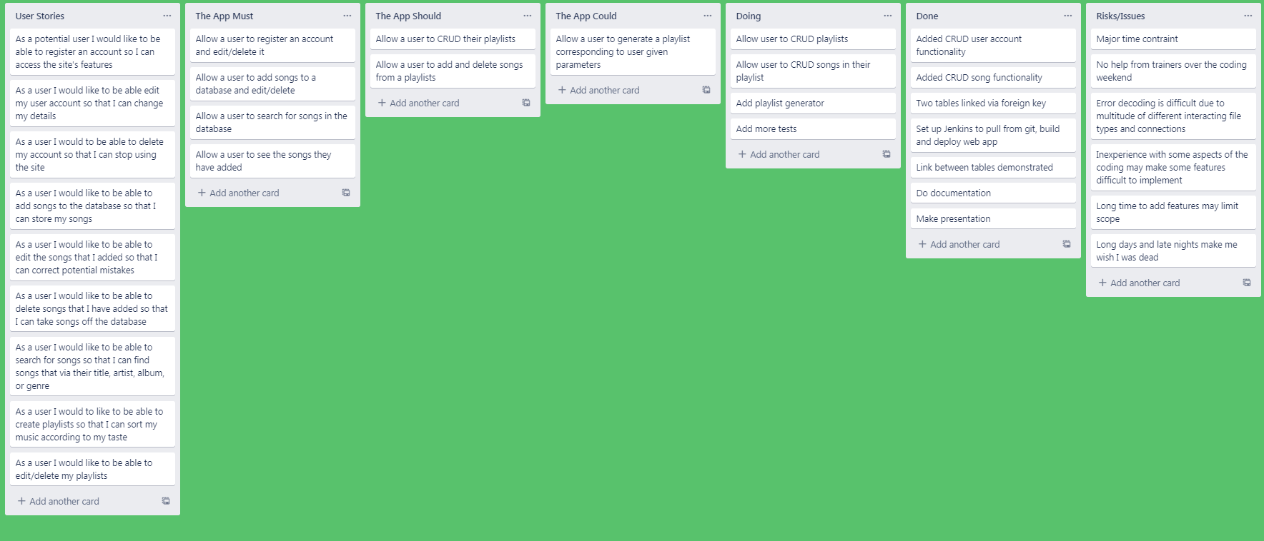
Planning

Slide 4
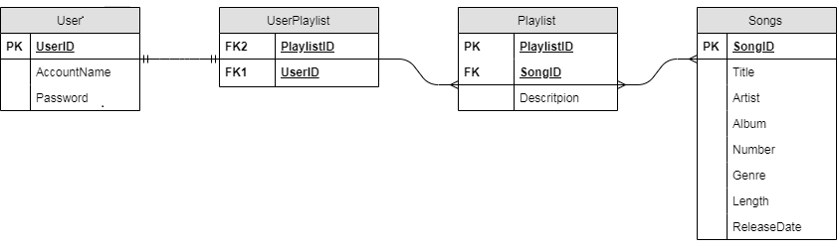
Initial Table Design

Slide 5
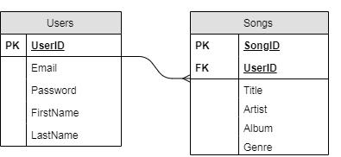
Final Table Design

Slide 6
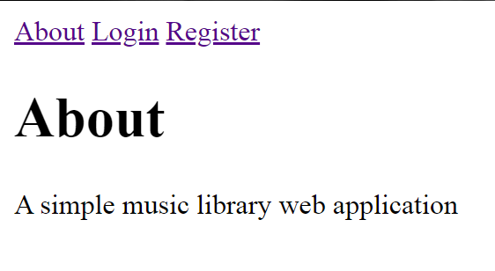
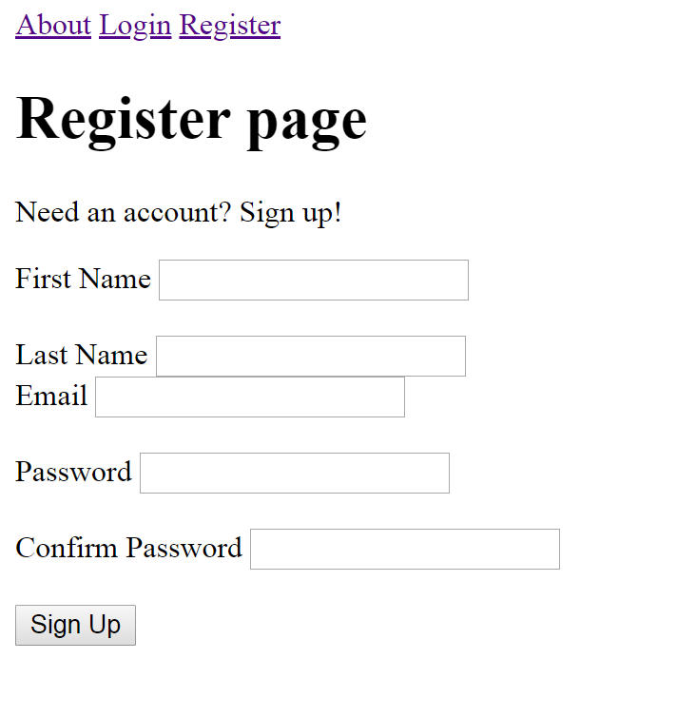
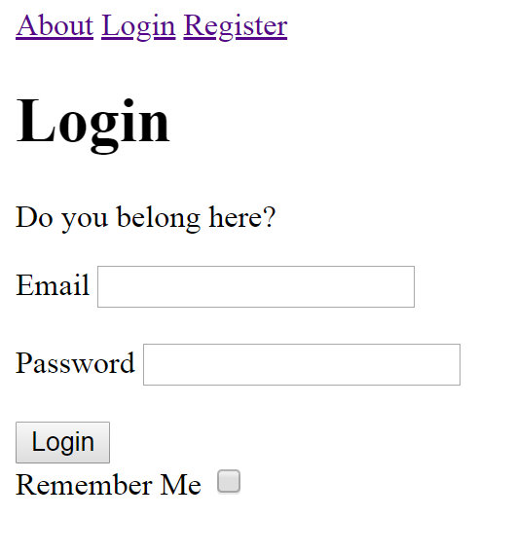
Front End

Slide 7
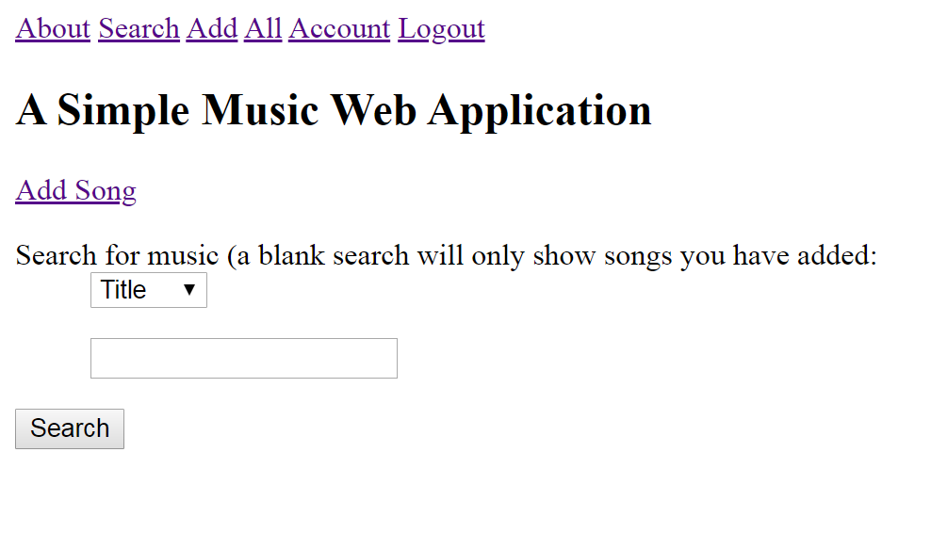
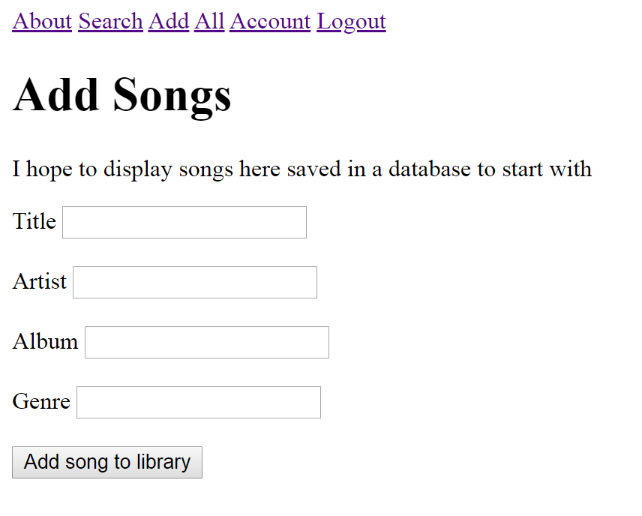
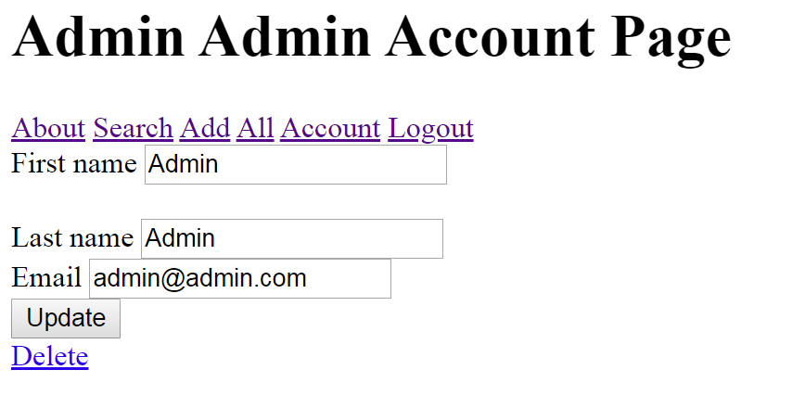
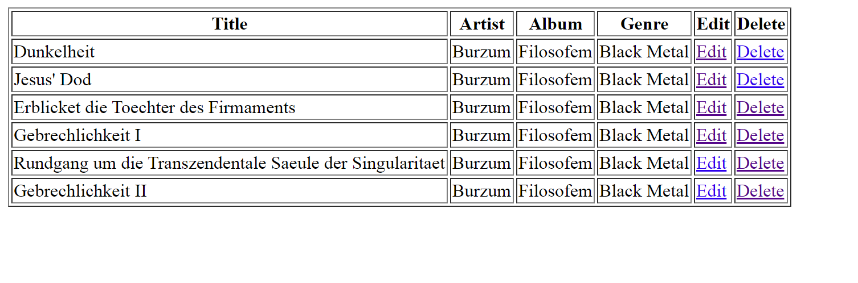
Front End

Slide 8
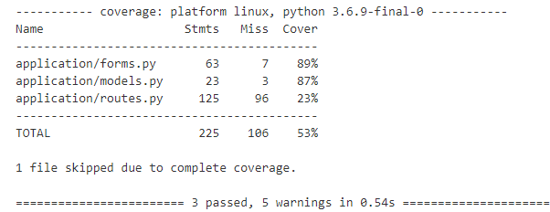
Testing
Tests written in Python code
Executed using pytest module
Tests run through Jenkins
Test coverage displayed

Slide 9
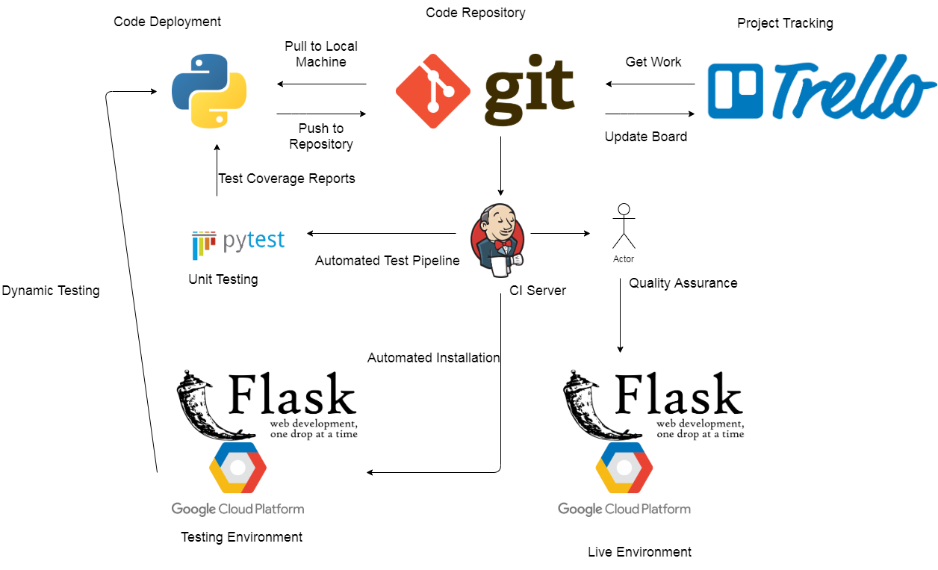
Pipeline

Slide 10
What went well
A working web application was created
Tools were utilised to accelerate the development process
Testing was automated
Working code produced through adaptation and datamining of readily available code
CI Pipeline was realised
Feature implementation time was estimated from previous coding sessions leading to redesign and omittance of features

Slide 11
What didn't go well
Project conceptualised late
Trello was not used regularly
Entire application coded in a few days
Code not fully understood and uncommented
Very few tests implemented
Only basic features implemented never reaching original idea scope
Stress of completion impacted physical and mental wellbeing

Slide 12
Demonstration

Slide 13
Questions and Feedback

