Slide 1
Fantasy Football Application

Slide 2
Contents
Introduction
Planning
Trello – user stories, Entity Relationship Diagram
Risks faced
Mitigation measures
Coding and deployment
Tools used
Demonstration
Future goals

Slide 3
Introduction
Aims
Design a CRUD functional application
Utilise version control system, Continuous Integration, automated deployment
My application
Fantasy football

Slide 4
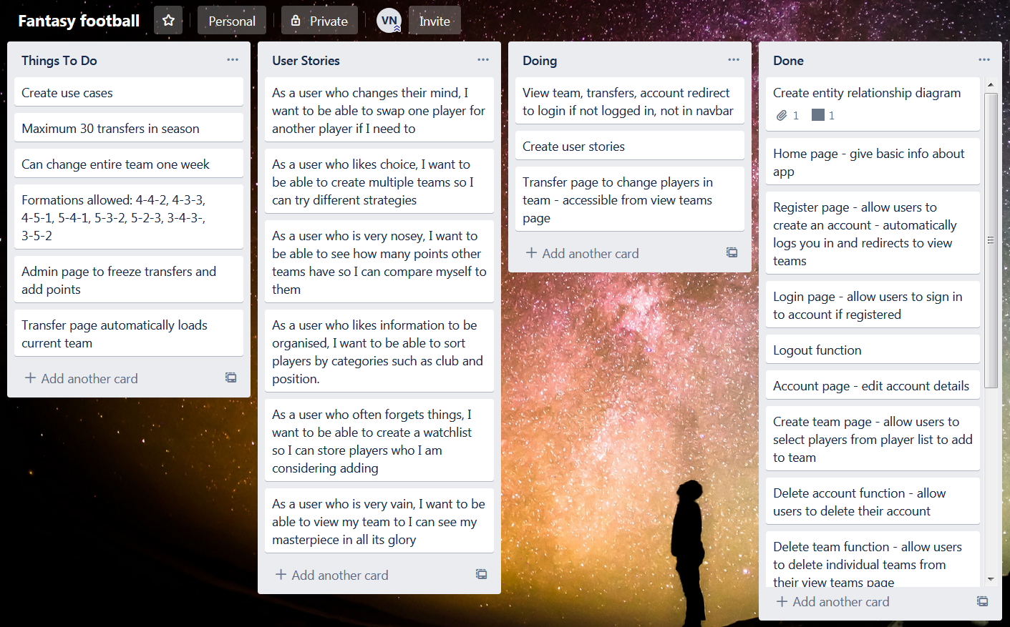
Planning - Trello

Slide 5
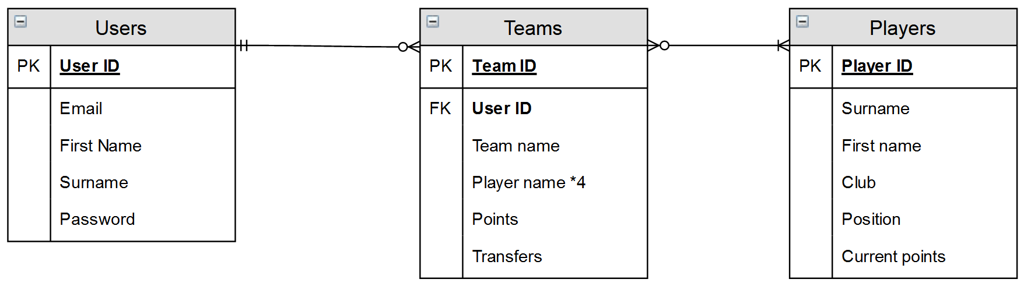
Design of Database

Slide 6
Risk Assessment
Risks involved in creation, deployment and maintenance of application

Slide 7
Losing Code
Impact – medium
Likelihood – medium
Mitigation measure
Regular uploads to GitHub

Slide 8
Website Malfunctions From Bad Code
Impact – medium
Likelihood – high
Mitigation measure
Regular testing of code and website

Slide 9
Database Hack
Impact – high
Likelihood – medium
Mitigation measure
Use environmental variables
Store hashed passwords in database

Slide 10
SSH Into VM
Impact – high
Likelihood – low
Mitigation measure
Tolerate

Slide 11
Technologies Used
Google Cloud Platform
MySQL
Python – Flask, SQLAlchemy, Jinja2
HTML
Git/GitHub
Jenkins
Gunicorn

Slide 12
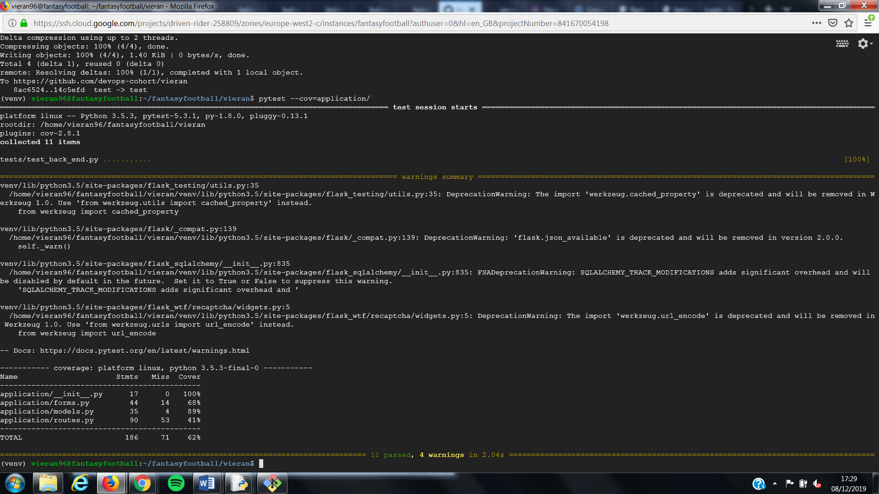
Testing

Slide 13
Live Demonstration
Fantasy Football Web Application

Slide 14





CI Pipeline

Slide 15
Future Plans
Allow 11 players in team
Transfer page to change team
Allow user to change formation
SSH into another server for deployment
Integration testing

Slide 16
Difficulties
Deleting users with many teams
Dropdown menu
Querying database in forms

Slide 17
Successes
Full CRUD functionality
Leader board table
HTML templating

Slide 18
Thank You For Listening
Any questions?

