Slide 1
Introduction to DevOps
Dave Carroll
@thedavecarroll

Slide 2
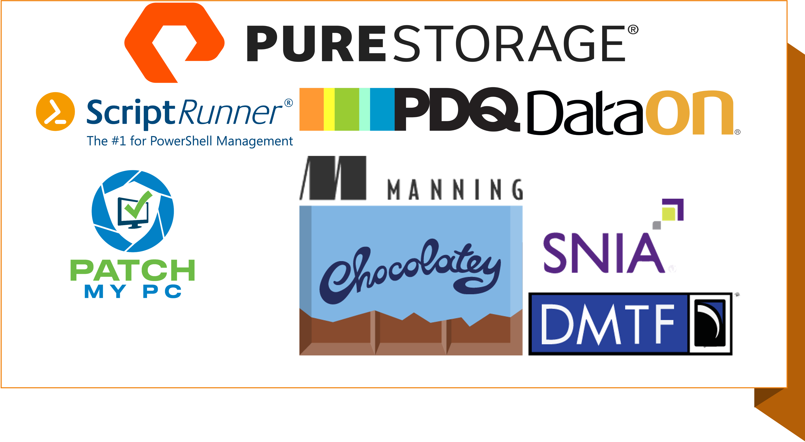

Slide 3
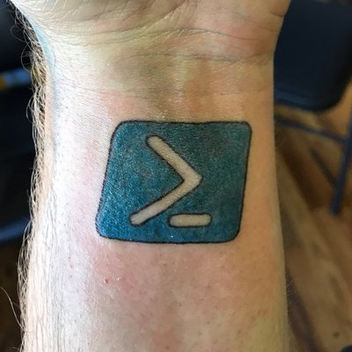

Get-SpeakerBio
DevOps Engineer/PowerShell Developer
Contributor to PowerShell Conference Book, volumes 2 and 3
Creator of PoShEvents, PoShGroupPolicy, and PSTemperature
PowerShell blogger for 6 years
Automating with PowerShell for 15 years
Solving IT problems for nearly 30 years

Slide 4
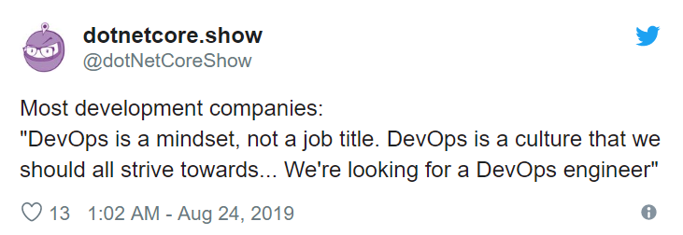
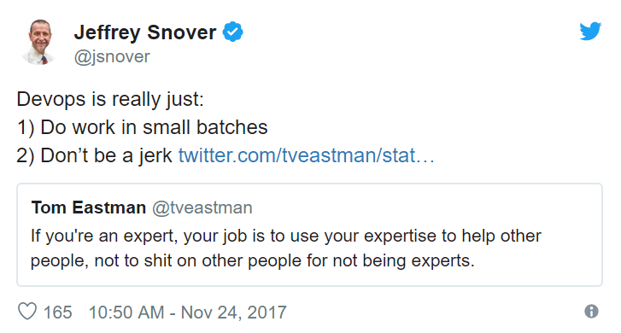
DevOps Defined (?)
Notes:
And what does a DevOps Engineer do day-to-day?
What does DevOps really mean?
For the last question, for every 10 people you ask, you could get 12 or more different responses. It’s not because they don’t know the definition of DevOps, it’s because the definition is subjective. It means something different to virtually everyone.
One of Jeffrey Snover’s Twitter quotes that I like a lot is this:
“DevOps is really just:
do work in small batches and
don't be a jerk”
DevOps is a framework, a set of practices and principles that focuses on the rapid release of applications into production and the care and feeding of them throughout their lifecycle. It’s about having all the necessary skills required to do this and the collaboration between team members and other teams.
“You build it, you run it” - Werner Vogels, Amazon CTO
DevOps starts as a mindset which turns to habits which eventually forms a culture.

Slide 5
DevOps History
2008 Agile Conference in Toronto
2009 O’Reilly Velocity Conference
“DevOps” coined by Patrick Debois for first DevOpsDays
Ideas spread through social media
The Phoenix Project
Notes:
In the 2008 Agile Conference in Toronto, Andrew Shafer held a “birds-of-a-feather” session called “Agile Infrastructure”.
Only one person attended, Patrick Debois, a Belgium consultant. He was frustrated dealing with the walls of separation between dev and ops.
At the O’Reilly Velocity Conference 2009, John Allspaw and Paul Hammond gave their presentation called “10+ Deploys per Day: Dev and Ops Cooperation at Flickr”.
Debois streamed this and was inspired. He coined the term DevOps when he organized the first DevOpsDays in Ghent, Belgium in 2009.
What is telling is that several people across the globe were coming to the same conclusion – there had to be a better way.
They may have met face-to-face, but the reality is that they shared ideas on social media (I think Twitter was the predominant service) and individual tech blogs.
They gave each other confidence that the idea of developers and system administrators could work side-by-side to deploy faster and more resilient services.
A friend suggested that I read The Phoenix Project. I’m glad I did.
The ideas that it shared through a fictional narrative using the Socratic method helped change my mindset and was my turning point in understanding what a DevOps culture could achieve.

Slide 6
DevOps Guiding Principles: The Three Ways
Systems Thinking
Amplify Feedback Loops
Continual Experimentation and Learning
Notes:
Gene Kim, co-author of the Phoenix Project and other DevOps books, developed The Three Ways which he wanted to use as the guiding principles of DevOps.
Systems Thinking
Focus on the performance for the entire system, not just individual components.
Amplify Feedback Loops
To improve the performance of the process, the upstream components must provide feedback to downstream components. Right to left feedback loops are created.
Continual Experimentation and Learning
Fosters risk taking and learning from mistakes.
Repetition and practice are required for mastery.

Slide 7
DevOps Culture Assessment – CALMS
Culture of Collaboration
Visualize work in progress (WIP)
Limit batch sizes
Manage queue lengths
Quick feedback
Automation, automation, automation
Goal of continuous delivery
PowerShell
Pipeline
Shared responsibility
Not “us” vs “them”
Common goal
Encourage communications between development and operations
Documentation
Trust
Distrust must go!
Measure all the things!
Visibility into all systems
Observability
Automation
Lean
Metrics
Sharing
Notes:
You can assess the DevOps culture of your organization by a couple different methods.
The primary method is the CALMS framework.
Collaboration
There is a culture of shared responsibility. Trust has to be regained. It’s not Us vs Them, it’s just Us.
Automation
Team members seek out ways to automate as many tasks as possible and must be comfortable with the idea of continuous delivery.
Lean
Team members can visualize work in progress (WIP), limit batch sizes and manage queue lengths.
Quick feedback is critical.
Metrics
Data is collected on everything and there are mechanisms in place that provide visibility into all systems.
Sharing
User-friendly communication channels that encourage ongoing communication between development and operations.

Slide 8
Collaboration
One Goal
2 Pizza Rule – Amazon
We are all in this together
People > Process > Tools
Notes:
Collaboration begins with a small team focusing on a single goal. That goal is normally a product or application, but it could also be just a feature of either.
Before DevOps, a project team would own the product until deployment where it’s handed off to the operations team which maintains it until they leave the company. Because, let’s face it, technical debt grows for a reason.
With DevOps, the team owns the product from the start and maintains it during its complete lifecycle.
Speaking of a DevOps team, how big should that be?
Jeff Bezos of Amazon instituted a “2 pizza rule” which states the optimum size for an individual team should be determined by how many people 2 pizzas can feed. Typically this is about 8.
Just remember, we are all in this together and we need to focus on the same goal.
People > Process > Tools
The People must change first. Then the Process can change. The tools like Azure DevOps or whatever, will NOT make a team DevOps.

Slide 9
Automation
Scripting Languages
Generative AI and Large Language Models
Source Control
Just-in-Time Infrastructure, aka Agile Infrastructure, Infrastructure as Code (IaC)
Configuration Management
Testing
CI/CD Pipeline
Notes:
The goal of automation is continuous delivery.
End-to-end automation is usually triggered via source control commits, which use scripting languages and configuration management tools that tests code and pushes it through the deployment pipeline. Eventually, the application or artifacts are delivered and/or deployed to production assuming all the tests have passed. Ideally, this includes standing up a pristine testing environment in which to deploy the code to test.
There are a tremendous number of tools that can help with automation, and it seems like more are added every day.

Slide 10
Scripting
PowerShell
Python
Bash (Shell Scripting)
Ruby
JavaScript (Node.js)
Formats (YAML, JSON, XML)
Editors (IDE’s)
Visual Studio Code (VS Code)
Visual Studio
Eclipse
IntelliJ IDEA
PyCharm
Notes:
I’m not going to spend a lot of time on scripting languages. We all should know about the big players, like PowerShell, Python, Go, and Ruby.
In DevOps though, you should really be proficient in at least two of these.
Though not scripting languages, I want to mention a few file types. Most of you have seen XML and JSON. We have PowerShell cmdlets to Convert or Export/Import them.
YAML, or yet another markup language, is used a lot in the CI pipeline. We will talk more about this one a little later.

Slide 11
GenAI vs LLMs
Generative AI
Any AI capable of generating new data
Wide range of outputs
Spans across various media types and use cases, from content creation to synthetic data generation
Large Language Models
Subset of gen AI for tasks involving human language
Specializes in producing and understanding text
Primarily used for text-based applications
Notes:
The Key Differences
Scope: Generative AI is a broad category that encompasses any AI capable of generating new data, including but not limited to text. LLMs are a subset of generative AI specifically designed for tasks involving human language.
Functionality: While generative AI can create a wide range of outputs, LLMs specialize in producing and understanding text. The design and training of LLMs are optimized for natural language processing (NLP) tasks.
Applications: Generative AI's applications span across various media types and use cases, from content creation to synthetic data generation. In contrast, LLMs are primarily utilized for text-based applications, such as chatbots, content generation, and language analysis.
In summary, while all LLMs can be considered a form of generative AI, not all generative AI are LLMs. The distinction lies in their specific capabilities and the nature of the data they generate or manipulate.

Slide 12
Source Control
Git
Subversion (SVN)
Mercurial
TFVC
GitHub
GitLab
BitBucket
Azure DevOps Repos
AWS CodeCommit
Google Cloud Source Repo
Notes:
Let’s talk source control.
Where do you currently store your PowerShell scripts?
Do they have filenames with v2, v3, or timestamps in them?
Can you easily revert to previous versions?
How do you handle multiple team members updating complex scripts?
You need source control. I wished I had seen the multiple benefits of it sooner.
There are several source control types, with the 3 most widely used being git, subversion (or svn), and mercurial.
I’ve worked in shops that have used git, which uses decentralized repositories, and subversion, which is centralized.
Though git is decentralized, there are many cloud or self hosted web-based services that shares git repositories with code maintainers. Others can fork a repo, creating their own copy of the repo, create a feature branch in which they will add their own code to the repo, and then create a pull request upstream for the repo’s owner to either merge or reject.

Slide 13
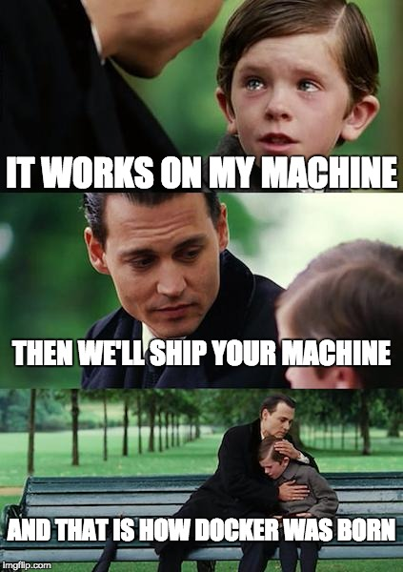
IaC
Infrastructure as Code (IaC)
AWS CloudFormation
Azure ARM Templates
Terraform
PowerShell Modules
AutomatedLab
Lab Builder
Containerization
Docker
Vagrant
Red Hat OpenShift
Orchestration Engines
Kubernetes
Docker Swarm
Notes:
Just-in-Time Infrastructure, or Agile Infrastructure
Describes tightly integrated infrastructure – networks, servers, storage, and security – that can be easily scaled up or scaled down.
This essentially is the cloud slider that allows you to increase or decreases resources.
It starts with Infrastructure as Code (IaC), typically with cloud providers, though there are several private cloud solutions.
Lab environments could also be provisioned using either of these PowerShell modules.
Within your provider, you could further containers, such as Docker or Vagrant. Containers are specialized VM’s which come fully assembled and can be provisioned and discarded easily. Unless you provide access to external resources like a database or a volume, when the container is deprovisioned, everything contained within it would be removed as well.
To manage the container environment, you use orchestration engines such as the Kubernetes.

Slide 14
Configuration Management
Ansible
Bicep
Chef
PowerShell Desired State Configuration (DSCv3)
Puppet
Terraform
Notes:
Now that you have can easily provision and deprovision your required infrastructure, you need some tool that allows you to configure these containers or full VMs.
If they are Windows based, you can use PowerShell Desired State Configuration (DSC) to enforce a specific configuration.
You can also use Puppet or Chef, both of which are a Ruby based.
You can also use Ansible or Terraform.

Slide 15
Testing
Unit
Integration
System
Acceptance
Pester
PSScriptAnalyzer
Linters
Selenium
Notes:
In order to ensure quality, code must be tested.
Typically, you would have unit tests which test specific pieces of code, such as a function. The type of tests could be white or black box, depending on how you write your tests.
You would then have integration tests which validate that the components interface with each other correctly. This requires white and black box testing.
System tests validate functionality of all the components. It also includes performance, usability, security, and scalability tests. It’s entirely black box testing since you are testing the functional requirements.
Lastly, you have user acceptance testing which gets the application in front of actual users. Sometimes this can be handled by a separate test environment, or it could be handled by rolling out to a subset of users based on feature flags or other audience selection methods.
In the PowerShell world Pester and PSScriptAnalyzer are the two primary methods for testing.
Pester tests can be written for unit, integration, and system testing. You can even test module metadata and the help files.
PSScriptAnalyzer can ensure you are using best practices for your PowerShell code.
Programs (or scripts) like PSScriptAnalyzer that check code for consistency are called linters and the process of checking code is called linting.
Selenium is a web application testing platform that can interact with the controls on webpages.

Slide 16
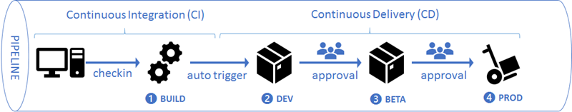
CI/CD Pipeline
Azure DevOps
GitHub Actions
GitLab
AppVeyor
Jenkins
TravisCI
TeamCity
AWS CodeBuild
AWS CodePipeline
Others
Notes:
Continuous integration involves checking in code and having it validated through testing.
Continuous delivery takes this code and saves the executables or scripts, called releases, to a central location.
Continuous deployment takes the releases and pushes them into test or production environments.
There are several CI/CD products available, for PaaS and some offer on-premises servers.
Jenkins
Azure DevOps
TravisCI
TeamCity
AppVeyor
GitHub Actions
AWS CodeBuild and AWS CodePipeline
A fully automated CI/CD pipeline is the goal. It provides the fastest way from code to release to deployment.

Slide 17
Lean
TPS
Respect for People
Make all work visible
Small batches
Manage Queue Lengths
Identify and protect constraints
Provide feedback loop
Prevent low quality from progressing
Continuous Improvement
Notes:
The CALMS assessment component of Lean comes largely from the Toyota Production System, created by Taiichi Ohno.

Slide 18
Metrics
Measure all the things!
Build visibility into systems.
Application Performance Monitoring (APM)
Log analytics and management.
Notes:
Measure all the things!
Build visibility into systems.
Application Performance Monitoring (APM), otherwise called tracing.
Log analytics and management.

Slide 19
Sharing
Documentation
Markdown
Consistent location
Properly versioned
Localized, if possible
Presentations
Blogging
Meetups, ignites, lightning, BOF
Notes:
The final part of the CALMS framework is Sharing.
Share your knowledge. Share your journey.
You don’t have to be foremost authority on a topic. There will always be someone that knows less that you, and someone that knows more than you. Always.
One of the downfalls that easily happens to us all is being too busy to document completely.
Markdown is a relatively simple way to create documentation using text-based indicators for headings, emphasis, tables, hyperlinks, and other text formatting. There are several flavors for markdown, but they are largely interchangeable. For instance, Leanpub uses their own implementation and GitHub has their own.
You can use the PowerShell platyPS module to turn markdown into an external help file for a module.
Simply having documentation is not enough. You must be able to find the documentation when you are looking for it.
In the middle of outage, you shouldn’t be desperately hunting documentation on troubleshooting or even design documents. And when you do find it, how can you be sure that it is the latest?
In my last job, I created a repo in our internal GitLab instance for documentation. Everyone could see the latest and greatest. And they could see what I changed.
Use something centralized with proper versioning. Whether it’s GitLab, GitHub, wikis, or Sharepoint, pick something and begin using it. And please don’t upload Word docs with filenames that have timestamps or versioning. If you want to use Word, use the built-in version tracking. Please.
Another way to share is through presentations. That’s one of the reasons you are here today.
You can also blog your adventures in PowerShell or your own journey to DevOps. Your approach to a topic may provide someone else with the aha! moment.
Lastly, by attending meetups or ignites or birds-of-a-feather mini-sessions, you can help each other overcome issues or learn something new.

Slide 20
A Day in the Life of a DevOps Engineer

Slide 21
Summary
“DevOps is not a Goal, but a never-ending process of continual improvement” – Jez Humble
“DevOps is not a trend and will eventually be the standard way of software development and operations, offering everyone a better quality of life.” – DORA State of DevOps 2019
“Plan for unplanned work.” – Dominica DeGrandis
Notes:
Most importantly, you need to adapt to the open - we’re all in this together, it’s everyone’s job - culture.

Slide 22
Summary, Part Deux
To begin your DevOps journey, consider the following:
Proficiency in multiple scripting languages
Everyday use of source control
Adopt a continuous improvement mindset
Strive for effective communication
Continuously improve your skills, technical and soft skills

Slide 23
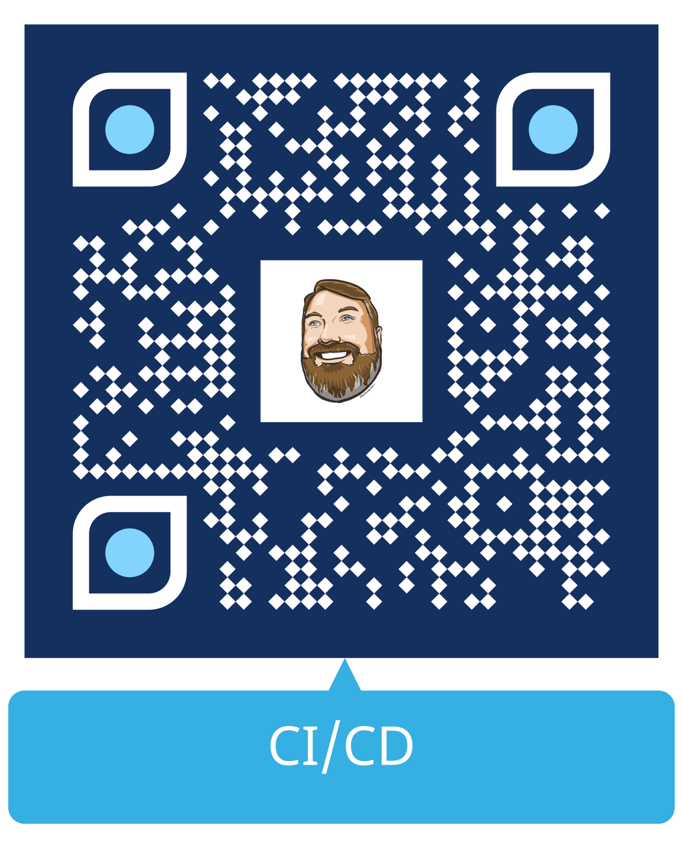
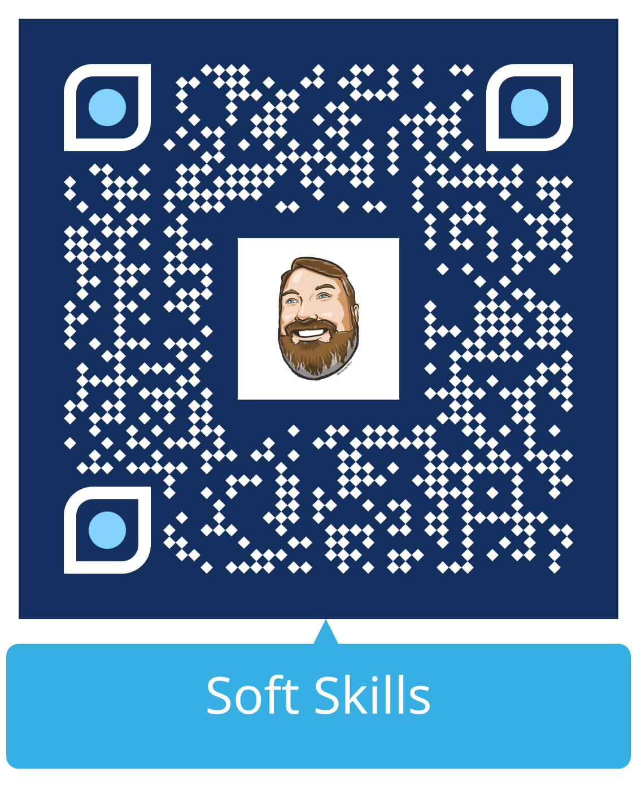
Good Info

Slide 24

THANK YOU
Please review this session

