Slide 1
From Script to Tool: Building Robust, Meaningful Tools with PowerShell
Matt McElreath
https://github.com/mmcelreath/summit-2026
https://www.linkedin.com/in/matt-mcelreath-ma/
‹#› / 15

Slide 2
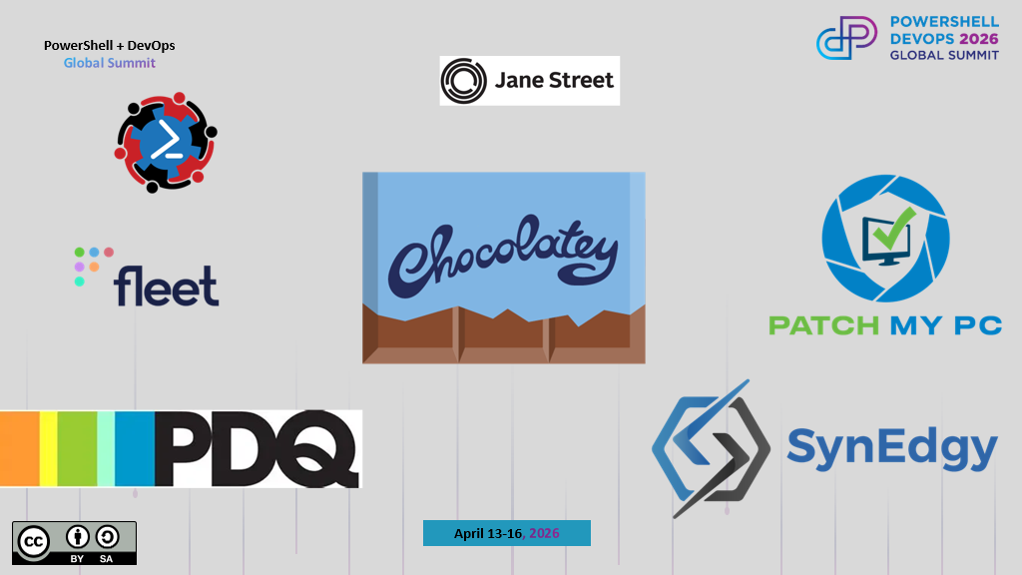
Keep this here and replace it with the update sponsor image that will be sent out the week prior to summit

Slide 3

About Me
Solution Architect @ FM
Focus on Infrastructure Atuomation (With PowerShell of course)
Long time listener, first time presenter

Slide 4
From Script to Tool: Building Robust, Meaningful Tools with PowerShell
Matt McElreath
https://github.com/mmcelreath/summit-2026
https://www.linkedin.com/in/matt-mcelreath-ma/
‹#› / 15

Slide 5
When do I…?
“I’ve learned the PowerShell syntax, gone to the trainings, read the books. How do I use it to improve my work?”
“When do I use the command line versus a script versus a function versus a Module?”

Slide 6
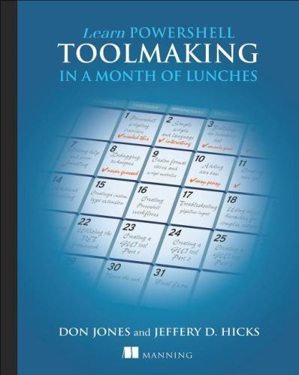
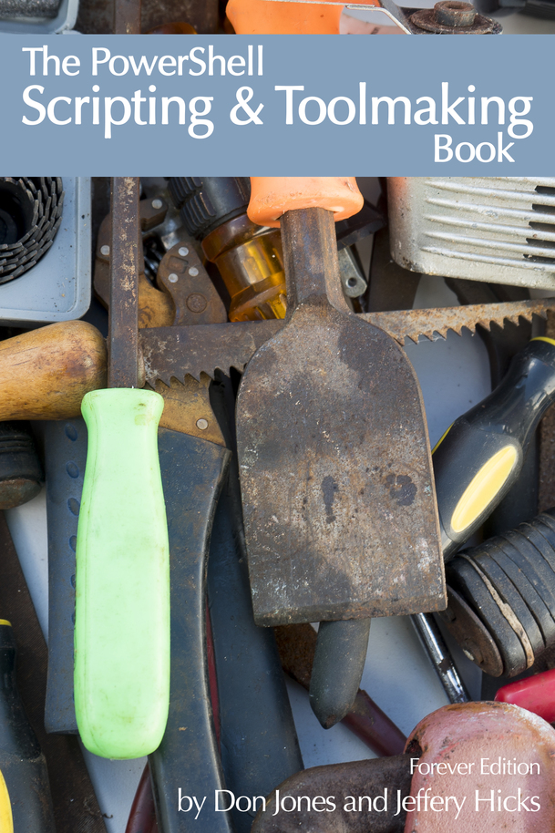
https://www.manning.com/books/learn-powershell-toolmaking-in-a-month-of-lunches
https://leanpub.com/powershell-scripting-toolmaking
Notes:
2012

Slide 7
What is Toolmaking In PowerShell
“We borrowed the term toolmaking from the tool and die industry… In that industry, there are machinists who produce a variety of different parts and products. To do so, they use tools – drill bits, dies and so forth– which are manufactured by tool and die makers. Both audiences– machinists and the tool and die makers–utilize many of the same skills and equipment, but they do so for different reasons.”
- Learn PowerShell Toolmaking in a Month of Lunches
- Don Jones
- Jeffery D. Hicks
Notes:
If you’re looking to make a jump into Toolmaking with PowerShell, since you’re here today, you’ve already got the skills. You may just need to switch up your mindset from doing to enabling.
Toolmakers make a “means to and end”. They’re not creating the final product, but providing the tools that will make the final product When we think of “Tools”, they can come in all sorts of shapes, sizes and uses. PowerShell tools are no different and there are usually no wrong answers here.

Slide 8
What is Toolmaking In PowerShell
Idea was based off of the tool and die industry
Machinists - Produce Parts and Products
Tool and Die Makers - Manufacture tools– drill bits, dies and other tools used by Machinists to produce products. A means to an end.
Most PowerShell users will be using “tools“ developed by others to produce an outcome (command line, combined in scripts, etc…)
Toolmakers goal create reusable, redistributable tools that can be used to complete tasks
Notes:
Toolmakers make a “means to and end”. They’re not creating the final product, but providing the tools that will make the final product When we think of “Tools”, they can come in all sorts of shapes, sizes and uses. PowerShell tools are no different and there are usually no wrong answers here.

Slide 9
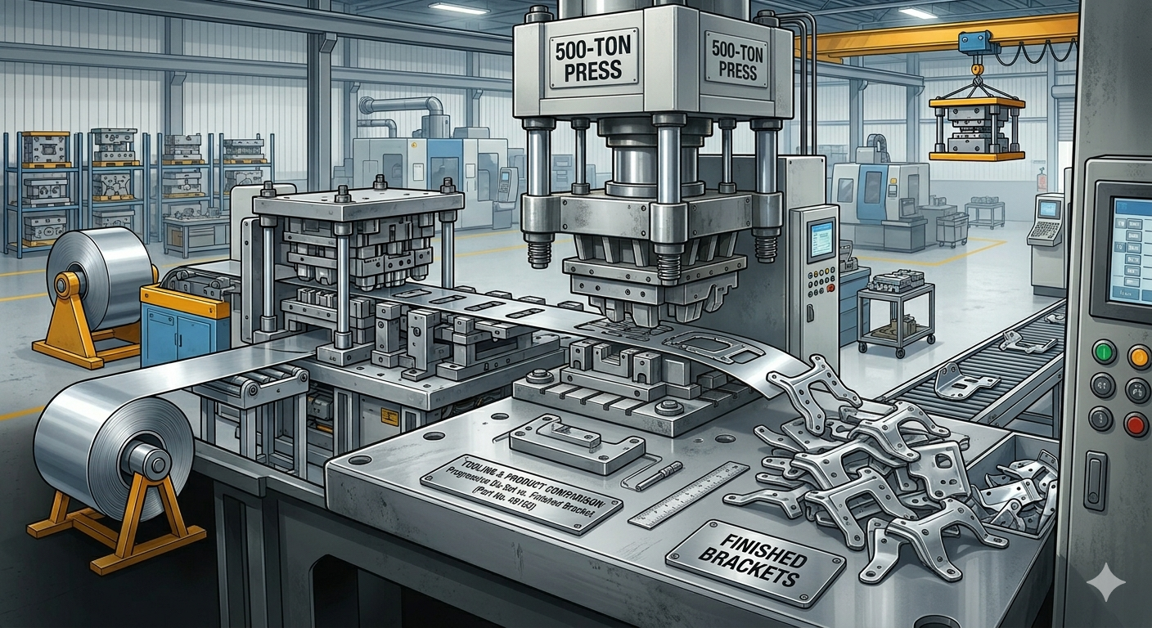
Tools
Output
User Input
Pipeline

Slide 10
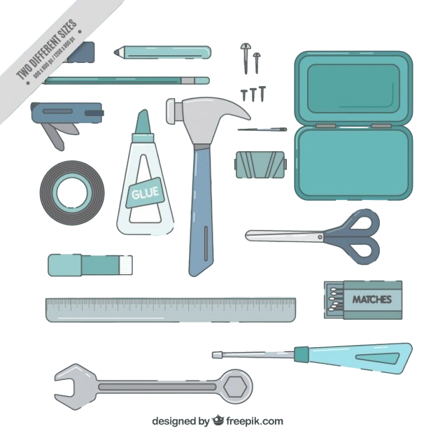
The Toolbox
Notes:
A long time ago, someone created a tool with a blunt end that was really good at hitting nails into something. Then, someone probably said “That’s great, but I screwed up and now I need to take those nails out”

Slide 11

The Toolbox
Notes:
A long time ago, someone created a tool with a blunt end that was really good at hitting nails into something. Then, someone probably said “That’s great, but I screwed up and now I need to take those nails out”

Slide 12

Understand Your Audience
Who will be using your tool(s)
Technical ability
PowerShell knowledge/experience
Different tools for different user types
How to accommodate for different user types
Notes:
Are you creating something for a GUI udrt or someone who will be really kicking the tires and trying things you haven’t even thought of yet
Someone might be great at using a hammer. But if you give them a wrench, they’re going to try to smash nails into a board with it. This may technically work, but not efficient.
Ex. If your tool needs to be passed sensitive data, will your users understand how to create a secure string first, or will you need to do that for them. Maybe have them pass a PS Credential if they are alreay familiar with taht.

Slide 13
The Toolmaking Journey
Hypothesis for Success
Command Line
Scripts
Functions
Modules

Slide 14
Starting at the Command Line
Find the commands/tools for what you’re trying to do
Ex. Get-ADUser, New-ADUser, Set-ADUser
Understand their usage
What are the parameters
How do they interact on the pipeline
What can go wrong
Easier to troubleshoot from the command line
What other commands can you use to interact with data
ConvertTo-CSV, ConvertFrom-JSON, etc…
Notes:
In your tools, you’re going to be using PowerShell commands that will run in a particular order, maybe passing data to each other. The command line is an easy place to test these commands methodically and with less complications. Errors you encounter will be easier to pinpoint and troubleshoot

Slide 15
Demo

Slide 16
Put your commands in a .ps1 file
Great for repeatability
OK for redistribution
Can be Parameterized for flexibility
Specify Parameter types for consistency
Parameter Validation!!!!
Comments, Comments, Comments

Slide 17
Demo

Slide 18
Putting your commands in functions
Paramaterized, reusable code within your script
Avoid duplicating code
Improve Readabilty
Compared to scripts, multiple functions don’t need separate files. Can be bundled into a single file
Comments, Comments, Comments

Slide 19
Demo

Slide 20
PowerShell Modules
Don’t be scared
Learn the structure of a PowerShell Module
The rest is just the same as the last couple slides
Use [CmdletBinding()]
Functions can be structured into folders containing multiple .ps1 files
Ex. Public and Private functions
Help documentation
Distribution is easy
PowerShell Gallery
Private Gallery
Comments, Comments, Comments

Slide 21
Demo

Slide 22
C.R.U.D
The basic operations of persistent storage
Create - New-ADUser
Read - Get-ADUser
Update - Set-ADUser
Delete - Remove-ADUser
Notes:
I don’t mean the stuff you get on your shoes when you forget to clean up after your dog
It’s not just the stuff that builds up on….
Used in database, Can be applied in PowerShell tools as well

Slide 23



Outputs
Basic Text
JSON
Hash Table
PSObjects
Notes:
I don’t mean the stuff you get on your shoes when you forget to clean up after your dog
It’s not just the stuff that builds up on….
Used in database, Can be applied in PowerShell tools as well

Slide 24
Error Handling
How does your tool handle Terminating and Non-Terminating errors
Use Try/Catch
Surfacing meaningful error messages
Notes:
I don’t mean the stuff you get on your shoes when you forget to clean up after your dog
It’s not just the stuff that builds up on….
Used in database, Can be applied in PowerShell tools as well

Slide 25
The Toolmaking Journey
Hypothesis for Success
Command Line
Scripts
Functions
Modules
Don’t Cling

Slide 26
Resources
PowerShell.Org YouTube Channel https://www.youtube.com/@PowershellOrg
Basic Toolmaking - The road to extensibility by Evgenij Smirnov https://www.youtube.com/watch?v=atWtV9UUjLI
The Human Side of PowerShell Scripting by Jeff Hicks https://www.youtube.com/watch?v=4xVDorpEhm8
https://www.manning.com/books/learn-powershell-toolmaking-in-a-month-of-lunches
Notes:
I don’t mean the stuff you get on your shoes when you forget to clean up after your dog
It’s not just the stuff that builds up on….
Used in database, Can be applied in PowerShell tools as well

Slide 27
THANK YOU
Feedback is a gift
Please review this session
via the mobile App

