Slide 1
From Chaos to Clarity
Taming Data with PowerShell
Matthew Dowst
@mdowst
1 / 15

Slide 2


Slide 3



Matthew Dowst
Principal Consultant
Managed automation architect
Author
PowerShell Weekly
PoshBytes

Slide 4
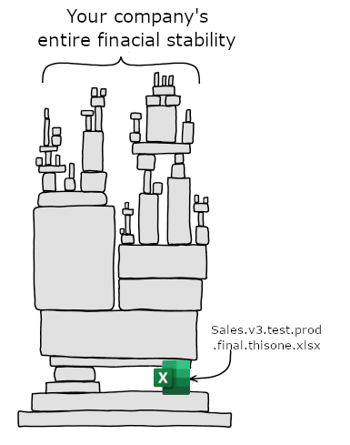
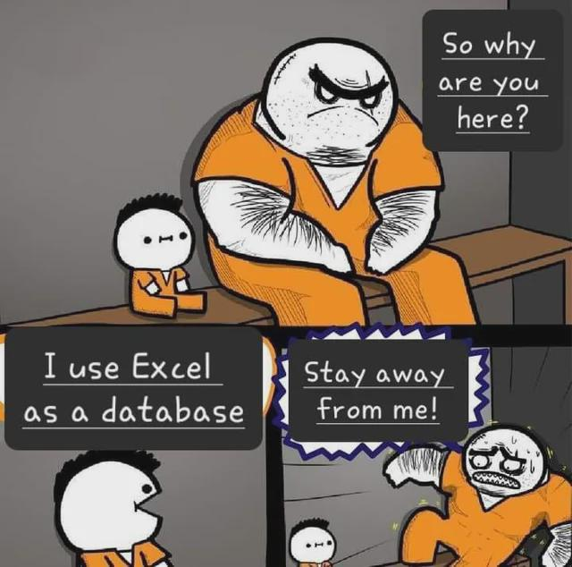
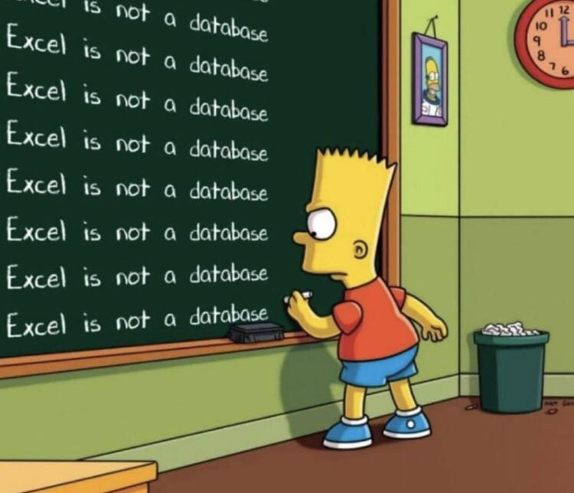
Excel Is Not A Database

Slide 5
Get Your Data Into Shape

Slide 6





Let’s get ready to rumble

Slide 7
Excel Is Not A Database

Slide 8
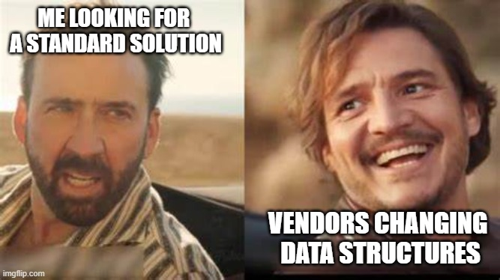
Dynamic Data Scripts

Slide 9
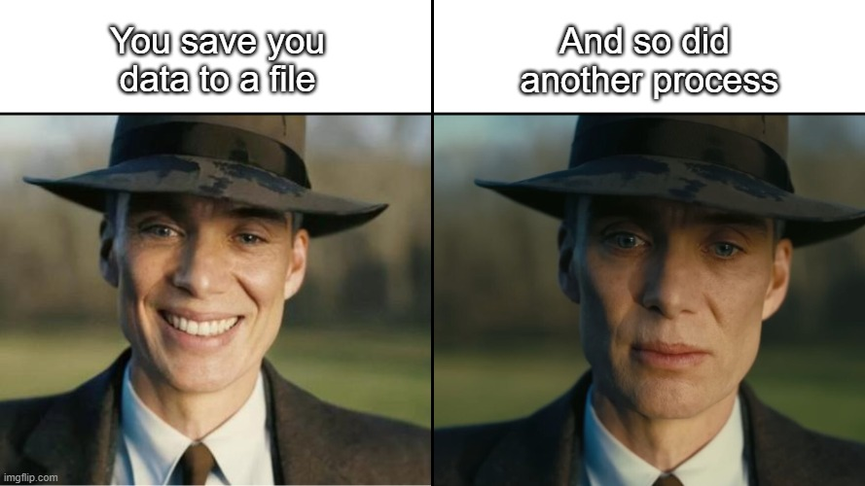
Protecting Your Files

Slide 10
THANK YOU
Feedback is a gift
Please review this session
via the mobile App

