Slide 1
PowerShell for Life
Automate the Everyday
Matthew Dowst
@mdowst
1 / 15

Slide 2


Slide 3



Matthew Dowst
Principal Consultant
2x Microsoft MVP
Father of 2
PowerShell Weekly
PoshBytes

Slide 4
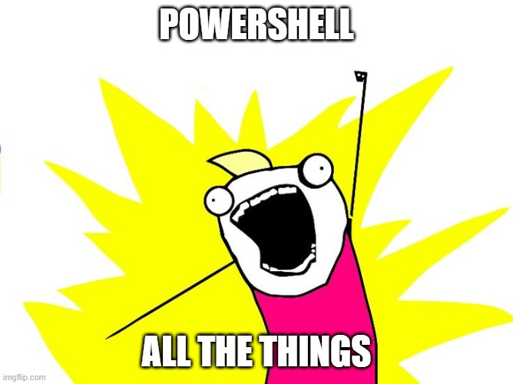

Slide 5
The Fun Part

Slide 7
depth | $orderedGiver | $candidatesByIndex | $usedReceivers
0 | Alice | Dave, Bob
1 | Bob | Alice, Carol
2 | Carol | Alice, Dave
3 | Dave | Carol, Alice, Bob
Carol at depth 2
Revert Bob at depth 2
Dave
Alice
Carol
Carol at depth 2
Alice
Alice
Assign Alice
Assign Carol
Assign Alice
Is Alice used?
Is Carol used?
Alice at depth 0
Bob at depth 1
Is Alice used?
Yes
No
Assign Dave
Assign Alice
Assign Dave
mark Carol used
No
mark Alice used
Is Dave used?
Is Alice used?
Is Dave used?
Continue
No
No
Yes
mark Dave used
mark Alice used
Backtrack

Slide 8
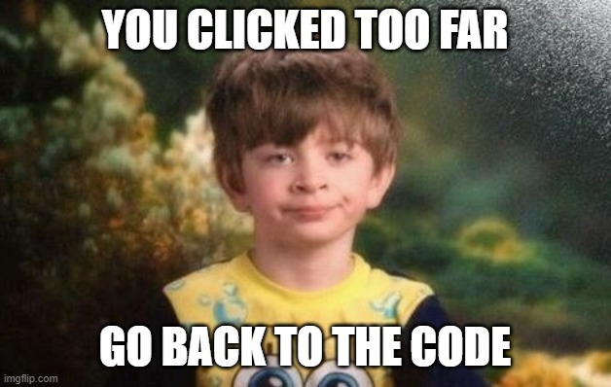

Slide 9
This Wasn’t Just “Fun Scripts”
Image processing pipeline
Event-driven notifications
Data modeling + forecasting
End-to-end ETL pattern (Input → Normalize → Decide → Act)
Constraint solver (with backtracking algorithm)

Slide 10
THANK YOU
Feedback is a gift
Please review this session
via the mobile App

