Slide 1
C4B Implementation Journey for Local Government
Jarom Hein
1 / 15

Slide 2
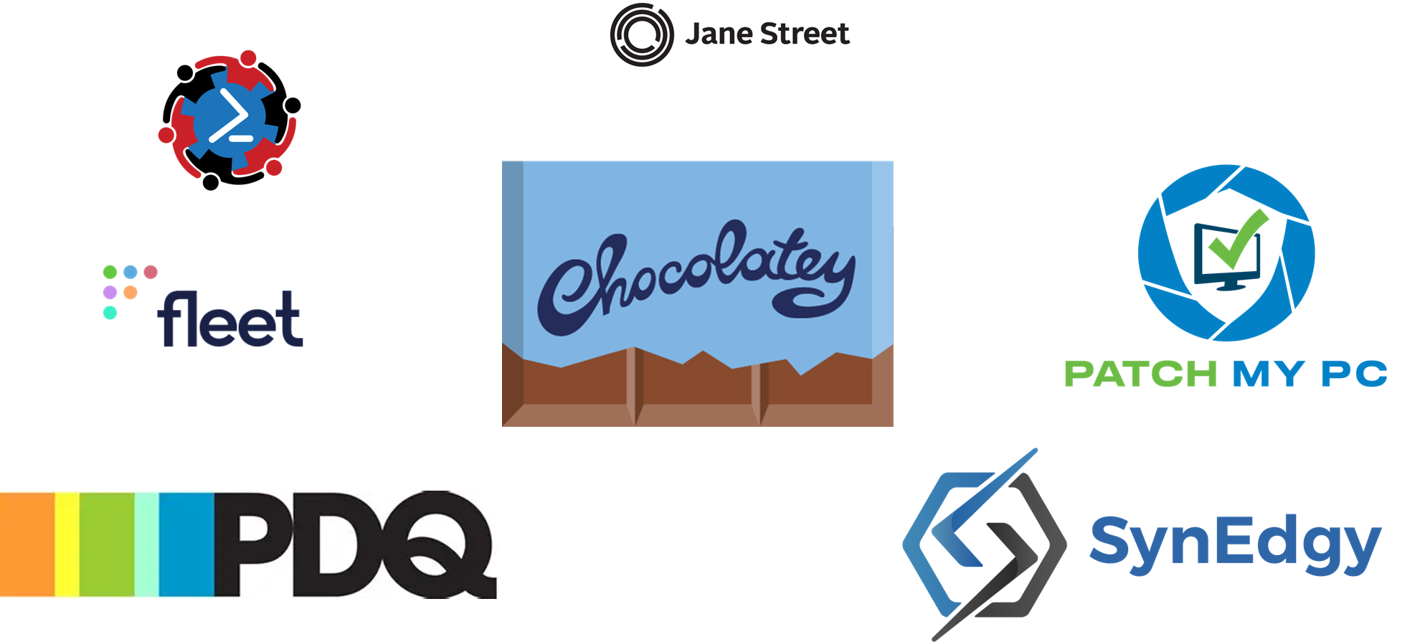

Slide 3

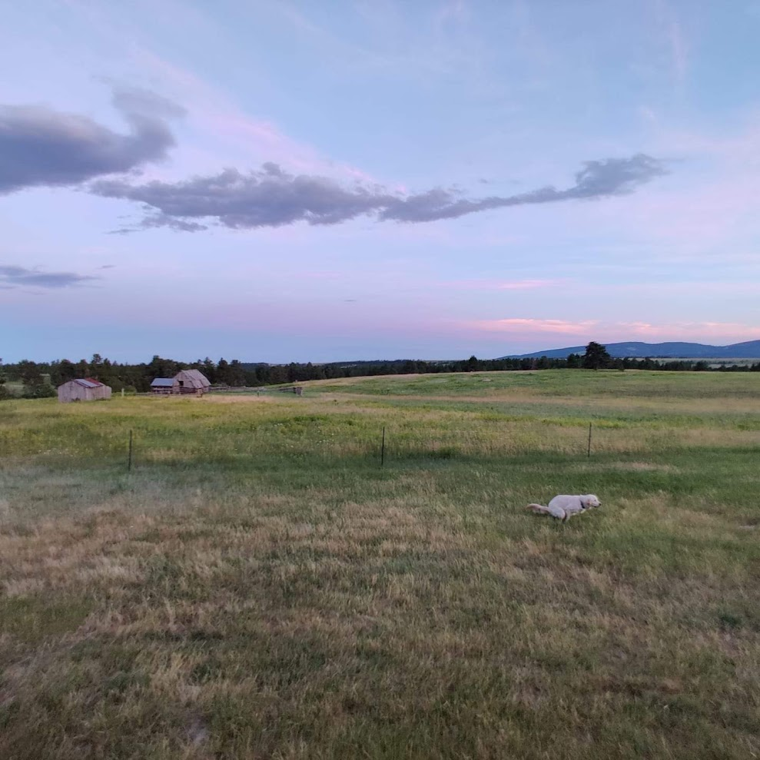

How did I end up here?
PowerShell + DevOps Global Summit
BA in Trumpet Performance
Legal Secretary
Paralegal
Business Application Analyst
Application Administrator
Application Division Manager
April 13-16, 2026

Slide 4
App Admin Perspective
PowerShell + DevOps Global Summit
Implementation of C4B for Missoula County
How a small team of App Admins converted over 200 applications to Chocolatey
Retiring Zenworks for app distribution after 20 years
Use cases
ArcGIS – Challenges of a large install and Proget
Imaging
April 13-16, 2026

Slide 5

Auditing hundreds of Applications
Lists & Spreadsheets & Scripts
Bundles vs Assets
Department verification
Low hanging fruit
Shortcut packages

Slide 6

People Problems
800+ employees
Resistance to change
Same-Same but Different
Communication black hole
Listening to “feedback”
IT pushback
Education

Slide 7

Implementation Hurdles
Small team, big change
GPO in a hybrid environment
Changing from Nexus to Proget

Slide 8

There can be only one
Killing Zenworks with Chocolatey
CCM deployment

Slide 9

It’s so BIG!
PowerShell + DevOps Global Summit
Chocolatey limitations on package size
Download completed instantly with a small file
Checksum and size mismatches
April 13-16, 2026

Slide 10

What is that?
Why is it downloading an HTML file instead of a ZIP?
Chocolatey feed authentication ≠ ProGet asset authentication
The URL used (`/assets/...`) was a UI endpoint, not an API endpoint
Standard credentials did not apply to asset downloads

Slide 11

The Breakthrough
PowerShell + DevOps Global Summit
Two changes resolved the core issue:
1. **Switch to the correct endpoint**
From: `/assets/...`
To: `/endpoints/{dir}/content/...`
2. **Use API key authentication**
Add `X-ApiKey` header
Eliminate login redirects and HTML responses
April 13-16, 2026

Slide 12
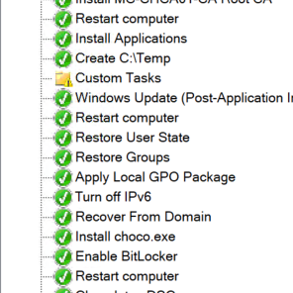

Combining Old with New
PowerShell + DevOps Global Summit
Inserting Chocolatey installation into MDT
Testing pains
April 13-16, 2026

Slide 13

So many steps
MDT provides the initial system baseline:​
Windows deployment​
Driver injection​
BitLocker preparation​
Baseline configuration​
Domain join​
Group Policy executes a startup PowerShell script when a system initializes
Installs Chocolatey​
Configures internal repositories​
Enables required Chocolatey features​
Prepares the endpoint for centralized software deployment​
Registers the endpoint with Chocolatey Central Management.​
The bootstrap script functions as a DSC-style configuration engine.​
Evaluates system state​
Verifies required configuration​
Remediates configuration drift​
Ensures deployment readiness​

Slide 14

Bootstrapping
Core Apps install during imaging
Extra robust script needed because MDT sucks
If it detects choco installs missing it moves into self-healing and runs install and client reg scripts
Goal to implement similar bootstrapping for department specific app groups

Slide 15
THANK YOU
Feedback is a gift
Please review this session
via the mobile App

