Slide 1
From Git To Gallery
Everything on-prem and open source
Emrys MacInally
Bsky @emrys.macinally.de
1 / 15

Slide 2
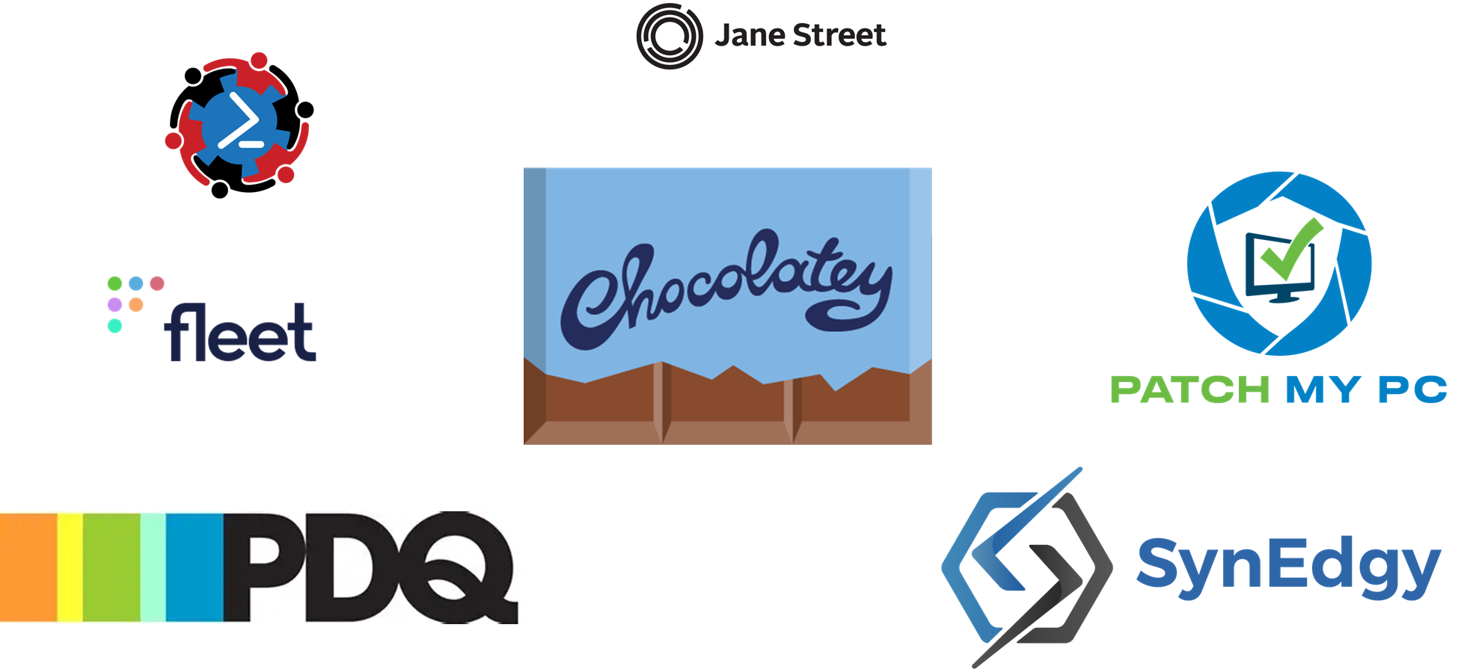

Slide 3

About Me
Teamlead ATLAS @ medavis
Over 20 years in the IT Industry
Fell in with PowerShell 17 years ago
…. and I hate PowerPoint! https://powerpointisfun.com

Slide 4
Agenda
Why should you use git and build your PowerShell stuff
Why self host your code CI and repositories
Disclaimer
Demo
Q&A: Questions & Discussion

Slide 5
Why this talk?
Why do I need git?
Source control is for devs!
If you write code, you are a dev!
Why should I build my modules?
I tested it on my machine
Copying & pasting modules is fine

Slide 6
Why git?
History — who changed what, when, and why (git log, git blame)
Undo — go back to any version that worked
Collaboration — multiple people, no overwrites, no "please don't touch my script"
Branching — experiment safely, don't break production
Diff — see exactly what changed between versions
Review — pull requests = code review for non-developers too
Notes:
It was working yesterday — what changed?"
"Someone overwrote my script on the shared drive"
"I have 6 versions of this script and I don't know which is current"
"Can we test this change without breaking production?"
"We need to prove this config didn't change during the incident window"

Slide 7
Why CI?
Automated tests — run Pester tests on every commit, automatically
Consistent builds — always built the same way, not on someone's laptop
Code quality — PSScriptAnalyzer on every push
Automated publishing — merge to main → publish to NuGet, every time
Fast feedback — broken tests fail in minutes, not when someone notices in production

Slide 8
Why packages repo?
Share modules internally — colleagues can Install-Module MyModule -Repository Internal
Version management — pin to a version, upgrade deliberately
No more "copy this .psm1 to your modules folder"
Dependency management — RequiredModules in your module manifest actually works
Notes:
Once you have a module you're proud of, how do you share it? Right now you probably send a .zip, or push a file to a share, or paste a link to a repo. That's fine for 2 people. It doesn't scale.
With an internal NuGet repository, your team can install your module with the same Install-Module command they use for anything from PSGallery. You control the versions. You can pull specific versions. You can proxy the public PSGallery through it so you have a local cache.
And when you're ready, you can push the same module to the public PSGallery to share with the wider PowerShell community — with one pipeline step.

Slide 9
Why On-Premises & OS
Data sovereignty — your code, your infrastructure, your rules
Regulatory compliance — some industries/contracts forbid cloud-hosted source control
European perspective — growing skepticism about US cloud providers
Air-gapped environments — a SaaS product simply isn't an option
Company policy — "we don't push internal code to external services"
Notes:
Why not just use GitHub or GitLab SaaS? Maybe you can. But consider: in many enterprise environments, internal scripts contain sensitive configuration, internal hostnames, credentials patterns — things you simply should not push to a US cloud provider.
And as Europeans we should be honest: we're becoming more cautious about that. Schrems II, GDPR, and recent political winds all point in the same direction. Having infrastructure you control at home, in your datacenter, or in a European cloud is increasingly not just preference — it's prudent.
Open source adds another dimension: you can audit the code. You're not trusting a black box. You can contribute fixes. You're not dependent on a company's pricing decisions or product discontinuation.
And the tools I'll show you today run on remarkably low-powered hardware. We're not talking about a rack of servers. A Raspberry Pi or an old laptop can run this entire stack.

Slide 10






Tech stack/Disclaimer
Source code server
CI Pipeline
Artifact repo
Notes:
Git lap – Forgejo - Gogs

Slide 11
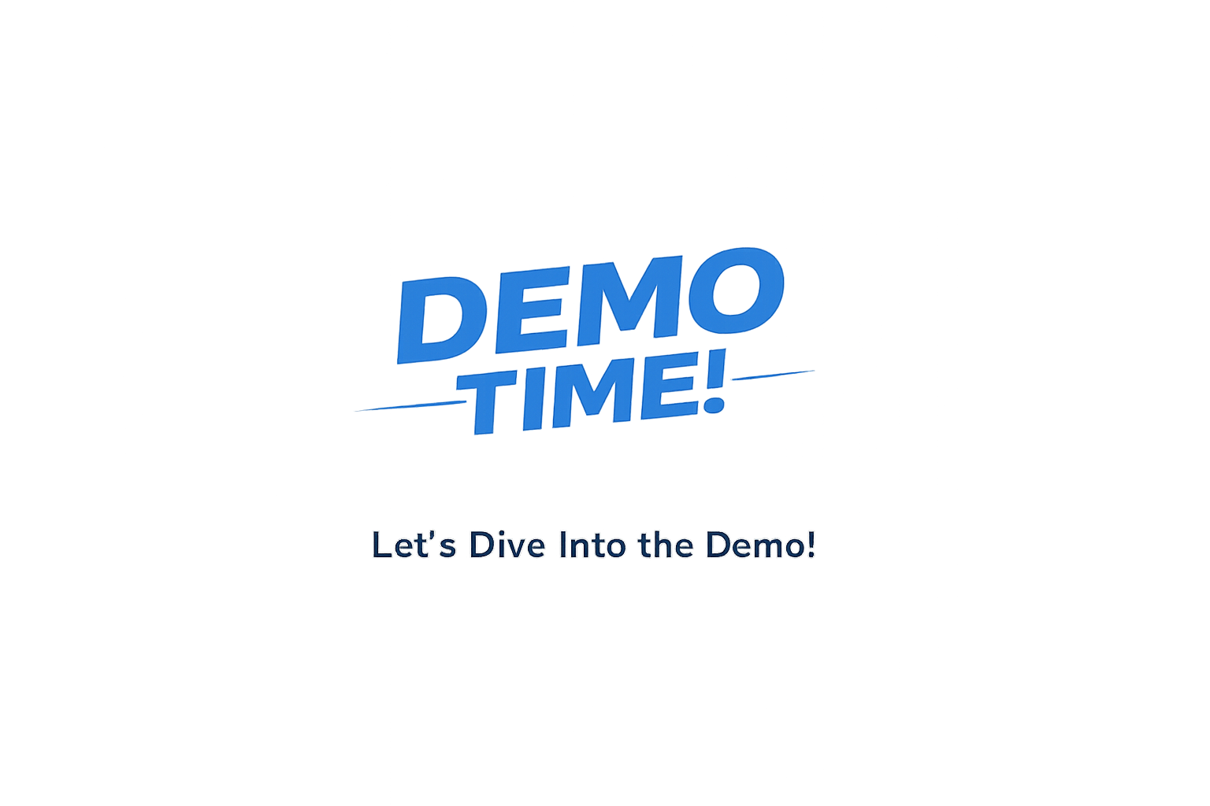
Demo

Slide 12
Q&A

Slide 13
THANK YOU
Feedback is a gift
Please review this session via the mobile App
Emrys MacInally | @emrys.macinally.de on Bluesky
Code & slides available on GitHub

