Slide 1

GitHub Actions
For Fun and Profit
Adam Driscoll
@adamrdriscoll.com
1 / 15

Slide 2
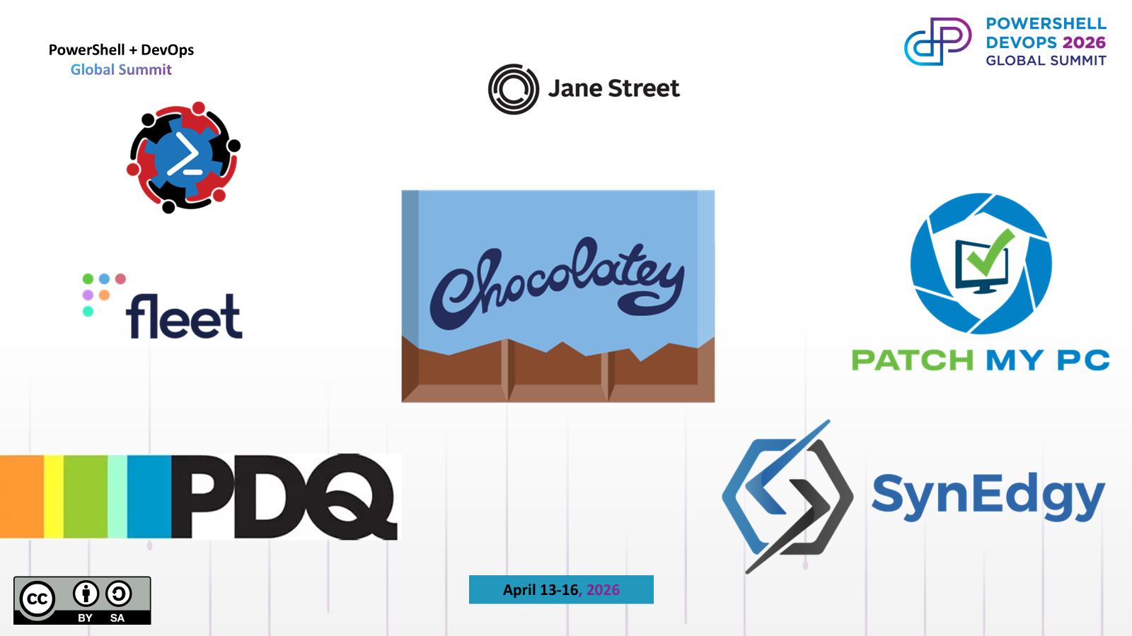

Slide 3

About Me
Developer @ Devolutions
Former PS MVP and Business Owner
Creator of PowerShell Universal
Tinkerer
Endurance Athlete

Slide 4
GitHub Actions
Workflows run as part of a repository
Triggered manually, scheduled and on events
Declarative YAML syntax
Composed of actions
Configurable runners, secrets, variables and environments

Slide 5
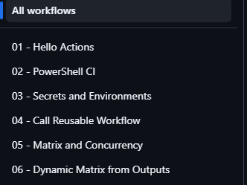
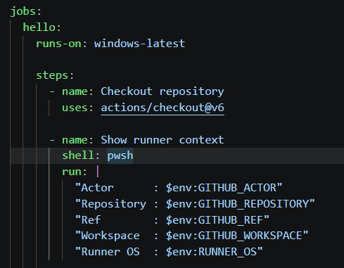

GitHub Actions Dictionary
Workflows
Jobs and Steps
Actions

Slide 6
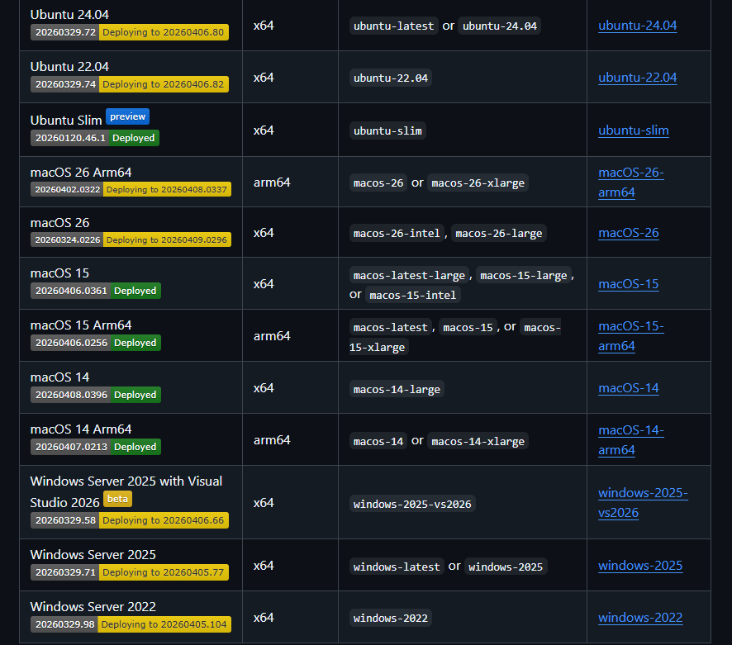
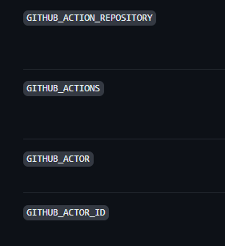
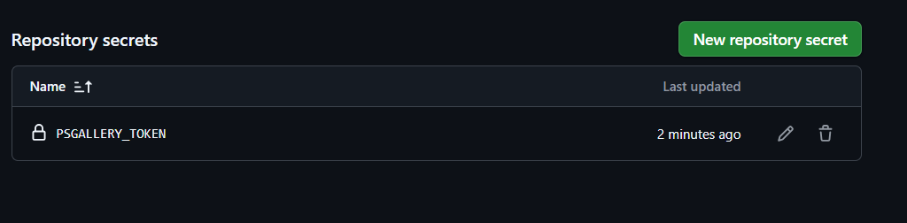
GitHub Actions Dictionary
Agents
Variables
Secrets

Slide 7
Example Actions
actions/checkout: Action for checking out a repo
actions/labeler: An action for automatically labelling pull requests
actions/setup-dotnet: Set up your GitHub Actions workflow with a specific version of the .NET core sdk
actions/upload-pages-artifact: A composite action for packaging and uploading an artifact that can be deployed to GitHub Pages.
Marketplace

Slide 8
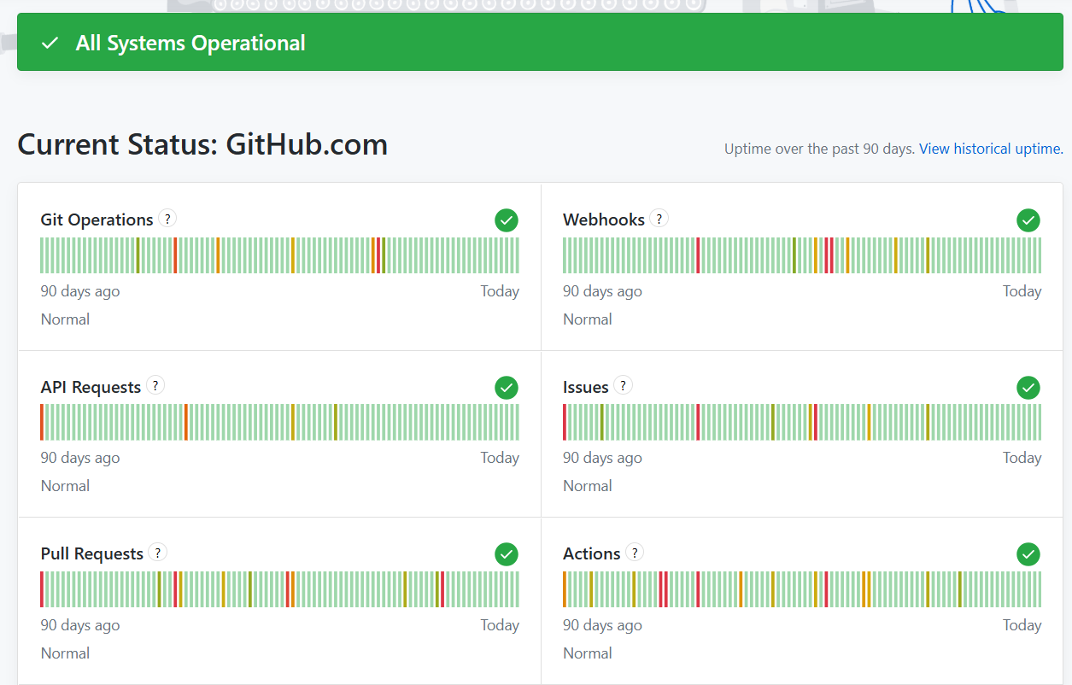
Demo!

Slide 9
Word of Caution
Verify actions before using them in workflows
Trivy GitHub Actions Supply Chain Compromise | Snyk
GitHub Actions Supply Chain Attack 2025: A Critical Security Breach
offensive-actions/release-tampering-pocs: Proof of Concepts for malicious maintainers: How to Tamper with Releases built with GitHub Actions Worfklows, presented at fwd:cloudsec Europe 2025
Disabling or limiting GitHub Actions for your organization - GitHub Enterprise Cloud Docs

Slide 10
THANK YOU
Feedback is a gift
Please review this session
via the mobile App

