Slide 1
Intersight Workload Engine IWE
Jeroen Wittock
TME
March 15 2022

Slide 2



IWE in the Intersight Ecosystem
IKS on VMware
IKS Cisco Virtualized
Kubernetes Extensions
Kubernetes Extensions
Optimization
Containers
Workload Optimizer
Containers
Virtual Machines
Virtual Machines
VMware
Cloud Orchestration
Workload Engine
Free with IKS
Server Management
Service for Terraform
Server Management
Automation
&
Orchestration
Notes:
IKS Cisco Virtualized is easier and cheaper:
Easier because it is now a full Cisco stack with no manual steps required to do integration with 3rd party components that also need to be lifecycle managed.
Cheaper because IWE is an IKS feature and comes free with IKS
Why
Businesses are pursuing application modernization based on cloud computing paradigms that promise benefits like faster delivery and efficient lifecycle management. Microservices architecture is one such cloud-native architecture, and applications built with microservices are often deployed and managed by Kubernetes. For the subset of such applications that need to be deployed on-premises, application developers expect the underlying infrastructure to provide cloud-like programmability, resiliency, and manageability.

Slide 3
What is IWE
Intersight
IKS Node (VM)
IKS Node (VM)
IKS Node (VM)
IKS Node (VM)
IKS Node (VM)
IKS
IWE
IWE : Operating System, Hypervisor, Clustering
Hyperflex Data Platform
Server Management
IWE Node
IWE Node
IWE Node
Use case: -> IKS!
Notes:
IWE nodes are physical machines
IKS nodes are VM’s

Slide 4
What Problem is IWE Solving?
Cloud Native App
CI/CD
Container
Manage
Operate
Secure
Registry
OS
Container (runtime)
Compute (vcpu, vgpu)
Network (vswitch, SRIOV, security, …)
Storage
(SDS, HCI, local, …)
Manage
Operate
Secure
Build Server
OS
HyperVisor
Manage
Operate
Secure
Compute
Network
Storage
Manage
Operate
Secure
Manage
Operate
Secure
Disks
CPU
RAID card
Topology
HA
SDN
SDS
GPU
10G, 40G, …
port density
Mgmt
Firmware
Mgmt
Mgmt
Firmware
Firmware
SAN
NAS
Obj
NIC
NVMe, SAS
ScSi
Notes:
Note: This is looking at cloud native from an infrastructure point of view.
Starting point is that customers want to run cloud native workloads. For all the well known reasons.
The whole idea of IKS plus IWE is to make it as easy and cheap as possible for a customer to gain the full set of capabilities to run cloud native workloads, not just the k8s part.
This slide is all about explaining all the components that you need and all the software that you need to install and maintain just to get to the point where you have the capability to run cloud native workloads.
What – Problem Statement
While applications can be run inside containers on bare-metal, running Kubernetes managed containers inside virtual machines allows organizations to achieve simpler lifecycle management and optimized resource utilization. Such deployments can deliver the compute performance that meets the requirements of several IT applications. The use of Kubernetes for managing application across a fleet of such virtual machines can make individual such virtual machines relatively dispensable. Hence, such virtual machines can be efficiently run on an infrastructure consisting of light-weight hypervisor deployed with appropriate networking, storage, and management mechanisms. IT infrastructure administrators are thus presented with the challenge of providing and operating such agile and elastic infrastructure that meets the needs of the application developers.

Slide 5
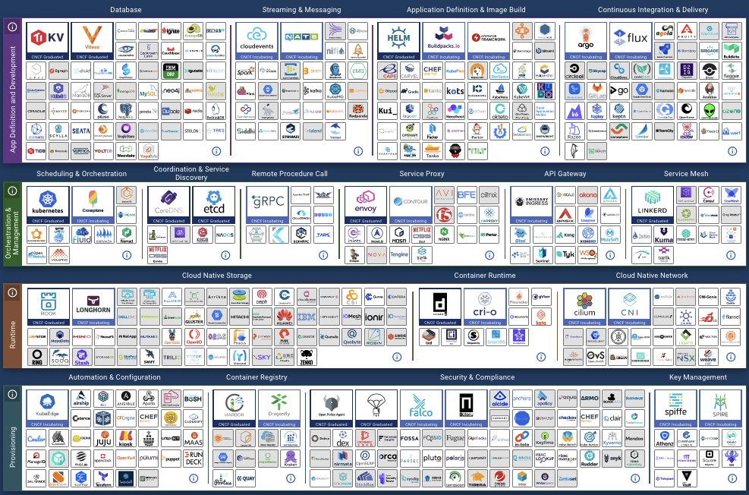
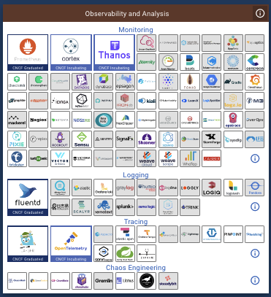
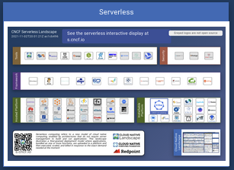
Cloud Native landscape.cncf.io: Options, Options, …
Notes:
There are plenty of projects solving different problems. Each of these projects are in various stages of maturing, they all have their own feature velocity. Choosing, integrating and maintaining is a big challenge and takes away time and effort from dealing with the workloads.

Slide 6



Deploying Cloud Native Applications
Cloud Native App
IWE + IKS ( + SMM )
CI/CD
Container
Manage
Operate
Secure
Registry
OS
Container (runtime)
Compute (vcpu, vgpu)
Network (vswitch, SRIOV, security, …)
Storage
(SDS, HCI, local, …)
Manage
Operate
Secure
Build Server
Fully Automated
OS
HyperVisor
Manage
Operate
Secure
Complete Support
Compute
Network
Storage
Manage
Operate
Secure
Full Stack Management
Manage
Operate
Secure
Disks
CPU
RAID card
Topology
HA
SDN
SDS
GPU
10G, 40G, …
port density
Mgmt
Firmware
Mgmt
Mgmt
Firmware
Firmware
SAN
NAS
Obj
NIC
NVMe, SAS
ScSi
Notes:
The IKS and IWE combination essentially takes care of most , if not all of the burden on the IT Ops team enabling the respond quicker to the demands of the Dev Ops teams. Which in this agile world are many and often. IT Ops can now deliver quickly and consistently on the demands from the Dev Ops folks while at the same time still providing all the capabilities and consistency expected of an enterprise production system.
An additional major advantage is that IWE and IKS pick and choose best of breed projects to achieve cloud native functionality including storage backend, observability, life cycle management, security, etc …

Slide 7
3 Steps to Cloud Native
Step 1: Claim your Servers
Intersight
Server Management
Notes:
We need to let intersight know what physical resources it has available for use.

Slide 8
3 Steps to Cloud Native
Step 2: Create & Deploy IWE Profile
Intersight
IWE
IWE : Operating System, Hypervisor, Clustering
Hyperflex Data Platform
Server Management
IWE Node
IWE Node
IWE Node
Notes:
Once the servers are claimed we can now create the IWE profile which will tie together all the config parameters (bundled in policies) with the hardware. The end result is an infrastructure provider that will be consumable by IKS in the 3rd and final step of the install process
An important thing to realize is that IWE does not required any software to be manually downloaded and pushed to the servers. All software is automatically pulled from Cisco and pushed / installed on the nodes.

Slide 9
A lot is done by the Automation!
Manual
Fully Automated by Intersight
Validate pre-requirements
Prepare Servers
Download and Install IWE OS
Setup IWE services
Deploy Distributed storage
Create IWE Cluster Profile
IWE Cluster is Online
Notes:
Key thing to realize is that even though it looks easy, there is actually a ton of stuff happening in the back ground. We do a lot of validation and pre-installation checks. And automatically we do firmware upgrades, OS hardening, patching, configuration, ….

Slide 10
3 Steps to Cloud Native
Step 3: Create & Deploy IKS Profile
Intersight
IKS Node (VM)
IKS Node (VM)
IKS Node (VM)
IKS Node (VM)
IKS Node (VM)
IKS
IWE
IWE : Operating System, Hypervisor, Clustering
Hyperflex Data Platform
Server Management
IWE Node
IWE Node
IWE Node
Notes:
3rd and final step is to create the IKS profile which will point to the IWE infrastructure provider to deploy the IKS cluster’s master and worker nodes.
Note:
IWE nodes are physical machines
IKS nodes are VM’s

Slide 11
A lot is done by the Automation!
Manual
Fully Automated by Intersight
Gather pre-requirements
Transfer image
Clone image
Bootstrap
Install addon operator
Install CNI
Install Essential Addon’s
Install Optional Addon’s
IKS Cluster Online
Notes:
Similar to the IWE installation automation, IKS has an extensive set of automated tasks as part of the IKS cluster installation.

Slide 12
Roadmap
HX M5 Hybrid
M6 Support
Automated Upgrades
HXDP 5.0
Connected TAC for clusters
Compute only nodes cluster expansion
GPU pass-through
IWE clusters without FI, reduced minimum node count (edge use case)
Notes:
Why are there no dates here? Well IWE is delivered as SaaS, meaning that features, enhancements and bugfixes are rolled out every couple fo days. It is hard to predict how long a certain piece of code will need to progress through staging and QA testing. What is shown here are the key things planned for this and the next quarter.

Slide 13
Sizing
Sizing discussions should always start from the workload’s requirements.
Cores versus Clockspeed
Memory
Storage: IOPS
Oversubscription?
IKS VM size > IKS VM’s per IWE node > IWE node specs
GPU

Slide 14

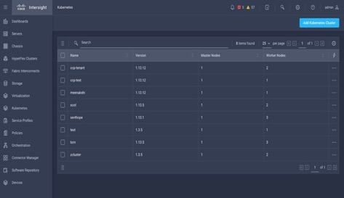

Cisco Intersight Workload Engine Enterprise Virtualization for Intersight Kubernetes Service
Reduce Costs
Eliminate excessive license costs for enterprise virtualization of Kubernetes clusters
Simplify Management and Operations
Manage, Operate, and Automat Kubernetes virtual infrastructure in Cisco Intersight
…
Enterprise Full Stack Support
Full stack support with enterprise SLA’s by Cisco’s industry leading TAC teams.
Generally Available Since December ‘21
Enterprise Virtualization included with IKS
Kubernetes & Virtualization from a single pane of glass
One-click Deploymant of secure Kubernetes clusters
Notes:
IWE looks like a Hyperflex cluster deployed from Intersight
No vendor lock-in, all Cisco stack with OpenAPIs to manage the stack through Intersight and 3rd party tooling and providing a 100% native Kubernetes API
Pricing: IWE + IKS – definitely lower than vSphere and Tanzu
High level tech specs:
3 nodes min, max 16 today (expanding in future)
All converged nodes: no compute only today (will add in future soon)

Slide 15
Call to Action
We have a Container / Kubernetes Platform
With IWE we have a full Cisco Stack
Spread the News

