Slide 1
What is Orchestration
Orchestration is the automated configuration, management, and coordination of computer systems, applications, and services. Orchestration helps IT to more easily manage complex tasks and workflows.

Slide 2
What is Kubernetes
Kubernetes (also k8s) is an open-source container-orchestration system for automating application deployment, scaling, and management.
It was originally designed by Google and is now maintained by the Cloud Native Computing Foundation.

Slide 3
Why we need Kubernetes
Containers are a good way to bundle and run applications. In a production environment, it is necessary to ensure that there is no downtime, Kubernetes takes care of that, it features:
Self-healing, by automatically restarting unhealthy or failing containers.
Storage orchestration, by automatically mounting volumes of different storage systems to containers.
Service discovery and load balancing, by balancing traffic to distributed containers identified by a DNS.
Secret and configuration management, by automatically binding to containers stored sensitive information like secret tokens, passwords or SSH keys.
Automated rollouts and rollbacks, by automatically creating new containers and removing old ones with no downtime when rolling updates or rolling back.

Slide 4
Kubernetes principles
Kubernetes was built to promote the features required by highly available distributed systems, such as auto-scaling, portability, high availability, and security.
Scalability, based on CPU utilization, Kubernetes provides horizontal scaling of pods. Though the limit for CPU usage is configurable, Kubernetes will automatically start new pods if it reaches the limit.
High Availability, Kubernetes provides high availability at both levels i.e., at the infrastructure level and application level. Replica sets ensure that the minimum number of required replicas for a given application of a stateless pod is running.
Security, Kubernetes positions security at multiple levels such as at cluster level, application level, and network level. The endpoints of API remain secured through the transport security layer. Only verified users, such as service account users or regular users can execute operations on the cluster via API requests.

Slide 5
Control Plane
The control plane manages the worker nodes and the Pods in the cluster. In production environments, the control plane usually runs across multiple servers and a cluster usually runs multiple nodes, providing fault-tolerance and high availability.

Slide 6
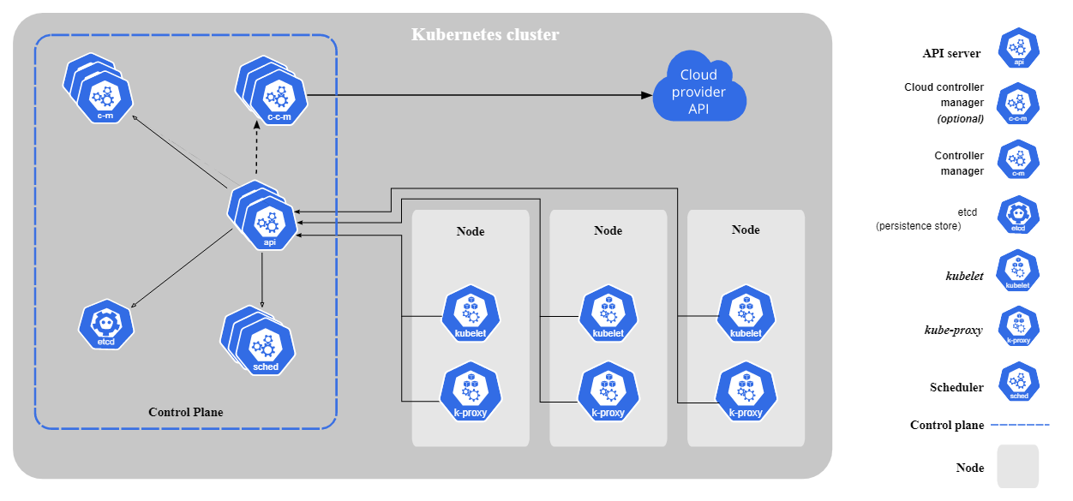

Slide 7
Control Plane components
The control plane role is making decisions in the cluster like scheduling deployments or restarting a failing pod.
It is composed of an API server, a database, a scheduler and a controller manager, for Cloud-managed clusters, there’s an additional cloud-controller manager.

Slide 8
Control Plane components
API Server, it is the way to interact with Kubernetes, for example, by using a CLI tool like kubectl or web tool like Kubernetes Dashboard.
ETCD, a key-value database used to store all cluster data.
Scheduler, it decides in what node new Pods can be deployed.
Controller manager, todo
Cloud-controller manager, todo

Slide 9
Node components
Node components run on all the clusters nodes (masters and workers) to maintain running Pods and providing Kubernetes runtime environment.
Kubelet, an agent used to guarantee containers are running in Pods
Kube Proxy, a network proxy used to maintain communication between Pods

Slide 10
What is a Pod?
It is a group of one or more containers, they share storage and network resources.
Pods are the smallest, most basic deployable object in Kubernetes.

Slide 11
Ports used by Kubernetes
Kubernetes components and resources require to have specific ports open such as
6443, used by API Server
10250, used by Kubelet
10251, used by Scheduler
10252, used by Controller manager
30000-32767, used by NodePort services

Slide 12
Kubernetes relies on a container runtime
On each node, a containers runtime should be installed, Docker is one of the most popular options, it doesn’t matter if the node is worker or master, all should have a container runtime.

Slide 13
Lab 1
Installing and running minikube

Slide 14
Namespace
Kubernetes supports multiple virtual clusters backed by the same physical cluster. These virtual clusters are called namespaces.
Objects like Pods, secrets, or volumes are associated to a namespace when created.

Slide 15
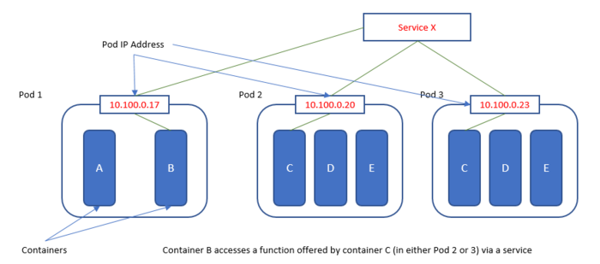
Pods and Networks

Slide 16
Again, what is a Pod?
It is a group of one or more containers, they share storage and network resources.
Pods are the smallest, most basic deployable object in Kubernetes.

Slide 17
Pod lifecycle
When you run “kubectl get pods” command, an output with pods status will be shown, values my vary from a pod to another, the status is a summary of where the pod is in its lifecycle
Value | Description
Pending | The Pod has been bound to a node, but one of containers is still not created
Running | The Pod has been bound to a node, and at least one container is running
Succeeded | All containers in the Pod have terminated in success and will not be restarted
Failed | All containers in the Pod have terminated, and at least one container has terminated in failure
Unknown | Typically due to an error in communicating with the host of the Pod.

Slide 18
Lab 2
Creating a Ghost-blog pod

Slide 19
Network, Services and DNS
Pods can communicate with each other using Kubernetes network through services, which is a network layer on top of pods, allowing access to a pod in network.
Each service will be assigned to a domain name based on the service name and the namespace, for example, if you’re service name is “ghost-blog” in “default” namespace, the DNS will be the following “ghost-blog.default” and it can be accessed by any Pod in the cluster.

Slide 20
Service types
Kubernetes provide Services as a network feature and it comes in multiple types
ClusterIP, this default type exposes the service on a cluster-internal IP. You can reach the service only from within the cluster.
NodePort, this type of service exposes the service on each node’s IP at a static port. A ClusterIP service is created automatically, and the NodePort service will route to it. From outside the cluster, you can contact the NodePort service by using “<NodeIP>:<NodePort>”.
LoadBalancer, this service type exposes the service externally using the load balancer of your cloud provider. The external load balancer routes to your NodePort and ClusterIP services, which are created automatically.

Slide 21
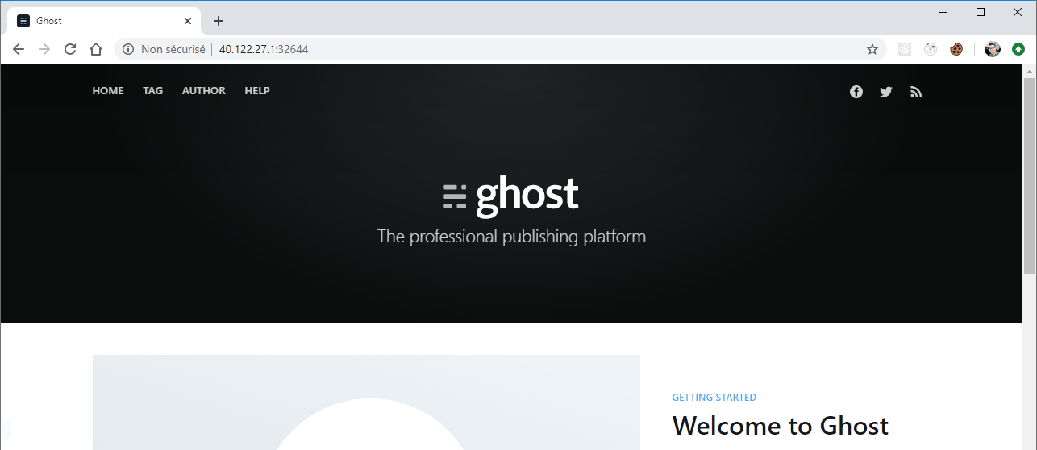
Accessing a Service from Internet
If a service type is NodePort-based, random port ranged between 30000 to 32767 will be given to it, which can be used with any of cluster nodes public IP address

Slide 22
Lab 3
Using services to access Pods

Slide 23
Lab 4
Deploying a votes app and rolling updates

Slide 24
Lab 5
Managing and configuring ingresses

Slide 25
Lab 6
Deploying Postgres using helm

