Slide 1
Kubernetes

Slide 2
What are you going to learn ?
What is Kubernetes ?
Kubernetes Components
Work loads
Pods
Controllers
Services
Load balancing
Networking
Storage
Setup Kubernetes Cluster
Learning Environment
Kubernetes with Minikube
Production Environment
Bootstrapping clusters with kubeadm
Cluster Administration

Slide 3
What is Kubernetes ?
Kubernetes is a portable, extensible, open-source platform for managing containerized workloads and services, that facilitates both declarative configuration and automation. It has a large, rapidly growing ecosystem. Kubernetes services, support, and tools are widely available
Why you need Kubernetes and what it can do ?
Service discovery and load balancing
Storage orchestration
Automated rollouts and rollbacks
Automatic bin packing
Self-healing
Secret and configuration management
What Kubernetes is not ?
Kubernetes is not a traditional, all-inclusive PaaS (Platform as a Service) system.
Does not deploy source code and does not build your application.
Does not provide application-level services, such as middleware (for example, message buses), data-processing frameworks (for example, Spark), databases (for example, MySQL), caches, nor cluster storage systems (for example, Ceph) as built-in services.
Does not dictate logging, monitoring, or alerting solutions.

Slide 4
Kubernetes Components
Control Plane Components:
The control plane's components make global decisions about the cluster, as well as detecting and responding to cluster events
kube-apiserver
The API server is a component of the Kubernetes control plane that exposes the Kubernetes API. The API server is the front end for the Kubernetes control plane. kube-apiserver is designed to scale horizontally—that is, it scales by deploying more instances. You can run several instances of kube-apiserver and balance traffic between those instances
etcd
Consistent and highly-available key value store used as Kubernetes' backing store for all cluster data.
kube-scheduler
Control plane component that watches for newly created Pods with no assigned node, and selects a node for them to run on.
kube-controller-manager
Control Plane component that runs controller processes.
Node controller: Responsible for noticing and responding when nodes go down.
Replication controller: Responsible for maintaining the correct number of pods for every replication controller object in the system.
Endpoints controller: Populates the Endpoints object (that is, joins Services & Pods).
Service Account & Token controllers: Create default accounts and API access tokens for new namespaces
cloud-controller-manager
A Kubernetes control plane component that embeds cloud-specific control logic.
Node controller: For checking the cloud provider to determine if a node has been deleted in the cloud after it stops responding
Route controller: For setting up routes in the underlying cloud infrastructure
Service controller: For creating, updating and deleting cloud provider load balancers

Slide 5
Kubernetes Components (Cont. )
Node Components:
Node components run on every node, maintaining running pods and providing the Kubernetes runtime environment.
kubelet
An agent that runs on each node in the cluster. It makes sure that containers are running in a Pod.
kube-proxy
kube-proxy is a network proxy that runs on each node in your cluster, implementing part of the Kubernetes Service concept.
kube-proxy maintains network rules on nodes. These network rules allow network communication to your Pods from network sessions inside or outside of your cluster.
Container runtime
The container runtime is the software that is responsible for running containers.
Kubernetes supports several container runtimes: Docker, containerd, CRI-O, and any implementation of the Kubernetes CRI (Container Runtime Interface).
Addons
DNS
Cluster DNS is a DNS server, in addition to the other DNS server(s) in your environment, which serves DNS records for Kubernetes services
Containers started by Kubernetes automatically include this DNS server in their DNS searches
Dashboard
Dashboard is a general purpose, web-based UI for Kubernetes clusters. It allows users to manage and troubleshoot applications running in the cluster, as well as the cluster itself
Container Resource monitor
Container Resource Monitoring records generic time-series metrics about containers in a central database, and provides a UI for browsing that data
Cluster level logging
A cluster-level logging mechanism is responsible for saving container logs to a central log store with search/browsing interface

Slide 6
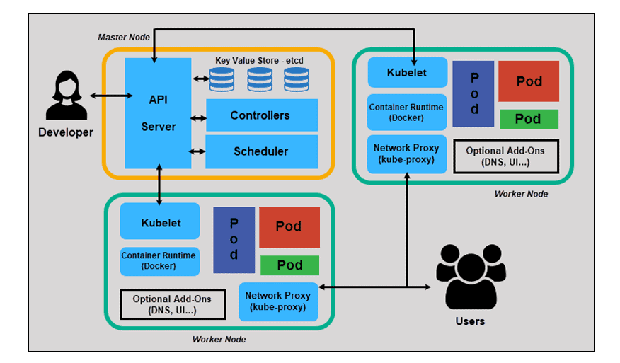
Kubernetes Components (Cont. )

Slide 7
Kubernetes Objects
Understanding Kubernetes Objects
A Kubernetes object is a "record of intent"--once you create the object, the Kubernetes system will constantly work to ensure that object exists. By creating an object, you're effectively telling the Kubernetes system what you want your cluster's workload to look like; this is your cluster's desired state.
Object Spec and Status
Almost every Kubernetes object includes two nested object fields that govern the object's configuration: the object spec and the object status.
For objects that have a spec, you have to set this when you create the object, providing a description of the characteristics you want the resource to have: its desired state.
The status describes the current state of the object, supplied and updated by the Kubernetes system and its components.
Required Fields
In the .yaml file for the Kubernetes object you want to create, you'll need to set values for the following fields:
apiVersion - Which version of the Kubernetes API you're using to create this object
kind - What kind of object you want to create
metadata - Data that helps uniquely identify the object, including a name string, UID, and optional namespace
spec - What state you desire for the object
Ref : https://kubernetes.io/docs/reference/generated/kubernetes-api/v1.19/#podspec-v1-core

Slide 8
Workloads
Pods
Pods are the smallest deployable units of computing that you can create and manage in Kubernetes.
A Pod is a group of one or more containers, with shared storage/network resources
A Pod models an application-specific "logical host": it contains one or more application containers which are relatively tightly coupled. In non-cloud contexts, applications executed on the same physical or virtual machine are analogous to cloud applications executed on the same logical host.
Pods in a Kubernetes cluster are used in two main ways:
Pods that run a single container. The "one-container-per-Pod" model is the most common Kubernetes use case; in this case, you can think of a Pod as a wrapper around a single container; Kubernetes manages Pods rather than managing the containers directly.
Pods that run multiple containers that need to work together. A Pod can encapsulate an application composed of multiple co-located containers that are tightly coupled and need to share resources
How Pods manage multiple containers
Pods are designed to support multiple cooperating processes (as containers) that form a cohesive unit of service. The containers in a Pod are automatically co-located and co-scheduled on the same physical or virtual machine in the cluster. The containers can share resources and dependencies, communicate with one another, and coordinate when and how they are terminated.
Restarting a container in a Pod should not be confused with restarting a Pod. A Pod is not a process, but an environment for running container(s). A Pod persists until it is deleted.

Slide 9
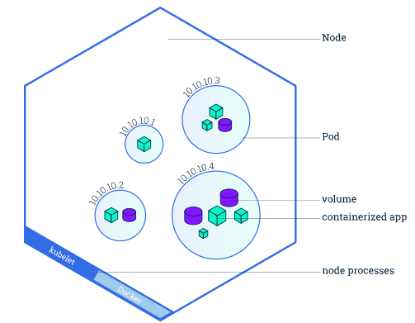
Workloads (Contd.)
Container Vs Pod Vs Node

Slide 10
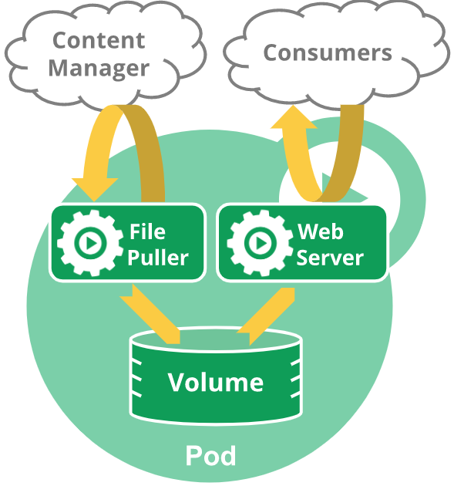
Workloads (Contd.)
Pods and controllers
You can use workload resources to create and manage multiple Pods for you. A controller for the resource handles
replication
rollout
automatic healing in case of Pod failure
For example, if a Node fails, a controller notices that Pods on that Node have stopped working and creates a replacement Pod. The scheduler places the replacement Pod onto a healthy Node.
Resource sharing and communication
Storage in Pods
Pod networking
Privileged mode for containers
This is useful for containers that want to use operating system administrative capabilities such as manipulating the network stack or accessing hardware devices. Processes within a privileged container get almost the same privileges that are available to processes outside a container

Slide 11
Controllers
ControllerA control loop that watches the shared state of the cluster through the apiserver and makes changes attempting to move the current state towards the desired state.
Following controllers available in Kubernetes to manage workloads
ReplicaSet
ReplicationController
DaemonSet
Jobs
CronJob
Deployments
StatefulSets
Pod templates
Controllers for workload resources create Pods from a pod template and manage those Pods on your behalf.
PodTemplates are specifications for creating Pods, and are included in workload resources such as Deployments, Jobs, and DaemonSets.
Each controller for a workload resource uses the PodTemplate inside the workload object to make actual Pods. The PodTemplate is part of the desired state of whatever workload resource you used to run your app.
Modifying the pod template or switching to a new pod template has no effect on the Pods that already exist. Pods do not receive template updates directly. Instead, a new Pod is created to match the revised pod template.

Slide 12
Controllers (Contd.)
ReplicaSet
A ReplicaSet's purpose is to maintain a stable set of replica Pods running at any given time. As such, it is often used to guarantee the availability of a specified number of identical Pod
A ReplicaSet is defined with fields, including
A selector - that specifies how to identify Pods it can acquire
A number of replicas - indicating how many Pods it should be maintaining
A pod template - specifying the data of new Pods it should create to meet the number of replicas criteria
A ReplicaSet then fulfills its purpose by creating and deleting Pods as needed to reach the desired number. When a ReplicaSet needs to create new Pods, it uses its Pod template.
A Deployment is a higher-level concept that manages ReplicaSets and provides declarative updates to Pods along with a lot of other useful features. Recommendation is using Deployments instead of directly using ReplicaSets, unless you require custom update orchestration or don't require updates at all.
This actually means that you may never need to manipulate ReplicaSet objects: use a Deployment instead, and define your application in the spec section
As with all other Kubernetes API objects, a ReplicaSet needs the
- apiVersion, (apps/v1)
- kind (ReplicaSet)
- metadata and
- spec

Slide 13
Controllers (Contd.)
Working with ReplicaSet:
Creating a Replicacet
kubectl create –f <rs-confiug.yaml>
Deleting a ReplicaSet and its Pods
kubectl get rs <rs-name>
Deleting just a ReplicaSet
kubectl delete rs <rs-name> --cascade=false
Isolating Pods from a ReplicaSet
Change the label of pod to isolate from ReplicaSet
Scaling a ReplicaSet
kubectl scale rs <rs-name> --replicas=<number of replicas>
ReplicaSet as a Horizontal Pod Autoscaler Target
kubectl autoscale rs <rs-name> --max=10 --min=3 --cpu-percent=50

Slide 14
Controllers (Contd.)
Replication Controller
It is the previous version of ReplicaSet. The primary difference with Replica Set is, this doesn’t support set based label selector. Rest all features which Replica set provides replication controller also provides
DaemonSet
A DaemonSet ensures that all (or some) Nodes run a copy of a Pod. As nodes are added to the cluster, Pods are added to them. As nodes are removed from the cluster, those Pods are garbage collected.
Some typical uses of a DaemonSet are:
running a cluster storage daemon on every node
running a logs collection daemon on every node
running a node monitoring daemon on every node
How Daemon Pods are scheduled
Normally, the node that a Pod runs on is selected by the Kubernetes scheduler. However, DaemonSet pods are created and scheduled by the DaemonSet controller instead.
How create DeamonSet
kubectl apply -f https://k8s.io/examples/controllers/daemonset.yaml
Taints and Tolerations
Normally, the node that a Pod runs on is selected by the Kubernetes scheduler. However, DaemonSet pods are created and scheduled by the DaemonSet controller instead.

Slide 15
Controllers (Contd.)
Communicating with Daemon Pods
Push: Pods in the DaemonSet are configured to send updates to another service, such as a stats database. They do not have clients.
NodeIP and Known Port: Pods in the DaemonSet can use a hostPort, so that the pods are reachable via the node IPs. Clients know the list of node IPs somehow, and know the port by convention.
DNS: Create a headless service with the same pod selector, and then discover DaemonSets using the endpoints resource or retrieve multiple A records from DNS.
Service: Create a service with the same Pod selector, and use the service to reach a daemon on a random node. (No way to reach specific node.)
Toleration Key | Effect | Version | Description
node.kubernetes.io/not-ready | NoExecute | 1.13+ | DaemonSet pods will not be evicted when there are node problems such as a network partition.
node.kubernetes.io/unreachable | NoExecute | 1.13+ | DaemonSet pods will not be evicted when there are node problems such as a network partition.
node.kubernetes.io/disk-pressure | NoSchedule | 1.8+
node.kubernetes.io/memory-pressure | NoSchedule | 1.8+
node.kubernetes.io/unschedulable | NoSchedule | 1.12+ | DaemonSet pods tolerate unschedulable attributes by default scheduler.
node.kubernetes.io/network-unavailable | NoSchedule | 1.12+ | DaemonSet pods, who uses host network, tolerate network-unavailable attributes by default scheduler.

Slide 16
Controllers (Contd.)
Jobs
A Job creates one or more Pods and ensures that a specified number of them successfully terminate. As pods successfully complete, the Job tracks the successful completions. When a specified number of successful completions is reached, the task (ie, Job) is complete
There are three main types of task suitable to run as a Job:
Non-parallel Jobs
normally, only one Pod is started, unless the Pod fails.
the Job is complete as soon as its Pod terminates successfully.
Parallel Jobs with a fixed completion count:
specify a non-zero positive value for .spec.completions.
the Job represents the overall task, and is complete when there is one successful Pod for each value in the range 1 to .spec.completions.
Parallel Jobs with a work queue:
do not specify .spec.completions, default to .spec.parallelism.
the Pods must coordinate amongst themselves or an external service to determine what each should work on. For example, a Pod might fetch a batch of up to N items from the work queue.
Job termination and cleanup
When a Job completes, no more Pods are created, but the Pods are not deleted either. Keeping them around allows you to still view the logs of completed pods to check for errors, warnings, or other diagnostic output. The job object also remains after it is completed so that you can view its status.
Deleting a Job will clean up the Pods it created.

Slide 17
Controllers (Contd.)
CronJob
A CronJob creates Jobs on a repeating schedule.
One CronJob object is like one line of a crontab (cron table) file. It runs a job periodically on a given schedule, written in Cron format.
All CronJob schedule: times are based on the timezone of the kube-controller-manager.
If your control plane runs the kube-controller-manager in Pods or bare containers, the timezone set for the kube-controller-manager container determines the timezone that the cron job controller uses.
To aovd parallal execution of same job, set the concurrencyPolicy to Forbid

Slide 18
Controllers (Contd.)
Deployments
You describe a desired state in a Deployment, and the Deployment changes the actual state to the desired state at a controlled rate
Creating a Deployment
- kubectl apply –f <dc-yaml>
- kubectl get deployments
- kubectl rollout status deployment <deployment-name> - To check the staus of deployment
- kubectl get pods --show-labels - To see labels of pods
- Pod-template-hash label
The pod-template-hash label is added by the Deployment controller to every ReplicaSet that a Deployment creates or adopts. This label ensures that child ReplicaSets of a Deployment do not overlap
Updating a Deployment
A Deployment's rollout is triggered if and only if the Deployment's Pod template (that is, .spec.template) is changed
Ex : kubectl --record deployment.apps/nginx-deployment set image deployment.v1.apps/nginx-deployment nginx=nginx:1.16.1
Deployment ensures that only a certain number of Pods are down while they are being updated. By default, it ensures that at least 75% of the desired number of Pods are up (25% max unavailable).
Deployment also ensures that only a certain number of Pods are created above the desired number of Pods. By default, it ensures that at most 125% of the desired number of Pods are up (25% max surge).

Slide 19
Controllers (Contd.)
Rolling Back a Deployment
Sometimes, you may want to rollback a Deployment; for example, when the Deployment is not stable, such as crash looping. By default, all of the Deployment's rollout history is kept in the system so that you can rollback anytime you want
kubectl set image deployment <deployment-name> nginx=nginx:1.161 --record=true
kubectl rollout history deployment.v1.apps/<deplopyment-name>
kubectl rollout history deployment.v1.apps/<deplopyment-name> --revision=2
kubectl rollout undo deployment.v1.apps/<deplopyment-name>
kubectl rollout undo deployment.v1.apps/<deplopyment-name> --to-revision=2
Scaling a Deployment
One can add more number of replicas or remove additional replicas of any existing deployment
kubectl scale deployment.v1.apps/<deployment-name> --replicas=<number of replicas>
kubectl autoscale deployment.v1.apps/<deployment-name> --min=10 --max=15 --cpu-percent=80
Pausing and Resuming a Deployment
You can pause a Deployment before triggering one or more updates and then resume it. This allows you to apply multiple fixes in between pausing and resuming without triggering unnecessary rollouts.
kubectl rollout pause deployment.v1.apps/<deployment-name>
kubectl rollout resume deployment.v1.apps/<deployment-name>
kubectl set resources deployment.v1.apps/nginx-deployment -c=nginx --limits=cpu=200m,memory=512Mi

Slide 20
Controllers (Contd.)
Deployment status
A Deployment enters various states during its lifecycle.
Progressing Deployment
Kubernetes marks a Deployment as progressing when one of the following tasks is performed:
The Deployment creates a new ReplicaSet.
The Deployment is scaling up its newest ReplicaSet.
The Deployment is scaling down its older ReplicaSet(s).
New Pods become ready or available (ready for at least MinReadySeconds).
Complete Deployment
Kubernetes marks a Deployment as complete when it has the following characteristics:
All of the replicas associated with the Deployment have been updated to the latest version you've specified, meaning any updates you've requested have been completed.
All of the replicas associated with the Deployment are available.
No old replicas for the Deployment are running.
Failed Deployment
Your Deployment may get stuck trying to deploy its newest ReplicaSet without ever completing. This can occur due to some of the following factors:
Insufficient quota
Readiness probe failures
Image pull errors
Insufficient permissions
Limit ranges
Application runtime misconfiguration

Slide 21
Controllers (Contd.)
Deployment Spec:
.spec.strategy specifies the strategy used to replace old Pods by new ones. .spec.strategy.type can be "Recreate" or "RollingUpdate".
Recreate Deployment : All existing Pods are killed before new ones are created
Rolling Update Deployment : The Deployment updates Pods in a rolling update fashion when .spec.strategy.type==RollingUpdate. You can specify maxUnavailable and maxSurge to control the rolling update process
spec.strategy.rollingUpdate.maxUnavailable is an optional field that specifies the maximum number of Pods that can be unavailable during the update process. The value can be an absolute number (for example, 5) or a percentage of desired Pods (for example, 10%).
Max Surge
.spec.strategy.rollingUpdate.maxSurge is an optional field that specifies the maximum number of Pods that can be created over the desired number of Pods. The value can be an absolute number (for example, 5) or a percentage of desired Pods (for example, 10%).
.spec.progressDeadlineSeconds is an optional field that specifies the number of seconds you want to wait for your Deployment to progress before the system reports back that the Deployment has failed progressing
.spec.minReadySeconds is an optional field that specifies the minimum number of seconds for which a newly created Pod should be ready without any of its containers crashing, for it to be considered available.

Slide 22
Controllers (Contd.)
.spec.revisionHistoryLimit is an optional field that specifies the number of old ReplicaSets to retain to allow rollback. These old ReplicaSets consume resources in etcd and crowd the output of kubectl get rs. The configuration of each Deployment revision is stored in its ReplicaSets; therefore, once an old ReplicaSet is deleted, you lose the ability to rollback to that revision of Deployment. By default, 10 old ReplicaSets will be kept, however its ideal value depends on the frequency and stability of new Deployments.
Paused
.spec.paused is an optional boolean field for pausing and resuming a Deployment. The only difference between a paused Deployment and one that is not paused, is that any changes into the PodTemplateSpec of the paused Deployment will not trigger new rollouts as long as it is paused. A Deployment is not paused by default when it is created.

Slide 23
Controllers (Contd.)
StatefulSets
StatefulSet is the workload API object used to manage stateful applications.
Manages the deployment and scaling of a set of Pods, and provides guarantees about the ordering and uniqueness of these Pods.
Like a Deployment, a StatefulSet manages Pods that are based on an identical container spec. Unlike a Deployment, a StatefulSet maintains a sticky identity for each of their Pods. These pods are created from the same spec, but are not interchangeable: each has a persistent identifier that it maintains across any rescheduling.
StatefulSets are valuable for applications that require one or more of the following.
Stable, unique network identifiers.
Stable, persistent storage.
Ordered, graceful deployment and scaling.
Ordered, automated rolling updates.
In the above, stable is synonymous with persistence across Pod (re)scheduling.
The storage for a given Pod must either be provisioned by a PersistentVolume Provisioner based on the requested storage class, or pre-provisioned by an admin.
Deleting and/or scaling a StatefulSet down will not delete the volumes associated with the StatefulSet. This is done to ensure data safety, which is generally more valuable than an automatic purge of all related StatefulSet resources.
StatefulSets currently require a Headless Service to be responsible for the network identity of the Pods. You are responsible for creating this Service.
StatefulSets do not provide any guarantees on the termination of pods when a StatefulSet is deleted. To achieve ordered and graceful termination of the pods in the StatefulSet, it is possible to scale the StatefulSet down to 0 prior to deletion.

Slide 24
Controllers (Contd.)
Ordinal Index
For a StatefulSet with N replicas, each Pod in the StatefulSet will be assigned an integer ordinal, from 0 up through N-1, that is unique over the Set.
Stable Network ID
Each Pod in a StatefulSet derives its hostname from the name of the StatefulSet and the ordinal of the Pod. The pattern for the constructed hostname is $(statefulset name)-$(ordinal). (Example - web-0,web-1,web-2)
The domain managed by this Service takes the form: $(service name).$(namespace).svc.cluster.local, where "cluster.local" is the cluster domain. As each Pod is created, it gets a matching DNS subdomain, taking the form: $(podname).$(governing service domain), where the governing service is defined by the serviceName field on the StatefulSet.
Deployment and Scaling Guarantees
For a StatefulSet with N replicas, when Pods are being deployed, they are created sequentially, in order from {0..N-1}.
When Pods are being deleted, they are terminated in reverse order, from {N-1..0}.
Before a scaling operation is applied to a Pod, all of its predecessors must be Running and Ready.
Before a Pod is terminated, all of its successors must be completely shutdown.
Update Strategies
On Delete
The OnDelete update strategy implements the legacy (1.6 and prior) behavior. When a StatefulSet's .spec.updateStrategy.type is set to OnDelete, the StatefulSet controller will not automatically update the Pods in a StatefulSet. Users must manually delete Pods to cause the controller to create new Pods that reflect modifications made to a StatefulSet's .spec.template.
Rolling Updates
The RollingUpdate update strategy implements automated, rolling update for the Pods in a StatefulSet. It is the default strategy when .spec.updateStrategy is left unspecified. When a StatefulSet's .spec.updateStrategy.type is set to RollingUpdate, the StatefulSet controller will delete and recreate each Pod in the StatefulSet. It will proceed in the same order as Pod termination (from the largest ordinal to the smallest), updating each Pod one at a time. It will wait until an updated Pod is Running and Ready prior to updating its predecessor

Slide 25


Labels and Selectors
Labels
Labels are key/value pairs that are attached to objects, such as pods.
Labels can be used to organize and to select subsets of objects.
Labels can be attached to objects at creation time and subsequently added and modified at any time.
Each object can have a set of key/value labels defined. Each Key must be unique for a given object.
Unlike names and UIDs, labels do not provide uniqueness. In general, we expect many objects to carry the same label(s).
Syntax and character set
Labels are key/value pairs. Valid label keys have two segments: an optional prefix and name, separated by a slash
Label selectors
Equality-based
Equality- or inequality-based requirements allow filtering by label keys and values. Matching objects must satisfy all of the specified label constraints, though they may have additional labels as well. Three kinds of operators are admitted =,==,!=.
Set-based
Set-based label requirements allow filtering keys according to a set of values. Three kinds of operators are supported: in,notin and exists (only the key identifier). For example

Slide 26
Concepts (Contd.)
Assigning Pods to Nodes
You can constrain a Pod to only be able to run on particular Node(s), or to prefer to run on particular nodes.
nodeSelector
nodeSelector is a field of PodSpec. It specifies a map of key-value pairs. For the pod to be eligible to run on a node, the node must have each of the indicated key-value pairs as labels (it can have additional labels as well).
Attach label to the node
Add a nodeSelector field to your pod configuration
Affinity and anti-affinity
Node affinity
Currently Two types of node affinity,
requiredDuringSchedulingIgnoredDuringExecution
preferredDuringSchedulingIgnoredDuringExecution
You can think of them as "hard" and "soft" respectively, in the sense that the former specifies rules that must be met for a pod to be scheduled onto a node (just like nodeSelector but using a more expressive syntax), while the latter specifies preferences that the scheduler will try to enforce but will not guarantee
The "IgnoredDuringExecution" part of the names means that, similar to how nodeSelector works, if labels on a node change at runtime such that the affinity rules on a pod are no longer met, the pod will still continue to run on the node.
Node affinity is specified as field nodeAffinity of field affinity in the PodSpec

Slide 27
Concepts (Contd.)
Inter-pod affinity and anti-affinity
Inter-pod affinity and anti-affinity allow you to constrain which nodes your pod is eligible to be scheduled based on labels on pods that are already running on the node rather than based on labels on nodes.
As with node affinity, there are currently two types of pod affinity and anti-affinity, called requiredDuringSchedulingIgnoredDuringExecution and preferredDuringSchedulingIgnoredDuringExecution which denote "hard" vs. "soft" requirements.
nodeName
nodeName is the simplest form of node selection constraint, but due to its limitations it is typically not used.
nodeName is a field of PodSpec. If it is non-empty, the scheduler ignores the pod and the kubelet running on the named node tries to run the pod.
Thus, if nodeName is provided in the PodSpec, it takes precedence over the above methods for node selection.

Slide 28
Namespaces
Namespace
Kubernetes supports multiple virtual clusters backed by the same physical cluster. These virtual clusters are called namespaces
Motivation for using namespaces
Each user community has its own:
resources (pods, services, replication controllers, etc.)
policies (who can or cannot perform actions in their community)+
constraints (this community is allowed this much quota, etc.)
Use cases include:
As a cluster operator, I want to support multiple user communities on a single cluster.
As a cluster operator, I want to delegate authority to partitions of the cluster to trusted users in those communities.
As a cluster operator, I want to limit the amount of resources each community can consume in order to limit the impact to other communities using the cluster.
As a cluster user, I want to interact with resources that are pertinent to my user community in isolation of what other user communities are doing on the cluster.

Slide 29
Namespaces
Kubernetes starts with four initial namespaces:
default The default namespace for objects with no other namespace
kube-system The namespace for objects created by the Kubernetes system
kube-public This namespace is created automatically and is readable by all users (including those not authenticated). This namespace is mostly reserved for cluster usage, in case that some resources should be visible and readable publicly throughout the whole cluster. The public aspect of this namespace is only a convention, not a requirement.
kube-node-lease This namespace for the lease objects associated with each node which improves the performance of the node heartbeats as the cluster scales
Not All Objects are in a Namespace
Most Kubernetes resources (e.g. pods, services, replication controllers, and others) are in some namespaces.
Namespace resources are not themselves in a namespace, and
low-level resources, such as nodes and persistentVolumes, are not in any namespace.
To see which Kubernetes resources are and aren't in a namespace:
# In a namespace
kubectl api-resources --namespaced=true
# Not in a namespace
kubectl api-resources --namespaced=false

Slide 30
Namespaces
Working with Namespaces
#list name spaces
kubectl get namespace
# Create Namespace
kubectl create ns <name space name>
# Delete namespace
kubectl delete ns <name space name>
# Set the cntext for the commands
kubectl config set-context --current --namespace=<name space name>
# See more details about namespace
Kubectl describe namespace <name-space-name>

Slide 31
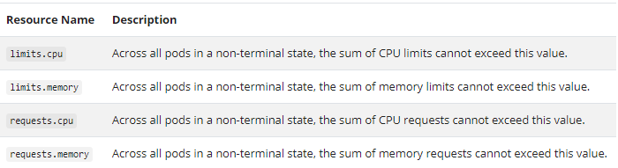
Policies
Resource Quotas
A resource quota, defined by a ResourceQuota object, provides constraints that limit aggregate resource consumption per namespace. It can limit the quantity of objects that can be created in a namespace by type, as well as the total amount of compute resources that may be consumed by resources in that project
Resource quotas work like this:
The administrator creates one ResourceQuota for each namespace.
Users create resources (pods, services, etc.) in the namespace, and the quota system tracks usage to ensure it does not exceed hard resource limits defined in a ResourceQuota.
If creating or updating a resource violates a quota constraint, the request will fail with HTTP status code 403 FORBIDDEN with a message explaining the constraint that would have been violated.
If quota is enabled in a namespace for compute resources like cpu and memory, users must specify requests or limits for those values; otherwise, the quota system may reject pod creation.
Compute Resource Quota
You can limit the total sum of compute resources that can be requested in a given namespace.

Slide 32
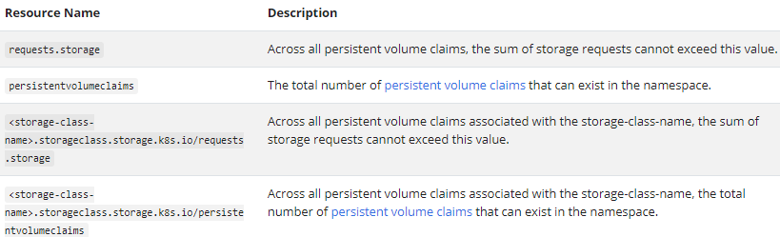
Policies (Contd.)
Resource Quota For Extended Resources
As overcommit is not allowed for extended resources, it makes no sense to specify both requests and limits for the same extended resource in a quota. So for extended resources, only quota items with prefix requests. is allowed for now
Storage Resource Quota
You can limit the total sum of storage resources that can be requested in a given namespace.

Slide 33
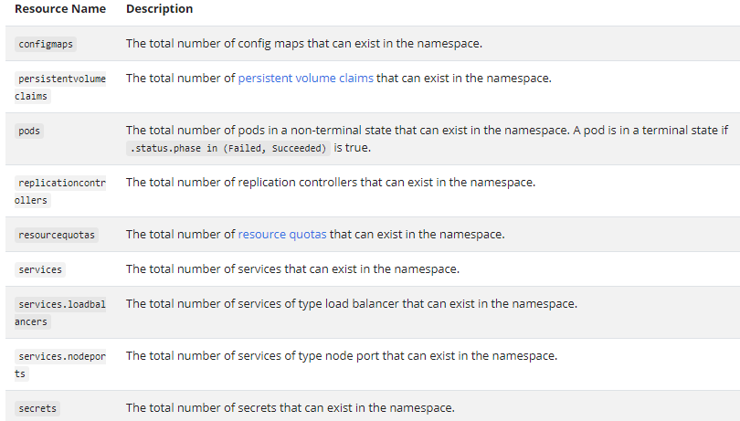
Policies (Contd.)
Object Count Quota

Slide 34
Policies (Contd.)
Limit Ranges
A LimitRange is a policy to constrain resource allocations (to Pods or Containers) in a namespace.
A LimitRange provides constraints that can:
Enforce minimum and maximum compute resources usage per Pod or Container in a namespace.
Enforce minimum and maximum storage request per PersistentVolumeClaim in a namespace.
Enforce a ratio between request and limit for a resource in a namespace.
Set default request/limit for compute resources in a namespace and automatically inject them to Containers at runtime
A LimitRange is enforced in a particular namespace when there is a LimitRange object in that namespace.
Overview of Limit Range
The administrator creates one LimitRange in one namespace.
Users create resources like Pods, Containers, and PersistentVolumeClaims in the namespace.
The LimitRanger admission controller enforces defaults and limits for all Pods and Containers that do not set compute resource requirements and tracks usage to ensure it does not exceed resource minimum, maximum and ratio defined in any LimitRange present in the namespace.
If creating or updating a resource (Pod, Container, PersistentVolumeClaim) that violates a LimitRange constraint, the request to the API server will fail with an HTTP status code 403 FORBIDDEN and a message explaining the constraint that have been violated.
LimitRange validations occurs only at Pod Admission stage, not on Running Pods.

Slide 35
Authenticating
Authenticating
All Kubernetes clusters have two categories of users:
service accounts managed by Kubernetes
normal users
Normal User:
It is assumed that a cluster-independent service manages normal users in the following ways:
an administrator distributing private keys
a user store like Keystone or Google Accounts
a file with a list of usernames and passwords
Service Account:
service accounts are users managed by the Kubernetes API.
They are bound to specific namespaces, and created automatically by the API server or manually through API calls.
Service accounts are tied to a set of credentials stored as Secrets, which are mounted into pods allowing in-cluster processes to talk to the Kubernetes API.
Every process inside or outside the cluster, from a human user typing kubectl on a workstation, to kubelets on nodes, to members of the control plane, must authenticate when making requests to the API server
Authentication strategies
You can enable multiple authentication methods at once. You should usually use at least two methods:
service account tokens for service accounts
at least one other method for user authentication.
X509 Client Certs
Static Token File
Bootstrap Tokens
Service Account Tokens
OpenID Connect Tokens
Webhook Token Authentication
Authenticating Proxy

Slide 36
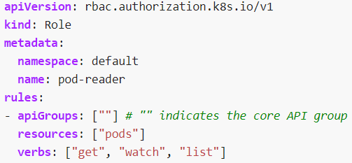
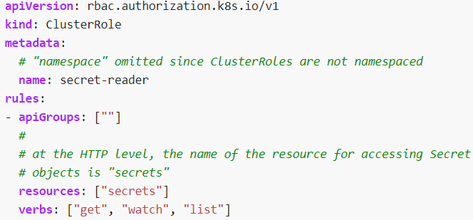
RBAC Authorization
Using RBAC Authorization
Role-based access control (RBAC) is a method of regulating access to computer or network resources based on the roles of individual users within your organization.
The RBAC API declares four kinds of Kubernetes object: Role, ClusterRole, RoleBinding and ClusterRoleBinding.
Role and ClusterRole
An RBAC Role or ClusterRole contains rules that represent a set of permissions. Permissions are purely additive (there are no "deny" rules).
A Role always sets permissions within a particular namespace; when you create a Role, you have to specify the namespace it belongs in.
ClusterRole, by contrast, is a non-namespaced resource. The resources have different names (Role and ClusterRole) because a Kubernetes object always has to be either namespaced or not namespaced; it can't be both.
ClusterRoles have several uses. You can use a ClusterRole to:
define permissions on namespaced resources and be granted within individual namespace(s)
define permissions on namespaced resources and be granted across all namespaces
define permissions on cluster-scoped resources
If you want to define a role within a namespace, use a Role; if you want to define a role cluster-wide, use a ClusterRole
Role ClusterRole

Slide 37
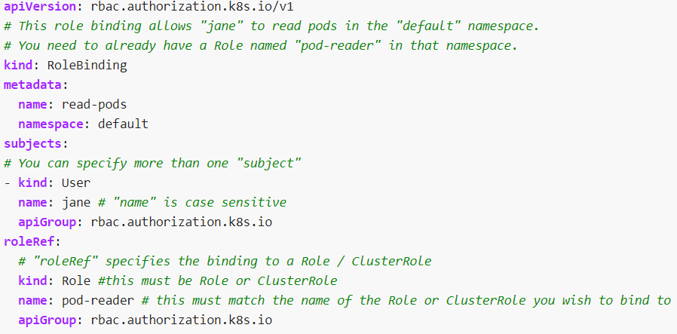
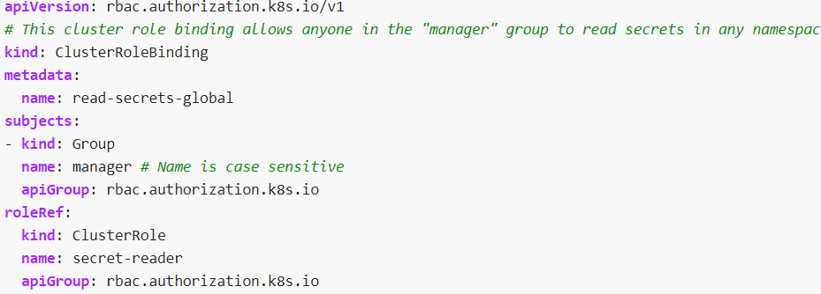
RBAC Authorization
RoleBinding and ClusterRoleBinding
A role binding grants the permissions defined in a role to a user or set of users. It holds a list of subjects (users, groups, or service accounts), and a reference to the role being granted.
A RoleBinding grants permissions within a specific namespace whereas a ClusterRoleBinding grants that access cluster-wide.
A RoleBinding may reference any Role in the same namespace. Alternatively, a RoleBinding can reference a ClusterRole and bind that ClusterRole to the namespace of the RoleBinding. If you want to bind a ClusterRole to all the namespaces in your cluster, you use a ClusterRoleBinding.
After you create a binding, you cannot change the Role or ClusterRole that it refers to. If you try to change a binding's roleRef, you get a validation error. If you do want to change the roleRef for a binding, you need to remove the binding object and create a replacement.
RoleBinding ClusterRolebinding

Slide 38
Volumes
Volumes
A Kubernetes volume has an explicit lifetime - the same as the Pod that encloses it.
Volume outlives any Containers that run within the Pod, and data is preserved across Container restarts.
When a Pod ceases to exist, the volume will cease to exist, too.
Kubernetes supports many types of volumes, and a Pod can use any number of them simultaneously.
At its core, a volume is just a directory, possibly with some data in it, which is accessible to the Containers in a Pod. How that directory comes to be, the medium that backs it, and the contents of it are determined by the particular volume type used.
To use a volume, a Pod specifies what volumes to provide for the Pod (the .spec.volumes field) and where to mount those into Containers (the .spec.containers[*].volumeMounts field).
Kubernetes supports several types of Volumes:
configMap
emptyDir
hostPath
persistentVolumeClaim
secret
etc

Slide 39
Volumes (Contd.)
hostPath
A hostPath volume mounts a file or directory from the host node's filesystem into your Pod
usecases for a hostPath are:
running a Container that needs access to Docker internals; use a hostPath of /var/lib/docker
running cAdvisor in a Container; use a hostPath of /sys
emptyDir
An emptyDir volume is first created when a Pod is assigned to a Node, and exists as long as that Pod is running on that node.
As the name says, it is initially empty. Containers in the Pod can all read and write the same files in the emptyDir volume, though that volume can be mounted at the same or different paths in each Container.
When a Pod is removed from a node for any reason, the data in the emptyDir is deleted forever.
By default, emptyDir volumes are stored on whatever medium is backing the node - that might be disk or SSD or network storage, depending on your environment. However, you can set the emptyDir.medium field to "Memory" to tell Kubernetes to mount a tmpfs (RAM-backed filesystem) for you instead.

Slide 40
Configmap
ConfigMap
A ConfigMap is an API object used to store non-confidential data in key-value pairs. Pods can consume ConfigMaps as environment variables, command-line arguments, or as configuration files in a volume.
A ConfigMap allows you to decouple environment-specific configuration from your container images, so that your applications are easily portable.
A ConfigMap is not designed to hold large chunks of data. The data stored in a ConfigMap cannot exeed 1 MiB
Unlike most Kubernetes objects that have a spec, a ConfigMap has data and binaryData fields.
There are four different ways that you can use a ConfigMap to configure a container inside a Pod:
Command line arguments to the entrypoint of a container
Environment variables for a container
Add a file in read-only volume, for the application to read
Write code to run inside the Pod that uses the Kubernetes API to read a ConfigMap
To consume a ConfigMap in a volume in a Pod:
Create a ConfigMap or use an existing one. Multiple Pods can reference the same ConfigMap.
Modify your Pod definition to add a volume under .spec.volumes[]. Name the volume anything, and have a .spec.volumes[].configMap.name field set to reference your ConfigMap object.
Add a .spec.containers[].volumeMounts[] to each container that needs the ConfigMap. Specify .spec.containers[].volumeMounts[].readOnly = true and .spec.containers[].volumeMounts[].mountPath to an unused directory name where you would like the ConfigMap to appear.
Modify your image or command line so that the program looks for files in that directory. Each key in the ConfigMap data map becomes the filename under mountPath

Slide 41
Secrets
Secrets
A Secret is an object that contains a small amount of sensitive data such as a password, a token, or a key.
To use a secret, a Pod needs to reference the secret. A secret can be used with a Pod in three ways:
As files in a volume mounted on one or more of its containers.
As container environment variable.
By the kubelet when pulling images for the Pod.
Built-in Secrets
Kubernetes automatically creates secrets which contain credentials for accessing the API and automatically modifies your Pods to use this type of secret.
To consume a Secret in a volume in a Pod:
Create a secret or use an existing one. Multiple Pods can reference the same secret.
Modify your Pod definition to add a volume under .spec.volumes[]. Name the volume anything, and have a .spec.volumes[].secret.secretName field equal to the name of the Secret object.
Add a .spec.containers[].volumeMounts[] to each container that needs the secret. Specify .spec.containers[].volumeMounts[].readOnly = true and .spec.containers[].volumeMounts[].mountPath to an unused directory name where you would like the secrets to appear.
Modify your image or command line so that the program looks for files in that directory. Each key in the secret data map becomes the filename under mountPath.

Slide 42
Persistent Volumes
Persistent Volumes
The PersistentVolume subsystem provides an API for users and administrators that abstracts details of how storage is provided from how it is consumed. To do this, kubernetes introduce two new API resources: PersistentVolume and PersistentVolumeClaim.
A PersistentVolume (PV) is a piece of storage in the cluster that has been provisioned by an administrator or dynamically provisioned using Storage Classes. It is a resource in the cluster just like a node is a cluster resource. This API object captures the details of the implementation of the storage, be that NFS, iSCSI, or a cloud-provider-specific storage system.
A PersistentVolumeClaim (PVC) is a request for storage by a user. It is similar to a Pod. Pods consume node resources and PVCs consume PV resources. Pods can request specific levels of resources (CPU and Memory). Claims can request specific size and access modes (e.g., they can be mounted ReadWriteOnce, ReadOnlyMany or ReadWriteManys).
Lifecycle of a volume and claim
Provisioning
Static
A cluster administrator creates a number of PVs. They carry the details of the real storage, which is available for use by cluster users
Dynamic
When none of the static PVs the administrator created match a user's PersistentVolumeClaim, the cluster may try to dynamically provision a volume specially for the PVC. This provisioning is based on StorageClasses: the PVC must request a storage class and the administrator must have created and configured that class for dynamic provisioning to occur.

Slide 43
Persistent Volumes (Contd.)
Binding
A control loop in the master watches for new PVCs, finds a matching PV (if possible), and binds them together.
If a PV was dynamically provisioned for a new PVC, the loop will always bind that PV to the PVC. Otherwise
The user will always get at least what they asked for, but the volume may be in excess of what was requested.
Once bound, PersistentVolumeClaim binds are exclusive, regardless of how they were bound. A PVC to PV binding is a one-to-one mapping, using a ClaimRef which is a bi-directional binding between the PersistentVolume and the PersistentVolumeClaim.
Using
Pods use claims as volumes. The cluster inspects the claim to find the bound volume and mounts that volume for a Pod.
If a user deletes a PVC in active use by a Pod, the PVC is not removed immediately. PVC removal is postponed until the PVC is no longer actively used by any Pods. Also, if an admin deletes a PV that is bound to a PVC, the PV is not removed immediately. PV removal is postponed until the PV is no longer bound to a PVC.
Reclaiming
When a user is done with their volume, they can delete the PVC objects from the API that allows reclamation of the resource. The reclaim policy for a PersistentVolume tells the cluster what to do with the volume after it has been released of its claim. Currently, volumes can either be Retained, Recycled, or Deleted.
Retain
The Retain reclaim policy allows for manual reclamation of the resource. When the PersistentVolumeClaim is deleted, the PersistentVolume still exists and the volume is considered "released". But it is not yet available for another claim because the previous claimant's data remains on the volume. An administrator can manually reclaim the volume
Delete
For volume plugins that support the Delete reclaim policy, deletion removes both the PersistentVolume object from
Kubernetes, as well as the associated storage asset in the external infrastructure
Recycle
Delete the content and make it eligible for re use by another PV

Slide 44
Persistent Volumes (Contd.)
Types of Persistent Volumes
PersistentVolume types are implemented as plugins. Kubernetes currently supports the following plugins:
GCEPersistentDisk
AWSElasticBlockStore
AzureFile
AzureDisk
CSI
FC (Fibre Channel)
FlexVolume
Flocker
NFS
iSCSI
RBD (Ceph Block Device)
CephFS
Cinder (OpenStack block storage)
Glusterfs
VsphereVolume
Quobyte Volumes
HostPath (Single node testing only -- local storage is not supported in any way and WILL NOT WORK in a multi-node cluster)
Portworx Volumes
ScaleIO Volumes
StorageOS

Slide 45
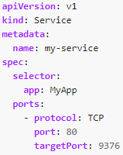
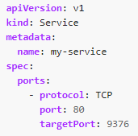
Services & Load Balancing
Services, Load Balancing, and Networking
Containers within a Pod use networking to communicate via loopback.
Cluster networking provides communication between different Pods.
The Service resource lets you expose an application running in Pods to be reachable from outside your cluster.
You can also use Services to publish services only for consumption inside your cluster.
Service
An abstract way to expose an application running on a set of Pods as a network service. Kubernetes gives Pods their own IP addresses and a single DNS name for a set of Pods, and can load-balance across them.
Use Case of a Service:
Consider a stateless image-processing backend which is running with 3 replicas. Those replicas are fungible—frontends do not care which backend they use. While the actual Pods that compose the backend set may change, the frontend clients should not need to be aware of that, nor should they need to keep track of the set of backends themselves.
Defining a Service
Service without Selector

Slide 46
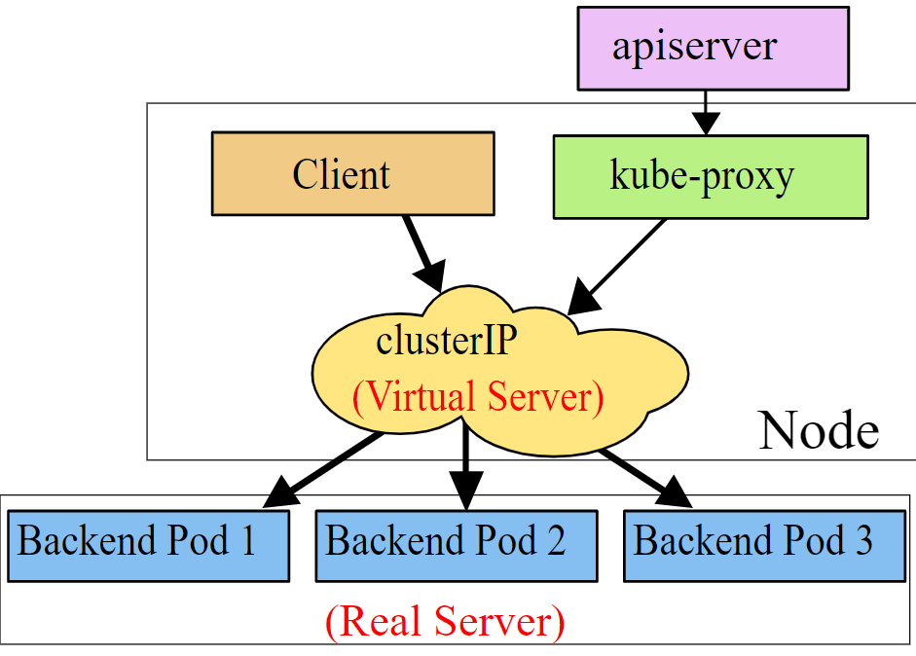
Services & Load Balancing (Contd.)
Virtual IPs and service proxies

Slide 47
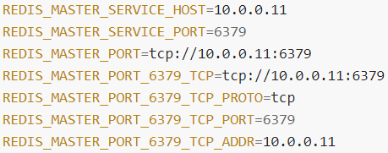
Services & Load Balancing (Contd.)
Discovering services
Kubernetes supports 2 primary modes of finding a Service - environment variables and DNS.
Environment variables
When a Pod is run on a Node, the kubelet adds a set of environment variables for each active Service.
For example, the Service redis-master which exposes TCP port 6379 and has been allocated cluster IP address 10.0.0.11, produces the following environment variables:
When you have a Pod that needs to access a Service, and you are using the environment variable method to publish the port and cluster IP to the client Pods, you must create the Service before the client Pods come into existence. Otherwise, those client Pods won't have their environment variables populated.
DNS
A cluster-aware DNS server, such as CoreDNS, watches the Kubernetes API for new Services and creates a set of DNS records for each one. If DNS has been enabled throughout your cluster then all Pods should automatically be able to resolve Services by their DNS name
For example, if you have a Service called my-service in a Kubernetes namespace my-ns, the control plane and the DNS Service acting together create a DNS record for my-service.my-ns. Pods in the my-ns namespace should be able to find it by simply doing a name lookup for my-service (my-service.my-ns would also work).
Pods in other namespaces must qualify the name as my-service.my-ns. These names will resolve to the cluster IP assigned for the Service.

Slide 48
Services & Load Balancing (Contd.)
Headless Services
Sometimes you don't need load-balancing and a single Service IP. In this case, you can create what are termed "headless" Services, by explicitly specifying "None" for the cluster IP (.spec.clusterIP).
For headless Services, a cluster IP is not allocated, kube-proxy does not handle these Services, and there is no load balancing or proxying done by the platform for them.
How DNS is automatically configured depends on whether the Service has selectors defined:
With selectors
For headless Services that define selectors, the endpoints controller creates Endpoints records in the API, and modifies the DNS configuration to return records (addresses) that point directly to the Pods backing the Service.
Without selectors
For headless Services that do not define selectors, the endpoints controller does not create Endpoints records. However, the DNS system looks for and configures either:
CNAME records for ExternalName-type Services.
A records for any Endpoints that share a name with the Service, for all other types.
Publishing Services (ServiceTypes)
Kubernetes ServiceTypes allow you to specify what kind of Service you want. The default is ClusterIP.
Type values and their behaviors are:
ClusterIP: Exposes the Service on a cluster-internal IP. Choosing this value makes the Service only reachable from within the cluster. This is the default ServiceType.
NodePort: Exposes the Service on each Node's IP at a static port (the NodePort). A ClusterIP Service, to which the NodePort Service routes, is automatically created. You'll be able to contact the NodePort Service, from outside the cluster, by requesting <NodeIP>:<NodePort>.
LoadBalancer: Exposes the Service externally using a cloud provider's load balancer. NodePort and ClusterIP Services, to which the external load balancer routes, are automatically created.
ExternalName: Maps the Service to the contents of the externalName field (e.g. foo.bar.example.com), by returning a CNAME record with its value. No proxying of any kind is set up.

Slide 49
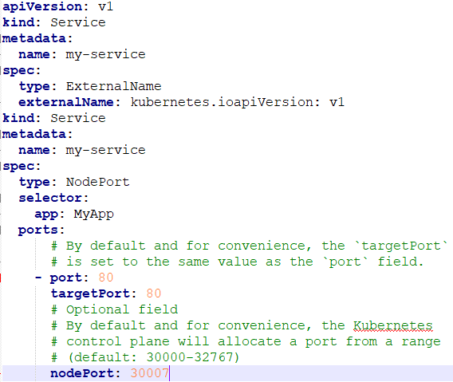
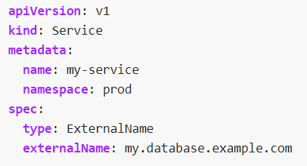
Services & Load Balancing (Contd.)
Type NodePort
If you set the type field to NodePort, the Kubernetes control plane allocates a port from a range specified by --service-node-port-range flag (default: 30000-32767). Each node proxies that port (the same port number on every Node) into your Service. Your Service reports the allocated port in its .spec.ports[*].nodePort field
If you want to specify particular IP(s) to proxy the port, you can set the --nodeport-addresses flag in kube-proxy to particular IP block(s); this is supported since Kubernetes v1.10.
If you want a specific port number, you can specify a value in the nodePort field. The control plane will either allocate you that port or report that the API transaction failed. This means that you need to take care of possible port collisions yourself. You also have to use a valid port number, one that's inside the range configured for NodePort use.
Type ExternalName
Services of type ExternalName map a Service to a DNS name, not to a typical selector such as my-service or cassandra. You specify these Services with the spec.externalName parameter.
ExternalName accepts an IPv4 address string, but as a DNS names comprised of digits, not as an IP address. ExternalNames that resemble IPv4 addresses are not resolved by CoreDNS or ingress-nginx because ExternalName is intended to specify a canonical DNS name. To hardcode an IP address, consider using headless Services.
NodePort
External Name

Slide 50
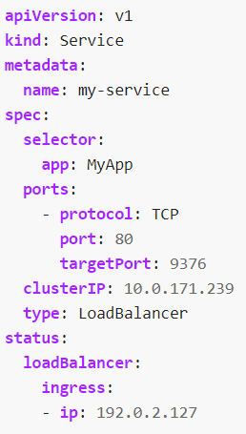
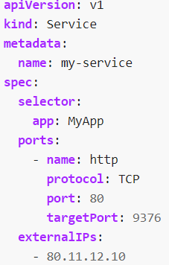
Services & Load Balancing (Contd.)
Type LoadBalancer
On cloud providers which support external load balancers, setting the type field to LoadBalancer provisions a load balancer for your Service. The actual creation of the load balancer happens asynchronously, and information about the provisioned balancer is published in the Service's .status.loadBalancer field.
External IPs
If there are external IPs that route to one or more cluster nodes, Kubernetes Services can be exposed on those externalIPs. Traffic that ingresses into the cluster with the external IP (as destination IP), on the Service port, will be routed to one of the Service endpoints. externalIPs are not managed by Kubernetes and are the responsibility of the cluster administrator.
Load Balancer
External IPs

Slide 51
DNS for Services & Pods
DNS for Services and Pods
Kubernetes DNS schedules a DNS Pod and Service on the cluster, and configures the kubelets to tell individual containers to use the DNS Service's IP to resolve DNS names
Every Service defined in the cluster (including the DNS server itself) is assigned a DNS name.
By default, a client Pod's DNS search list will include the Pod's own namespace and the cluster's default domain. This is best illustrated by example:
Assume a Service named foo in the Kubernetes namespace bar. A Pod running in namespace bar can look up this service by simply doing a DNS query for foo. A Pod running in namespace quux can look up this service by doing a DNS query for foo.bar.
Services
"Normal" (not headless) Services are assigned a DNS A or AAAA record, depending on the IP family of the service, for a name of the form my-svc.my-namespace.svc.cluster-domain.example. This resolves to the cluster IP of the Service.
"Headless" (without a cluster IP) Services are also assigned a DNS A or AAAA record, depending on the IP family of the service, for a name of the form my-svc.my-namespace.svc.cluster-domain.example. Unlike normal Services, this resolves to the set of IPs of the pods selected by the Service.
Pods
In general a pod has the following DNS resolution: pod-ip-address.my-namespace.pod.cluster-domain.example.
For example, if a pod in the default namespace has the IP address 172.17.0.3, and the domain name for your cluster is cluster.local, then the Pod has a DNS name:
172-17-0-3.default.pod.cluster.local.
Any pods created by a Deployment or DaemonSet exposed by a Service have the following DNS resolution available:
pod-ip-address.deployment-name.my-namespace.svc.cluster-domain.example

Slide 52
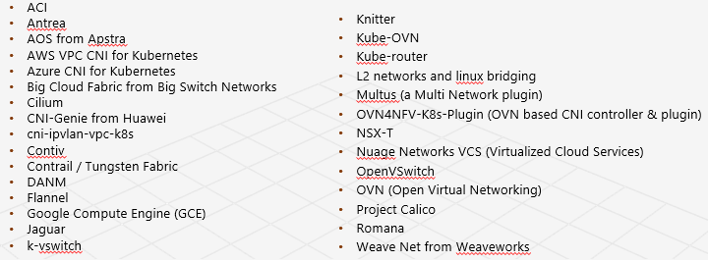
Cluster Networking
Cluster Networking
This helps to define how communication between Pod-to-Pod in a Kubernetes cluster
Every Pod gets its own IP address.
Kubernetes IP addresses exist at the Pod scope - containers within a Pod share their network namespaces - including their IP address.
This means that containers within a Pod can all reach each other's ports on localhost.
This also means that containers within a Pod must coordinate port usage, but this is no different from processes in a VM. This is called the "IP-per-pod" model.
Kubernetes network model
Kubernetes imposes the following fundamental requirements on any networking implementation
pods on a node can communicate with all pods on all nodes without NAT
agents on a node (e.g. system daemons, kubelet) can communicate with all pods on that node
pods in the host network of a node can communicate with all pods on all nodes without NAT
How to implement the Kubernetes networking model

Slide 53
Network Policies
Network Policies
If you want to control traffic flow at the IP address or port level (OSI layer 3 or 4), then you might consider using Kubernetes NetworkPolicies for particular applications in your cluster.
NetworkPolicies are an application-centric construct which allow you to specify how a pod is allowed to communicate with various network "entities" over the network.
The entities that a Pod can communicate with are identified through a combination of the following 3 identifiers:
Other pods that are allowed (exception: a pod cannot block access to itself)
Namespaces that are allowed
IP blocks (exception: traffic to and from the node where a Pod is running is always allowed, regardless of the IP address of the Pod or the node)
When defining a pod- or namespace- based NetworkPolicy, you use a selector to specify what traffic is allowed to and from the Pod(s) that match the selector.
Meanwhile, when IP based NetworkPolicies are created, we define policies based on IP blocks (CIDR ranges)
Isolated and Non-isolated Pods
By default, pods are non-isolated; they accept traffic from any source.
Pods become isolated by having a NetworkPolicy that selects them. Once there is any NetworkPolicy in a namespace selecting a particular pod, that pod will reject any connections that are not allowed by any NetworkPolicy. (Other pods in the namespace that are not selected by any NetworkPolicy will continue to accept all traffic.)
Network policies do not conflict; they are additive. If any policy or policies select a pod, the pod is restricted to what is allowed by the union of those policies' ingress/egress rules. Thus, order of evaluation does not affect the policy result

Slide 54
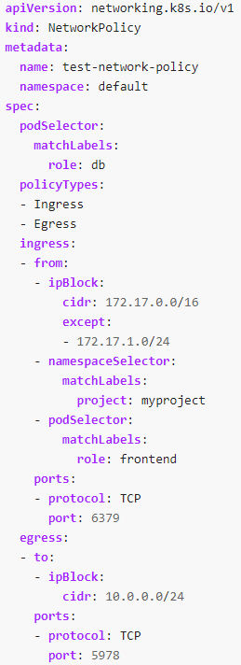
Network Policies (Contd.)
podSelector: Each NetworkPolicy includes a podSelector which selects the grouping of pods to which the policy applies. The example policy selects pods with the label "role=db". An empty podSelector selects all pods in the namespace.
policyTypes: Each NetworkPolicy includes a policyTypes list which may include either Ingress, Egress, or both. The policyTypes field indicates whether or not the given policy applies to ingress traffic to selected pod, egress traffic from selected pods, or both. If no policyTypes are specified on a NetworkPolicy then by default Ingress will always be set and Egress will be set if the NetworkPolicy has any egress rules.
ingress: Each NetworkPolicy may include a list of allowed ingress rules. Each rule allows traffic which matches both the from and ports sections. The example policy contains a single rule, which matches traffic on a single port, from one of three sources, the first specified via an ipBlock, the second via a namespaceSelector and the third via a podSelector.
egress: Each NetworkPolicy may include a list of allowed egress rules. Each rule allows traffic which matches both the to and ports sections. The example policy contains a single rule, which matches traffic on a single port to any destination in 10.0.0.0/24.
So, the example NetworkPolicy:
isolates "role=db" pods in the "default" namespace for both ingress and egress traffic (if they weren't already isolated)
(Ingress rules) allows connections to all pods in the "default" namespace with the label "role=db" on TCP port 6379 from:
any pod in the "default" namespace with the label "role=frontend"
any pod in a namespace with the label "project=myproject"
IP addresses in the ranges 172.17.0.0–172.17.0.255 and 172.17.2.0–172.17.255.255 (ie, all of 172.17.0.0/16 except 172.17.1.0/24)
(Egress rules) allows connections from any pod in the "default" namespace with the label "role=db" to CIDR 10.0.0.0/24 on TCP port 5978

Slide 55
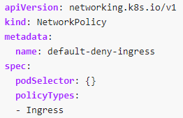
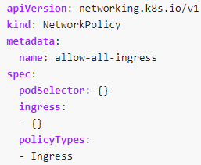
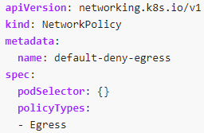
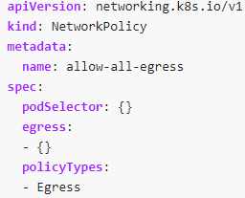
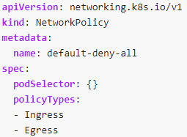
Network Policies (Contd.)
Default deny all ingress traffic
You can create a "default" isolation policy for a namespace by creating a NetworkPolicy that selects all pods but does not allow any ingress traffic to those pods.
Default allow all ingress traffic
If you want to allow all traffic to all pods in a namespace (even if policies are added that cause some pods to be treated as "isolated"), you can create a policy that explicitly allows all traffic in that namespace.
Default deny all egress traffic
You can create a "default" egress isolation policy for a namespace by creating a NetworkPolicy that selects all pods but does not allow any egress traffic from those pods.
Default allow all egress traffic
If you want to allow all traffic from all pods in a namespace (even if policies are added that cause some pods to be treated as "isolated"), you can create a policy that explicitly allows all egress traffic in that namespace.
Default deny all ingress and all egress traffic
You can create a "default" policy for a namespace which prevents all ingress AND egress traffic by creating the following NetworkPolicy in that namespace.

Slide 56
Setup Kubernetes Cluster
The following solutions are available to setup a production grade Kubernetes cluster
Installing Kubernetes with deployment tools
Bootstrapping clusters with kubeadm
Installing Kubernetes with kops
Installing Kubernetes with Kubespray
Turnkey Cloud Solutions
Running Kubernetes on Alibaba Cloud
Running Kubernetes on AWS EC2
Running Kubernetes on Azure
Running Kubernetes on Google Compute Engine
Running Kubernetes on Multiple Clouds with IBM Cloud Private
Running Kubernetes on Tencent Kubernetes Engine

Slide 57
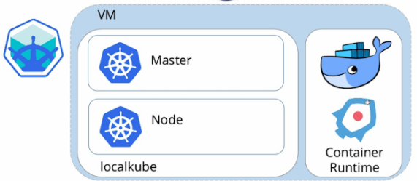
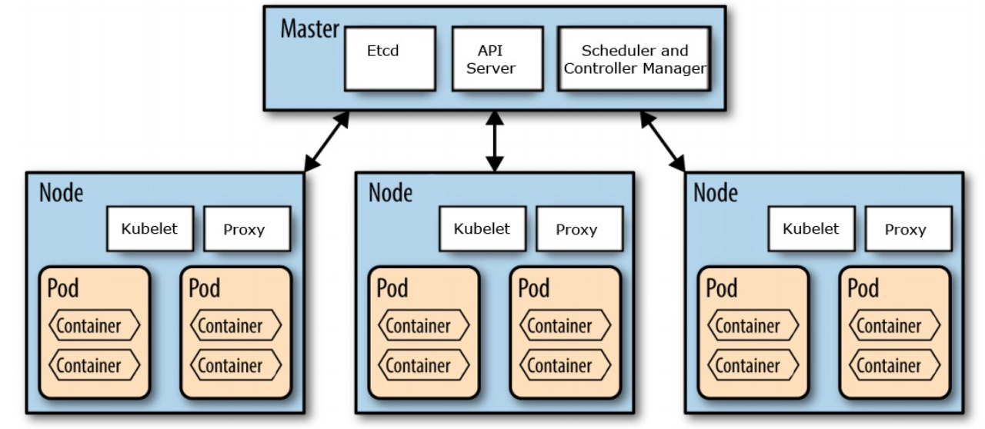
Setup Kubernetes Cluster (Cont.)
Options for Non - Highly Available topology :
- A single VM hosts all the kubernetes components
- Good use case for learning environment
Minikube
- One Control plan, single point of failure for the complete cluster
- Not recommended for hosting production applications
Single Control plan setup

Slide 58
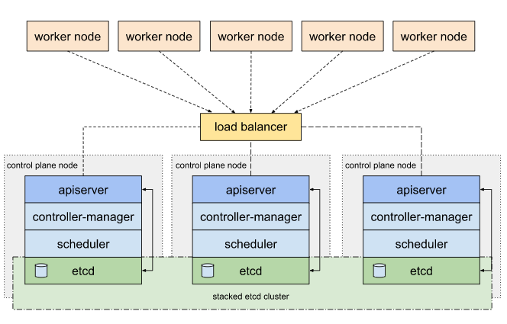
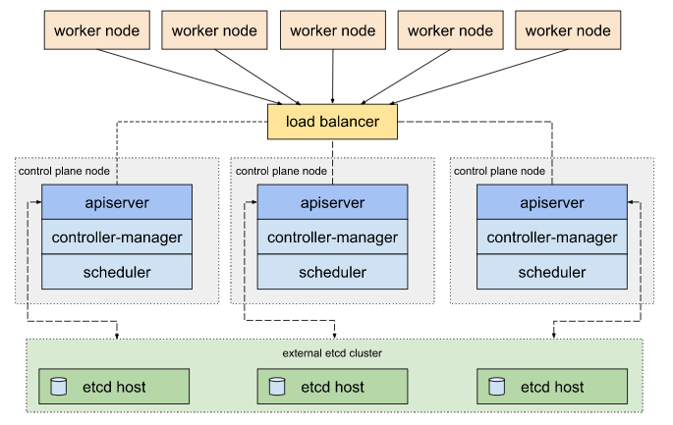
Setup Kubernetes Cluster (Cont.)
Options for Highly Available topology
Stacked etcd topology
etcd members are co-located with control plane components
etcd on each node interacts with the kube-apiserver on that node only
External etcd topology
etcd are not co-located with control plane nodes
Kube-apiserver on each node interacts with all the etcd members cluster
Stacked etcd topology External etcd topology

Slide 59
Kubernetes with Minikube
Minikube is a tool that makes it easy to run Kubernetes locally. Minikube runs a single-node Kubernetes cluster inside a Virtual Machine (VM) on your laptop for users looking to try out Kubernetes or develop with it day-to-day
Minikube supports the following Kubernetes features:
DNS
NodePorts
ConfigMaps and Secrets
Dashboards
Container Runtime: Docker, CRI-O, and containerd
Enabling CNI (Container Network Interface)
Ingress
Supported OS:
Windows
Mac
Linux
Install and Setup Minikube :
Install kubectl - https://kubernetes.io/docs/tasks/tools/install-kubectl/#install-kubectl-on-windows
Install Hypervisor - https://www.virtualbox.org/wiki/Downloads
Install Minikube - https://github.com/kubernetes/minikube/releases/latest/download/minikube-installer.exe

Slide 60
Kubernetes with Minikube (Cont.)
minikube start --driver=<driver-name>
This command creates and configures a Virtual Machine that runs a single-node Kubernetes cluster. This command also configures your kubectl installation to communicate with this cluster.
Working with minikube :
kubectl create deployment hello-minikube --image=k8s.gcr.io/echoserver:1.10
kubectl expose deployment hello-minikube --type=NodePort --port=8080
kubectl get pod
minikube service hello-minikube --url
kubectl delete services hello-minikube
kubectl delete deployment hello-minikube
minikube stop
minikube delete
kubectl config use-context minikube
minikube dashboard
minikube service [-n NAMESPACE] [--url] NAME
minikube ssh
Ref: https://kubernetes.io/docs/setup/learning-environment/minikube/

Slide 61
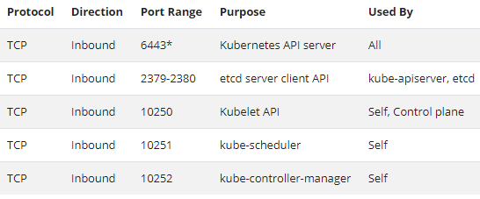
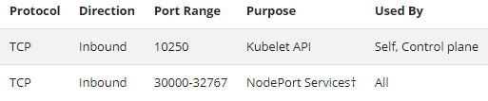
Bootstrapping clusters with kubeadm
Pre-requisites for cluster setup :
One or more machines running one of:
Ubuntu 16.04+
Debian 9+
CentOS 7 / Red Hat Enterprise Linux (RHEL) 7
Fedora 25+
HypriotOS v1.0.1+
Flatcar Container Linux (tested with 2512.3.0)
2 GB or more of RAM per machine & 2 CPUs or more
Full network connectivity between all machines in the cluster (public or private network is fine)
Unique hostname, MAC address, and product_uuid for every node.
Swap disabled
Certain ports are open on your machines
Control plan nodes Worker nodes

Slide 62
Bootstrapping clusters with kubeadm (Cont.)
Installing runtime
Supported Container runtime interfaces
Docker
CRI-O
Continerd
frakti
Install docker: https://kubernetes.io/docs/setup/production-environment/container-runtimes/
Installing kubeadm, kubelet and kubectl
Instructions to install: https://kubernetes.io/docs/setup/production-environment/tools/kubeadm/install-kubeadm/
Setup single Control plane cluster:
kubeadm init --apiserver-advertise-address=<IP Address of Control plane node> --control-plane-endpoint=<Control plane VIP IP> --pod-network-cidr=<POD IP CIDR> --service-cidr=<Service IP CIDR> - Run this command on Control plane node
kubeadm join <API Server Endpoint> --token <bootstrap-token> --discovery-token-ca-cert-hash <CA hash> - Run this on each worker node
Install Kubernetes addon’s:
Pod Network:
curl https://docs.projectcalico.org/manifests/canal.yaml -O
kubectl apply -f canal.yaml
Dashboard:
curl https://raw.githubusercontent.com/kubernetes/dashboard/v2.0.4/aio/deploy/recommended.yaml -O
kubectl apply -f recommended.yaml

Slide 63
Bootstrapping clusters with kubeadm (Cont.)
What’s exactly “kubeadm init” is does ?

Slide 64
Kubernetes Version Skew
Kubernetes versions are expressed as x.y.z, where x is the major version, y is the minor version, and z is the patch version
The Kubernetes project maintains release branches for the most recent three minor releases (1.19, 1.18, 1.17). Kubernetes 1.19 and newer receive approximately 1 year of patch support. Kubernetes 1.18 and older received approximately 9 months of patch support.
kube-apiserver
newest kube-apiserver is at 1.19
other kube-apiserver instances are supported at 1.19 and 1.18
kubelet & kube-proxy
Kubelet & kube-proxy must not be newer than kube-apiserver, and may be up to two minor versions older.
Kubelet & kube-proxy should be at same version on the node
If, kube-apiserver is at 1.19 -> kubelet is supported at 1.19, 1.18, and 1.17
If kube-apiserver instances are at 1.19 and 1.18 -> kubelet is supported at 1.18, and 1.17 (1.19 is not supported because that would be newer than the kube-apiserver instance at version 1.18)
kube-controller-manager, kube-scheduler, and cloud-controller-manager
kube-controller-manager, kube-scheduler, and cloud-controller-manager must not be newer than the kube-apiserver instances they communicate with
If, kube-apiserver is at 1.19 -> kube-controller-manager, kube-scheduler, and cloud-controller-manager are supported at 1.19 and 1.18
Kubectl
kubectl is supported within one minor version (older or newer) of kube-apiserver
If kube-apiserver is at 1.19 -> kubectl is supported at 1.20, 1.19, and 1.18
If kube-apiserver instances are at 1.19 and 1.18 -> kubectl is supported at 1.19 and 1.18

Slide 65
Supported component upgrade order
kube-apiserver
In a single-instance cluster, the existing kube-apiserver instance is 1.18
In an HA cluster, all kube-apiserver instances are at 1.18 or 1.19 (this ensures maximum skew of 1 minor version between the oldest and newest kube-apiserver instance)
The kube-controller-manager, kube-scheduler, and cloud-controller-manager instances that communicate with this server are at version 1.18 (this ensures they are not newer than the existing API server version, and are within 1 minor version of the new API server version)
kubelet instances on all nodes are at version 1.18 or 1.17 (this ensures they are not newer than the existing API server version, and are within 2 minor versions of the new API server version)
kube-controller-manager, kube-scheduler, and cloud-controller-manager
The kube-apiserver instances these components communicate with are at 1.19 (in HA clusters in which these control plane components can communicate with any kube-apiserver instance in the cluster, all kube-apiserver instances must be upgraded before upgrading these components)
Upgrade kube-controller-manager, kube-scheduler, and cloud-controller-manager to 1.19
kubelet
The kube-apiserver instances the kubelet communicates with are at 1.19
Optionally upgrade kubelet instances to 1.19 (or they can be left at 1.18 or 1.17)
kube-proxy
kube-proxy must be the same minor version as kubelet on the node.
kube-proxy must not be newer than kube-apiserver.
kube-proxy must be at most two minor versions older than kube-apiserver
Ref: https://github.com/kubernetes/sig-release/blob/master/releases/patch-releases.md

Slide 66
Questions ?

