Slide 1
ECONOMIC BURDEN OF VTE
PE
DVT
MI
Stroke
$12,148
$7001
$12,680
$11,514
0 $2500 $5000 $7500 $10,000 $12,500 5,000
Inpatient Costs
MI = Myocardial Infarction
AHRQ – Statistics from the HCUP-3 nationwide inpatient sample for 1994: DRG.
Available at http://www.ahrq.gov/data.hcup/94drgs.htm. Accessed April 7, 2004.

Slide 2
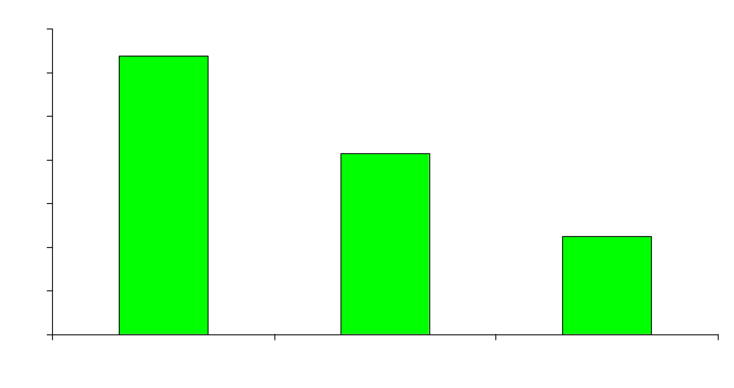
Cost of COPD in United States in 2000
$Billions
Costs
10% of people with COPD responsible for >70% of COPD-related
medical care costs. In-patient hospitalization and emergency department
care accounts for >73% of this cost
COPD costs $1,522 per person per year (3 times asthma costs)
American Lung Association, 2001

Slide 3

VTE OFTEN DETECTED TOO LATE
At least 70% of fatal PE
detected post-mortem
was not suspected
or diagnosed^{1,2}
30%
At autopsy, approximately 63% of DVT cases were clinically undiagnosed²
70%
1. Stein PD, et al. Chest 1995;110:978-981.
2. Sandler DA, et al. J R Soc Med 1989;82:203-205.
Notes:
One possible interpretation is that we could assess our patients for the development of VTE and then treat the patient when a DVT or PE occurs.
However, the problem with such an approach is that VTE diagnosis may be difficult and often goes undetected until it is too late. At least 70% of the time, a fatal PE is not detected until post-mortem. Studies have also shown that at autopsy, approximately 63% of DVT cases were clinically undiagnosed.
The 2001 ACCP Consensus Conference publication states that it is inappropriate to wait for the symptoms and then rely on the diagnosis and treatment of established VTE.
So what available evidence do we have to clue us into, or point to, the types of patients who are at risk for VTE that enter our hospitals?

Slide 4

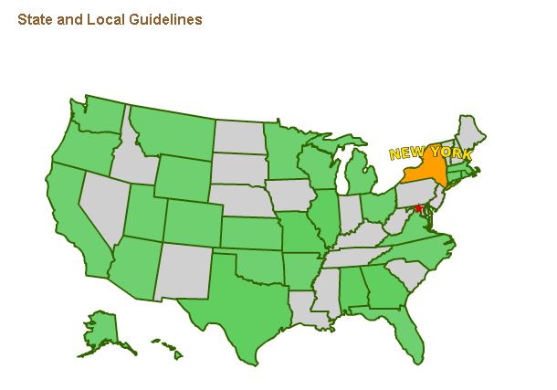
Notes:
The actually map is now all green as there is information about billing, coding and reimbursement for every state. To access information for a particular state; just click on the state on the map.

