Slide 1
Modernizing Enterprise Apps with App Platforms
An 8-hour hands-on workshop — App Service, containers, low-code + AI, GitHub Copilot .NET modernization, and Application Insights observability
Microsoft Canada · MAPAQ Modernization Workshop

Slide 2
Agenda — a full day, eight blocks
• 0 · Welcome, objectives & personas (30 min)
• 1 · Shared understanding of app modernization (45 min)
• 2 · Modernization strategy & decisions (45 min)
• 3 · Accelerate with low-code + AI · Copilot .NET agent (60 min)
• 4 · Provision & the App Service blade deep-dive (75 min)
• 5 · Instrumentation: browser → web → API → SQL (60 min)
• 6 · Application Insights — the one-hour deep dive (60 min)
• 7 · Cost, alerts, teardown & next steps (45 min)
Notes:
Roughly 8 hours with breaks and lunch. Modules 4 and 6 are the centerpieces — protect their time. Each module pairs slides with a live demo or a lab.

Slide 3
What you will be able to do
• Identify and define the digital skills your transformation needs
• Build a skilling plan mapped to each customer persona
• Enable key roles to take on Cloud Challenges through new ways of working
• Share a common language for modern application modernization
• Make an informed modernization strategy decision
• Accelerate delivery using low-code and AI
Notes:
These six objectives are the spine of the day. Reread them at each module boundary so the room can see the throughline.

Slide 4
Who is in the room
• Business & IT decision makers — fund and prioritize
• Enterprise & solution architects — choose the target platform
• Developers & DevOps engineers — build and ship
• Operations & SRE — run and observe
• Change & enablement leads — grow the skills
Notes:
Ask for a show of hands per persona. You will tailor emphasis: architects care about strategy slides, developers about Copilot and instrumentation, ops about App Service scaling and App Insights.

Slide 5
Digital skills for transformation
• Cloud fluency — IaaS vs PaaS vs containers vs serverless
• Modern .NET — ASP.NET Core, EF Core, minimal APIs
• Observability — telemetry, tracing, KQL, dashboards
• Automation — IaC (Bicep), CI/CD, azd
• AI-assisted engineering — Copilot, modernization agents
Notes:
Frame skills as capabilities, not certifications. Each capability maps to a hands-on activity later today.

Slide 6
A skilling plan by persona
• Decision makers → value framing, TCO, risk & compliance
• Architects → platform selection, the 5 Rs, reference architectures
• Developers → modern .NET, Copilot agent, instrumentation
• Ops / SRE → App Service operations, scaling, App Insights, alerts
• Enablement → labs, brown-bags, an internal community of practice
Notes:
This slide is the deliverable many sponsors want. Encourage attendees to leave with a draft plan for their own org.

Slide 7
Enabling roles for Cloud Challenges
• Cloud Challenges = time-boxed, real-workload skilling sprints
• Pair each role with a concrete deliverable from today's app
• Architects own the target design; developers own a migrated module
• Ops own a working dashboard and an alert; everyone learns by doing
• Celebrate completion — momentum compounds
Notes:
Position the workshop itself as a Cloud Challenge: by end of day each persona walks away with something they built.

Slide 8
New ways of working
• Infrastructure as code — environments are reproducible (azd up / azd down)
• Trunk-based, small PRs, automated checks
• Observability-driven development — instrument first, optimize with data
• AI in the loop — Copilot for code, modernization agent for upgrades
• You build it, you run it — dev and ops share the dashboard
Notes:
Contrast with the legacy ticket-and-handoff model. Everything we do today is reproducible and observable.

Slide 9
What 'modernization' actually means
• Not a rewrite by default — a spectrum of options
• Move the workload to a platform that removes undifferentiated heavy lifting
• Adopt managed services for identity, data, and observability
• Improve developer velocity, reliability, security, and cost
• Outcome over output — measure business impact
Notes:
Defuse the fear that modernization = full rewrite. Most value comes from rehost/replatform plus targeted refactors.

Slide 10
Why modernize now
• End-of-support runtimes and OS — security & compliance risk
• Slow, manual releases — long lead time to change
• Scaling pain — vertical-only, fixed capacity, weekend firefights
• Limited observability — mean-time-to-know is hours, not seconds
• Cost — paying for idle, oversized VMs
Notes:
Have the room call out which driver is loudest for them. You will tie each back to an App Service or App Insights capability.

Slide 11
The Azure app platform landscape
• App Service — managed web apps & APIs, fastest path for .NET
• Azure Container Apps — serverless containers, scale-to-zero, microservices
• AKS — full Kubernetes when you need maximum control
• Azure Functions — event-driven, consumption serverless
• Today's target: App Service running .NET containers from ACR
Notes:
Right-size the platform to the team. We chose App Service for MAPAQ: PaaS simplicity, container flexibility, built-in scale and diagnostics.

Slide 12
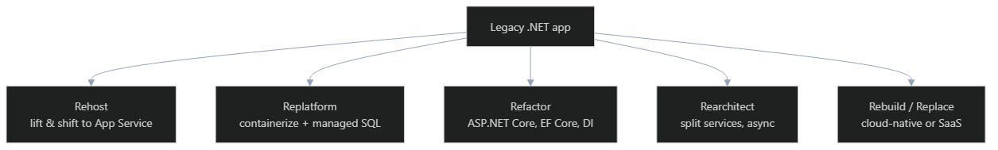
The modernization strategy — the 5 Rs
Notes:
MAPAQ today is Replatform + targeted Refactor: containerized .NET 10 on App Service, Entra-only SQL, modern instrumentation. Walk left-to-right: effort and value both increase.

Slide 13
Making an informed decision
• Assess: runtime version, dependencies, statefulness, data gravity
• Score each app: business value × technical risk
• Pick the lowest-effort R that unblocks the business outcome
• Prove it on one app end-to-end before scaling the pattern
• Tools: .NET Upgrade Assistant + GitHub Copilot modernization agent
Notes:
Decision-making is iterative and non-linear: you may rehost first, then refactor later. Today MAPAQ is our proof app.

Slide 14
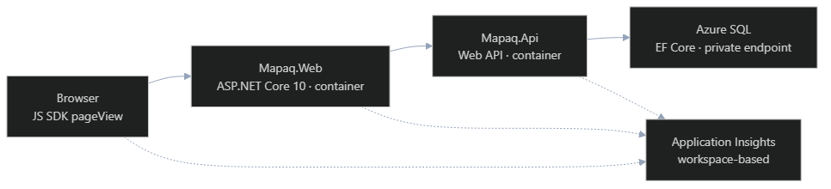
MAPAQ — our reference architecture
Notes:
This is exactly what is deployed in rg-dev-001: two .NET containers on App Service (P1v3), Entra-only Azure SQL behind a private endpoint, one workspace-based Application Insights resource.

Slide 15
Accelerate with low-code + AI
• Low-code (Power Platform) for surrounding apps, portals, and workflow
• AI-assisted coding shifts effort from typing to reviewing
• Copilot for everyday code, tests, and docs
• Specialized agents for whole-project upgrades and migrations
• Humans stay in control — review every change
Notes:
Position AI as a force multiplier, not a replacement. The modernization agent we show next does the heavy, repetitive upgrade work.

Slide 16
GitHub Copilot in VS Code
• Inline completions and chat grounded in your codebase
• Agent mode — multi-step tasks with tool use
• Skills and MCP tools extend what Copilot can do
• Works with your repo, terminal, tests, and Azure tooling
• Already installed in this workshop environment
Notes:
Open VS Code and show the Copilot chat panel. Confirm the C# Dev Kit and the modernization extension are present.

Slide 17
GitHub Copilot app modernization for .NET
• Installed as a VS Code extension in this lab
• Assesses the solution and proposes an upgrade plan
• Automates target-framework upgrades and package updates
• Fixes breaking changes and explains each edit
• Tracks progress through a dashboard with tasks
Notes:
This is the GitHub Copilot app modernization - upgrade for .NET tooling. It drives the upgrade end-to-end while you review. Highlight that it works task-by-task, not in one risky bang.

Slide 18
How the modernization agent works
Notes:
Emphasize the loop: apply → build → test → fix. The agent iterates until the project compiles and tests pass, then moves to the next project in topological order.

Slide 19
Demo — run the .NET modernization agent
• 1 · Open the solution; start the modernization agent
• 2 · Review the generated assessment & upgrade options
• 3 · Confirm options; let it scaffold tasks
• 4 · Watch it upgrade a project, build, and run tests
• 5 · Review the diff, accept, and commit
Notes:
DEMO. Run the agent against a sample legacy project. Narrate each task as it lands. Stop to show one breaking-change fix and how the agent explains it. Keep the dashboard visible.

Slide 20
Module 4 — Provision (azd up)
• azd env new mapaq-dev
• azd up — Bicep deploys RG, Log Analytics, App Insights, App Service, SQL, ACR, VNet
• Two .NET container apps are built, pushed to ACR, and deployed
• Connection strings & identity are wired as App Settings — never in code
Notes:
The environment in rg-dev-001 was deployed exactly this way from the pipeline. First run ~6–8 min. Outputs include the App Insights connection string.

Slide 21
Infrastructure as code — Bicep modules
• infra/main.bicep — composes everything
• modules/loganalytics.bicep · appinsights.bicep — observability foundation
• modules/appservice.bicep — Web + API with managed identity, containers
• modules/sql.bicep — Azure SQL, Entra-only auth, private endpoint
• modules/vnet.bicep · privateEndpoints.bicep · keyvault.bicep · identity.bicep
Notes:
Open infra/ in VS Code. Reinforce: every resource in rg-dev-001 came from these files — reproducible and reviewable.

Slide 22
What is actually deployed — rg-dev-001
• App Service Plan: P1v3 (PremiumV3, Linux) — autoscale-capable
• mapaq-web & mapaq-api — Linux containers pulled from Azure Container Registry
• Azure SQL — private endpoint, Entra-only authentication
• Application Insights — workspace-based, backed by Log Analytics
• Managed identity, Key Vault, VNet with app + private-endpoint subnets
Notes:
These are the real resources. Use the parameterized PowerShell script (scripts/open-monitoring-dashboard.ps1) to jump straight to the live dashboard during the demo.

Slide 23
The App Service blade — a map
• Overview — URL, status, plan, location, health check
• Deployment — Deployment Center, slots, container settings
• Settings — Configuration, Environment variables, Identity, Networking
• Monitoring — Log stream, Metrics, App Insights, Diagnose & solve
• Scale — Scale up (plan) and Scale out (instances / autoscale)
Notes:
Open the mapaq-web app in the portal. Give the room a 60-second orientation before diving into each section.

Slide 24
App Service — settings that matter
• Always On = On — keeps the app warm (set on MAPAQ)
• Health check path = /healthz — unhealthy instances are removed
• HTTPS only, Minimum TLS = 1.2, FTP state = Disabled
• Stack/runtime — here it's a custom container, not a built-in stack
• Managed identity — the app authenticates to SQL, ACR, and App Insights
Notes:
These are the actual production settings on mapaq-web. Explain why each hardening choice was made.

Slide 25
Configuration & environment variables
• App settings inject configuration as environment variables
• Live keys: APPLICATIONINSIGHTS_CONNECTION_STRING, ApplicationInsights__ConnectionString
• Identity-based ingestion: APPLICATIONINSIGHTS_AUTHENTICATION_STRING + AZURE_CLIENT_ID
• ConnectionStrings__MapaqSql, MapaqApi__BaseAddress, WebOrigin
• Container: DOCKER_REGISTRY_SERVER_URL, WEBSITES_PORT, OTEL_RESOURCE_ATTRIBUTES
Notes:
IMPORTANT reconciliation point: the live app uses MANAGED IDENTITY for App Insights ingestion (the AUTHENTICATION_STRING + AZURE_CLIENT_ID pair), and the double-underscore keys map to .NET config sections. The repo appsettings.json placeholders are intentionally empty — real values are injected here by the pipeline. Show the Environment variables tab live.

Slide 26
Environments & deployment slots
• Separate App Service environments per stage: dev / test / prod
• Deployment slots = staging copies on the same plan
• Warm up a slot, then swap with near-zero downtime
• Slot-sticky settings stay put across a swap
• Pattern: deploy to staging → smoke test → swap to production
Notes:
rg-dev-001 is the dev environment. Explain how the same Bicep + azd promotes to test/prod by changing the environment. Mention slot swap for safe releases.

Slide 27
Running .NET in containers on App Service
• Image source: Azure Container Registry (acr…azurecr.io/mapaq-web:<sha>)
• Continuous deployment from ACR on new image push
• WEBSITES_PORT tells App Service which container port to bind
• Pull authenticated via the app's managed identity (no admin creds)
• Same image runs locally, in CI, and in Azure — parity
Notes:
Open Deployment Center → Container settings. Show the image tag is a git SHA. This is the 'using containers' story: build once, promote the artifact.

Slide 28
Log Stream — live application logs
• Monitoring → Log stream shows stdout/stderr in real time
• Enable App Service logs (filesystem) for quick debugging
• Container logs surface startup, health-check, and request lines
• Great for 'is it even starting?' moments during a deploy
• For durable analysis, send logs to Log Analytics / App Insights
Notes:
DEMO. Open Log stream, then hit the app URL and watch requests scroll. Contrast ephemeral log stream vs durable telemetry in App Insights.

Slide 29
Scale up — vertical (bigger instances)
• Scale up = change the App Service Plan tier/size
• More CPU, memory, and features per instance
• Current plan: P1v3 — can move to P2v3 / P3v3
• Premium tiers unlock VNet integration, more slots, autoscale
• Scale up when a single request is resource-hungry
Notes:
Open Scale up (App Service plan). Show the tier grid. Emphasize: scaling up changes the size of each instance — it's a plan-level change that affects all apps on the plan.

Slide 30
Scale out — horizontal (more instances)
• Scale out = run more copies of the app behind the load balancer
• Manual: set a fixed instance count
• Automatic: rules-based autoscale (Premium plans)
• Scale out for throughput and resilience
• Stateless apps scale out cleanly — keep session state external
Notes:
Open Scale out. Show manual instance count first, then switch to Custom autoscale for the next slide. MAPAQ apps are stateless, so they scale out safely.

Slide 31
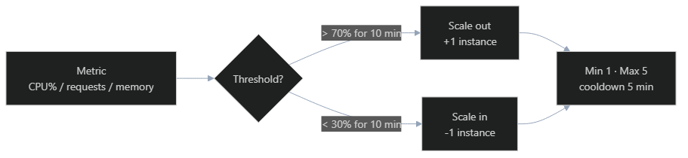
Autoscale rules — out and in
Notes:
DEMO. Create a scale-out rule (CPU > 70% → +1) and a scale-in rule (CPU < 30% → -1). Set min/max instances and a cooldown. Explain the default instance limits protect cost and stability. Optionally run the load-test script to trigger it.

Slide 32
Demo — App Service blade tour
• 1 · Overview & URL — confirm the app is running
• 2 · Environment variables — show the real injected settings
• 3 · Deployment Center — container image from ACR
• 4 · Log stream — watch live requests
• 5 · Scale up vs scale out — then add an autoscale rule
Notes:
DEMO checklist. Run scripts/start-local.ps1 beforehand if you want a local compare. Then drive the portal top-to-bottom using this order.

Slide 33
Module 5 — Web auto-instrumentation
• dotnet add package Microsoft.ApplicationInsights.AspNetCore
• builder.Services.AddApplicationInsightsTelemetry();
• Reads APPLICATIONINSIGHTS_CONNECTION_STRING from configuration
• Requests, dependencies, exceptions, and traces — with zero extra code
Notes:
Show Program.cs in Mapaq.Web. The magic is propagation, covered two slides down.

Slide 34
API + SQL instrumentation
• Same AI SDK on Mapaq.Api
• EF Core 10 SQL calls auto-tracked as SqlClient dependencies
• HttpClientFactory propagates traceparent to downstream calls
• Custom events: TelemetryClient.TrackEvent with custom dimensions
Notes:
EF Core → SqlClient instrumentation ships with the SDK; no extra package. This is how the SQL span appears in the waterfall.

Slide 35
W3C Trace Context — traceparent
• Format: 00-{trace-id}-{parent-id}-{flags}
• Browser SDK starts the trace and emits the header on every fetch/XHR
• ASP.NET Core honours and forwards it automatically
• Result: one operation_Id stitches all four spans together
Notes:
Open browser DevTools → Network → a request → Headers, and show the real traceparent. This is the thread that ties the whole story together.

Slide 36
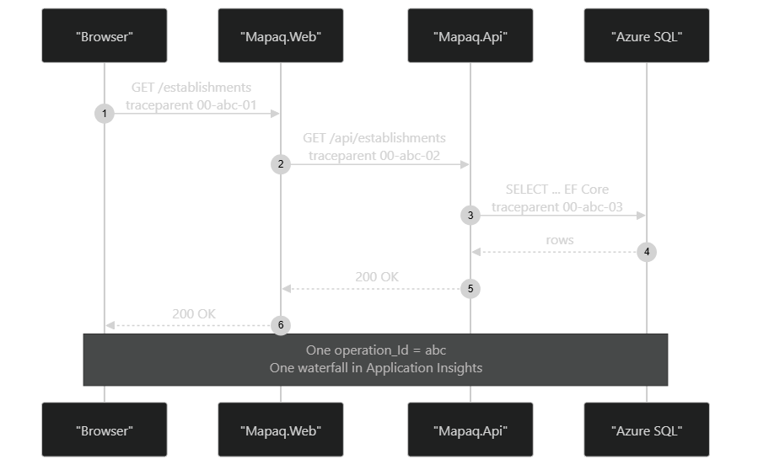
End-to-end trace — the centerpiece
Notes:
The visual anchor of the workshop. One operation_Id across four tiers becomes a single transaction in App Insights.

Slide 37
Browser correlation
• Add the Application Insights JavaScript SDK to _Layout.cshtml
• Pass the connection string via server-side ViewData — never hard-code
• enableCorsCorrelation: true and enableRequestHeaderTracking: true
• distributedTracingMode: AI_AND_W3C to emit traceparent
Notes:
The snippet must load before any script that issues fetch/XHR, or early page views are lost.

Slide 38
Browser SDK — minimal config
• Use connectionString (instrumentationKey is deprecated)
• enableAutoRouteTracking: true for SPA-style navigation
• correlationHeaderExcludedDomains for third-party hosts
• samplingPercentage: 100 in dev, lower in prod
Notes:
Sampling is set on the SDK options object, per app — not in the portal.

Slide 39
Module 6 — Application Insights, the one-hour deep dive
• Live Metrics — real-time pulse
• Transaction Search & end-to-end transaction view
• Application Map — auto-discovered topology
• Failures & Performance — triage by symptom
• Logs (KQL) · Workbooks · Work items · Local + remote logging · Alerts
Notes:
This is a full hour. Keep the live app generating traffic the whole time so every blade has data. Use the dashboard-opener script to navigate fast.

Slide 40
Live Metrics — the room-pleaser
• Sub-second latency from app to portal
• Stream is not persisted — sampling does not apply
• Filter by cloud_RoleName to isolate Mapaq.Api
• Great for demos and deploy-watching; not a substitute for alerts
Notes:
DEMO. Open Live Metrics and ask the room to load the page. Watch the request and dependency rates jump. Filter to the API role.

Slide 41
Transaction Search & end-to-end view
• Search every request, dependency, exception, trace, and pageView
• Click a request to open the end-to-end transaction
• See the waterfall: browser → web → API → SQL under one operation_Id
• Drill into a SQL dependency to see the command and duration
Notes:
DEMO. Find a recent request, open the transaction, and walk the waterfall top to bottom. This is where the traceparent story pays off visually.

Slide 42

Application Map
Notes:
DEMO. Application Map auto-discovers topology from telemetry — no config. Click a node to see performance and failures for that component.

Slide 43
Failures & Performance blades
• Failures — top failing operations, response codes, exception types
• Performance — slowest operations, dependency duration, p50/p95/p99
• Drill from an aggregate straight into sample transactions
• Triage by user impact first, then by cause
Notes:
DEMO. If you can, force a 5xx (stop the API or hit a bad route) and watch Failures light up, then drill to the exception.

Slide 44
Logs (KQL) — one query, one operation_Id
• Open the Logs blade on the App Insights resource
• union requests, dependencies, pageViews
• Filter by operation_Id, project the key columns, order by time
• The result is the same waterfall, as data you can chart and export
Notes:
DEMO. Run the query on the next slide. The union across tables is the trick newcomers miss.

Slide 45
KQL query — copy / paste
• union requests, dependencies, pageViews
• | where operation_Id == 'PASTE-OPERATION-ID'
• | project timestamp, itemType, name, duration, success, target
• | order by timestamp asc
Notes:
Grab the operation_Id from the traceparent in DevTools or from Transaction Search, paste it in, and run. Save the query to the workbook.

Slide 46
Workbooks — shareable dashboards
• Pre-built workbook: 24h volume, p95 latency, fail %, top dependencies
• Parameterised by role name and time range
• Mix KQL, metrics, text, and parameters in one document
• Importable via JSON — no Power BI required
Notes:
DEMO. Open the workbook, change the time range and role parameter, and show the visuals update. Mention these are version-controllable as JSON.

Slide 47
Create work items from Application Insights
• Configure a work item integration (Azure DevOps / GitHub)
• From a failure or transaction, click 'Create work item'
• Telemetry context (operation_Id, stack, app version) is attached
• Closes the loop: detect → file → fix → verify
• Our ADO workflow: Epic → Feature → User Story/Bug, tag 'Agentic AI'
Notes:
DEMO. Show the work item integration on the App Insights resource, then create a bug from a real failure. Highlight how the telemetry context lands on the work item so a developer can reproduce it.

Slide 48
Local vs remote logging
• Local: ILogger console + App Service Log stream for fast feedback
• Remote: ILogger → Application Insights as traces (durable, queryable)
• Structured logging — log properties become custom dimensions in KQL
• Correlation: logs carry the same operation_Id as the request
• Set levels via appsettings + ApplicationInsights LoggerProvider
Notes:
DEMO. Emit a structured log locally and watch it in the console, then find the same entry in App Insights traces filtered by operation_Id. This is the local-and-remote logging story.

Slide 49
Smart alerts & detection
• Smart Detection auto-finds failure-rate & latency anomalies
• Metric alerts on availability, server response time, failed requests
• Action groups → email, SMS, Teams/webhook, or automation
• Alert on symptoms (user impact), not just causes
Notes:
DEMO. Show Smart Detection settings and create one metric alert (e.g., failed requests > N in 5 min) wired to an action group.

Slide 50
Demo — App Insights, what to show
• 1 · Live Metrics while the room loads the app
• 2 · Transaction Search → end-to-end waterfall
• 3 · Application Map → click the SQL node
• 4 · Failures → drill to an exception → create a work item
• 5 · Logs (KQL) → workbook → an alert
Notes:
DEMO master checklist for the hour. Keep traffic flowing throughout. Use scripts/open-monitoring-dashboard.ps1 to jump straight to the resource.

Slide 51
Cost controls — no surprises
• Daily cap on the App Insights resource for the workshop
• Sampling: 100% in dev, 10–25% typical in prod
• Workspace-based AI uses Log Analytics commitment tiers
• Right-size the App Service plan; scale in when idle
• Tag everything for billing slices
Notes:
Tie cost back to the scaling and sampling levers shown earlier. The daily cap protects the subscription.

Slide 52
Troubleshooting checklist
• No telemetry? Verify APPLICATIONINSIGHTS_CONNECTION_STRING in App settings
• Identity ingestion failing? Check AZURE_CLIENT_ID + AUTHENTICATION_STRING + role assignment
• Container won't start? Confirm WEBSITES_PORT and the image tag in Deployment Center
• Browser pageViews missing? Snippet must load before other scripts
• SQL deps missing? EF Core needs the AI SDK — package alone is not enough
Notes:
Keep this slide visible during labs. Most questions map to one of these lines. The identity line is specific to how rg-dev-001 is configured.

Slide 53
Teardown
• azd down --purge --force
• --purge removes soft-deleted Key Vaults and AI resources
• --force skips the interactive confirmation
• Verify the resource group is gone in the portal
Notes:
Always demo teardown live. A workshop without teardown is a billing time-bomb. (Skip on the shared rg-dev-001 if it must persist.)

Slide 54
Next steps & your skilling plan
• Pick one real app and run the Copilot .NET modernization agent on it
• Stand up App Service + App Insights with azd in your own subscription
• Draft your per-persona skilling plan from Module 0
• Run a Cloud Challenge sprint with your team
• Adopt observability-driven development as the default
Notes:
Send the room home with one concrete commitment each. Offer the labs and wiki as the follow-on path.

Slide 55
References
• learn.microsoft.com/azure/app-service/
• learn.microsoft.com/azure/azure-monitor/app/app-insights-overview
• learn.microsoft.com/dotnet/core/porting/ (upgrade & modernization)
• github.com/Azure/azure-dev (azd)
• GitHub Copilot app modernization for .NET — VS Code Marketplace
Notes:
All MS Learn pages have the EN/FR locale switcher in the top-right.

Slide 56
Merci · Thank you
• Slides, labs & wiki: this repository
• Bilingual decks: docs/decks/ (EN and FR)
• Monitoring shortcut: scripts/open-monitoring-dashboard.ps1
• Bonne modernisation! · Happy modernizing!
Notes:
Close in both languages. Hand the room to Q&A and point them at the wiki for the full delivery guide.

