Slide 1
DESJARDINS — CROESUS — MICROSOFT | JOINT WORKING SESSION
GPD Central SSO: what the evidence proves,
and the two questions that close it
Entra ID app registrations, Conditional Access, and the server-side /token redemption
3 August 2026
▶ Live demo — croesus-spa.azurewebsites.net
▶ Question list (Q1–Q9) on GitHub
▶ Full analysis — README
Notes:
Framing: this is a joint fact-finding session, not a defect report. The Conditional Access block is correct-by-design. We have one open question and two asks that close it.

Slide 2
WHY WE ARE HERE
The question on the table
▪ Desjardins users sign in to GPD Central. A second, non-interactive sign-in then arrives from the Croesus AWS backend and is blocked by Conditional Access in non-prod.
▪ One question: is that expected OAuth behaviour, or a misconfiguration?
▪ The answer decides the remedy — an internal Desjardins change or a vendor-side change at Croesus.
▪ Nobody is at fault yet. The block is a Zero Trust control working as designed; the open item is what the blocked call actually is.
Notes:
Keep this cooperative. State plainly that the CA block is not a Desjardins misconfiguration and not an accusation against Croesus.

Slide 3
WHERE WE STAND TODAY
Bottom line
▪ The Conditional Access block is correct-by-design. CA reacts to the origin and context of the request, not to the grant type.
▪ The /token redemption is now confirmed server-side — a Desjardins browser trace shows /authorize but no /token. This corroborates Croesus.
▪ The grant is still not classified from a captured request. /token is the normal endpoint for code redemption and refresh — it is not evidence of On-Behalf-Of.
▪ The “Unbound (1008)” line is a device- and session-binding status, not proof of token replay and not a grant classifier.
▪ Next: resolve the fork with Q7 and Q8. Change nothing in Conditional Access until then.
Notes:
This slide is the executive summary. If the session ends after five minutes, these five lines are what must land.

Slide 4
DISCIPLINE
What the evidence does — and does not — prove
Observation | What it proves | What it does NOT prove
Calls to /oauth2/v2.0/token | A token is being requested at the standard endpoint | Not OBO. Code redemption and refresh use the same endpoint
Sign-in status “Unbound (1008)” | The client is not integrated with the platform broker | Not token replay. Not a grant type. Out of scope for browser→Graph
Conditional Access blocked the call | The request lacked compliant-device context from an untrusted IP | Nothing about which grant was used — CA is grant-agnostic
Three exported registrations are ‘spa’ | No secret, no certificate, no exposed API scope | Not the full inventory — other registrations may exist (Q8)
Notes:
This is the credibility slide. Showing what we refuse to over-claim earns the right to the ask on slide 9.

Slide 5
STEP 1 — DONE
New evidence: the browser trace
A Desjardins user captured a HAR of a real Central sign-in.
Present in the trace
Absent from the trace
/oauth2/v2.0/authorize
The front-channel leg runs in the user's browser, as expected.
/oauth2/v2.0/token — no occurrence at all
The code leaves the browser but is redeemed elsewhere.
Conclusion: the redemption is server-side. This corroborates Olivier's account and rules out browser redemption for this capture.
Consequence: Desjardins can no longer observe the Origin header — it now exists only on Croesus's outbound request. Caveat: one sample, one environment.
Notes:
Credit Mathieu for capturing this. Emphasise that this confirms what Croesus said — we are validating the vendor, not contradicting them.

Slide 6
HYPOTHESIS TO VERIFY
The fork this creates
Microsoft Entra rejects a plain server-side redemption of a ‘spa’ authorization code with AADSTS9002327. A server-side redemption and a spa-only registration cannot both hold.
Branch A — the redemption FAILS
Branch B — the redemption SUCCEEDS
Entra returns AADSTS9002327.
A spa public client cannot service a no-Origin redemption. The supported registration shape is missing.
Fix: Croesus registers a ‘web’ confidential client with a certificate credential.
No AADSTS9002327 in the logs.
Then the backend authenticates as a registration outside the three spa exports we were given.
Fix: Croesus discloses the complete inventory (Q8); any accommodation is scoped to it.
Caveat: if Conditional Access blocks the leg first, the logs show a CA failure code instead — that does not settle the question.
Notes:
This is the core hypothesis slide. Exactly one branch is true and each has a different, small remediation. Neither is a crisis.

Slide 7
BACKGROUND
Why the registration shape matters
 | spa (public client) | web (confidential client)
Credential | None — no secret, no certificate | Secret or certificate required
Redeems a code | Only from a cross-origin browser request (Origin header) | From a server, no Origin required
Server-side redemption | Rejected: AADSTS9002327 | Supported
Exposed API scope | None in the three exports | Required for On-Behalf-Of
What we hold today | All three: dev-dev, dev-prod, prod-prod | None disclosed
“Tokens issued for the 'Single-Page Application' client-type may only be redeemed via cross-origin requests.” — AADSTS9002327
Notes:
Make the point technically, not accusingly: this is a platform rule, not an opinion. It is also cheap to fix on either branch.

Slide 8
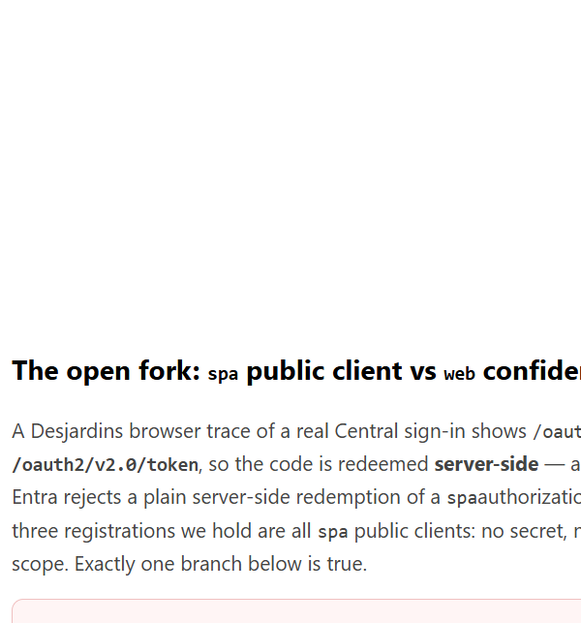
SCREENSHOT
The same fork, live in the demo
▶ Open it live — croesus-spa.azurewebsites.net
Notes:
The panel renders without signing in, so it can be walked through on screen share. Q7, Q8, and the full question list are clickable straight from the page.

Slide 9
OWNERSHIP OF THE EVIDENCE
Who can answer what
Question | Who can answer | Status
Origin header on a browser-side /token call | Desjardins — browser DevTools | Ruled out — no /token in the HAR
Origin header on the server-side /token call | Croesus only — their outbound request | Open — Q7
Did the second leg succeed or fail with AADSTS9002327? | Desjardins — own Entra sign-in logs | In progress
Complete registration / service-principal inventory | Croesus | Open — Q8
AWS egress IP ranges, intended flow definition | Croesus | Open — Q4, Q1
Details: README — Who can capture the /token Origin header →
Notes:
The raw Origin header is never a field in the tenant sign-in logs. It exists only on the HTTP request the caller sends to Entra.

Slide 10
WHAT WE NEED FROM CROESUS
The asks: Q7 and Q8
Q7 — one redacted /token capture
Q8 — complete registration inventory
For one successful and one failing transaction:
Is an Origin header present? • grant_type • client_id • redirect URI • client-authentication method
Presence indicators or SHA-256 hashes only. Never raw codes, tokens, secrets, or assertions.
Every app registration and service principal GPD Central uses, across environments.
Including any confidential web/API registration that is not among the three spa exports we hold.
Promoted to equal priority by the server-side finding.
Also open: Q1 intended flow • Q4 AWS egress ranges • Q5 cross-tenant device compliance • Q6 token-binding compatibility • Q9 Central vs Conseiller parity
▶ Full question list Q1–Q9 on GitHub →
Notes:
Stress the redaction rule up front. It is what makes Q7 answerable by a security-conscious vendor.

Slide 11
ONCE THE FORK IS RESOLVED
Remediation ladder
▪ Classify first. No Conditional Access change, no AWS IP allowlist, and no OBO mandate until the grant is known.
▪ Branch A → register a web confidential client. A certificate credential on the Croesus side. Smallest possible change; no Desjardins policy change needed.
▪ Branch B → scope to the disclosed registration. Apply any accommodation to that specific service principal rather than to a broad IP range.
▪ Rule out device trust as the lever. Cross-tenant ‘Trust compliant devices’ only fires on a B2B guest sign-in, and the blocked leg is a server-side call with no device context at all.
▪ On-Behalf-Of is an option, not a requirement. It applies only if a genuine confidential middle tier is proven — which requires an exposed API scope and a credential.
Notes:
The point: every branch has a small, reversible fix. Nobody needs a re-architecture, and Desjardins does not need to weaken CA. On device trust — credit Mathieu Santerre for the correction: the inbound trust settings honour a device claim carried in a guest's token from their home tenant, so they cannot bridge Prod device state into a native non-prod sign-in.

Slide 12
REFERENCE IMPLEMENTATION
The working demo
▪ A live SPA + API in a Microsoft demo tenant that makes the flow shapes observable — nothing runs against Desjardins or Croesus tenants.
▪ Wrong vs right: a token replay to Microsoft Graph is rejected on audience, while a real On-Behalf-Of exchange issues a distinct, separately audienced token.
▪ The registration fork: a panel walks through spa vs web and the AADSTS9002327 behaviour, with direct links to Q7 and Q8.
▪ Token inspector and evidence panel: decoded claims show audience binding rather than a reused bearer. The raw-token inspector is gated off by default — we ask the vendor for hashes, so we do not demo copying live tokens.
▪ Tier 2 exhibits (gated): a server-side replay control, and a report-only Token Protection policy that reproduces the real 1008 signal on a supported resource.
▶ Open the demo — croesus-spa.azurewebsites.net
▶ Evidence narrative (Q‑by‑Q mapping)
▶ Demo walkthrough guide
▶ Evidence KQL queries
Notes:
Demo order: sign in, Call API, show the evidence panel, then the replay button, then scroll to the registration-fork panel and click through to Q7/Q8.

Slide 13
LEAVING THIS SESSION
Next steps and owners
# | Action | Owner | Closes
1 | Query Entra sign-in logs for the server-side leg: success vs AADSTS9002327 | Desjardins | Narrows the fork without the vendor
2 | Provide one redacted /token capture (hashes / presence only) | Croesus | Q7
3 | Provide the complete registration and service-principal inventory | Croesus | Q8
4 | Provide AWS egress IP ranges and the intended flow definition | Croesus | Q4, Q1
5 | Choose the minimum remediation once the branch is known | Joint | The escalation
Guardrail until then: do not change Conditional Access, do not allowlist the AWS egress IPs, and do not mandate On-Behalf-Of.
Notes:
Close by restating the guardrail. It protects both parties: no premature policy loosening, no premature vendor re-architecture.

Slide 14
EVERYTHING REFERENCED IN THIS DECK
Links
▶ Question list Q1–Q9 (escalation packet)
▶ Escalation packet — full document
▶ Full analysis — README
▶ Who can capture the /token Origin header
▶ Evidence narrative — question-by-question mapping
▶ On-Behalf-Of demo guide
▶ Evidence KQL queries
▶ Repository — devopsabcs-engineering/croesus
▶ Live demo application
Notes:
Share the deck itself — every link is clickable in slideshow mode.

