Slide 1

DRS << Area>> offerings

Slide 2

Agenda
Future Trend Offerings
How to Contact & Important Links
DRS < Technology Platform >
Knowledge Offerings
DRS < Team > Service Offerings
DRS < Team> Value Proposition

Slide 3
Service Offerings (Reference Example Below)
Applications Maintained
JIRA\Confluence\
FishEye
GIT\GERRIT
Initiative
DevOps\Code Quality Initiative Collaboration
Defect Prediction with DePress
HP Testing Tools Portfolio(HP ALM,UFT,PC)
Requirements Management roll out with HP ALM
End to End Tool Support
Services
Collaboration with HCL on AOM
SonarQube
Securing Needed Licenses
VIAP,JAVA ALM CCB
Health check\Security Improvements
Continuous Feature Improvements\
Automatic Defect Prediction
Tool \Plug-ins Evaluations\Migrations\Roll outs \Version Upgrades\Integrations
New Features Awareness to different community members

Slide 4
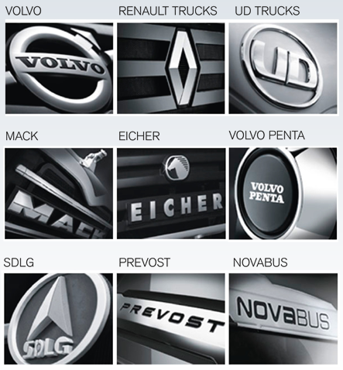
Value Proposition
Please add relevant points why deliveries should follow your services (methods\tools\processes)

Slide 5

VOLVO Specific Framework Offerings For Example NVS\JVS related offerings\information \Link .Also please specify What value it adds to customers\end users
NVS (.Net for Volvo Solutions), is a reference architecture that shall be used when developing new .NET applications at Volvo (can also be applied to existing applications)
NVS is based on the Volvo Group Target Architecture (VGTA) and the 10 EA principles
Also based on recommended architecture for .NET applications from Microsoft
https://teamplace.volvo.com/sites/volvoit-dotNET/WebPartLib/NVSWebPage.aspx

Slide 6
Knowledge Offerings:
Trainings, e-learnings, videos, coaching offerings (Example as below)
One can also share links if you have handy
Existing ILT
Proposed ILT
OPC & JCL
MQ MAINFRAME
Endevor
RDz – Carma
RDz – Debugger
RDz – DB2
RDz - FM/FA
DDD/ZOS Arch/VGTA/AVS
Easytrieve/E-Plus
Advanced DB2
WEB services / Ivory
IMS TM/TN
CICS
Work In Progress – eLearnings
Cobol Training – Basic
JCL Training – Basic
VICS/VILMA II
Introduction training
XML
ITA training

Slide 7
Future Trends\Roadmap
New technologies\future IT trends where your area will concentrate in year 2017 & 2018
What is already in plan for future trends

Slide 8

Reach us for support & Important Links
Write to us at DRS support Mailbox
<< Support Mailbox>>
DRS Trainings
http://teamplace.volvo.com/sites/DRS/Development/SitePages/Trainings.aspx
DRS Portal
http://teamplace.volvo.com/sites/DRS/Development/SitePages/HomePage.aspx
DRS << Individual Area> portal (Example below)
http://teamplace.volvo.com/sites/DRS/GeneralDevelopmentTools/SitePages/HomePage.aspx

