Slide 1

DRS DPAF( DP & SCCM) offerings

Slide 2

Agenda
Future Trend Offerings
How to Contact & Important Links
DRS ADF Framework
Knowledge Offerings
DRS Development Practices Service Offerings
DRS Development Practices Value Proposition

Slide 3
Development Practices Service Offerings
SCCM
Identifying the CI & defining the project structure
Agile/ SCRUM/
Kanban
Coaching on how to manage projects
Practitioner Community
Promoting /Sharing latest news about SCCM / ADF
VGU Training
SCCM Fundamental / Intermediate
Branching Merging strategy
Change & Release Management
Agile / SCRUM
Kanban
Knowledge sharing session
Suggesting WOW
Evaluating the methods
Participant Count - Agile: 121 & SCCM: 88
Supporting ADF
Know more about Development Practices

Slide 4
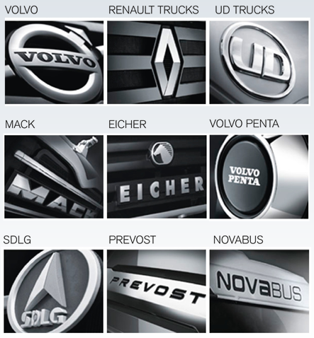
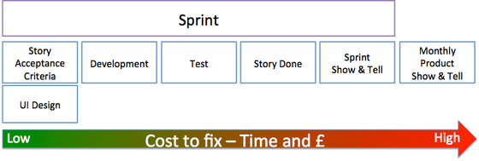
Value Proposition - Agile
Agile approach manages requirements in User
Story format to enable customer centric
deliverables
Iterative product development increases potential return on investment with the real working software and decreases business and technical risks
Welcome changing requirements by lowering the cost of change

Slide 5

Value Proposition - SCCM
Establishing baselines for releases
Traceability of changes integrating version control
& defect tracking system
Implementing Change process for standard,
normal & emergency fixes
Automation of Build & Deployment using
Continuous Integration
Environment / Infrastructure Management
Notes:
Multiple tasks accomplished using automation

Slide 6
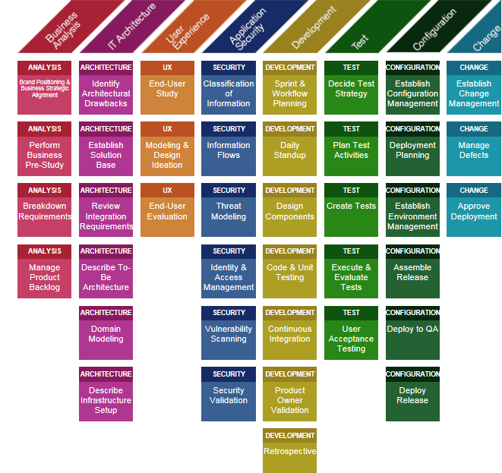
VOLVO Specific Framework Offerings Application Development Framework - Link
Is a toolbox of methods, guidelines and expected deliverables with connections to process in application development supplemented by examples and templates
It answers HOW to develop applications
It has RACI matrix describing who is responsible for activity execution and in what scope
Activity Maturity model mapping Project Assurance Plan with Project Handbook phase with ADF activities

Slide 7

Knowledge Offerings:
Trainings, e-learnings, videos, coaching offerings
VGU trainings
100195: Software Change and Configuration Management Fundamental
100196: Software Change and Configuration Management Intermediate
SCCM Intro (video link)
SCCM Practitioner Communities(PC)

Slide 8

Future Trends\ Roadmap
DevOps in the context of new IT strategic priorities 2017-2020
Transformation of 5 pilot projects to DevOps equipped methods
Pilot transformation to get completed by end of 2017
Eficode engaged for this DevOps transformation
Notes:
What DevOps is going to bring in
Reduce Lead-time & Increase Quality
Collaboration between Developer & Operations
Treating your code as an infrastructure
Automation of CI / CD to achieve the goal of Continuous Delivery
A tool-chain approach

Slide 9

Reach us for support & Important Links
Remedy (soon Snow)
Application Development competence area (Link)
SCCM homepage (Link)

