Slide 1
Shared IT Services DevOps- Transformation Introduction
Notes:
[]

Slide 2
Agenda
Team Introduction
Mission – DevOps Transformation
What is DevOps
Key Components of DevOps
Q/A
DevOps Strategy
Pilot High level scenario
Team Expectations
Notes:
The objectives we have set for this course are the following: … (read and explain details if necessary.)” Ask: “How do these match your own goals and objectives? Does anyone have any doubts or questions?”
Explain what is in and out of scope:
We will not cover busines change management processes
This training is about processes, practices, methods related to development and maintenance of software

Slide 3


Team Introduction
Team member | Representing
Marcin Klimkiewicz | PM – SITS EMEA
Waldemar Jankowski | Development Platforms&Tools
Fryderyk Kajdzik | Runtime Practice Support (RPS)
Katarzyna Wojcik | VPS4IT
Rafal Likitarczuk | Project Practise Support (PPS)
Arun Ramachandran | Development Practises&Frameworks (DPaF)

Slide 4

Mission: DevOps Transformation
To transform selected teams from regular Development practices to DevOps equipped method with the help of the external company Eficode. This would help us to produce quality artifacts, test and ship at frequent intervals with less TAT & more time to add value to improvise the quality of the product .
High level approach
Pilot identification & finalizing
Baseline and impact analysis
Build implementation plan and start transformation of projects

Slide 5
What is DevOps ?
DevOps is the practice of operations
& development engineers participating
together in the entire service lifecycle,
from design through the development
process to production support.
Reduce Lead-time & Increase Quality
Developer and operations collaboration
Treating your code as an infrastructure
Automation of CI / CD to achieve the
goal of Continuous Delivery
A tool-chain approach
DevOps
Lean
&
Agile
Culture
Process
Automation
People
Technology
Notes:
represents a change in IT culture, focusing on rapid IT service delivery through the adoption of agile, lean practices in the context of a system-oriented approach
emphasizes people (and culture), and seeks to improve collaboration between operations and development teams
implementations utilize technology — especially automation tools that can leverage an increasingly programmable and dynamic infrastructure from a life cycle perspective
DevOps (a clipped compound of "software DEVelopment" and "information technology OPerationS") is a term used to refer to a set of practices that emphasize the collaboration and communication of both software developers and information technology (IT) professionals while automating the process of software delivery and infrastructure changes. It aims at establishing a culture and environment where building, testing, and releasing software can happen rapidly, frequently, and more reliably. [Wikipedia]

Slide 6
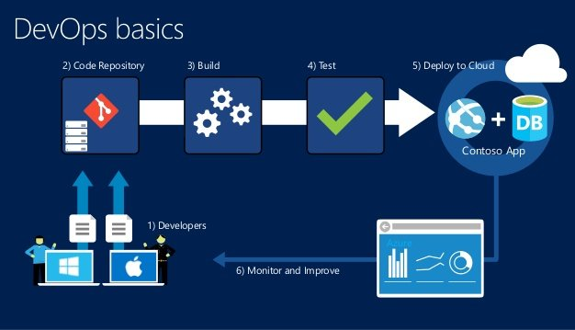
What Tools Are Used in DevOps
Source Code Repository
Build Server
Configuration Management
Virtual Infrastructure
Test Automation
Pipeline Orchestration

Slide 7
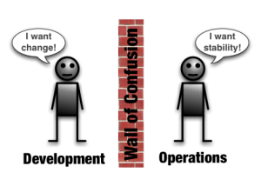
What is DevOps ?
DevOps is a response to the growing awareness that there is a disconnect between what is traditionally considered development activity and what is traditionally considered operations activity. This disconnect often manifests itself as conflict and inefficiency.
DevOps is an umbrella concept that refers to anything that smoothes out the interaction between development and operations.
Notes:
It’s safe to assume DevOps is offspring of agile software development
expanding agile benefits also into application release, deployment and operation
merging together developement and operation worlds

Slide 8
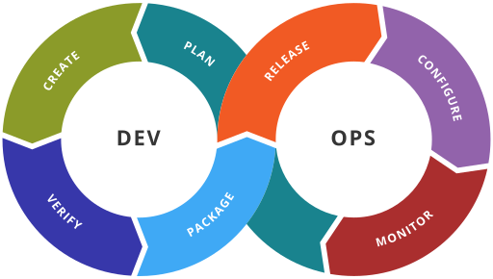
What is DevOps ?
DevOps is a cultural shift and collaboration (between development, operations and testing) and there is no single DevOps tool. It is rather a set (or "DevOps toolchain") consisting of multiple tools.
DevOps tools fit into one or more of the below categories which is reflective of key aspects of the software development and delivery process.
Notes:
http://dev2ops.org/2010/02/what-is-devops/ - good article about DevOps if more info needed

Slide 9
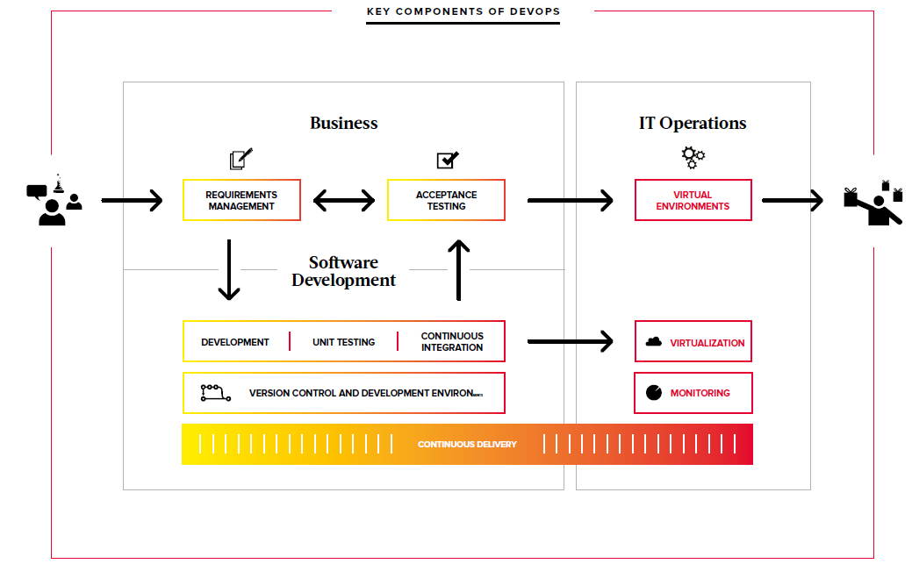
Key Components of DevOps by Eficode

Slide 10
Why DevOps ?
Companies that practice DevOps have reported significant benefits including:
significantly shorter time to market
improved customer satisfaction
better product quality
more reliable releases
improved productivity and efficiency
increased ability to build the right product by fast experimentation
increased employee engagement
Notes:
DevOps is a powerful idea because it resonates on many different levels. It’s by no means a magical panacea, but if you can make DevOps work you it can help in removing barriers that are both a significant time-sink and a source of morale killing frustration.
DevOps enables the benefits of Agile development to be felt at the organizational level. DevOps does this by allowing for fast and responsive, yet stable, operations that can be kept in sync with the pace of innovation coming out of the development process.

Slide 11

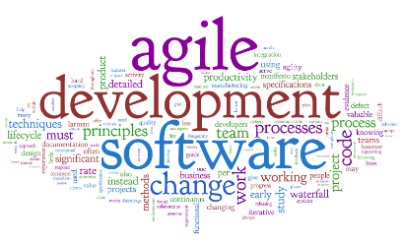

Where DevOps is applicable ?
SERVICE CATALOGUE AWARENESS
TRANSFORMATION COMMITMENT
CONTINUOUS IMPROVEMENT SPIRIT
AGILE PRACTITIONERS OR ASPIRING
NATURAL CANDIDATES
Notes:
Pilot selection criteria:
Java & .NET technology track to start with
In house developed apps, not COTS at this stage, preferably a web application
Pilots: avoid burden of firewall/perimeter protection -> intranet applications (Volvo CI/VCN)
Pilot team ready for the change and want to change !! Great role of TL and/or DM to support and drive the change

Slide 12
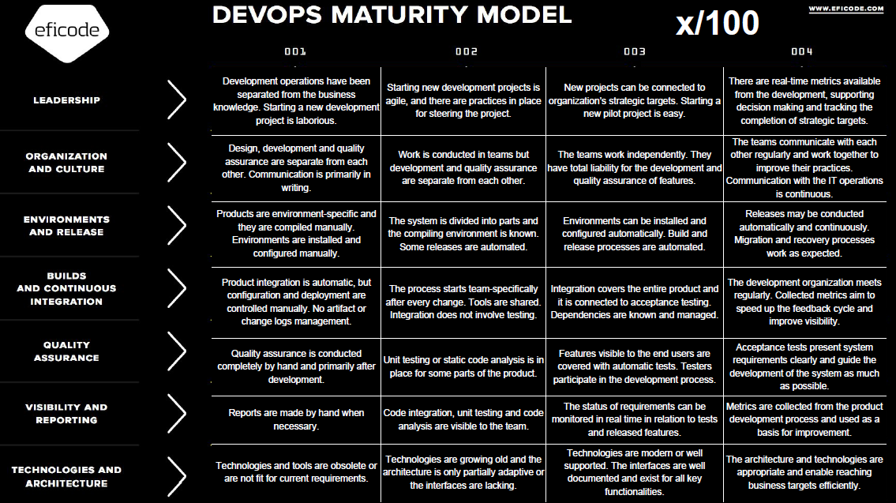
DevOps maturity levels
Notes:
Some level of maturity in the lean thinking is important criteria – so the transformation is not started from scratch.

Slide 13
DevOps Pilot scenario – Eficode work
1. Pilot team meeting
Team buy-in, agree on interviews and action plan
½-1 day, workshop, target team manager & team members
2. Perform interview & collect data
5 days, 5-7 persons interview + technical check, face to face
3. Build baseline and implementation plan
3 days, report on current state and prioritized roadmap
Presenting the plan for Volvo Group IT (project team, pilot team)
4. Decision: Go – No-Go
5. Start transformation project
Define governance model, roles and targets
Notes:
Important to know that duration of the implementation phase might be different. Depends on the maturity level.

Slide 14
Roles and responsibilities
Eficode | Pilot team | Project team
Driver role |  | Observer role
Will assess the team and propose the next steps | Will actively participate in the pilot transformation | Will monitor the pilot project and learn based on the observations
Will start and drive the transformation project according to the agreed scope | Will document the observations and share with the project team | Will support the pilot project if required (ex. administration, communication..)
Will document the findings and results as well as share with the project team | Will support in designing the implementation approach for the next teams | Will document the observations in order to produce the methodology for further concept roll out and and design the implementation approach

Slide 15
Time plan
There is no specific time plan for each and every pilot project – it will be proposed and agreed after the assessment done by Eficode.
The target is to finalize pilot transformations by end of 2017 and this statement will be reviewed after all pilot teams are involved and interviewed by Eficode (specific time plan per pilot is an input and pre-requisit to the overall project planning).

Slide 16
Costs
Any cost related to Eficode work is to be covered by DRS.
Pilot team involvement in DevOps pilot activities will not be covered by DRS.

Slide 17

Key message
The purpose of the pilot project is to help in understanding how DevOps concept can be useful for Volvo Group IT and how it can be delivered.
It is important that Pilot team closely cooperates with both Eficode and Project team as well as document and share the findings.
Project team will support in all the transformation activities (ex. Communication, administration..)
1 project member assigned to each pilot project and supporting the activities.

Slide 18

Our expectations and more info
Pilot team eager to accept the change and ready for it, need to secure enough time for the change process and work with Eficode consultant
Good support from the managers in driving thru the change
Documentation of the observations and results, lessons learned
Project team will support you in the transformation process
Eficode service cost is covered by DRS
Notes:
Project support – communication, templates for documenting results, etc.
What is pilot team expectation?

Slide 19

Questions
Contact: Chairman: Bartosz Celmer (Volvo)
Project Manager: Marcin Klimkiwicz (Volvo)

