Slide 1
AUTOMATION TESTING

Slide 2
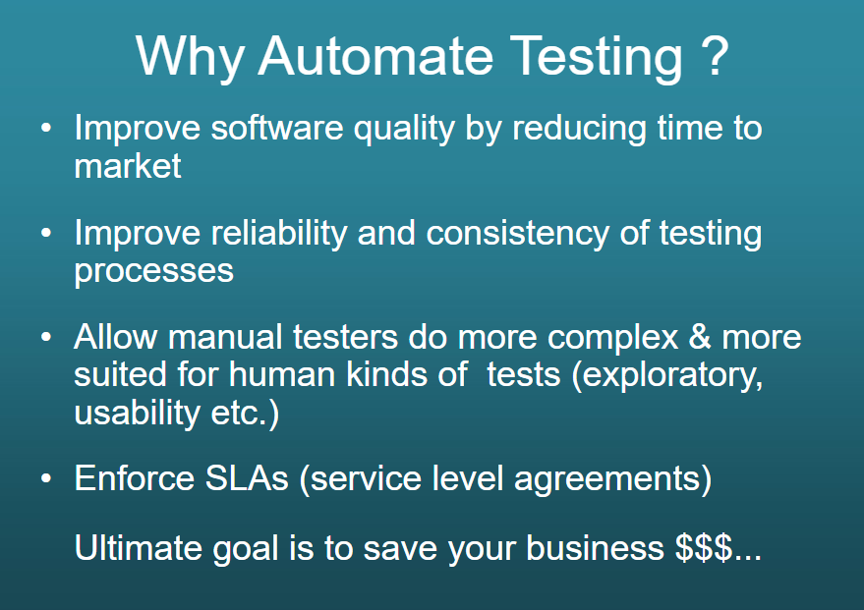

Slide 3
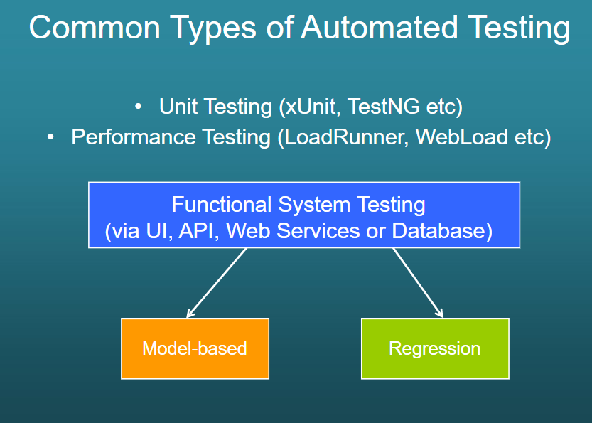

Slide 4
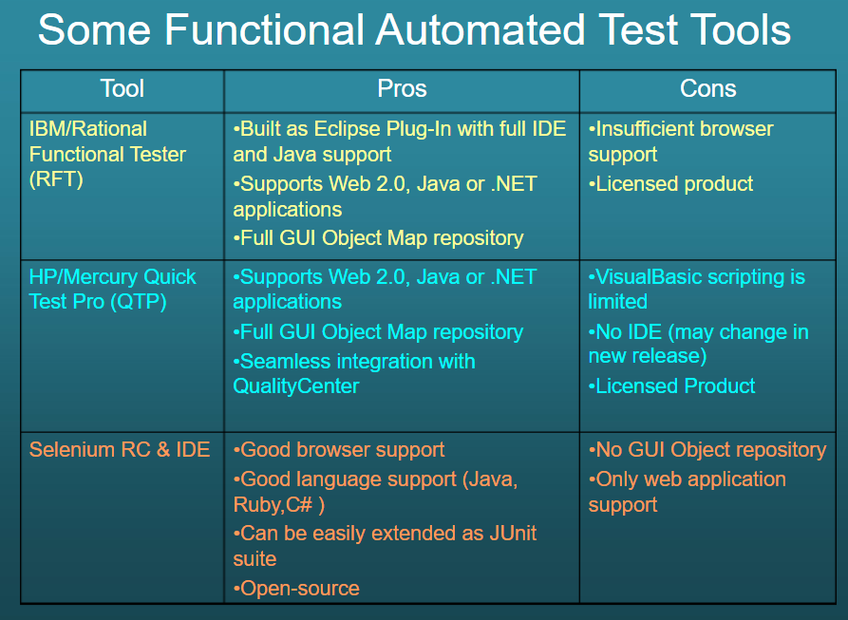

Slide 5
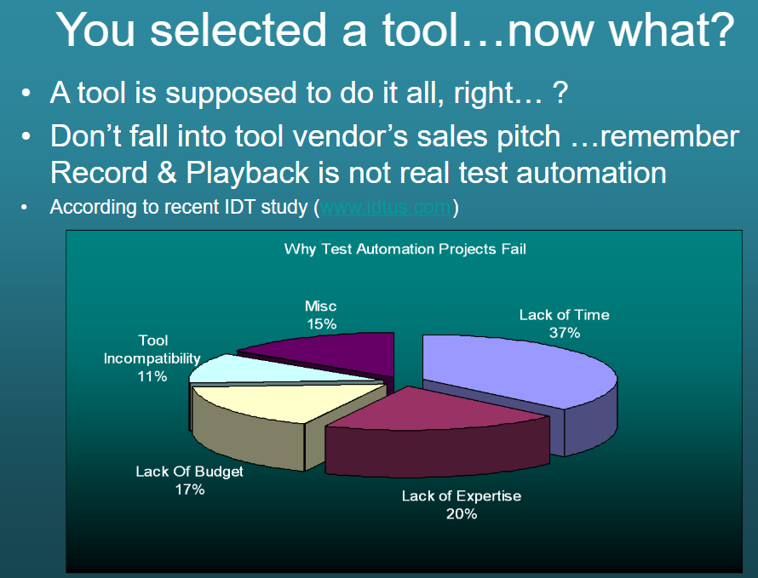

Slide 6
What to Automate ?
Simple Things
Hard Things
Do it Manually | Automate It
Automate It | Buy or Write Software
Done Once
Done often

Slide 7
What to Automate ?
What to Automate ?
Automate the primary functions that will be used by the End-users
Automate the BVTs
Automate End-to-End Scenarios
What not to Automate ?
Do not try to automate not-so critical portions in the beginning
Do not automate status bars, help screens

Slide 8
When to Automate ?
Is the Build Stable ?
Are the Test Cases and Test Scenarios ready and Final ?
Are the Test Data ready ?
Is the Test Bed ready ?
Is the Test Automation tool installed ?
When not to Automate ?
If the AUT is not Large\Complex
If you receive only few builds to test
If the feature doesn’t work accurately

Slide 9
How much to Automate ?
Ideally 60% Automation is expected for a Regression Suite
First, automate the primary functions that will be performed by the targeted end-users
Next, add the not-so-critical portions of the application as time permits.
Develop a test coverage matrix

Slide 10
THE AUTOMATED TEST LIFECYCLE METHODOLOGY
1. Decision to Automate Testing
2. Test Tool Acquisition
3. Automated Testing Introduction Process
4. Test Planning, Design, and Development
5. Execution and Management of Tests
6. Test Program Review and Assessment
Notes:
This systematic method maximizes test coverage
outline the potential benefits and test tool proposal
test tool evaluation and selection
Steps necessary to outline automated testing to the project
Identifies the test procedure standards, defines the tests, defines development standard
Test plans are executed
This is done throughout the lifecycle

Slide 11
Why automate?
Verification and Validation of the requirements and organisation
Defects and Failures caused by misunderstood requirements or coding errors
Compatibility of the Software
Notes:
Verification – developed software matches the requirements
Validation – it is what the organisation wanted
Defects and failures – incorrectly setup environments or wrong version of software being deployed – human error - bug or malfunction - system malfunctioning or failing
Compatible – so that new software deployed wont mess up any existing apps

Slide 12
Advantages & Disadvantages of Automated Testing
Advantages
Disadvantages
Reliable: eliminating human error
Reusable
Better Quality Software
Fast
Cost Reduction
High investment is needed in the tools and training
High man power requirement for test preparations
A lot of testing areas left uncovered
Notes:
Reliable: carries out the same operations - eliminating human error Reusable: can reuse tests on different versions of an application Better Quality Software: can run more tests in less time with fewer resources – good coverage Fast: run tests significantly faster than human users. Cost Reduction: number of resources for tests are reduced.
Replaces: manually mundane and labour intensive tasks

Slide 13
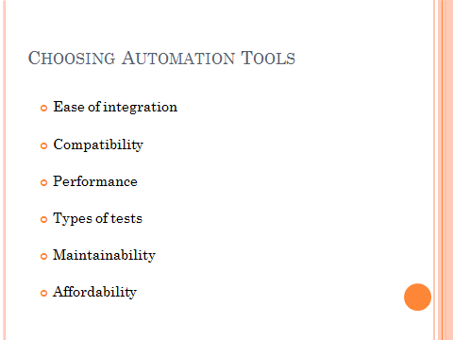

Slide 14

Automation Methodology
Determine Automation
objective
Application understanding/KT
Identification of Automation scope
Identify tools
Tool Evaluation
Tool Selection
Feasibility study
Plan & design scripts
Automation Plan
Define automation framework
Design Automation test suite
Setup test environments
Avail application connectivity
Install automation tools
Setup test bed
Develop
libraries
Develop
Scripts
Develop test
Suites
Design automation framework
Develop Script libraries
Develop Automation test suite
Deploy test
Suites
Test suite execution
Test results summary
Test closure

Slide 15
Automation Framework
Definition
An underlying skeleton upon which a test suite is built
A simplified description of a complex entity or process
A tiered organization of the function libraries
Advantages and Benefits
Rapid Script Development
Reusability
Smart Exception-handling
Well Organized Code
Test Data Management
Ease of maintenance

Slide 16
Automation Framework Features
Well defined
architectural design
100% Reliability of
Utility scripts, online execution, report packs
Less time to
test large data
100%
Automation
Framework
Script execution in multiple environments
Robust and Stable
due to error and exception handling
Easier, faster and efficient analysis of result logs
Easy debugging and script maintenance
Communication of results
@

Slide 17


Architecture
Automation Suite
Test Data
Test Case
Engine
Test Data
Init Script
Driver Script
@
Reports
Utility Scripts
(Application)
Utility Scripts
(Common)

Slide 18
Test Automation Group’s Scope
Assumptions
An integrated tool suite must be the primary test management, planning, development, and implementation vehicle.
The tool suite must be used to direct and control test execution, to store and retrieve test artifacts, and to capture/analyze/report test results.
Testing standards must be documented and followed.

Slide 19
Assumptions…
The tool suite must include
a tool of choice for defect tracking and resolution.
a component for test requirements management.
a configuration management tool of choice
All of the tools described above must be integrated with desktop tools such as MS Office.
The proper automated testing workspaces must be created on test servers that are separate from development servers.

Slide 20
Constraints
These constraints limit the success of the automation effort if they are not heeded.
The automated tools group resources must remain independent of any manual testing group.
There may not be a large enough number of available staff on the automation team.
The level of cooperation of the software development group and their management with respect to automated tool use may be too low.

Slide 21
Constraints…
There may be a lack of cooperation and information exchange with developers in creating testable applications.
The release schedules for major versions of the AUT and for customer-specific releases of the AUT can be too tight.
There is uncertainty associated with the GUI updates in AUT.
There may be corporate mandates on what tools must be used.

Slide 22
Critical Success Factors
Following critical success factors can be treated as a set of test automation guidelines
Test automation must be implemented as a full-time effort, not a sideline.
The test design process and the test automation framework must be developed as separate entities.
The test framework must be application independent.

Slide 23
Critical Success Factors…
The test framework must be easy to expand, maintain, and enhance.
The test strategy/design vocabulary must be framework independent.
The test strategy/design must hide the complexities of the test framework from testers.

Slide 24
Strategic Objectives
These objectives are based on the critical success factors listed above.
Implement a strategy that will allow tests to be developed and executed both manually (initial test cycle) and via an automation framework (regression test cycles).
Separate test design and test implementation to allow test designers to concentrate on developing test requirements, test planning, and test case design while test implementers build and execute test scripts.

Slide 25
Strategic Objectives…
Implement a testing framework that both technical and non-technical testers can use.
Employ a test strategy that assures that test cases include the navigation and execution steps to perform, the input data to use, and the expected results all in one row or record of the input data source.
Realize an integrated approach that applies the best features of keyword-driven testing, data-driven testing, and functional decomposition testing.

Slide 26
Strategic Objectives…
Implement an application-independent test automation framework.
Document and publish the framework.
Develop automated build validation (smoke) tests for each release of the application.
Develop automated environmental setup utility scripts for each release of the application.

Slide 27
Strategic Objectives…
Develop automated regression tests for
GUI objects and events
Application functions
Application special features
Application performance and scalability
Application reliability
Application compatibility
Application performance
Database verification

Slide 28
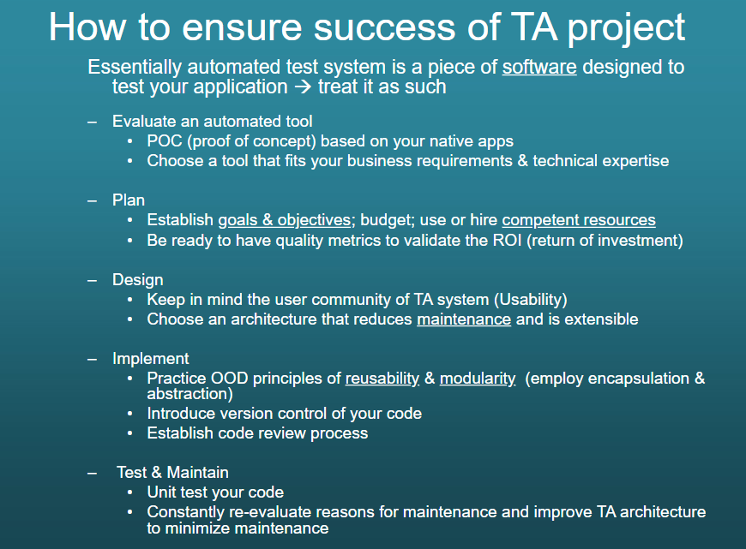

Slide 29
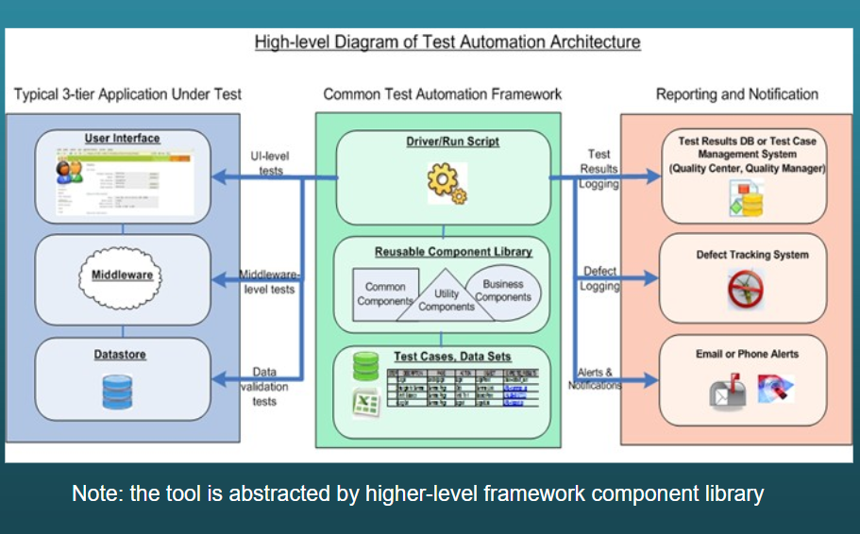

Slide 30
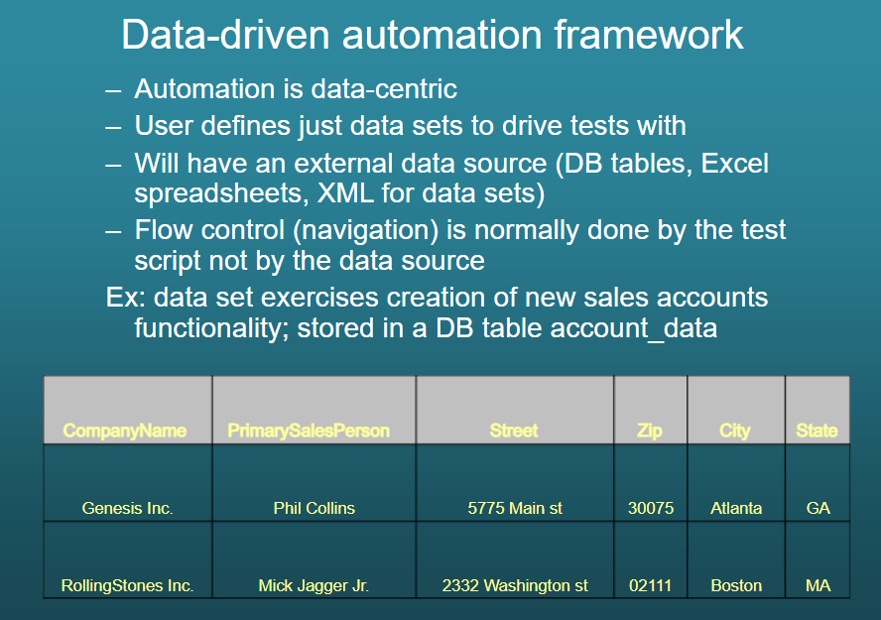

Slide 31
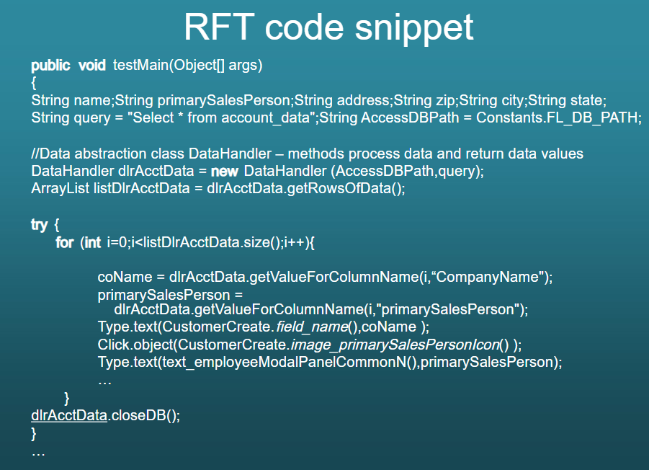

Slide 32
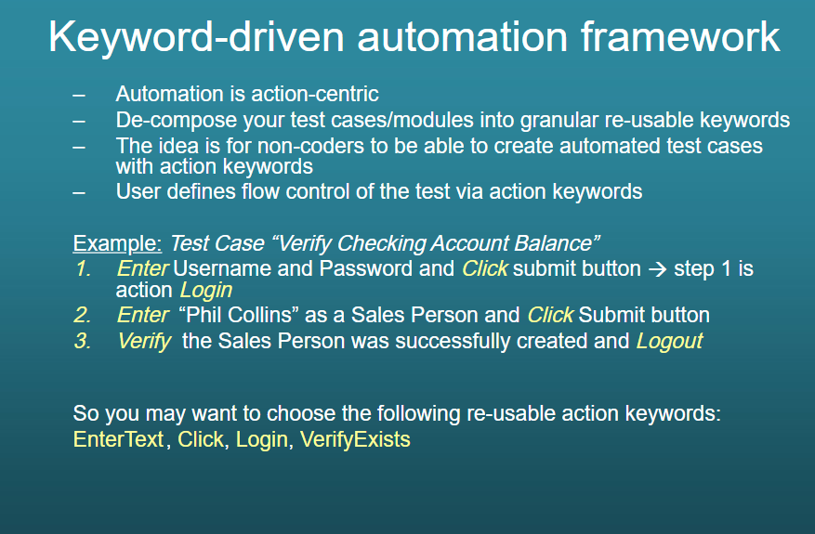

Slide 33
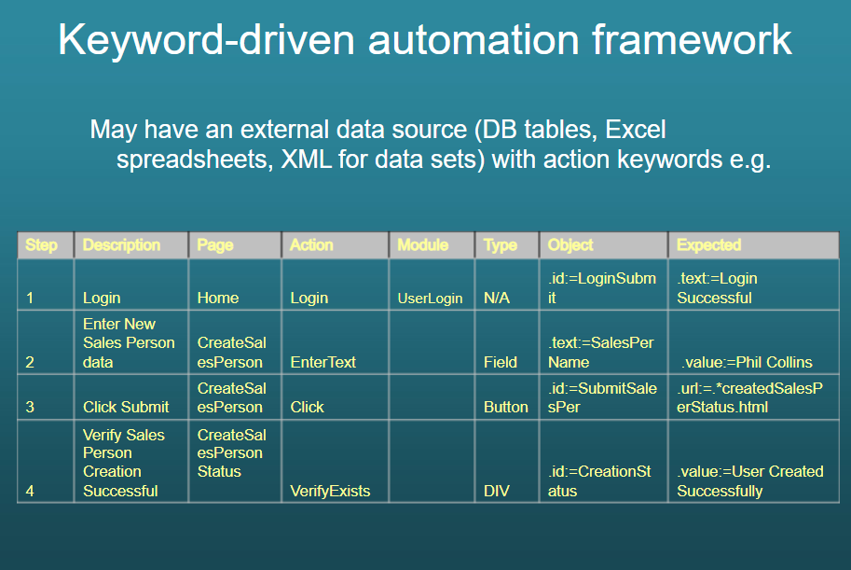

Slide 34
