Slide 1

Zoomers Meeting
April 2026
Strategic Thinking Strategic Execution Strategic Analysis

Slide 2
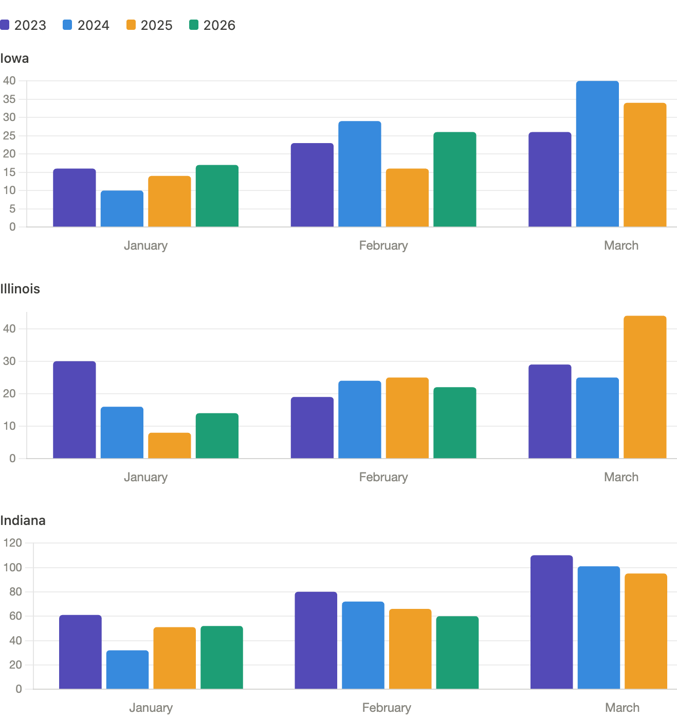
Sales View
March 2025
34 Sales
March 2025
44 Sales
March 2025
95 Sales

Slide 3
March Creative

Slide 4









Web Banners + Display

Slide 5







Facebook

Slide 6

Email

Slide 7

Class C Motorhomes Email

Slide 8
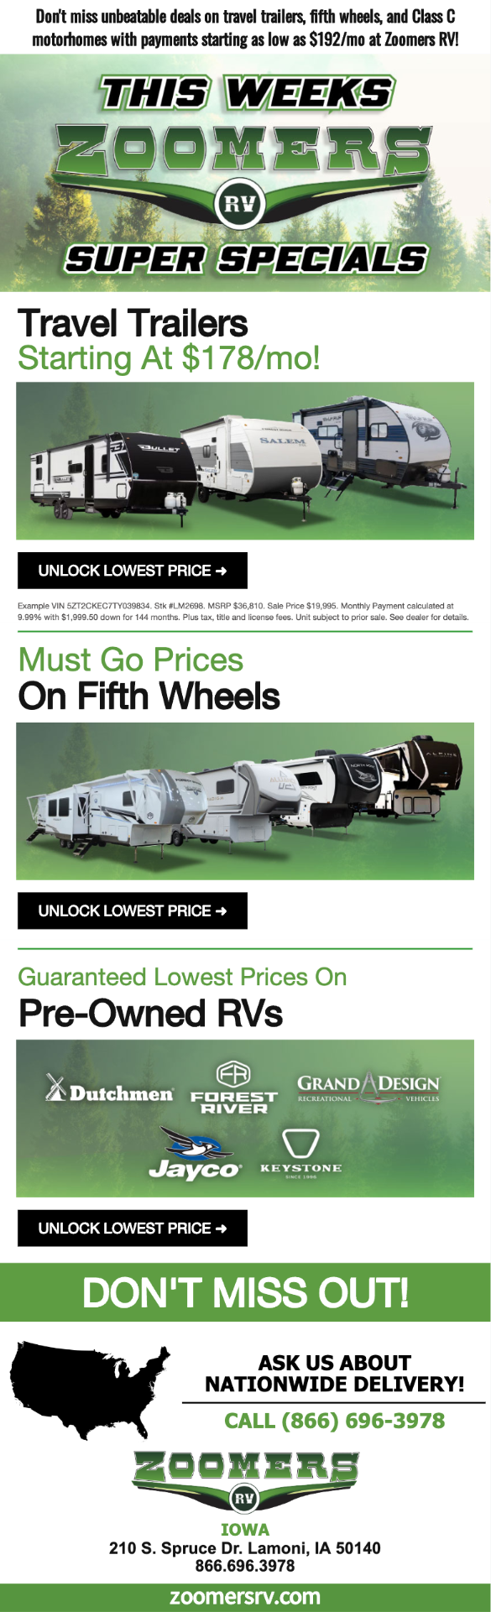
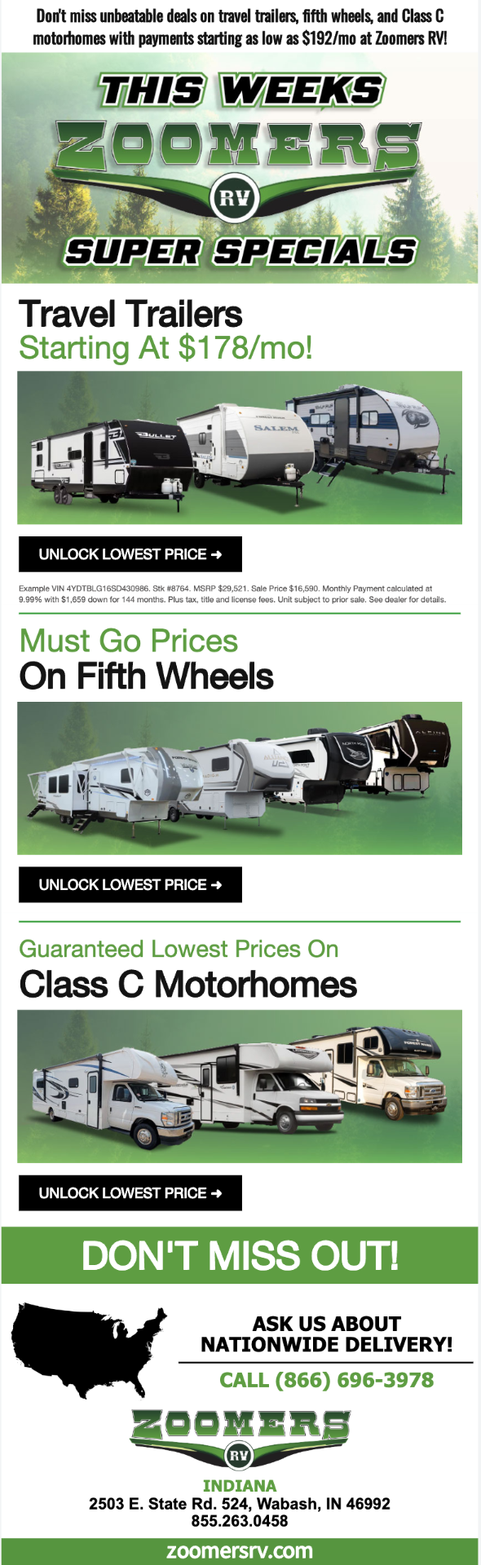

Aged Inventory EMail
Iowa
Indiana
Illinois

Slide 9
Results

Slide 10
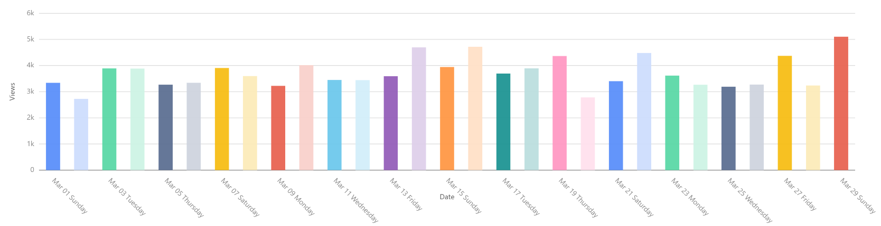
Smart Analytics VDPs - March
Month | Total | Organic Search | Paid Search + Cross Network | Facebook | Direct
March
February
% Change

Slide 11
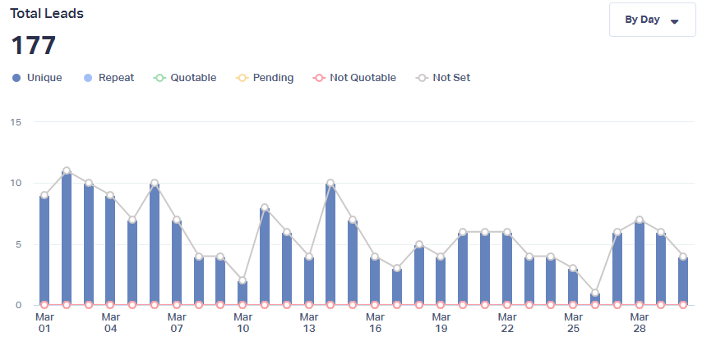
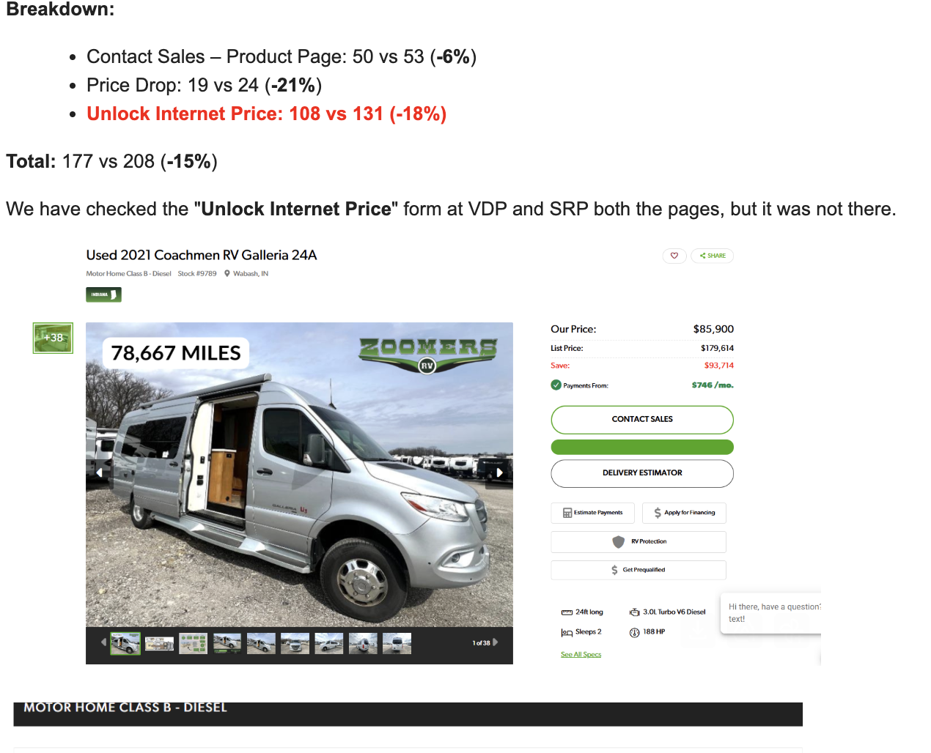
What Converts Leads March
Source/ Medium
Direct
Google PPC
email
organic
referral
Facebook
Grand Total
Form Name | Direct | Google CPC | facebook | organic | referral | Grand Total
Contact Sales - Product Page
Price Drop
Unlock Internet Price
Grand Total

Slide 12
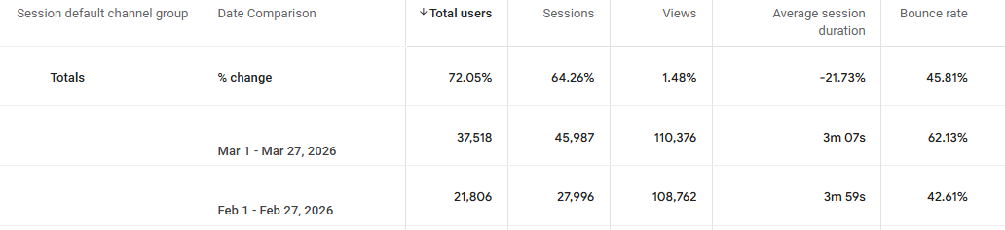
Paid Search GA4 Overview - March

Slide 13
Zoomers RV Organic Search Data March
Data Type | Overall Total | Organic Search | Organic Search %
Users
Sessions
Pageviews
Time on site
Bounce Rate
VDP
Button Interaction
Form Fill

Slide 14
Zoomers RV Paid Search Data March
Data Type | Overall Total | Paid Search | Paid Search %
Users
Sessions
Pageviews
Time on site
Bounce Rate
VDP
Button Interaction
Form Fill

Slide 15
Paid Search Ads Overview - March
MOM | Cost | Impressions | Clicks | CPC | CTR | Search Impr Share
March
February
Change %

Slide 16
Paid Search Ads Overview - MoM March
Indiana
Illinois
Iowa
 | Cost | Impression | Clicks | CPC | CTR | Search Impr Share
March
February
Change %
 | Cost | Impression | Clicks | CPC | CTR | Search Impr Share
March
February
Change %
 | Cost | Impression | Clicks | CPC | CTR | Search Impr Share
March
February
Change %

Slide 17
Pmax Ads Overview - March
 | Cost | Impression | Clicks | CPC | CTR
March | {{ads_cost}} | {{ads_impr}} | {{ads_clicks}} | {{ads_cpc}} | {{ads_ctr}}
February | {{ads_cost_prev}} | {{ads_impr_prev}} | {{ads_clicks_prev}} | {{ads_cpc_prev}} | {{ads_ctr_prev}}
Change % | {{ads_cost_pct}} | {{ads_impr_prev}} | {{ads_clicks_pct}} | {{ads_cpc_pct}} | {{ads_ctr_pct}}

Slide 18
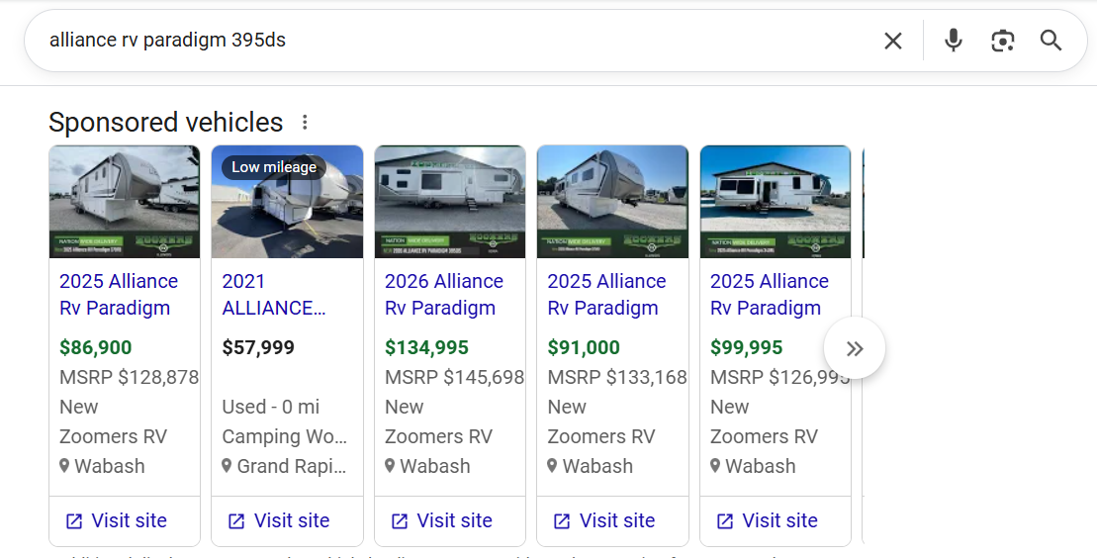
Shopping Ads Overview - March
Cost | Impression | Clicks | CPC | CTR
Example of live shopping ads

Slide 19
Auction Insights - March
Auction Insights Report Link

Slide 20

Display Results - March
Indiana
Cost
Impression
Clicks
CPC
CTR
Illinois
Cost
Impression
Clicks
CPC
CTR
Iowa
Cost
Impression
Clicks
CPC
CTR

Slide 21
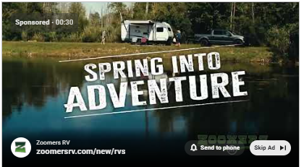
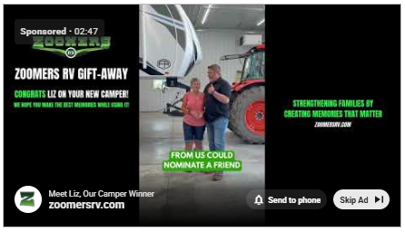
YouTube Results - March
Indiana
Cost
Impression
Views
Avg CPV
View Rate
Illinois
Cost
Impression
Views
Avg CPV
View Rate
Iowa
Cost
Impression
Views
Avg CPV
View Rate

Slide 22
OTT Results - March 2026
Campaign Type | Creative | Impressions | Complete Views | VCR% | CPV | Sessions | Cost Per Session | Page Views | Cost Per Page Views
OTT
OTT
OTT

Slide 23
OTT / Campaign Overview
$2,500
24,023
$50.12
1.83x
Avg CPM
Avg Frequency
Total Spend
Households Reached
IN + IA + IL
97.5%
1,745
View-Through Rate
Page Views
43,780
874
Total Impressions
Web Sessions
42,668
$0.05
Completed Views
Avg Cost Per View

Slide 24
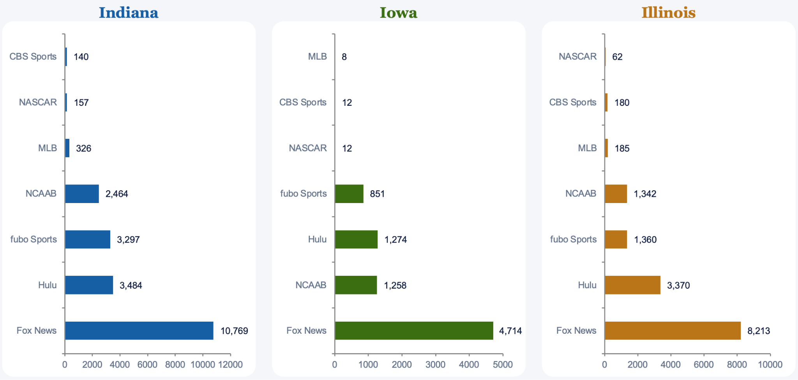
OTT / Top Placement Breakdown

Slide 25
OTT / Web Session Performance
874
1,745
$2.43
TOTAL SESSIONS
TOTAL PAGE VIEWS
AVG COST PER SESSION
TOP ZIP CODES
Indiana
Area Code | City | Web Sessions | Impressions
46750 | Huntington | 70 | 3,591
46953 | Marion | 60 | 3,051
46992 | Wabash | 60 | 3,187
Iowa
Area Code | City | Web Sessions | Impressions
50144 | Leon | 36 | 1,837
50140 | Lamoni | 28 | 1,445
50065 | Mount Ayr | 2 | 105
Illinois
Area Code | City | Web Sessions | Impression
62864 | Mount Vernon | 79 | 3,878
62812 | Benton | 58 | 2,928
62896 | West Frankfort | 41 | 2,032

Slide 26
Geofence Results - March 2026
Campaign Type | Geofence Locations | Creative | Impressions | Clicks
Geofence
Geofence

Slide 27
Facebook + Email Results

Slide 28
March Ads
March Video
 | Reach | Impressions | Clicks | CPC | Frequency | CTR
Dynamic
Indiana
Illinois
Iowa
Motorhome Hashed
Aged Inventory (All)
Belle Clair Show
Clicks:
Average CPC:
Average Freq:
Average CTR:
Thruplays:
Average CTTP:
Average Freq:
 | Reach | Impressions | ThruPlays | CPTP | Frequency
IN - Spring Adventure Vid
IL - Spring Adventure Vid
IA - Spring Adventure Vid

Slide 29
March Email
 | Amount | Open Rate | Clicks | Unsubscribes
Indiana Database 1
Indiana Database 2
Indiana Intender
Indiana Super Specials Intender
Iowa Database 1
Iowa Database 2
Iowa Intender
Iowa Super Specials Intender
Illinois Database 1
Illinois Database 2
Illinois Intender
Illinois Super Specials Intender
 | Amount | Open Rate | Clicks | Unsubscribes
Motorhome Conquest (IN)
Motorhome Intender (IN)

Slide 30
Engage

Slide 31
ENGAGE Lead Nurture
1
All
Unique means 1 email id (they could’ve opened or clicked multiple times)
All Of Your Website Traffic
All Website Visitors
All traffic
Google Analytics
Overview | Zoomer’s RV
Identified Visitors
Unique Opens
Unique Clicks
2
Identified
Visitors We Identify
Identified Visitors
Engaged User
VDP views
3
Nurtured
Nurture
Email Sequence
Re-engage prospect with multiple emails
Lead
Identify and Influence Your Most Engaged Website Visitors into Sales-Ready Leads.
Sale

Slide 32
SEO

Slide 33

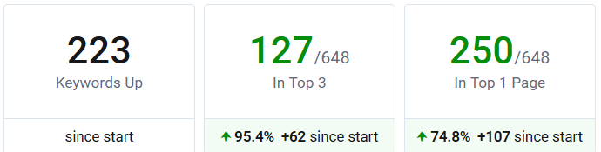
Keyword Movements Summary:
Overall Keyword Growth: We've seen an impressive increase of 223 keywords ranking higher since the start, showcasing the effectiveness of our optimization strategies.
Top 3 Keywords: 127 keywords are now ranking in the top 3 positions, which is a fantastic milestone. This represents a 95.4% increase and highlights how well we've aligned our efforts with user intent to drive relevant traffic.
Top 10 Keywords: The increase of 250 keywords in the top 10 rankings is another strong indicator of success. With a 74.8% improvement, it’s clear that we’re not only bringing in more traffic but also positioning content effectively for visibility.
This massive improvement demonstrates that we’ve successfully optimized the keywords based on user intent, ensuring that our content resonates with what users are searching for, ultimately driving higher engagement and results.

Slide 34
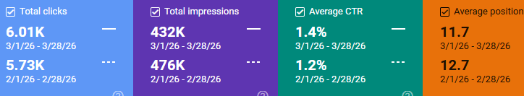
Google Search Console Update – March-26 vs February-26
Total clicks increased from 5.73K in February to 6.01K in March (approximately 5% growth), indicating continued improvement in organic traffic.
Total impressions declined from 476K to 432K (approximately 9% decrease), suggesting a reduction in overall search visibility or demand.
CTR improved from 1.2% to 1.4%, reflecting stronger engagement and better performance in converting impressions into clicks.
Average position improved from 12.7 to 11.7, indicating stronger keyword rankings, which helped drive higher clicks despite the drop in impressions.

Slide 35
Keyword Movement March-26
Here is the G-Sheet Link for the Keyword rankings

Slide 36
April Creative

Slide 37

Motorhome Campaign - Continue
Facebook
Intender + EMail
sold : 2 2025s
3 2026s
Indiana

Slide 38
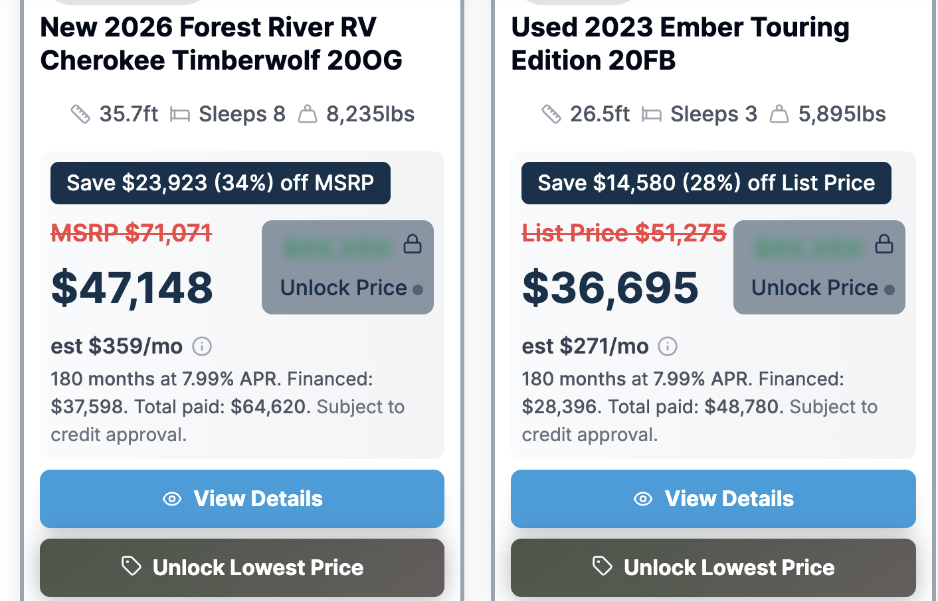
April/May
Given the focus needed to move the 200 aged units we recommend changing the creative direction for April & May to be more a more urgent message giving consumers reasons to believe this is the time to get a big deal.
This would be the focus on all platforms. OTT budget dramatically increases for April/May
We would tag the units on the lot and on the website
From aged inventory list sent over 3/23
6 aged units have sold
LM5703
C-2076
9159
9220
Z2778
Z2803
Sale Pending
Unlock Zoomer 200 Price

Slide 39



April-May
The Zoomers 200 (Favorite)
The race is on.
Two hundred RVs have been sitting on the lot too long— and now it’s a full-on sprint to sell them.
Welcome to The Zoomers 200.
Where every unit is priced to move—fast. That means incredible discounts on new and pre-owned RVs.
We’re talking some of the lowest prices in the nation on America’s top brands—from motorhomes to travel trailers.
Look for the Deep Discount tag— on ZoomersRV.Com and on our lots The longer it’s been here, the bigger the savings.
But don’t wait—these deals won’t last long.
The Zoomers 200. Happening now at all three Zoomers RV locations.

Slide 40
2026 Budget

Slide 41
2026 Budget

Slide 42
Appendix

Slide 43
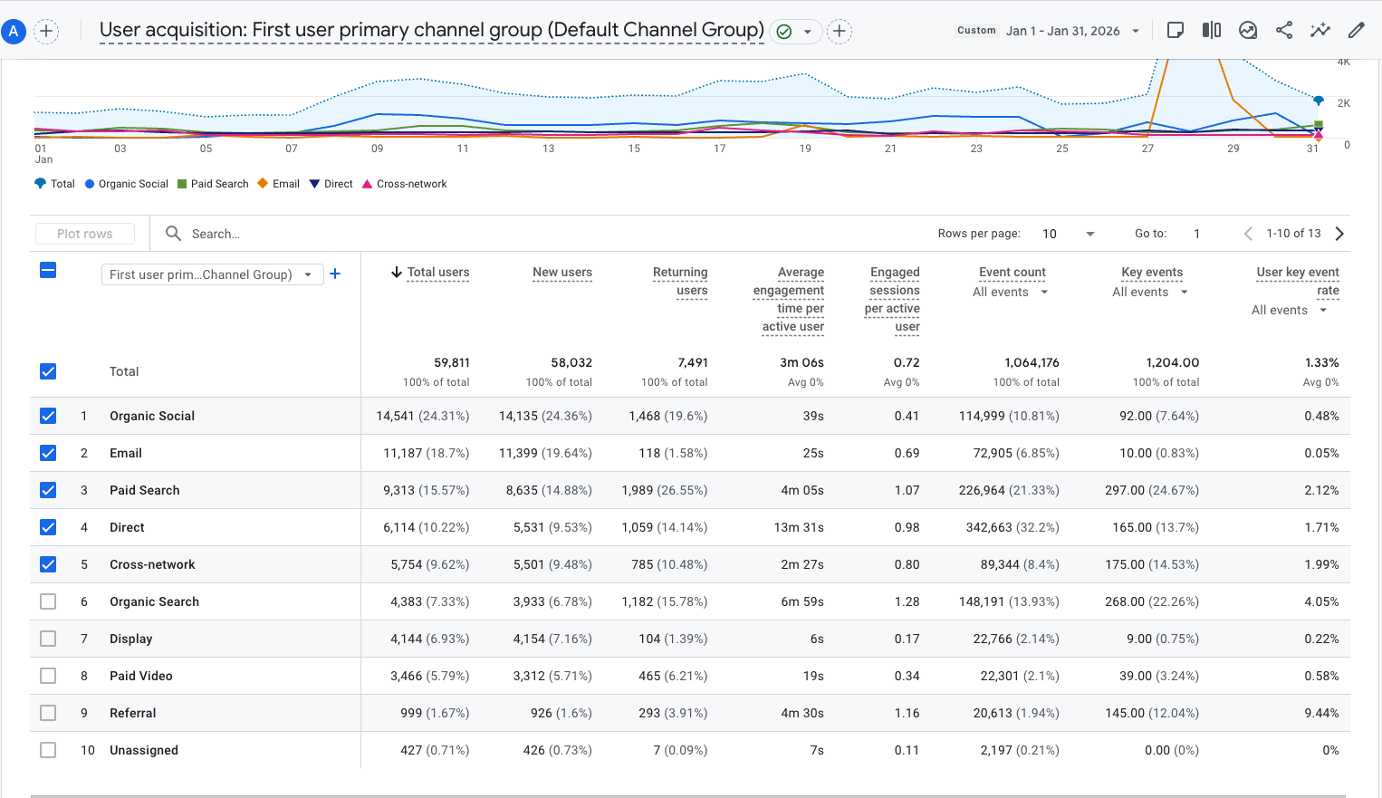
User Acquisition

