Slide 1


AWS Application Load Balancer
Author: Chandu

Slide 2
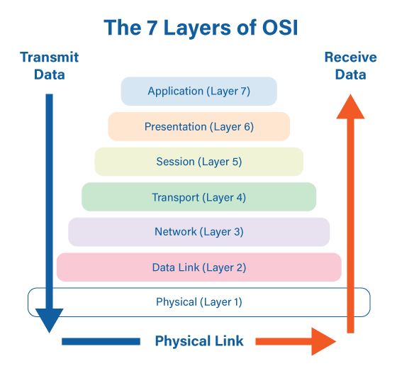
AWS Application Load Balancer
OSI Layers

Slide 3

AWS Application Load Balancer
What is meant by Load Balancer?
A load balancer is a device that sits between the user and the server group and acts as an invisible facilitator, ensuring that all resource servers are used equally.

Slide 4
Types of Load Balancer
In AWS we have total 3 types of load balancers
  Application Load Balancer
  Network Load Balancer
  Gateway Load Balancer
Author: Chandu

Slide 5
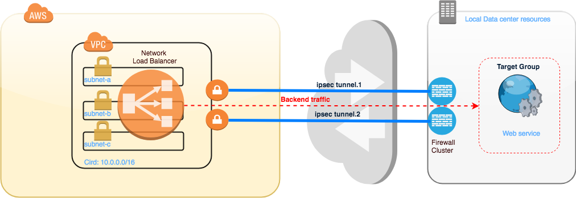
AWS Application Load Balancer
Network Load Balancer
This Load Balances the layer 4 traffic.
Network Load Balancer is optimized to handle sudden traffic patterns while using a single static IP address per Availability Zone.
It is integrated with other popular AWS services such as Auto Scaling, Amazon EC2 Container Service (ECS), Amazon CloudFormation, and AWS Certificate Manager (ACM).

Slide 6
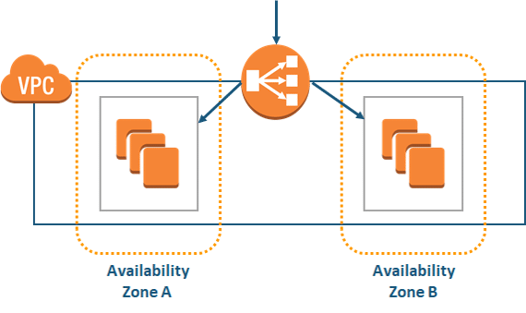
AWS Application Load Balancer
Application Load Balancer
This Load Balances the Layer 7 traffic.
The load balancer distributes incoming application traffic across multiple targets, such as EC2 instances, in multiple Availability Zones.
This increases the availability of your application. You add one or more listeners to your load balancer.

Slide 7
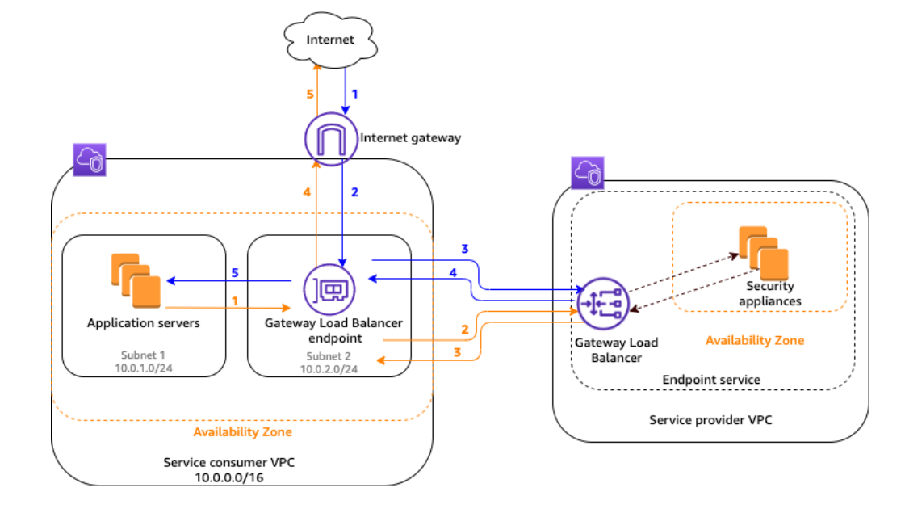
AWS Application Load Balancer
Gateway Load Balancer
This is useful when we are using VPN kind of applications. These we also called as virtual appliances.
Example of gateway applications are firewall applications.

Slide 8





Demo
VPC
Internet Gateway
Target Group
Subnet-1
Subnet-2

Slide 9


Thank You!

