Slide 1
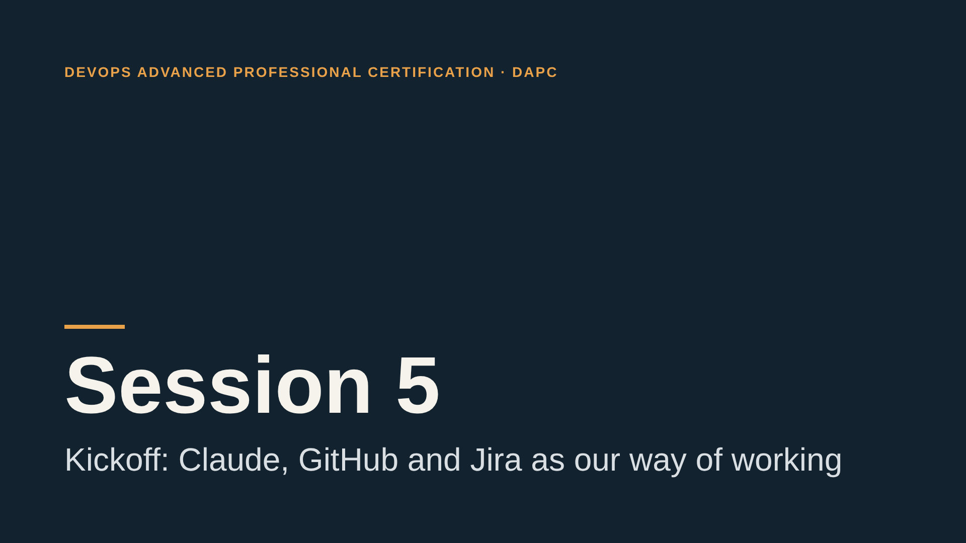
Notes:
Welcome everyone. Today is the first session of the new way of working: I talk less, and you do more. By the end of the session you will have Claude connected to GitHub and Jira, a ticket closed through a pull request, and your first skill. Total instructor talk time today is about 20 minutes. The rest of the time is yours. Move straight to the agenda.

Slide 2
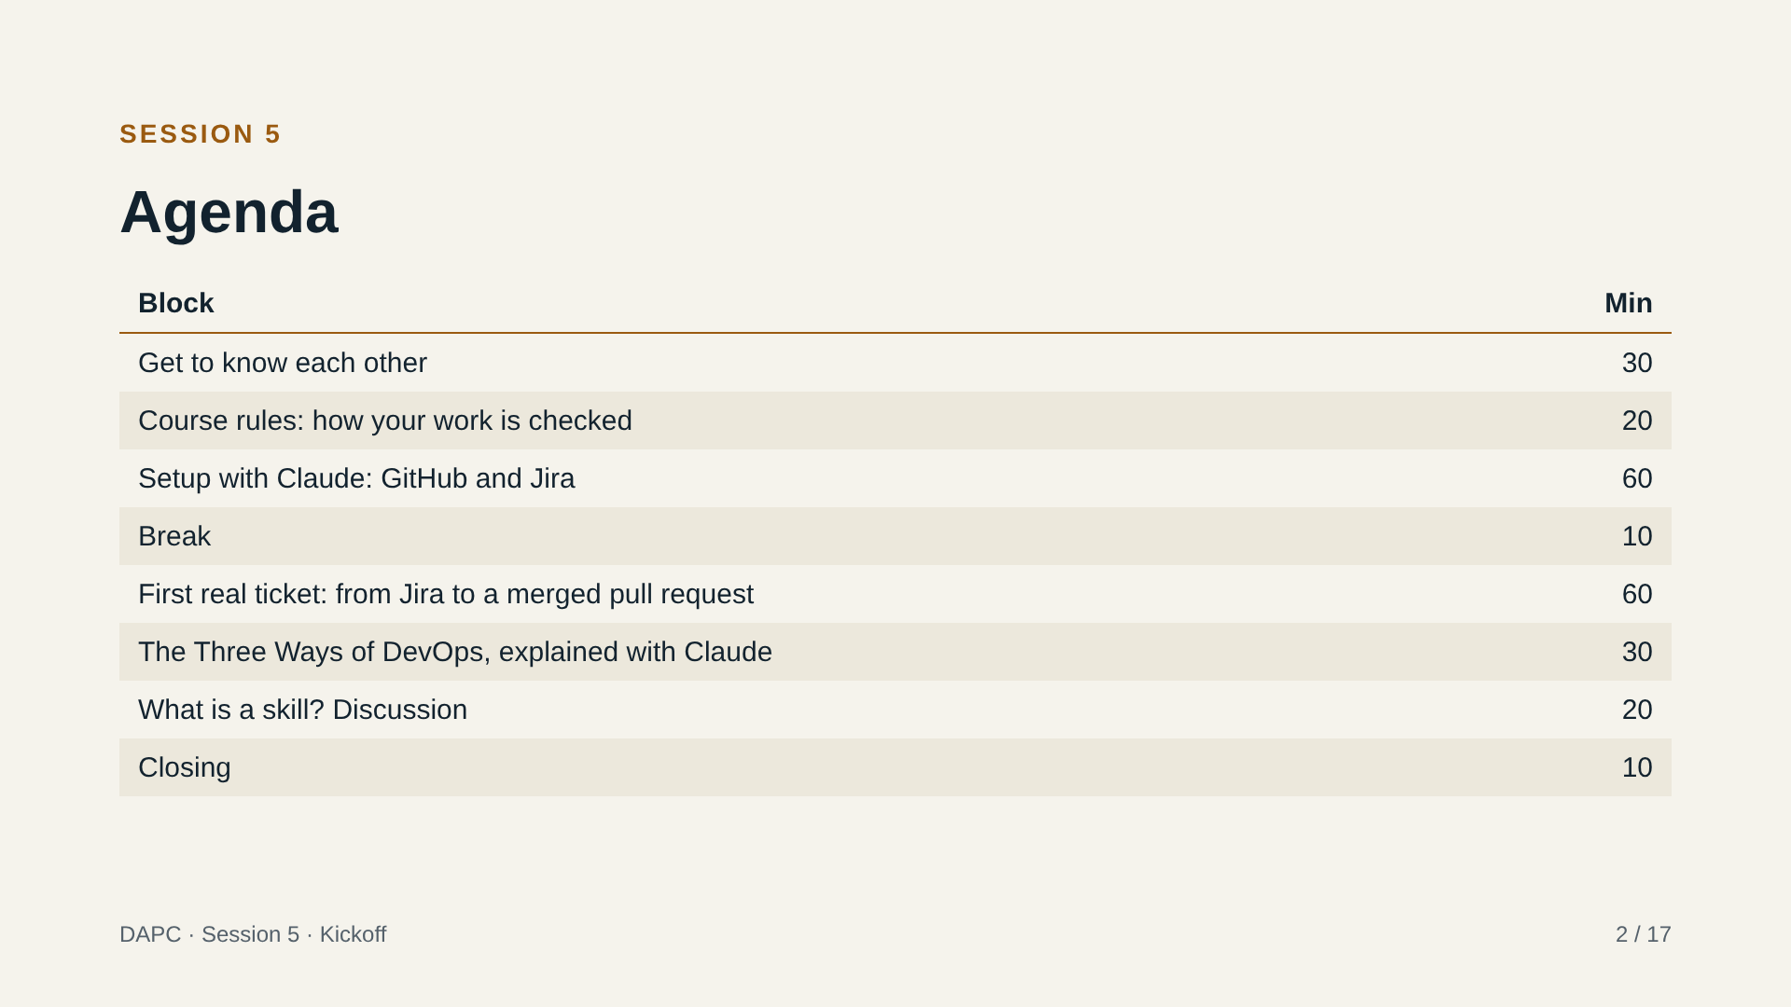
Notes:
Walk through the agenda in under a minute. Point out that most blocks are practical: setup, the first ticket and the Three Ways activity are done by participants, and the last block is a group discussion about skills. Only the course rules block is mostly me. Remind everyone that breaks are real breaks.

Slide 3
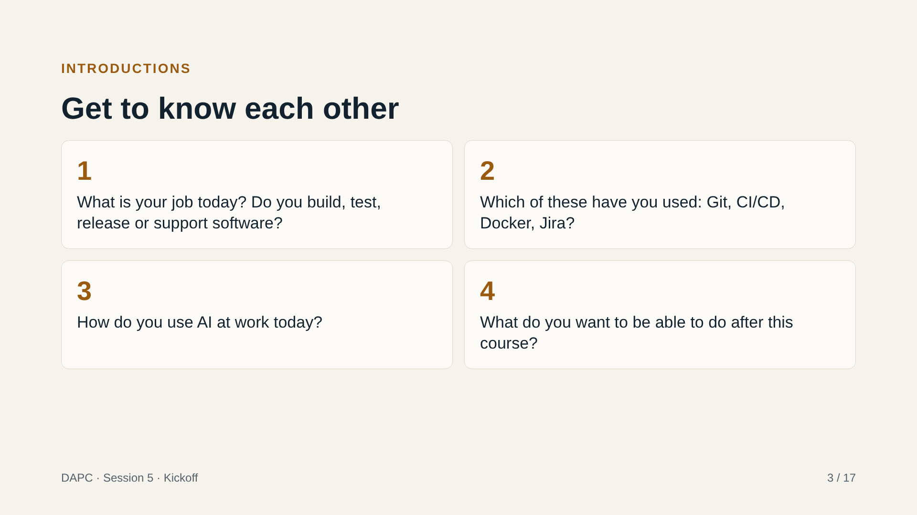
Notes:
Each participant answers the four questions out loud, about 3 minutes each. Keep time. Take notes as they speak: their answers to question 4 (expectations) go on a shared list that we come back to at the end of the session. Their answers to questions 2 and 3 tell you who needs help during setup, so note who is new to Git or Jira and who already uses Claude daily. Pair people later: someone with more experience with someone with less. Answer first yourself (30 seconds), so nobody feels shy. Do not comment on individual levels. Tip: if the group is quiet, start with the person who looks most comfortable.

Slide 4
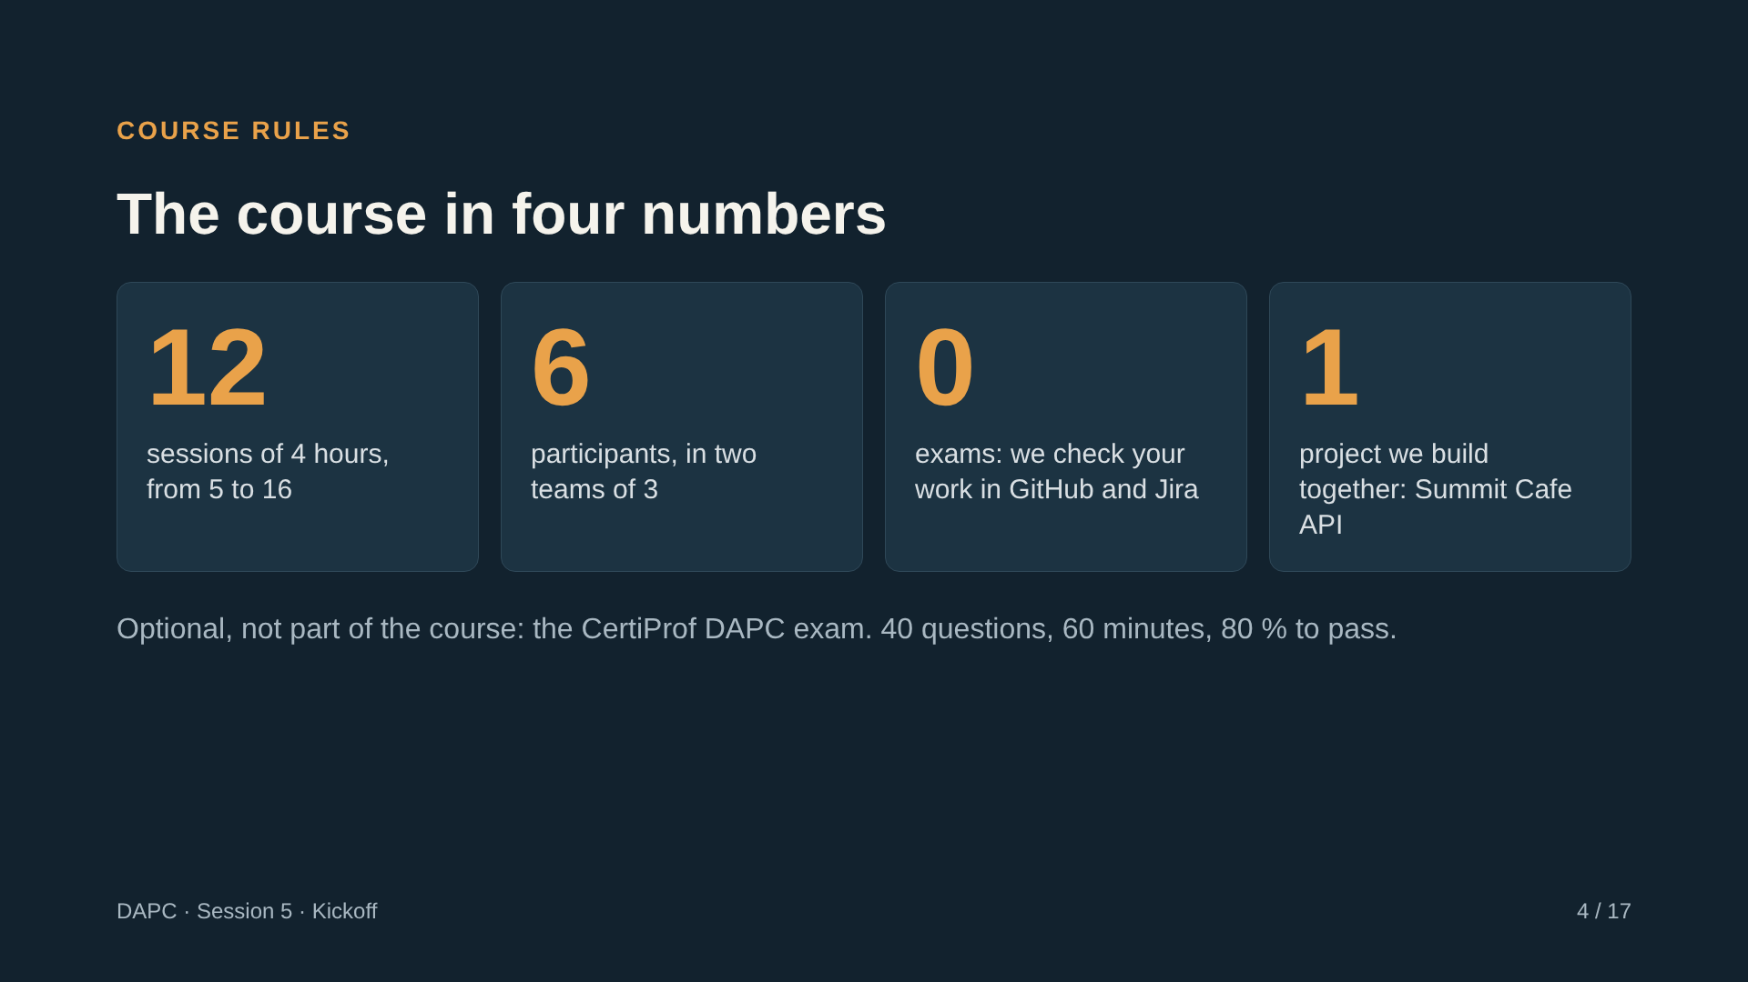
Notes:
This is the one slide where I explain how the course works. Key messages: (1) We have 12 sessions left, and most of the time is yours. (2) There are no exams or quizzes. What you do in GitHub and Jira is how we see your progress. (3) We build one main project together, the Summit Cafe API, a small Flask REST API that we can deploy to Render. Each session adds a capability to it. (4) The CertiProf exam is optional and separate. Each session will point out the key concepts for the exam, and in the last session you can practice with the official sample exam. Tell them: sessions 6 and 12 will be led by Patricia, who is a quality engineer. Keep this slide under 3 minutes.

Slide 5
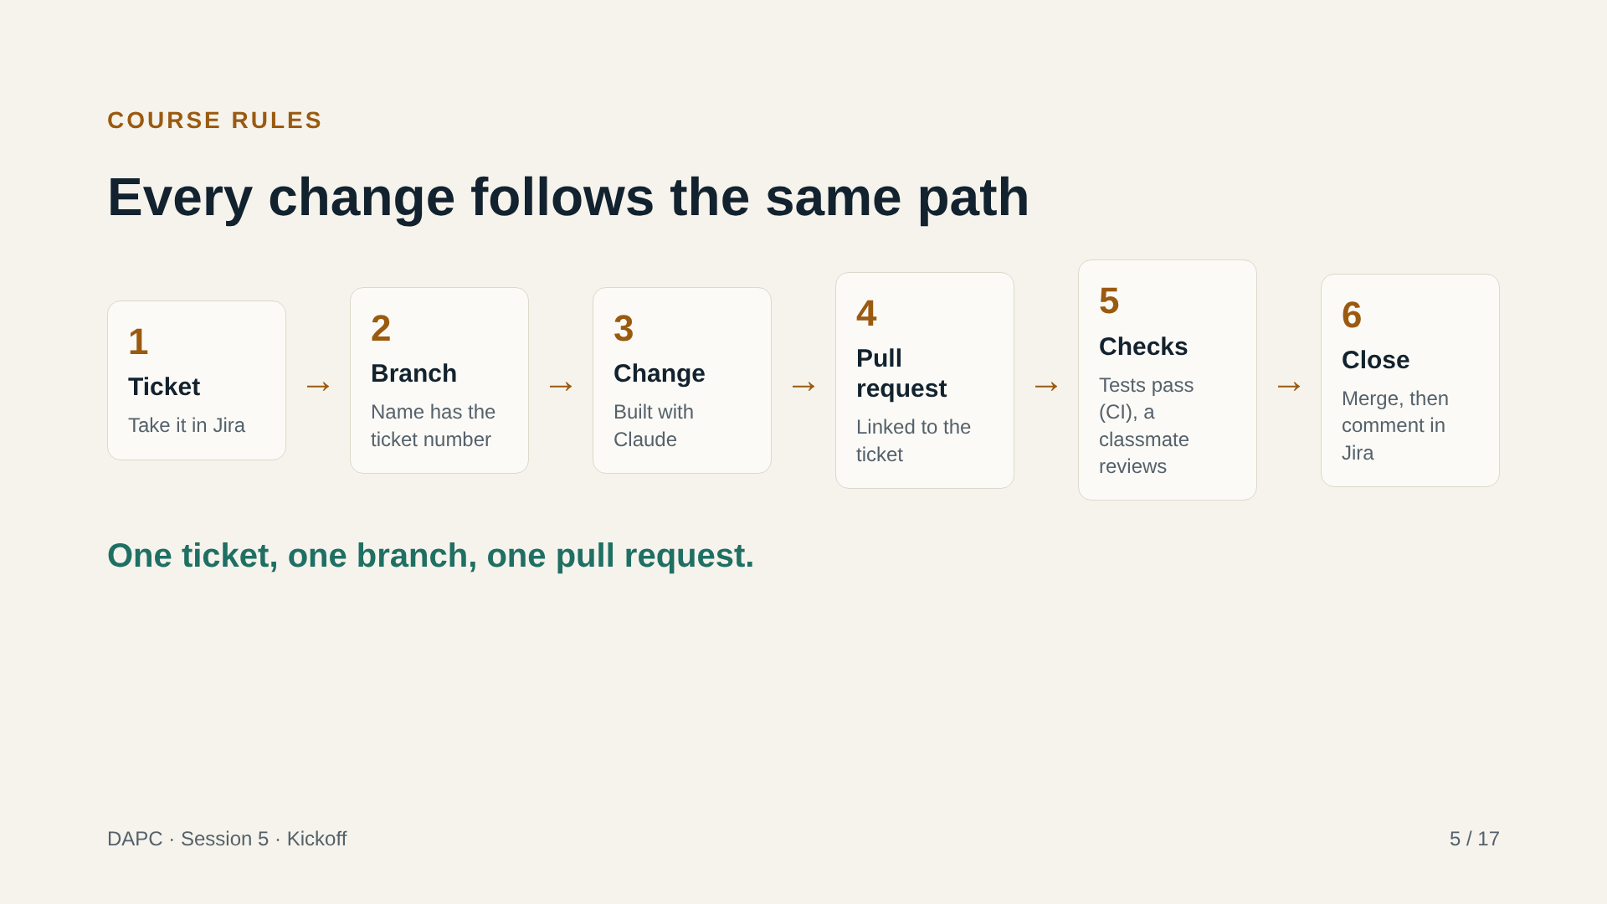
Notes:
This is the path every change takes for the rest of the course. Read the six steps once. Stress two things. First, nothing goes straight to main: the protection rule on main requires a pull request, passing tests (CI = automatic tests) and one approval. Second, the ticket number (SCRUM-N) appears everywhere: in the branch name, the commit message and the PR title. That is what lets the system match your PRs to your tickets automatically. Ask: why is it useful that every change is small and tied to one ticket? Take one answer, then move on. If the Jira workflow in SCRUM uses different column names than "In Progress" and "Done", tell the group the real names now.

Slide 6
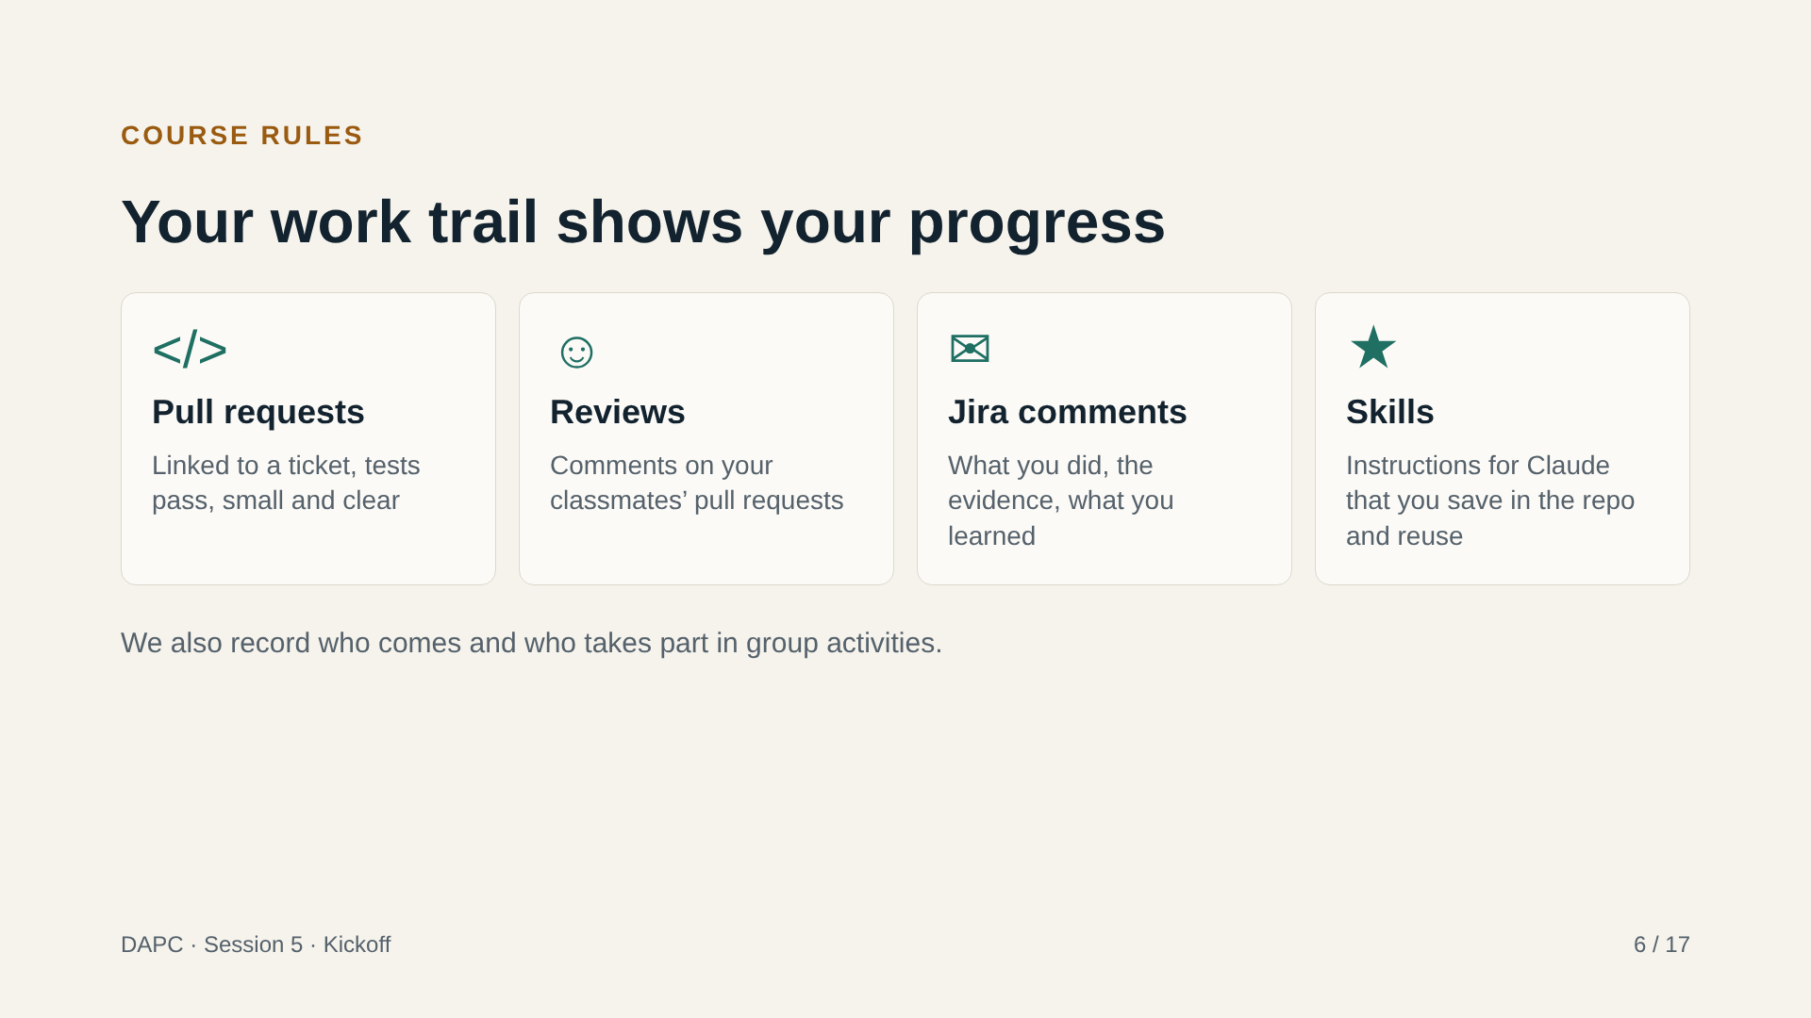
Notes:
This is the most important slide about how we check your progress. The work trail is the record of what you did. There are no exams. What counts is what you leave behind in GitHub and Jira, and it is measured automatically: your pull requests, your reviews of others, your comments in tickets, and the skills you contribute. Say clearly: the exact scoring has not been published yet. Do not invent numbers in class. Promise a date to share it. Encourage the habit: small PRs, clear comments, helpful reviews. Reviews of classmates count as much as your own work, because that is what a real team does.

Slide 7
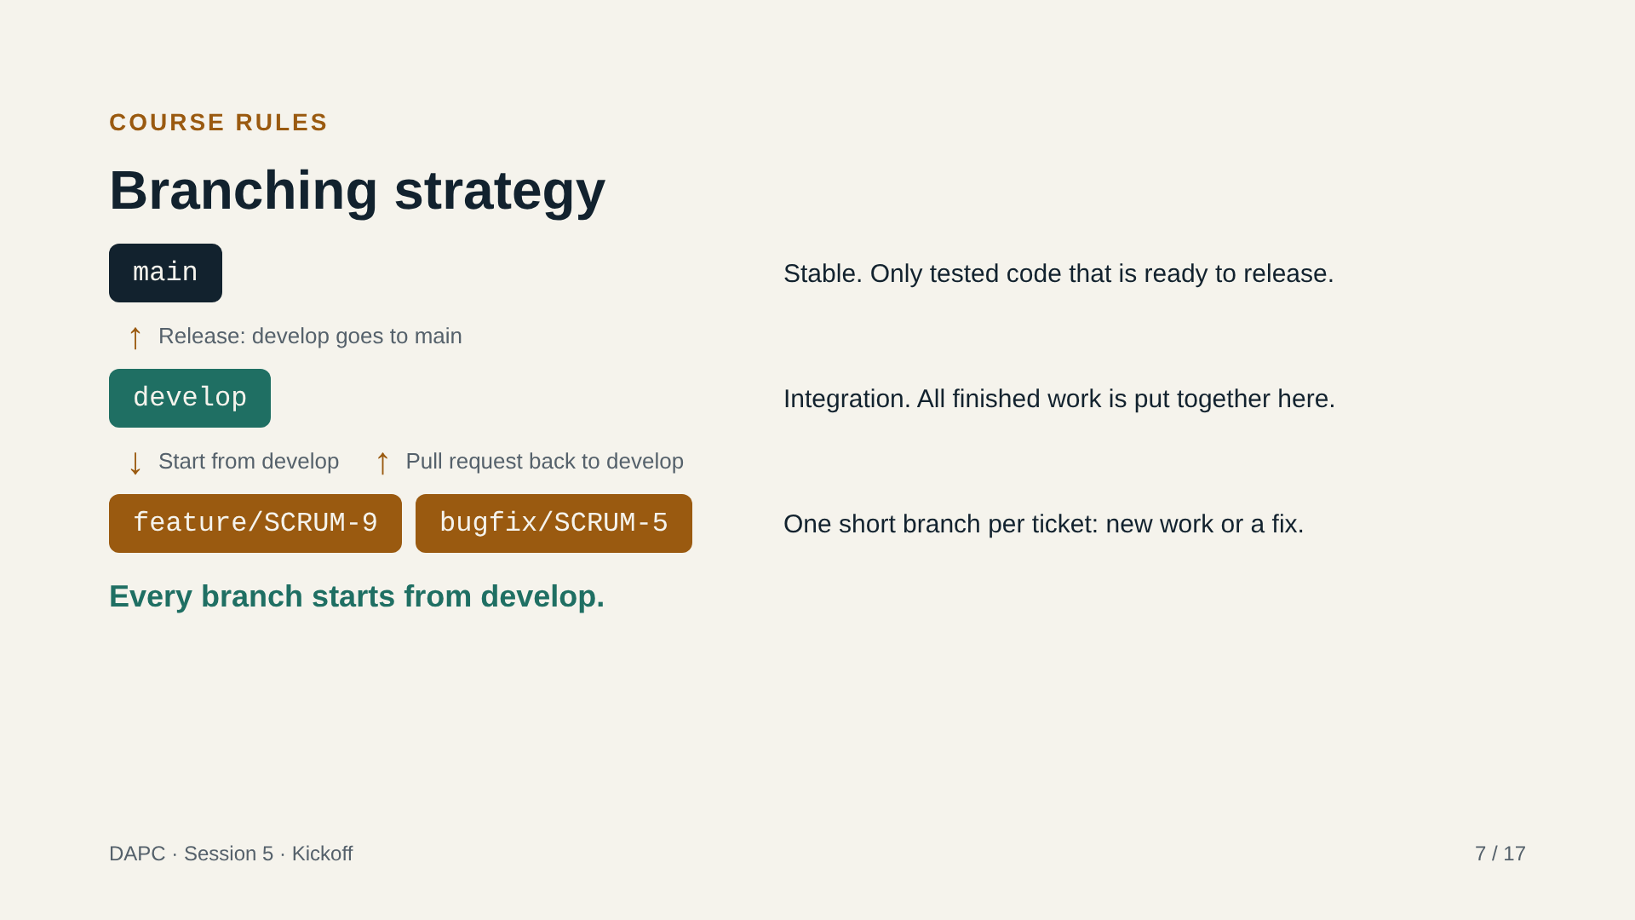
Notes:
Our branching strategy has two permanent branches and short work branches. Main holds stable code that is ready to release. Develop is where all finished work is put together. Every work branch starts from develop and comes back to develop through a pull request, never directly. Branch names start with the type of work, feature or bugfix, then a slash, then the Jira ticket key. When develop is ready, it is released to main. Both main and develop are protected (nobody can push to them directly): only pull requests with passing tests and a review. Instructor note: this requires creating the develop branch and protecting both branches before the session, and setting develop as the branch that pull requests target by default. The examples use real starter tickets: SCRUM-9 (a feature) and SCRUM-5 (a bug fix). Allow about 5 minutes.

Slide 8
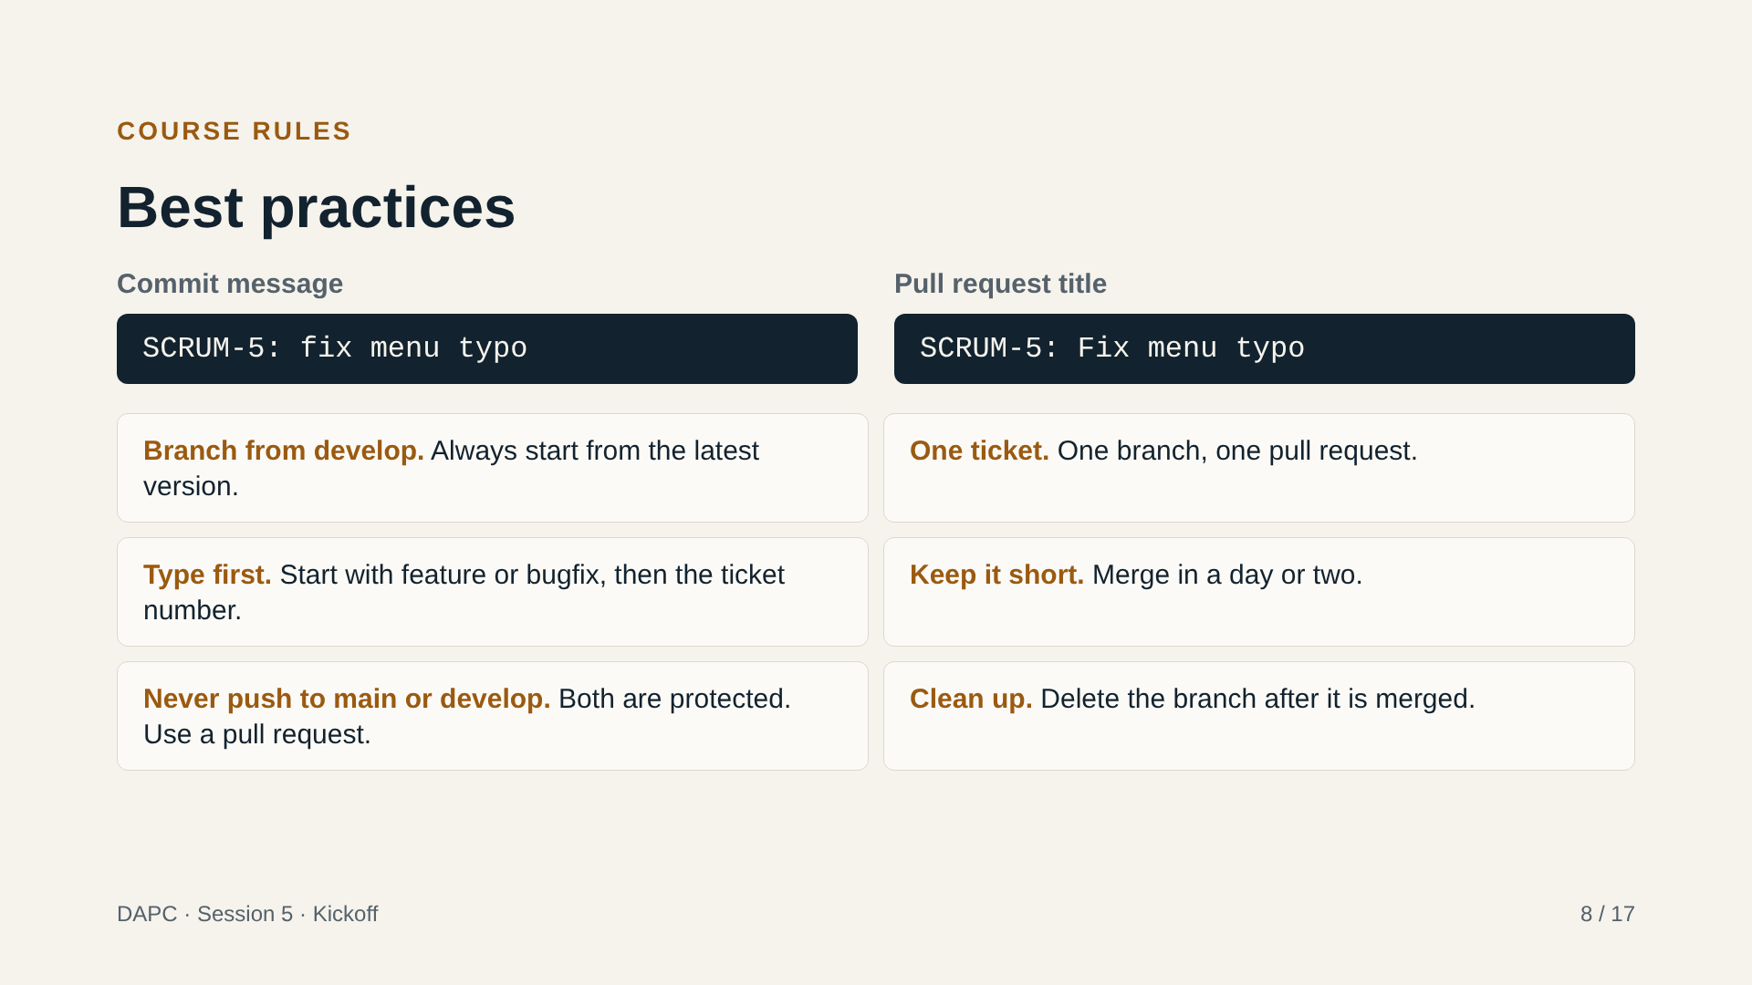
Notes:
The same ticket number goes in the commit message and the pull request title. That is how we match your branches, commits, pull requests and tickets automatically and build your work trail. Go through the six practices quickly: branch from develop, one ticket per branch and per pull request, type first, short branches, never push directly to main or develop because both are protected, and delete the branch after merging. Ask: why are short branches easier to merge? Take one answer and move on. Heads-up for later: when we study trunk-based development in the next sessions, we will compare it with this strategy, so keep your questions. Questions at the end of this slide close the course rules block; then move to setup.

Slide 9
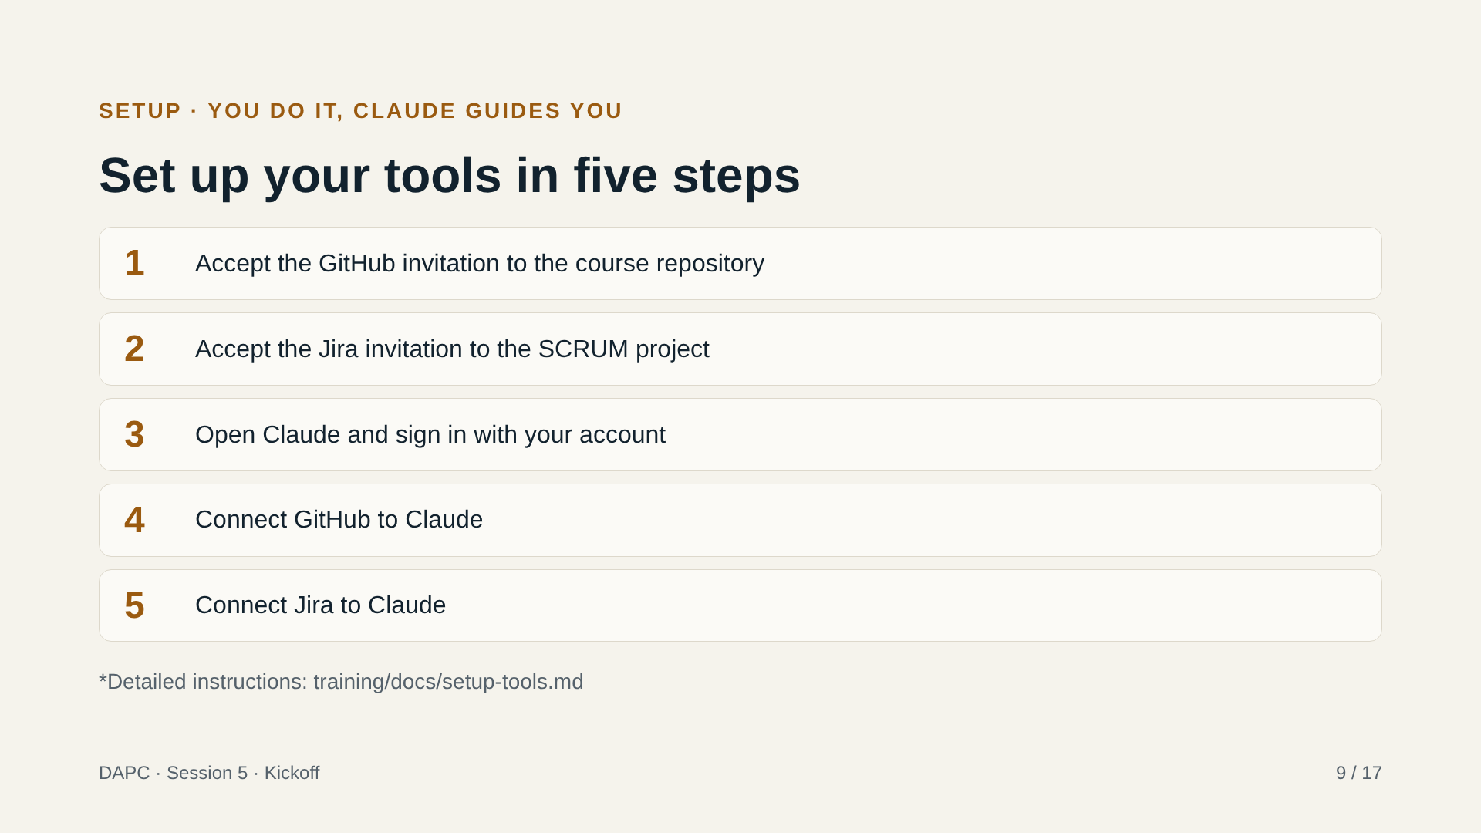
Notes:
Participants do this themselves. Keep this slide on screen while they work and walk around, or watch the chat. They should use Claude to guide them through each step: for example, "I just got an email invitation to a GitHub repository, what do I do?" Show on screen where to find the connections for GitHub and Jira in Claude's settings (the menu names change, so check them live before the session). Pair people: someone who already finished helps their neighbour. Everyone has a Claude Pro plan, so if a connection is blocked, check the account first. Expected time: 50 minutes, including problems. Anyone who finishes early moves to the next slide and verifies the connection.

Slide 10
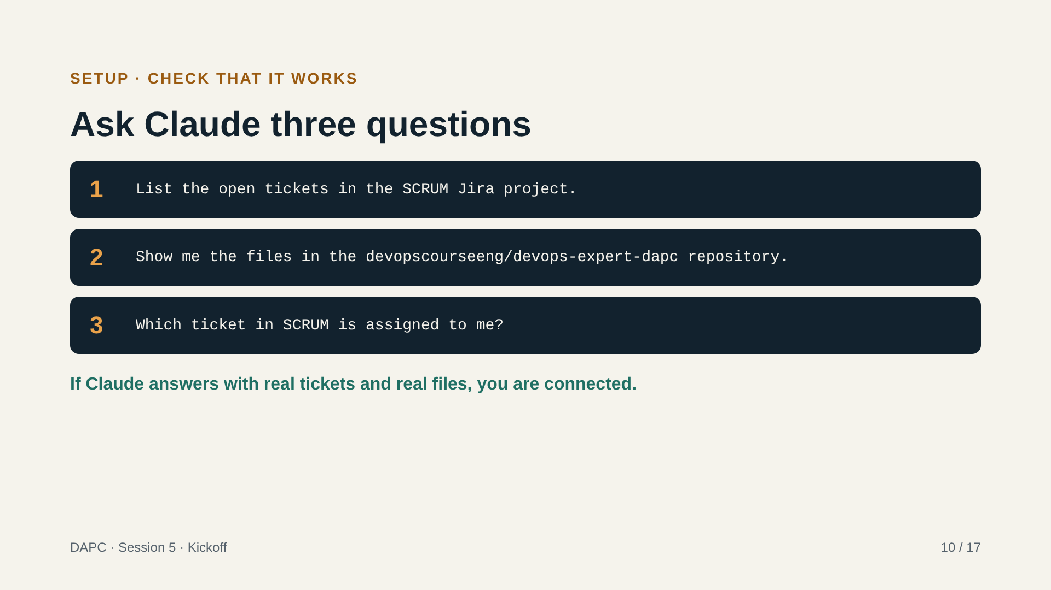
Notes:
When someone finishes the setup, they paste these three prompts into Claude one at a time. The test is simple: Claude shows real tickets from SCRUM and real files from the repository. If it says it cannot see them, go to the next slide. Question 3 only works if the starter tickets are already assigned, so assign at least one ticket per participant before the session. Whoever passes all three tests can help a neighbour. When most of the group is connected, announce the break (1:30).

Slide 11
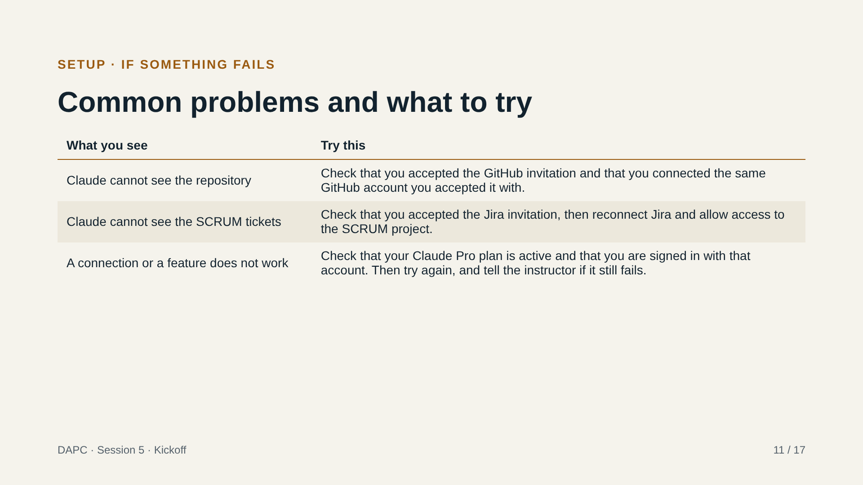
Notes:
Leave this slide up as a reference during setup; do not present it. The three rows cover the problems we expect most. Everyone in the course has a Claude Pro plan, so plan limits should not block a step. If someone is stuck for more than 10 minutes, pair them with a classmate who has finished instead of solving it live in front of everyone. Note down every problem that comes up: it becomes the first skill material later.

Slide 12
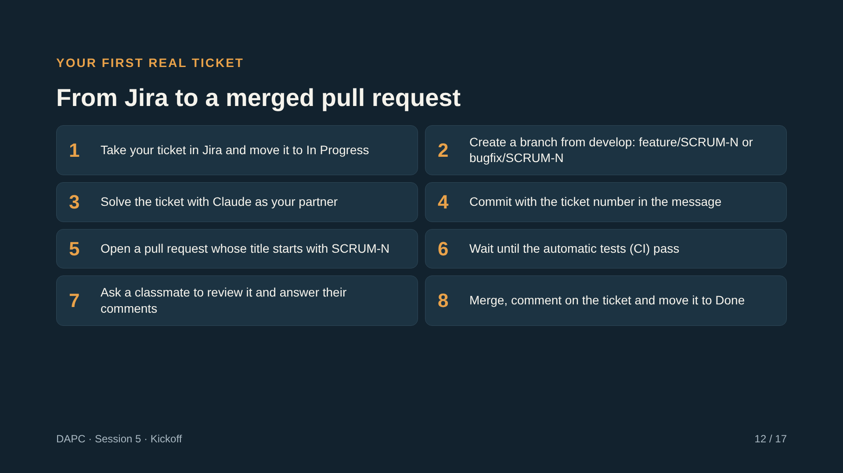
Notes:
Each participant takes one of the starter tickets and follows the eight steps. The first ticket is easy on purpose (for example, fix the typo in the menu of the Summit Cafe API) because the goal is the process, not the code. Walk around and watch for: the branch name, the ticket number in commit and PR, and whether the CI actually ran. Reviews: each person reviews the PR of the person to their left, so every PR gets one review. If CI is not green because of a setup problem, fix it with the group and write down the problem in a ticket. Aim to have the first PRs merged in the first 40 minutes, leaving the last 20 for reviews and Jira comments. The tickets used here are the starter tickets prepared before the session (see training/docs/starter-tickets.md in the repository).

Slide 13
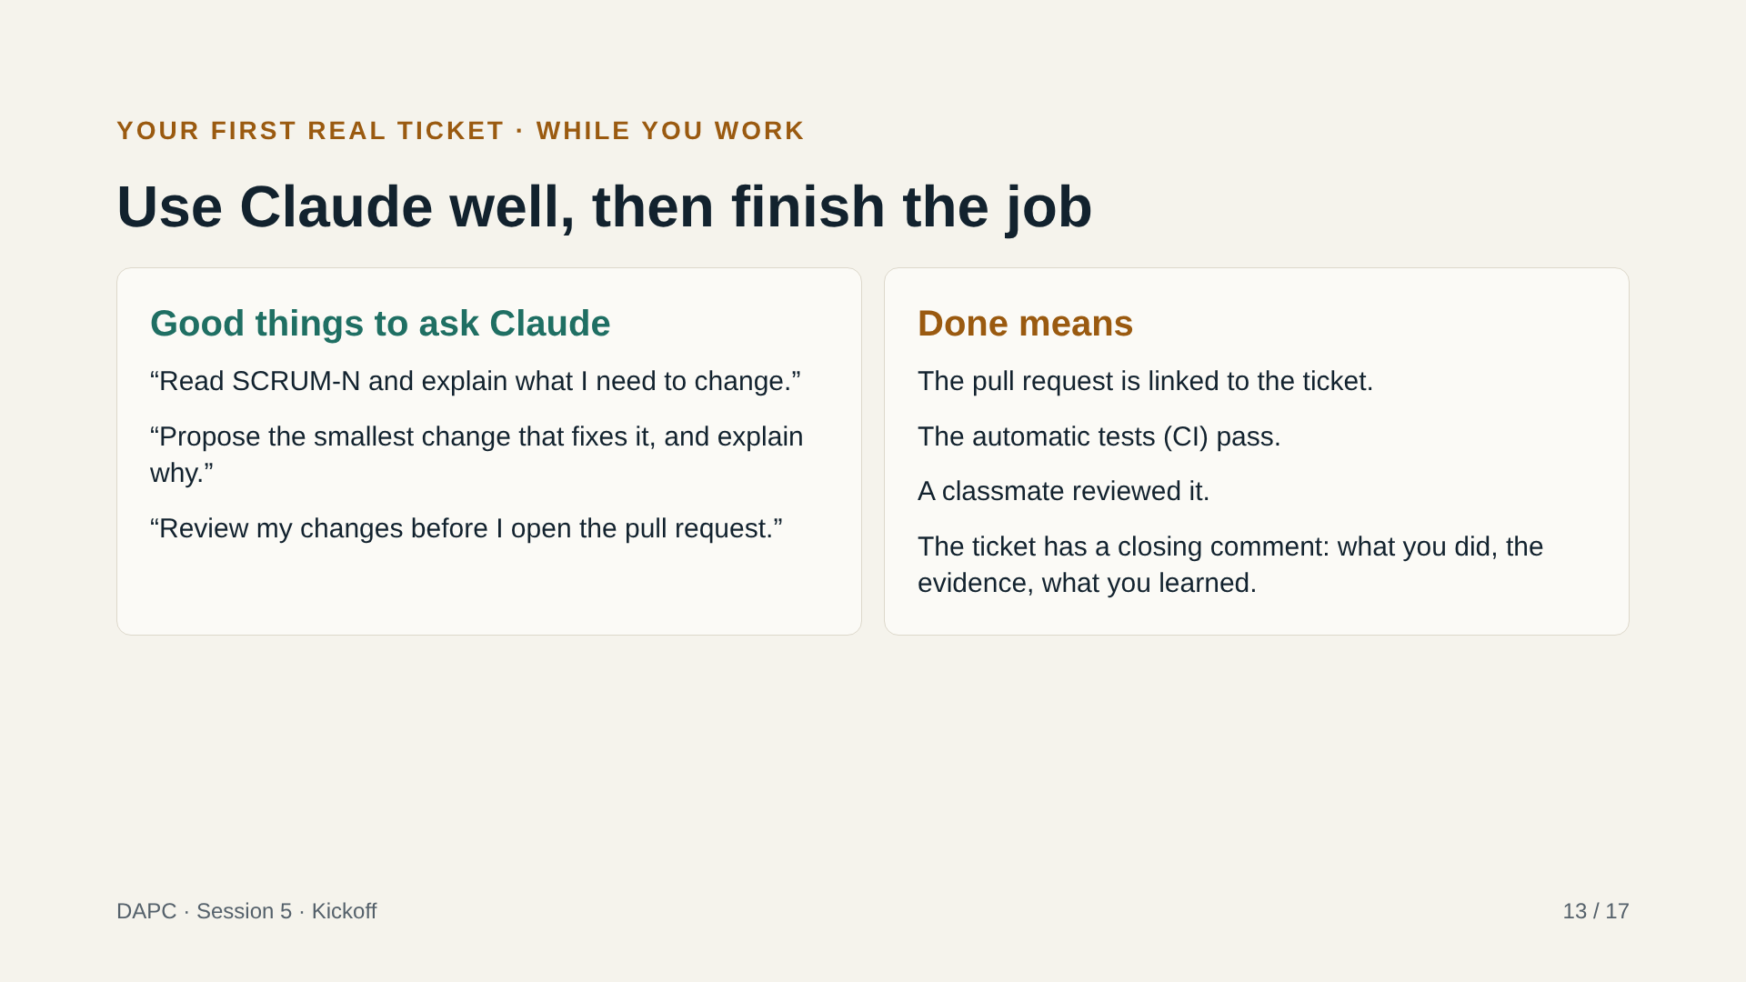
Notes:
Keep this slide as a reference during the ticket work. The left card shows how to use Claude as a partner, not as a machine that only gives answers: it explains, suggests and reviews, but the participant understands and decides. Remind them that they must be able to explain every line they commit. The right card is the definition of done; their work trail depends on all four points. If someone finishes early, they review another PR or help a neighbour, which also counts in the work trail.

Slide 14
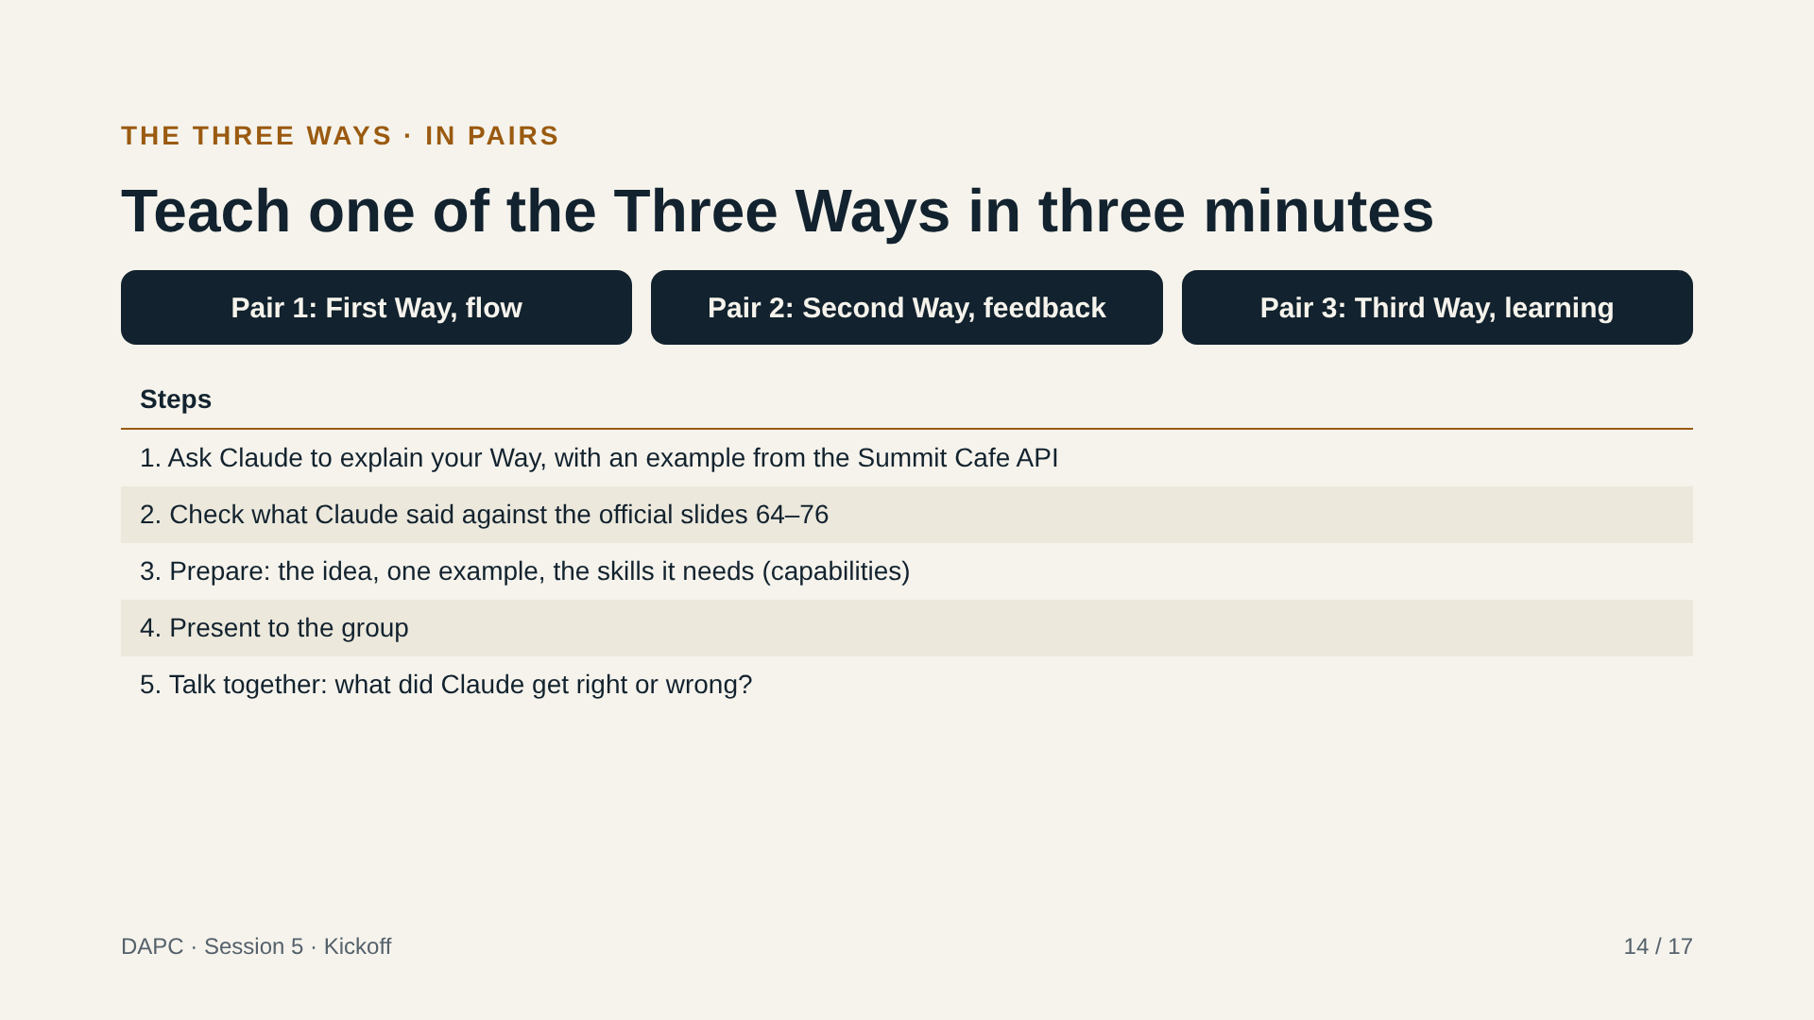
Notes:
This is a recap of the Three Ways (slides 64 to 76), now built by the participants with Claude instead of presented by me. With six participants, I suggest three pairs, one Way per pair, so every Way is covered. (The plan says two teams of 3; if you prefer that, give Team A the First and Second Ways and Team B the Third Way plus the capabilities of each.) Rules: Claude gives the first explanation, but the pair must verify it against the official slides and say where Claude was incomplete or wrong. The group talk at the end is the key moment: which details did Claude miss? That is a lesson in verifying AI answers. Use the next slide as your answer key for the group talk; do not show it before the presentations.

Slide 15
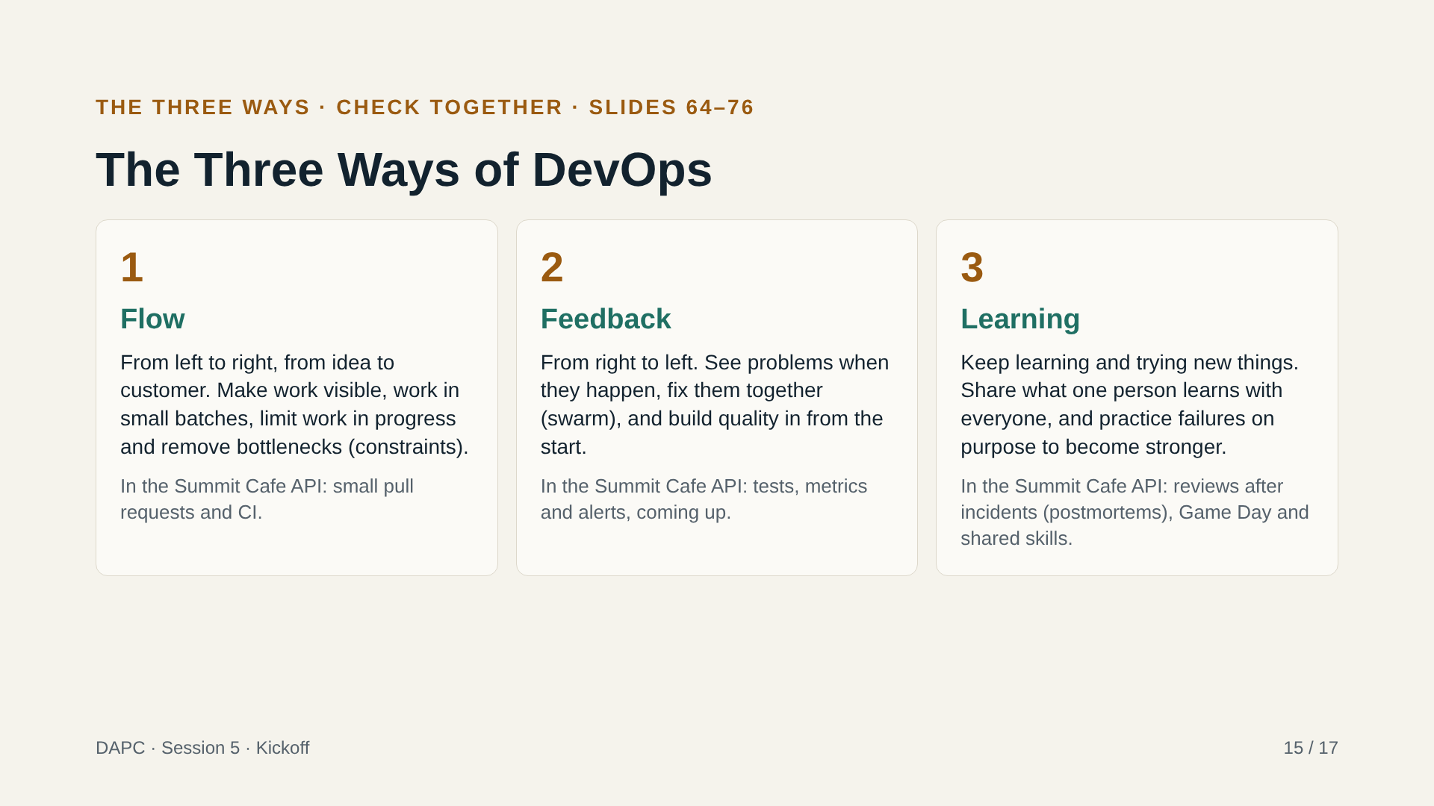
Notes:
Use this slide as the answer key during the group talk; show it only after the three presentations. Compare each pair’s explanation with it: what did the pair say that is here? What did Claude add that is not in the official material? What did it miss? The official material (slides 64 to 76) also connects each Way to the capabilities it needs; if a pair did not mention them, add them now. For the exam, remember: the Three Ways of DevOps and the capabilities each one needs. Close the block by saying that every later session in the course belongs to one of the three Ways, and the session plan labels them.

Slide 16
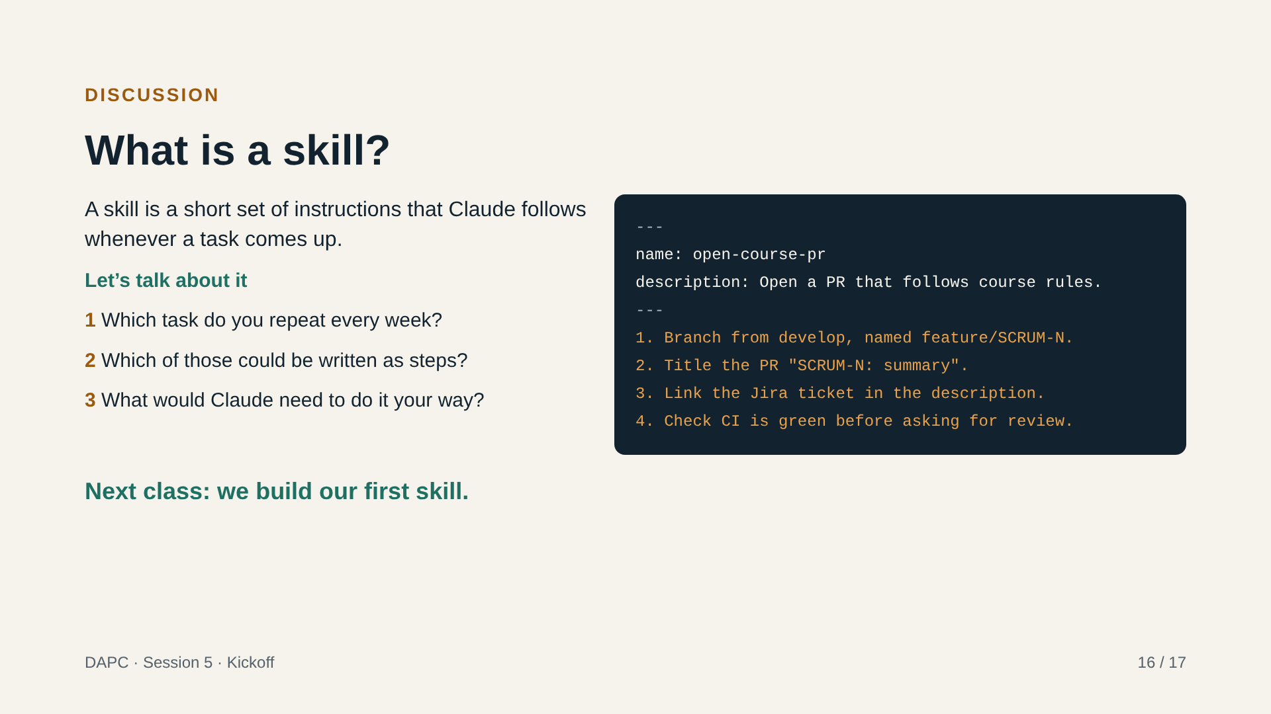
Notes:
This block is a discussion, not an exercise. Explain the idea in one minute: a skill is a folder with a file of instructions that Claude loads when the task matches, and it can also carry reference files and scripts. The example on the right is only a model of what the file looks like; do not build it today. Then ask the group the three questions. Collect answers on a shared list: the repeated tasks they mention are the candidates for the first skills. Guide the group toward tasks from this course (opening a pull request, writing a Jira closing comment, running a review) and from their own jobs. Close by confirming that in the next class every participant builds their first skill, so they should arrive with one repeated task in mind. Note for the instructor: skills need code execution enabled; test a free account before the next class.

Slide 17
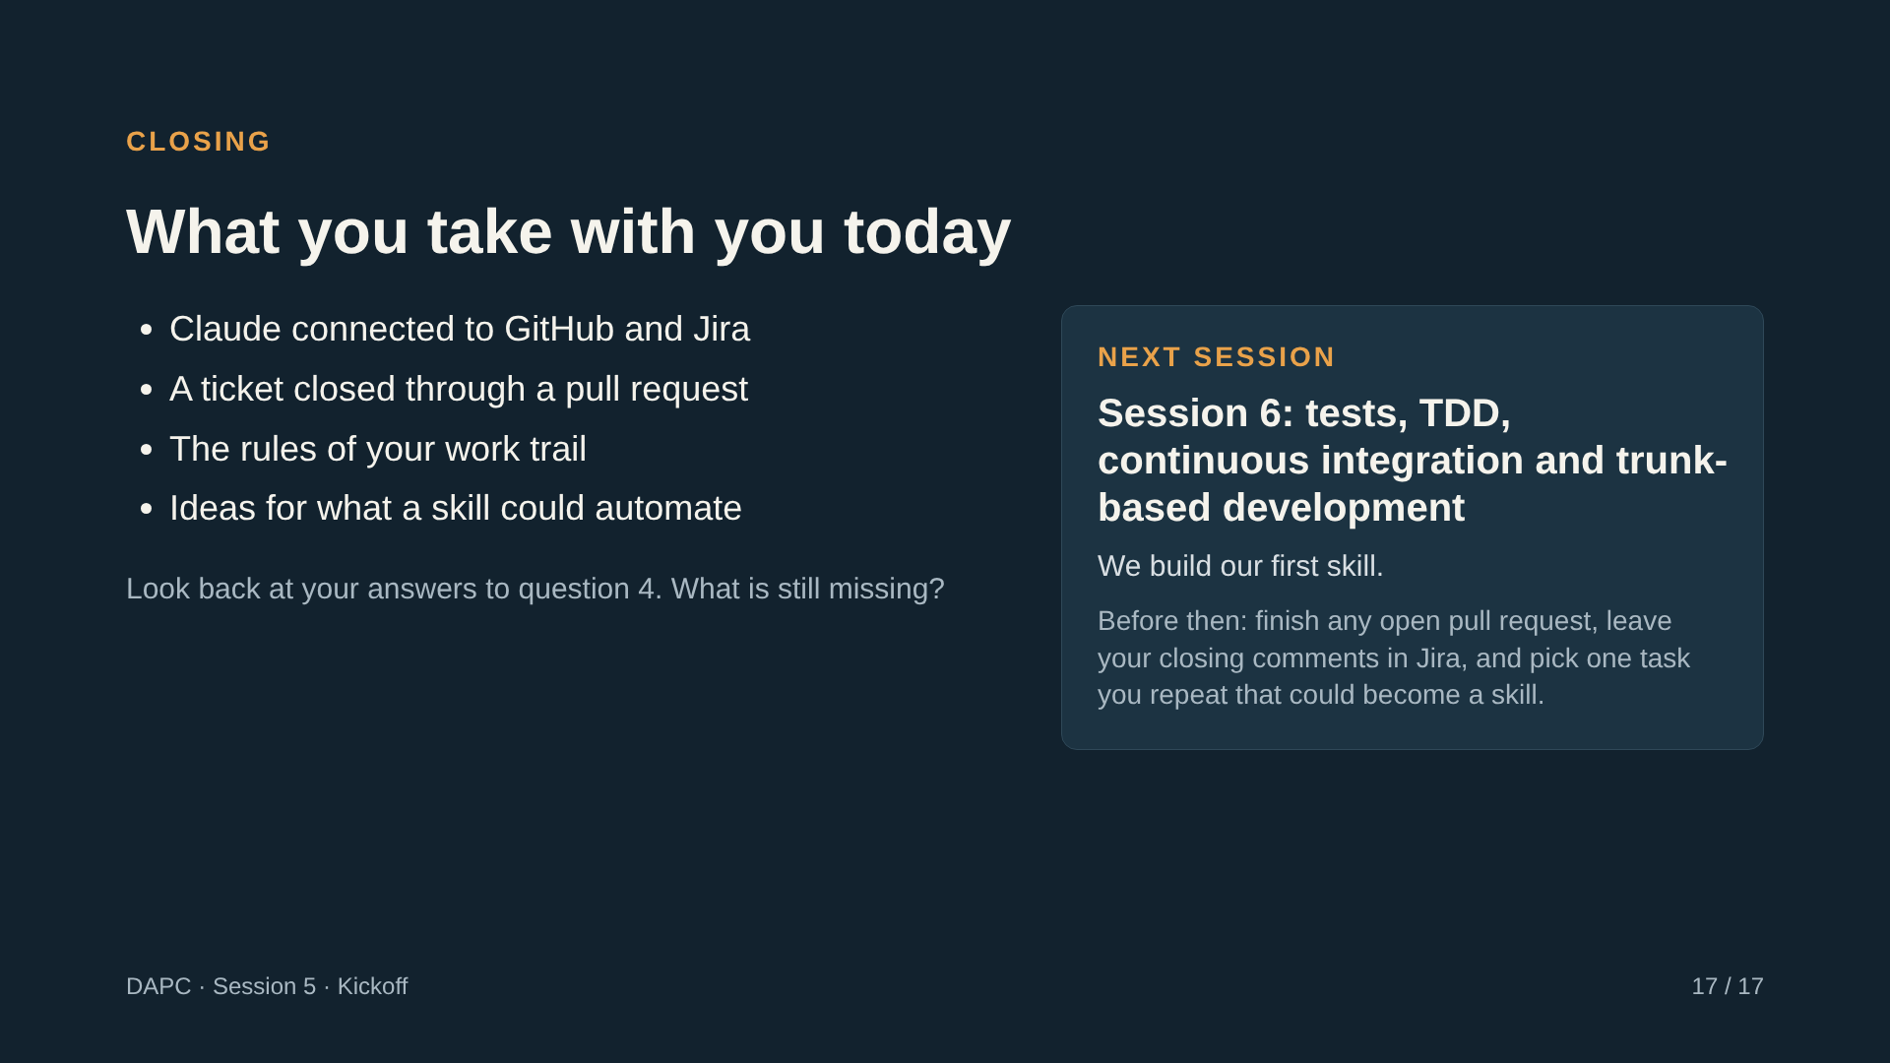
Notes:
Close quickly. Read the four outcomes and ask for a thumbs-up if each one is true for them; anyone without a thumbs-up gets help after the session. Go back to the expectations list you wrote at the start (question 4) and tick off what we covered. Announce the next session: it is led by Patricia, who is a quality engineer, and it is about tests, TDD and continuous integration. Confirm that we will build our first skill in that session, and ask everyone to bring one repeated task in mind. Remind everyone that open pull requests and Jira comments still count after the session ends. Leave the remaining time for questions or for finishing open pull requests.

