Slide 1
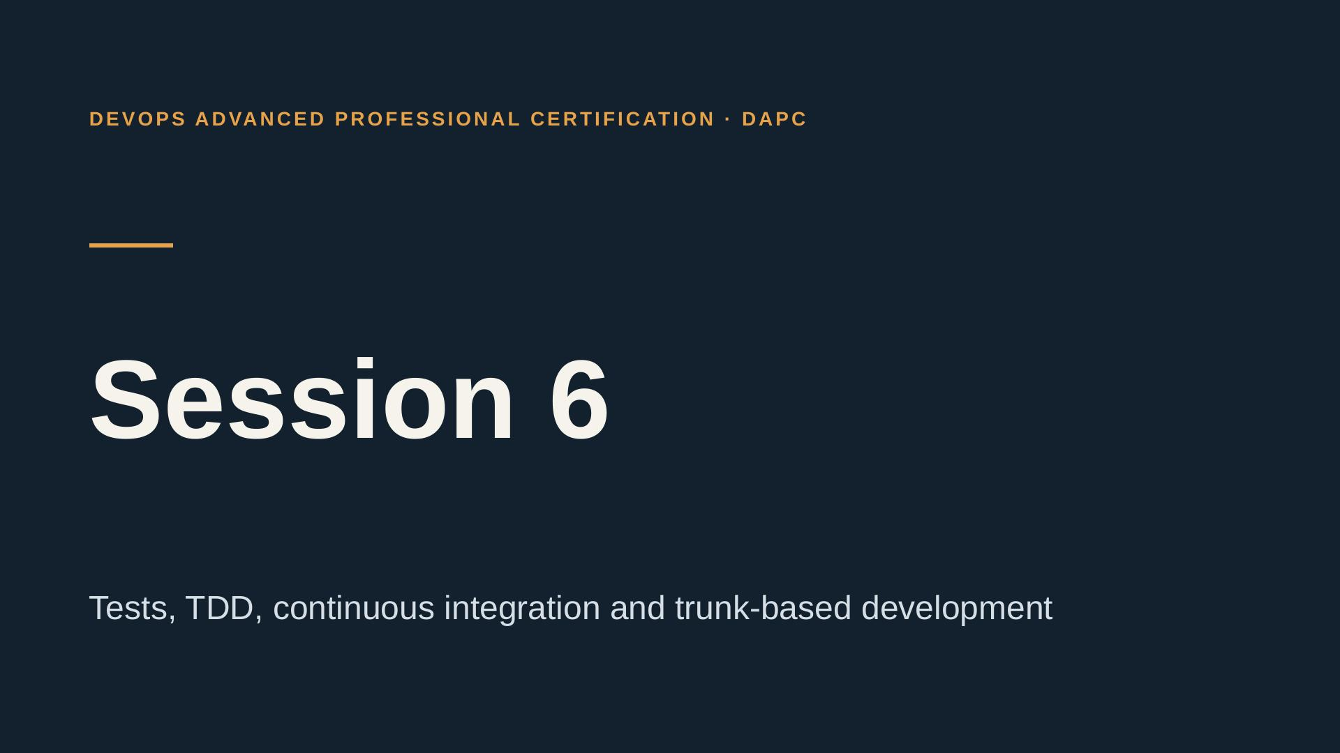
Notes:
Welcome. Today the pipeline becomes a safety net. By the end you will have tests that block a bad change, one feature built test-first, and your first skill. Most of the time is yours.

Slide 2
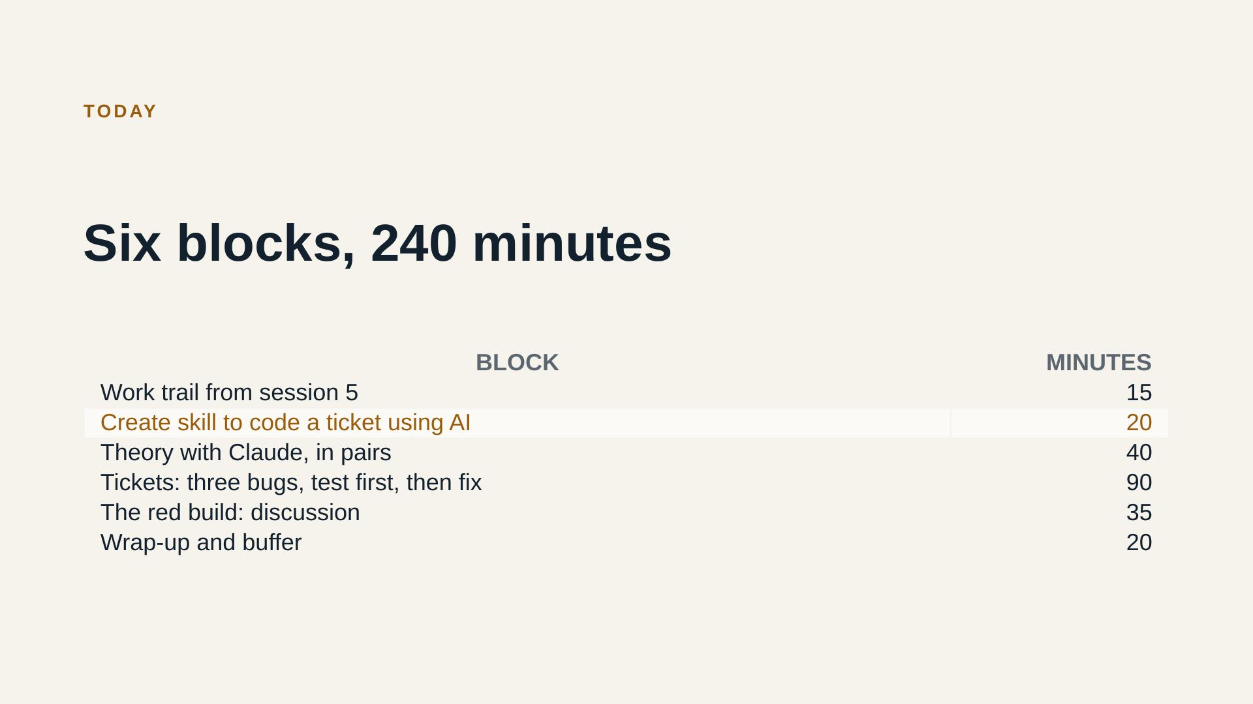
Notes:
Walk through the agenda in under a minute. Blocks 2 and 4 are yours. I only facilitate.

Slide 3
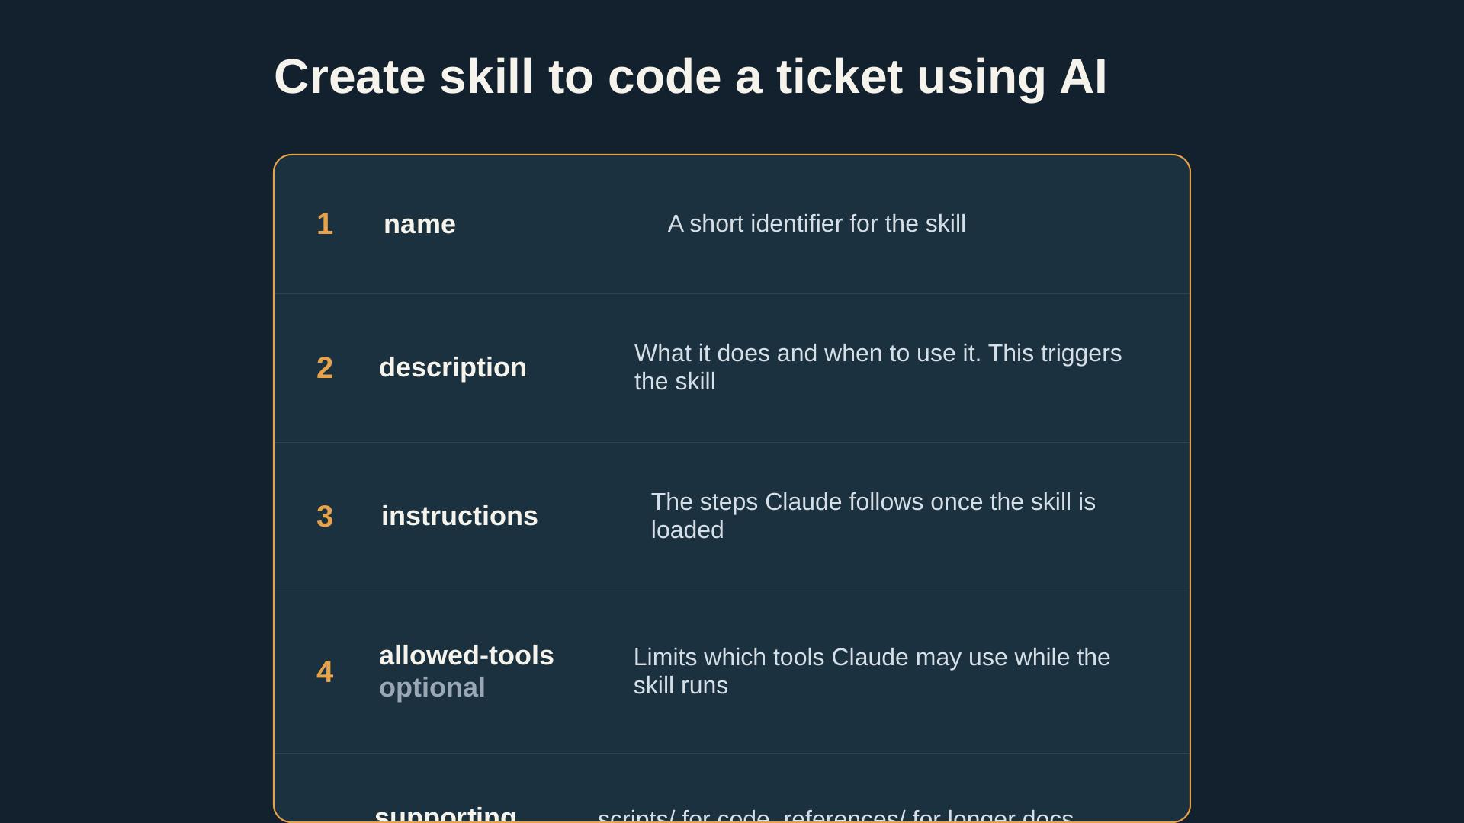
Notes:
Session 5 introduced the idea. Participants build the skill with Claude, test it on one real ticket, and contribute it to the repo. The two examples are only models.

Slide 4
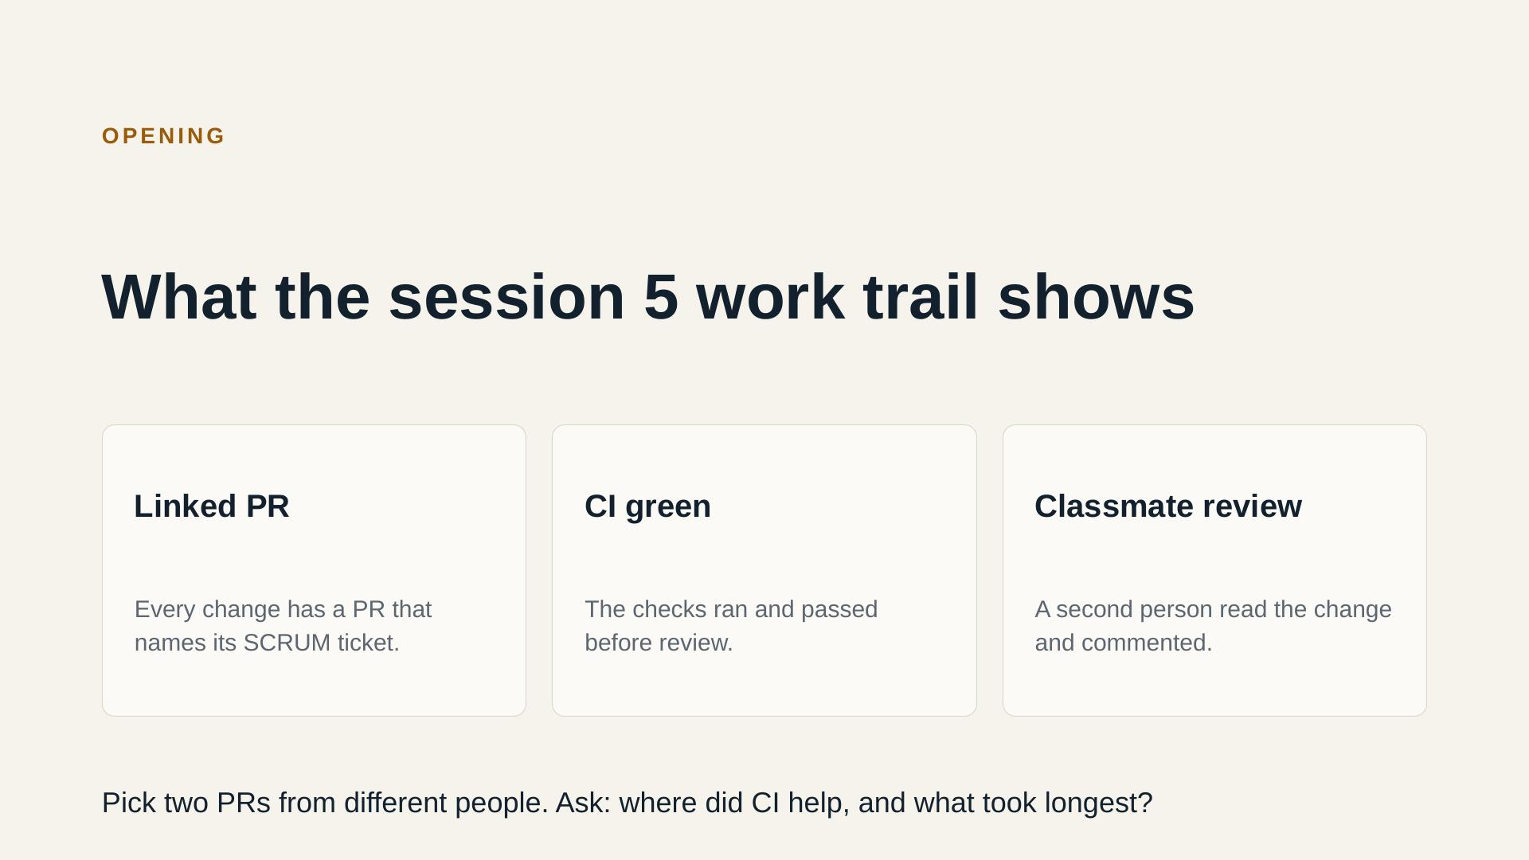
Notes:
Pick PRs from two different people. Ask the authors where CI helped and what took the longest. Keep it to 15 minutes including questions.

Slide 5
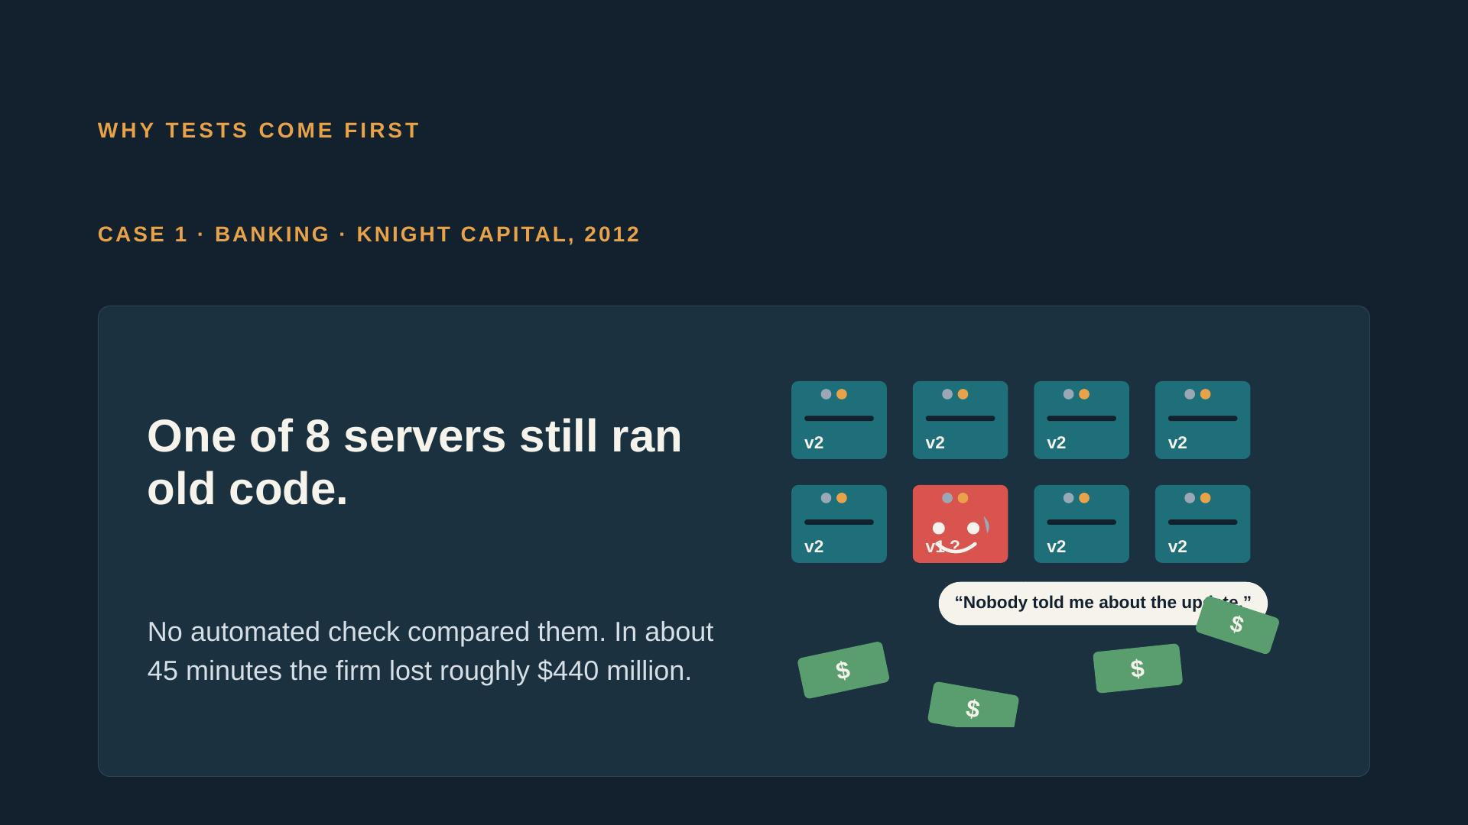
Notes:
Ask: which part of our own work looks like the 5 percent? The case is the HP LaserJet firmware team in the official material. Keep it to about 5 minutes.

Slide 6
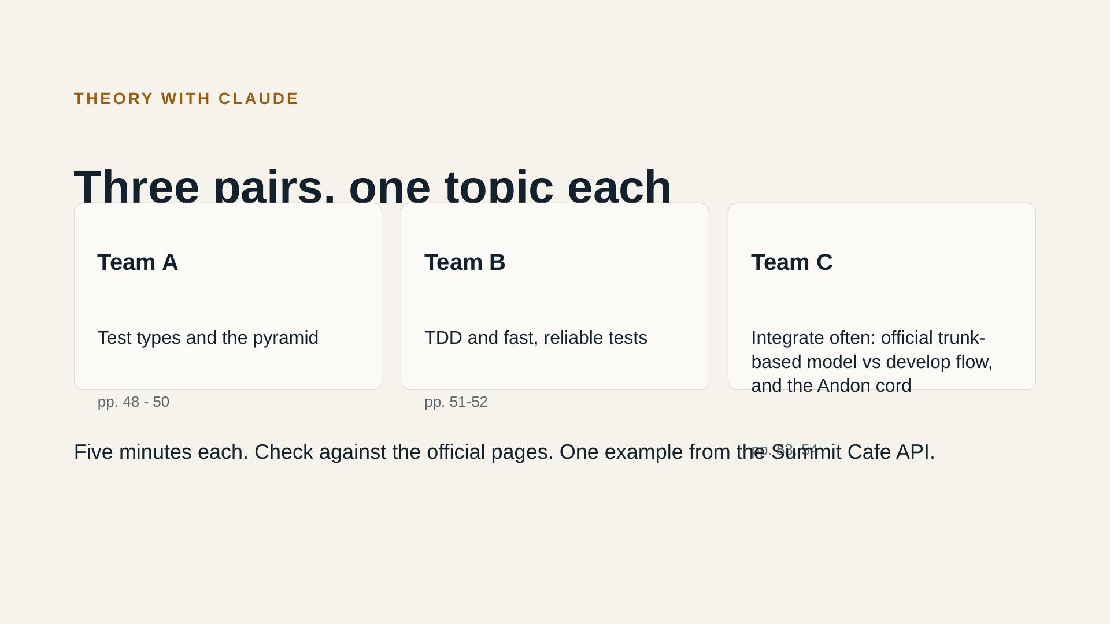
Notes:
Each pair builds its explanation with Claude, then checks it against the official pages listed on the card. Each explanation needs one example from the Summit Cafe API. Five minutes each, then the group talks.

Slide 7
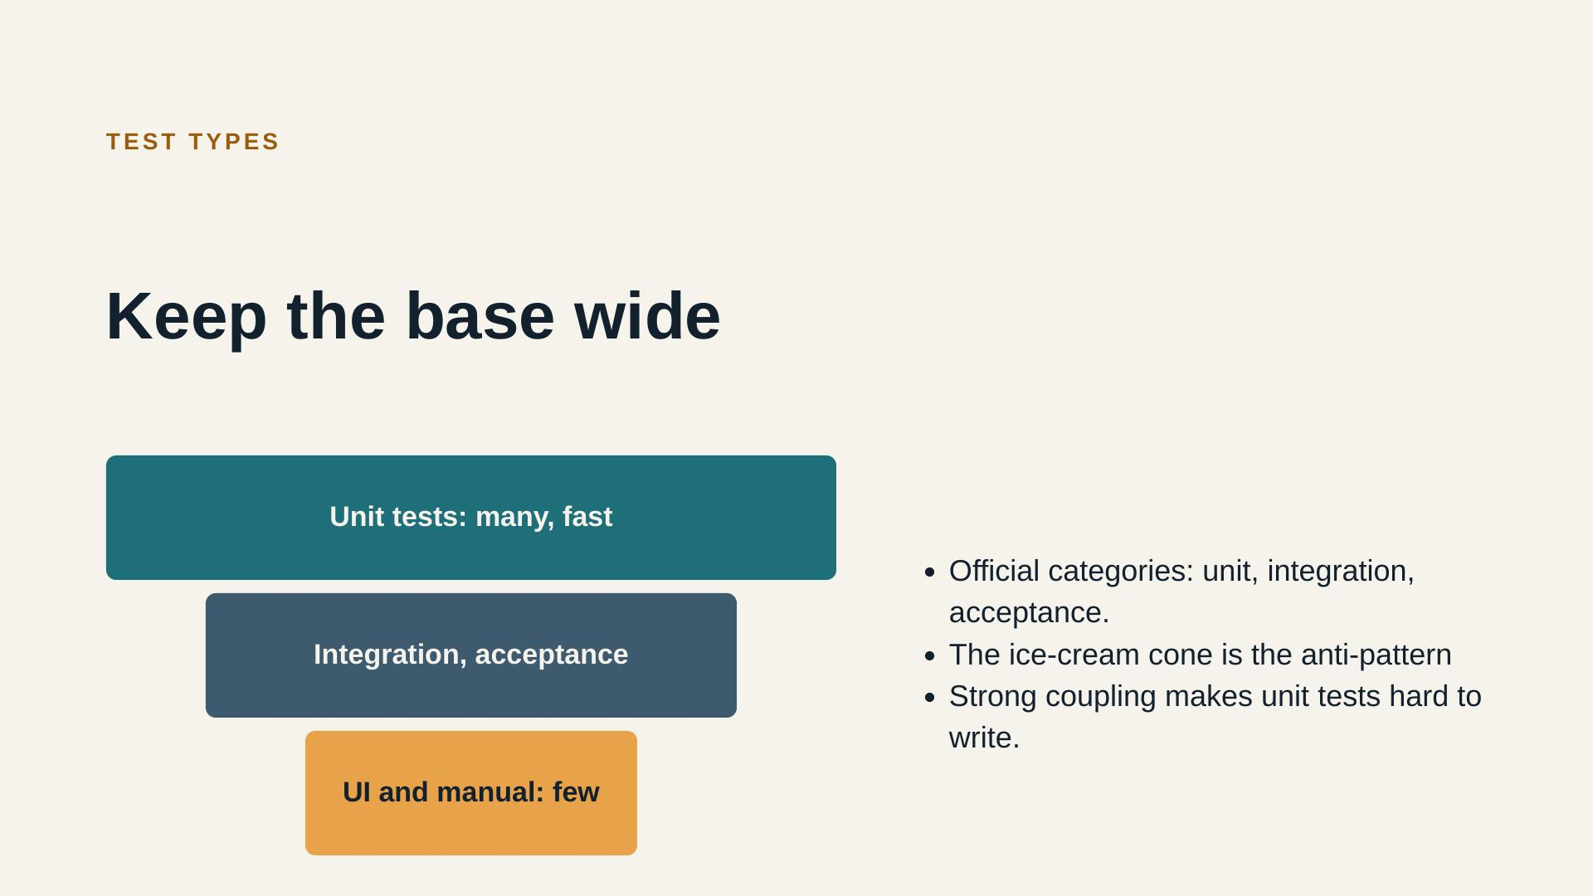
Notes:
Ask: which of our current tests are unit tests, and which are API tests? Be honest about the gap. Slide 107 also says a strongly coupled system makes unit and acceptance tests hard to write. That is a design signal, not only a testing problem.

Slide 8
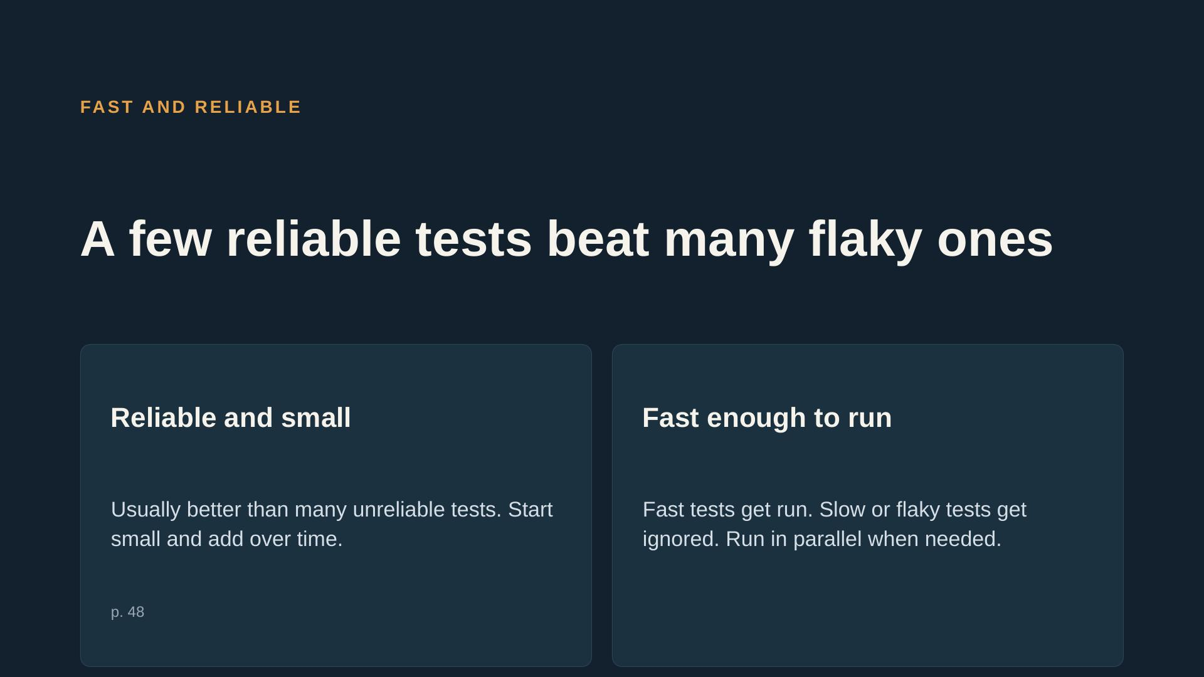
Notes:
Ask participants to name one flaky test they have seen. Do not spend time on tools here.

Slide 9
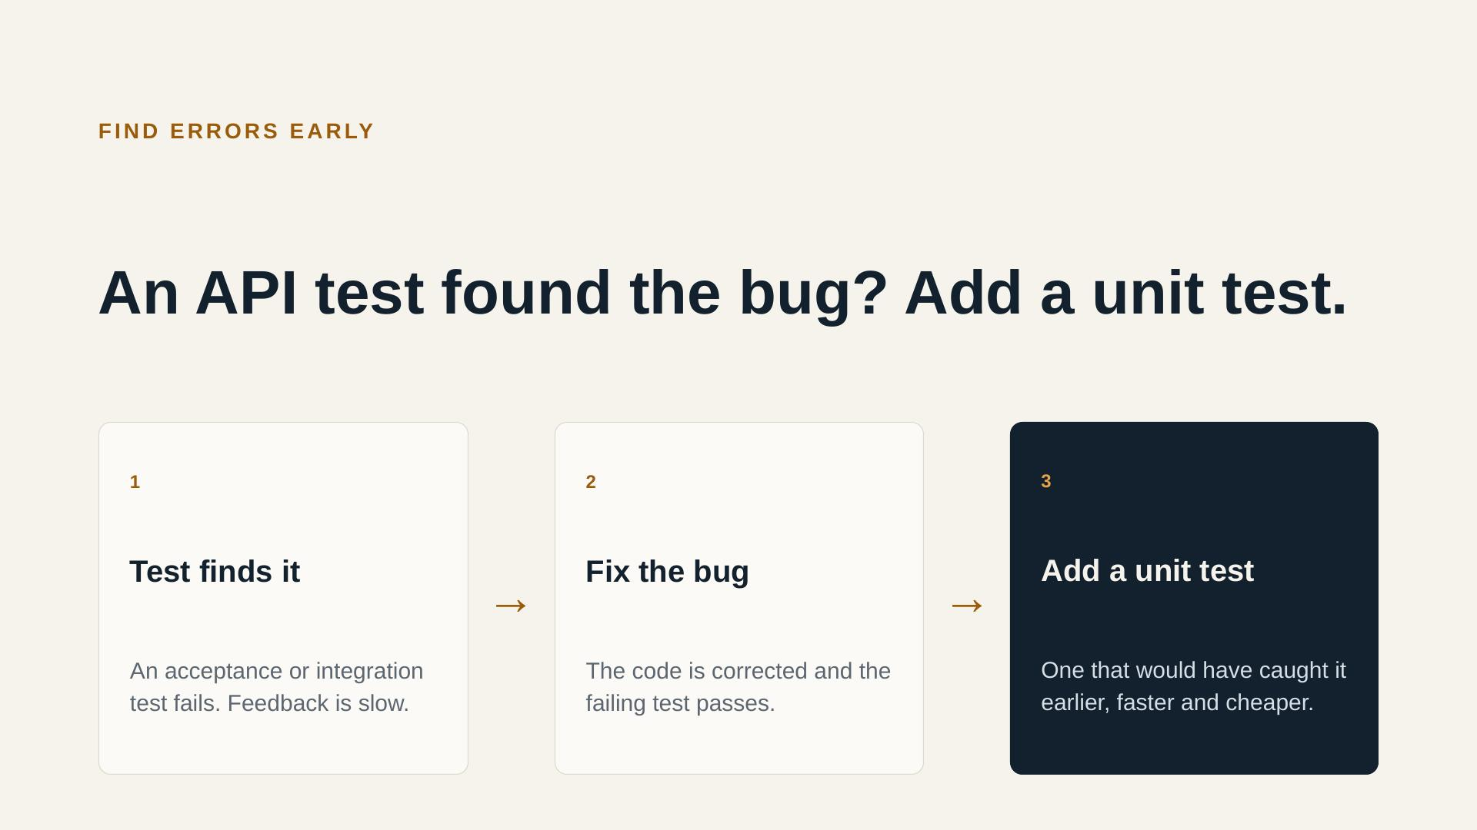
Notes:
This is the rule behind ticket (a). Show it with one example: an API test fails, the bug is fixed, then a unit test is added for the same bug. Official material, page 106.

Slide 10
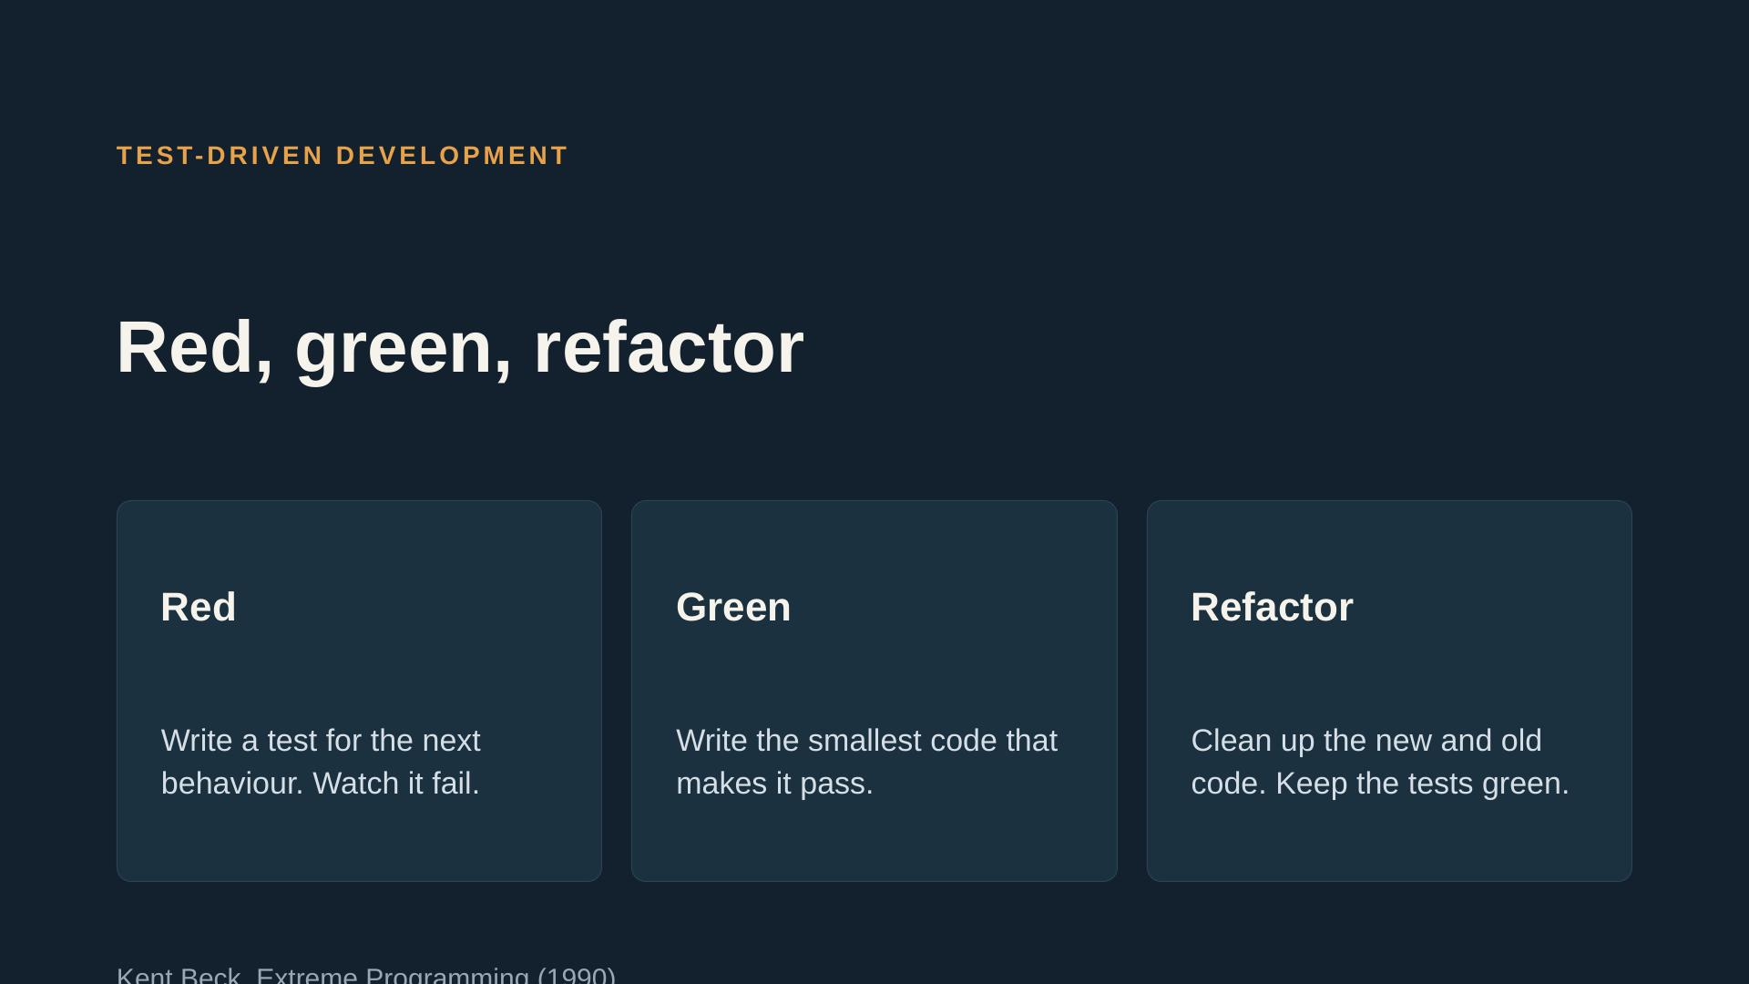
Notes:
Show the cycle on a tiny example, about 2 minutes. Then the pairs do it for real in ticket (b). Mention ATDD (acceptance test-driven development) briefly; it is on the same official page.

Slide 11
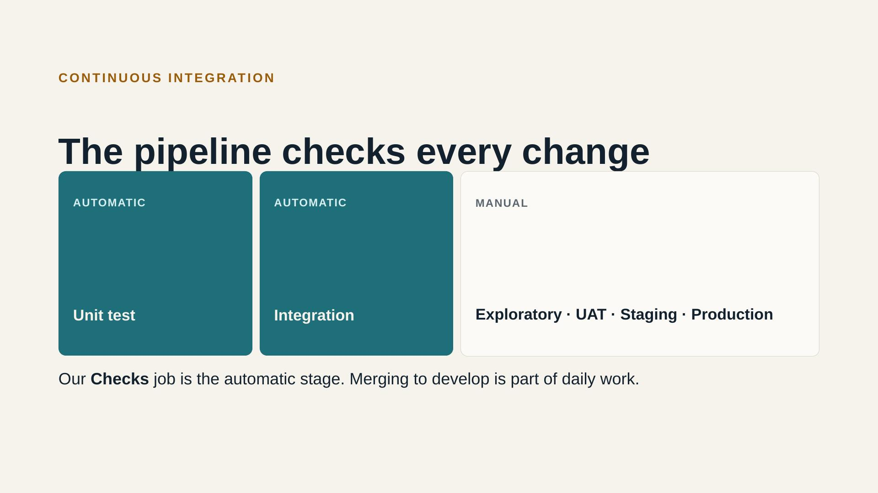
Notes:
Connect this to our ci.yml: the Checks job is our automatic stage. Point out which official stages we do not have yet. We get to them in later sessions. Official pages 104 and 115 to 117.

Slide 12
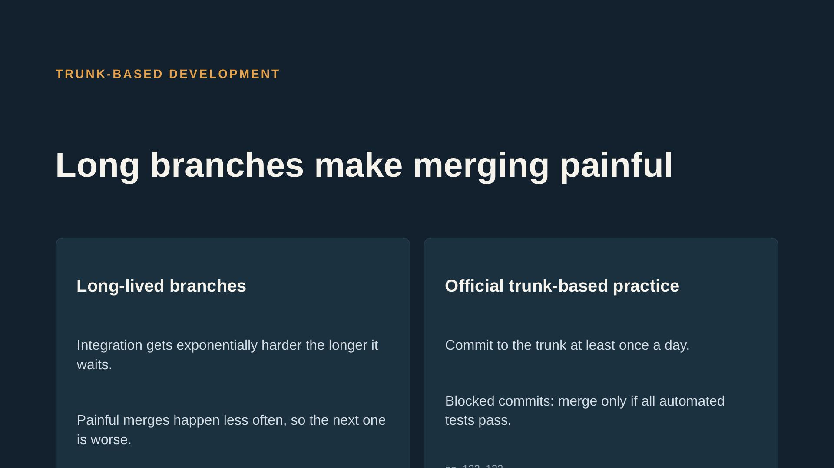
Notes:
This course keeps main and develop (decision in the plan). Say clearly why: the team uses short branches from develop, with the same goal of small, frequent, tested integration. Do not present trunk-based as wrong, and do not present our model as the official one.

Slide 13
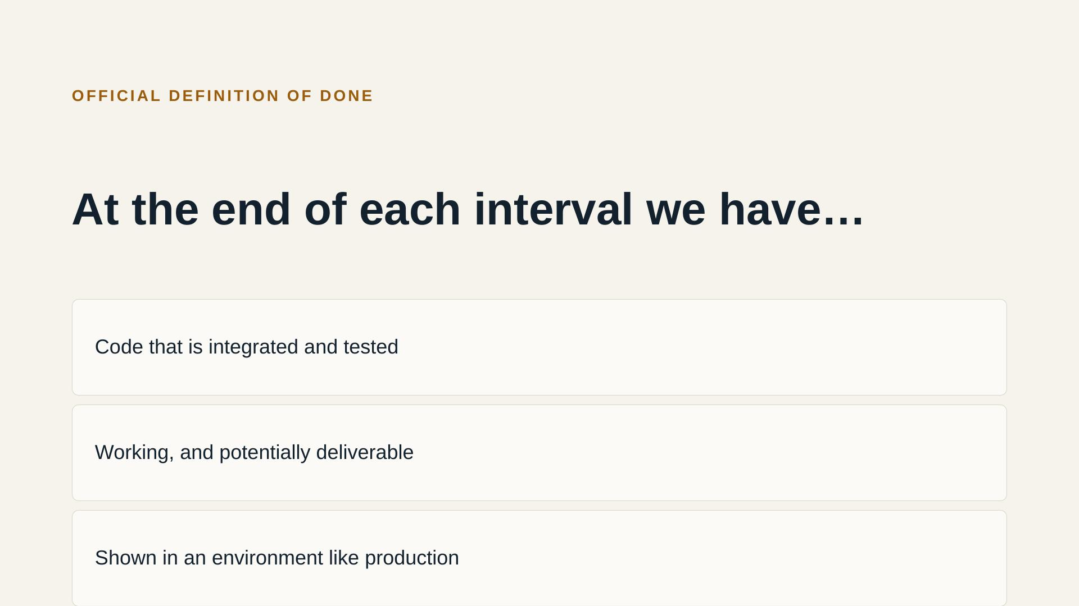
Notes:
Official definition of done for each development interval, page 123. Ask: which of these points do we already meet, and which do we not yet?

Slide 14
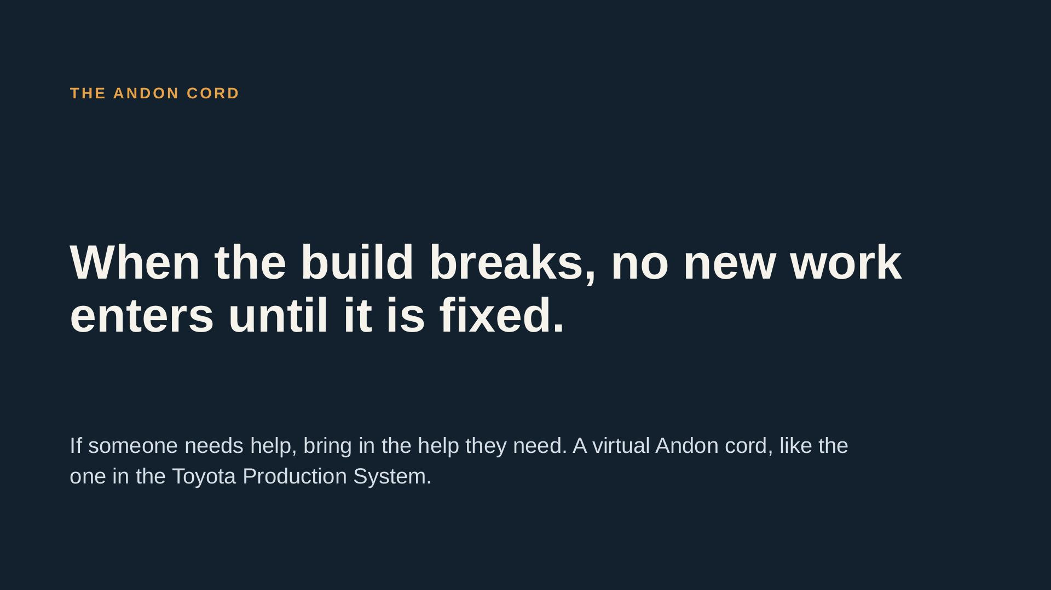
Notes:
Official material, pages 100 and 113. This is the basis for the discussion block next. Note: the official discussion divider on page 114 has no questions; the questions are ours.

Slide 15
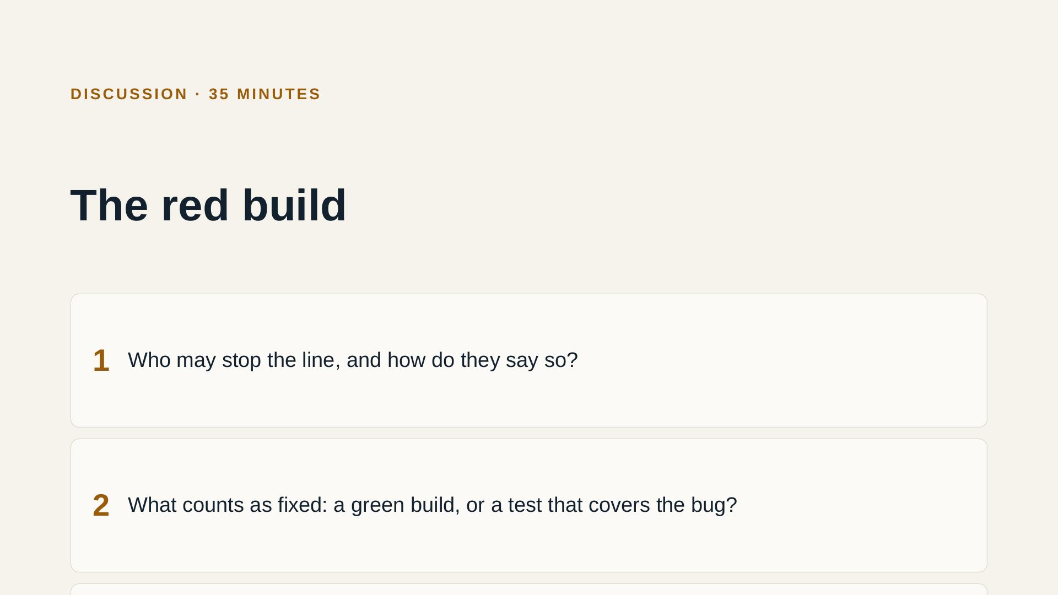
Notes:
Teams write their answers, then the group agrees one rule. Break a test on purpose and open a PR, so the group sees the block. These are our questions: the official discussion divider on page 114 has none.

Slide 16
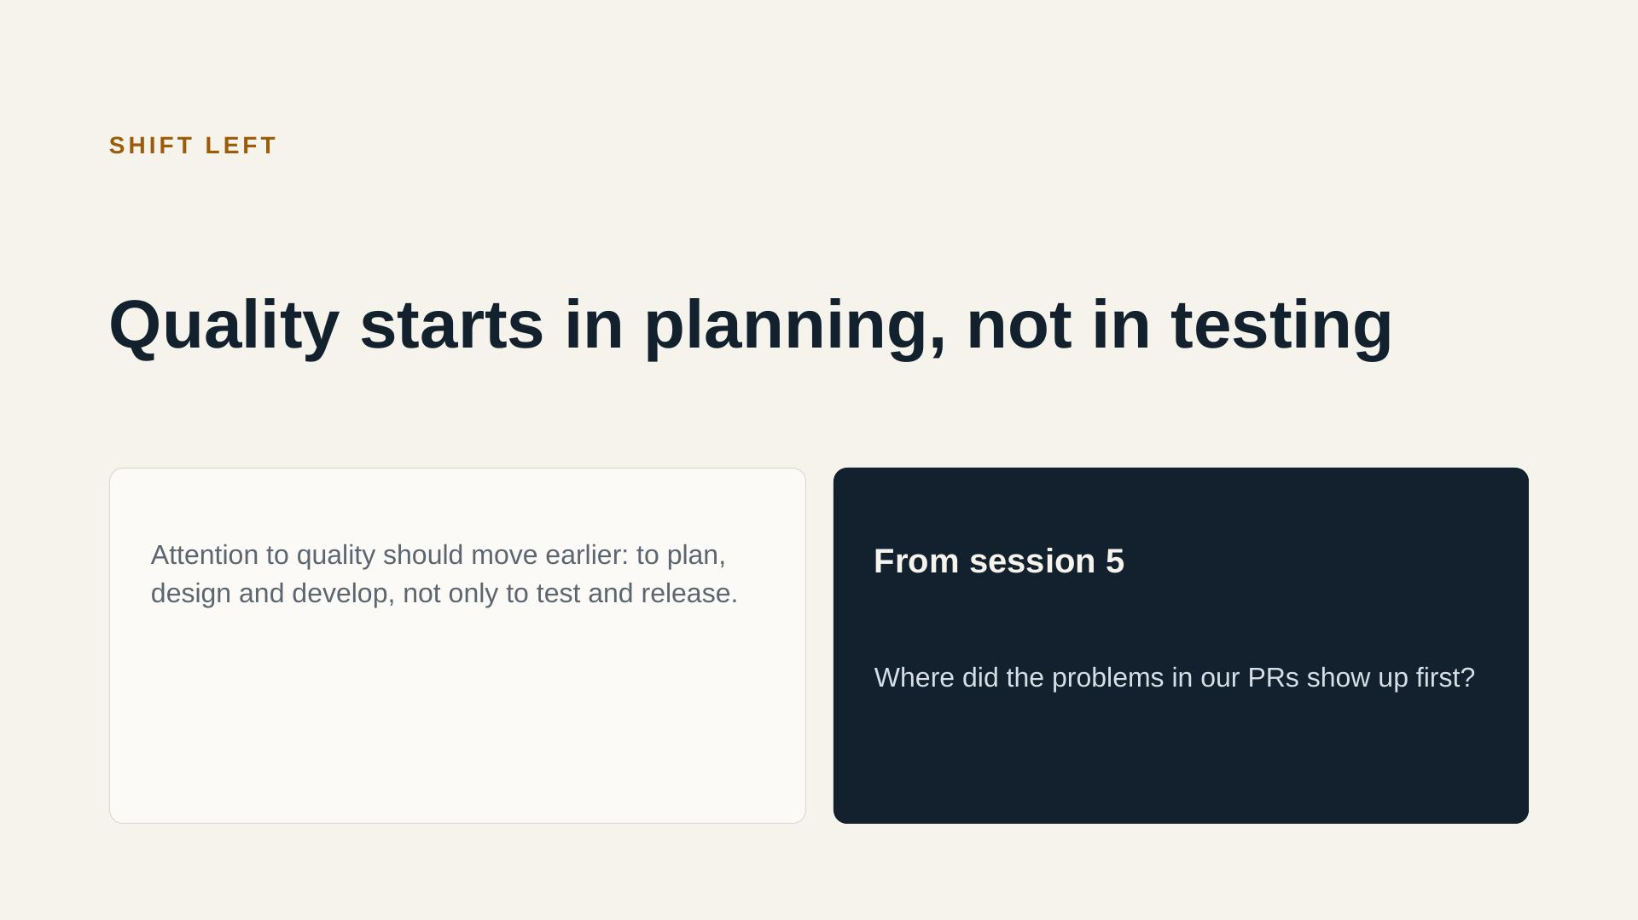
Notes:
Official chart on page 124 (source credited on the slide). Page 103: quality is built in from the first stages, which gives a quick feedback loop. Connect to session 5: where did the problems in the PRs show up first?

Slide 17
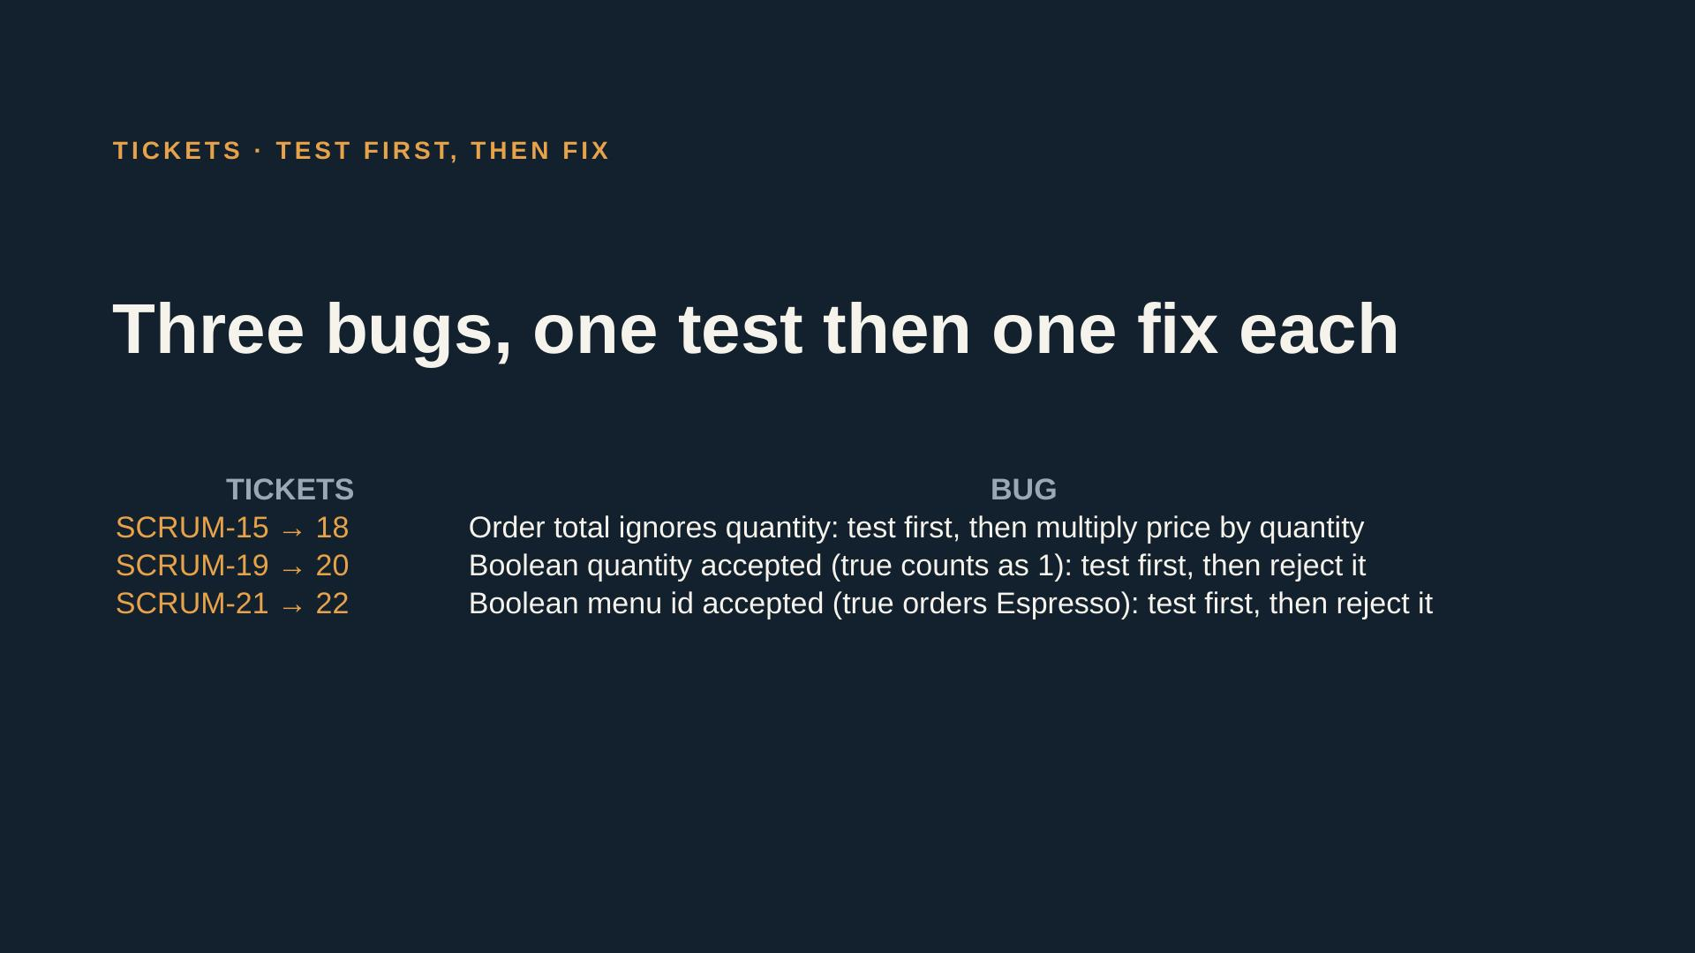
Notes:
Each pair takes one bug: the test ticket comes first and must fail, then the fix ticket turns it green. Walk around and watch for tests that only check the code runs, not what it returns. Full acceptance criteria are in the ticket spec file.

Slide 18
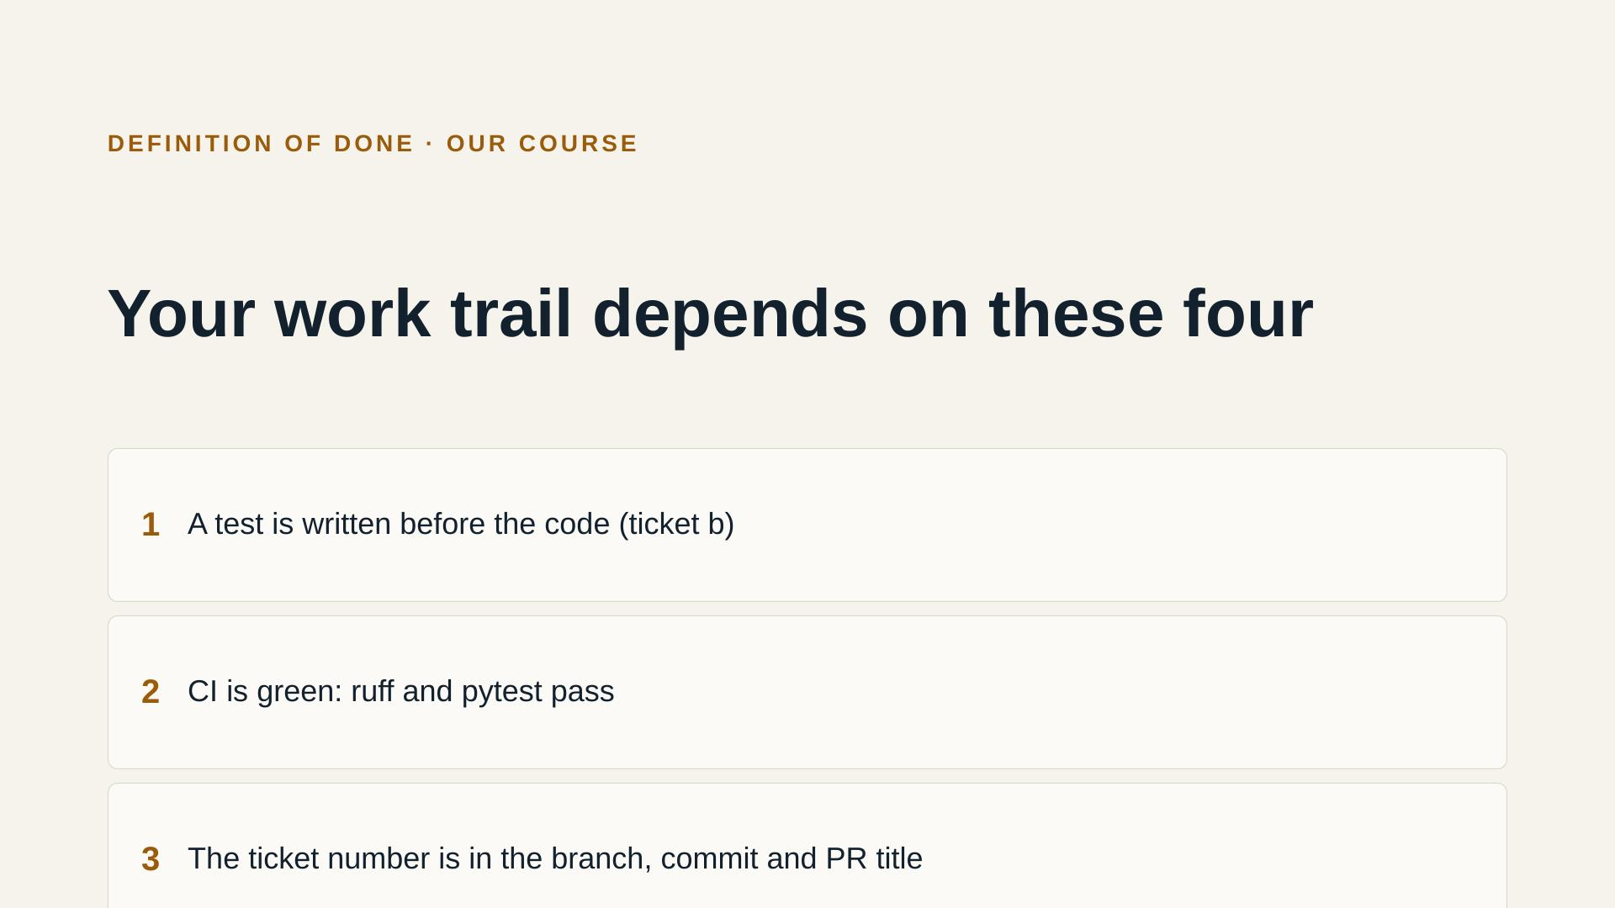
Notes:
Same four points as session 5, with tests added. Compare with the official definition of done on page 123: integrated, tested, potentially usable. Which official points do we already meet?

Slide 19
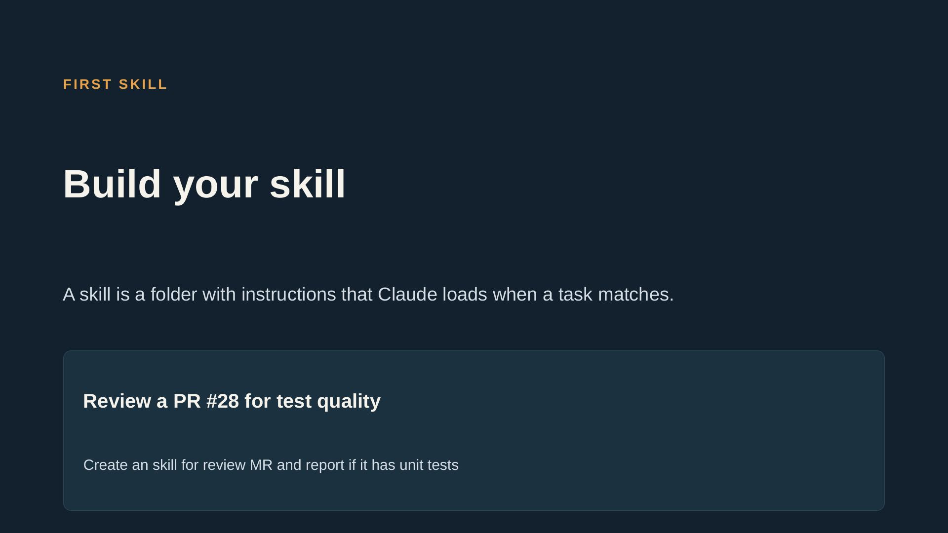
Notes:
Session 5 introduced the idea. Participants build the skill with Claude, test it on one real ticket, and contribute it to the repo. The two examples are only models.

Slide 20
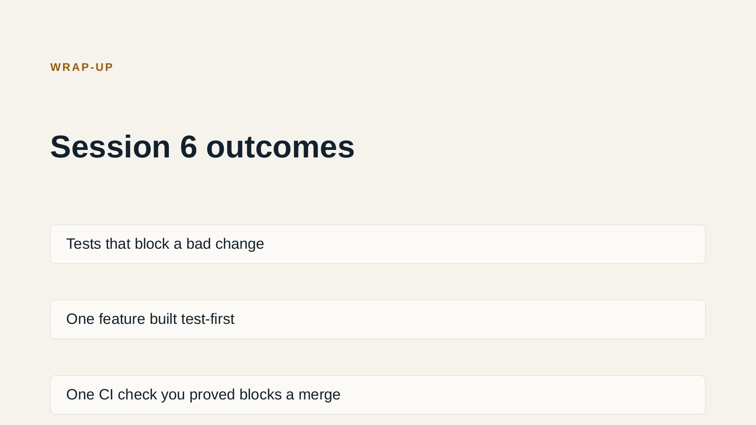
Notes:
Ask for a thumbs-up on each outcome. Anyone without one gets help after the session. Go back to the expectations list from session 5, question 4, and tick off what we covered. Announce session 7, led by Alex: low-risk releases.

