Slide 1
Index
0 - Setup AWX

Slide 2
0 - Setup AWX
Install Dependencies
Install Minikube
Install Docker
Install AWX
Setup SSH Key

Slide 3
Setup AWX
wsl --unregister Ubuntu
wsl --install -d Ubuntu
sudo apt install git make -y
sudo apt update
sudo apt install -y curl wget apt-transport-https
curl -LO https://storage.googleapis.com/minikube/releases/latest/minikube-linux-amd64
sudo install minikube-linux-amd64 /usr/local/bin/minikube
minikube version
curl -LO https://storage.googleapis.com/kubernetes-release/release/$(curl -s https://storage.googleapis.com/kubernetes-release/release/stable.txt)/bin/linux/amd64/kubectl
chmod +x kubectl
sudo mv kubectl /usr/local/bin/
kubectl version -o yaml
sudo apt update
sudo apt install apt-transport-https ca-certificates curl software-properties-common
curl -fsSL https://download.docker.com/linux/ubuntu/gpg | sudo gpg --dearmor -o /usr/share/keyrings/docker-archive-keyring.gpg
echo "deb [arch=amd64 signed-by=/usr/share/keyrings/docker-archive-keyring.gpg] https://download.docker.com/linux/ubuntu $(lsb_release -cs) stable" | sudo tee /etc/apt/sources.list.d/docker.list > /dev/null
sudo apt update
sudo apt install docker-ce
docker --version
sudo systemctl start docker
sudo systemctl enable docker
sudo usermod -aG docker $USER
newgrp docker
minikube start --vm-driver=docker --addons=ingress
minikube status
kubectl get pods -A
git clone https://github.com/ansible/awx-operator.git
cd awx-operator/
git checkout 2.19.0
export NAMESPACE=ansible-awx
make deploy
kubectl get pods -n ansible-awx
cp awx-demo.yml awx-ubuntu.yml
vi awx-ubuntu.yml
---
apiVersion: awx.ansible.com/v1beta1
kind: AWX
metadata:
name: awx-ubuntu
spec:
service_type: nodeport
kubectl create -f awx-ubuntu.yml -n ansible-awx
kubectl get pods -n ansible-awx
kubectl get svc -n ansible-awx
kubectl logs -f deployments/awx-operator-controller-manager -c awx-manager -n ansible-awx
minikube service awx-ubuntu-service --url -n ansible-awx
kubectl get secret -n ansible-awx | grep -i password
kubectl get secret awx-ubuntu-admin-password -o jsonpath="{.data.password}" -n ansible-awx | base64 --decode; echo
upwSKOtZB5bvuMbsUF9sOOFEbs41voie

Slide 4
1 – Hello World AWX
Create a Playbook
Upload to Git
Create Organization
Create Project
Create Inventory
Create Credential
Create Job Template
Run the Job

Slide 5
Create a Playbook
vi helloWorld.yml
---
- name: Hello World Playbook
hosts: localhost
tasks:
- name: Print Hello World
debug:
msg: "Hello, World!"

Slide 6
Upload to Git
git add .
git commit -m "Uploading a helloWorld.yml"
git push origin ansibleSena

Slide 7
Create Organization
Log in to the AWX web UI.
Navigate to Access > Organization > Add.
Fill in the following fields:
Name: myOrganization.
Save the Organization.

Slide 8
Create Project
Log in to the AWX web UI.
Navigate to Projects > Add.
Fill in the following fields:
Name: Hello World Project
Organization: myOrganization
Source Control Type: (e.g., Git)
Source Control URL: https://github.com/devopsdelivery/yoda
Source Control Branch: ansibleSena
Save the project.

Slide 9
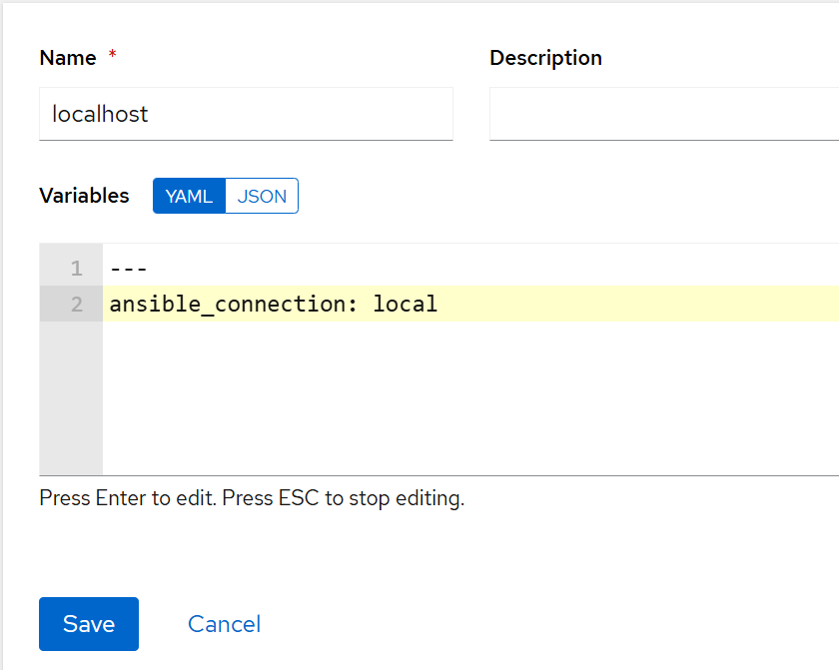
Create Inventory
Step 2: Create an Inventory
Go to Inventories > Add.
Provide a name (e.g., Local Inventory).
Provide a organization (myOrganizaiton).
Save the Inventory
Edit Local Inventory > Hosts > Add
Save the new host

Slide 10
Create Credential
Step 3:Create a Credential
Navigate to Credentials > Add.
Provide:
Name: Local Credential
Credential Type: Machine
Username: (your local machine username)
Password: (if required).

Slide 11
Create Job Template
Step 4: Create a Job Template
Go to Templates > Add > Job Template.
Provide the following details:
Name: Hello World Job
Inventory: Select the inventory you created earlier.
Project: Select the project linked to your playbook.
Playbook: Select hello_world.yml.
Credentials: Select the credential created earlier.

Slide 12
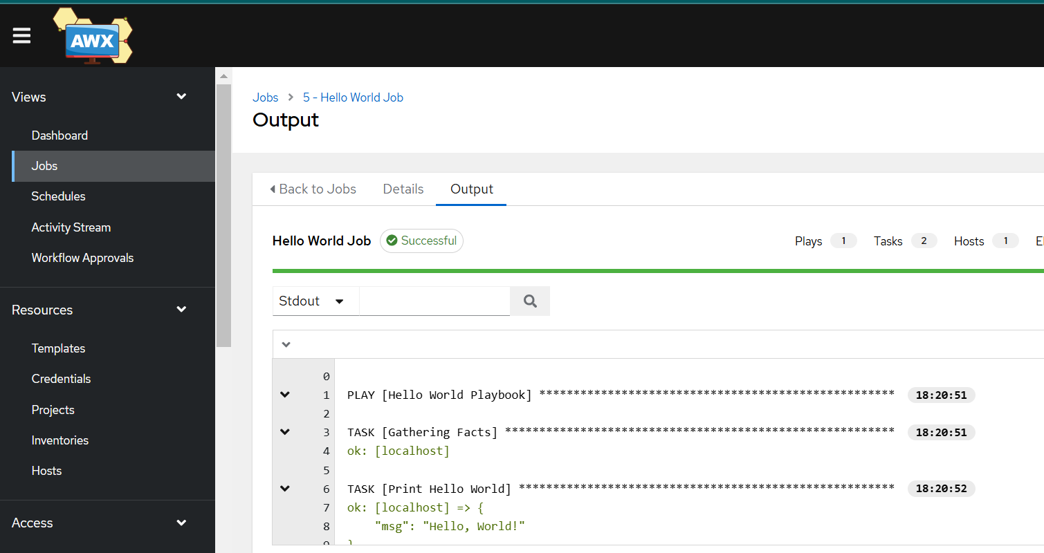
Run the Job
Navigate to Templates.
Click the rocket icon next to your Hello World Job.
Monitor the job in Jobs to see the output.

