Slide 1
Index
0 - Setup Ansible
1- Inventory
2- Variabes
3- Playbook

Slide 2
0 - Setup Ansible
Install Linux (Ubuntu)
Install Ansible
Install SSH
Setup SSH Key

Slide 3
Install Linux (Ubuntu)
Steps:
#1 Enable WSL:
Open PowerShell as Administrator and run:
wsl --install
This installs WSL and the default Ubuntu distribution.
#2 Install Ubuntu:
After the WSL installation, restart your computer if prompted.
Open the Microsoft Store and search for "Ubuntu". Install the desired version (e.g., Ubuntu 22.04).
#3 Start Ubuntu:
Open Ubuntu from the Start menu.
Complete the setup by creating a username and password.
You now have a fully functional Linux shell.

Slide 4
Install Ansible
To configure the PPA on your system and install Ansible run these commands:
$ sudo apt update
$ sudo apt install software-properties-common
$ sudo add-apt-repository --yes --update ppa:ansible/ansible
$ sudo apt install ansible

Slide 5
Install SSH
sena@PTDVTL2249:~/ansible$ sudo apt install openssh-server
sena@PTDVTL2249:~/ansible$ ssh-keygen
Generating public/private ed25519 key pair.
Enter file in which to save the key (/home/sena/.ssh/id_ed25519):
Enter passphrase (empty for no passphrase):
Enter same passphrase again:
Your identification has been saved in /home/sena/.ssh/id_ed25519
Your public key has been saved in /home/sena/.ssh/id_ed25519.pub
The key fingerprint is:
SHA256:qErlxYrYAIzPEJPorM38OJObH+aZQ9tWd+J8CCdXexA sena@PTDVTL2249
The key's randomart image is:
+--[ED25519 256]--+
|+. |
|=o E |
|*. . |
|.* . . o |
|o+o . + S . o |
|.+++.+ + = o . |
|. +=*o . O + . |
| .==++o + . |
| +==o . |
+----[SHA256]-----+

Slide 6
Setup SSH Key
sena@PTDVTL2249:~$ cd ~/.ssh
sena@PTDVTL2249:~/.ssh$ cat *.pub >> authorized_keys
sena@PTDVTL2249:~/.ssh$ chmod 640 authorized_keys
sena@PTDVTL2249:~/ansible$ sudo systemctl restart sshd

Slide 7
1 – Setup Inventory
INI Format
YML Format

Slide 8
Inventories
You are managing the following servers:
Web Servers:
web01.example.com (IP: 127.0.0.1)
web02.example.com (IP: localhost)
Database Servers:
db01.example.com (IP: 192.168.1.20)
db02.example.com (IP: 192.168.1.21)
The web servers need to be grouped under [webservers], and the database servers need to be grouped under [dbservers]. You will also create a group called [all] to represent all servers in the inventory.

Slide 9
Inventory INI format
[webservers]
web01.example.com ansible_host=127.0.0.1
web02.example.com ansible_host=localhost
[webservers:vars]
http_port=80
[dbservers]
db01.example.com ansible_host=192.168.1.20
db02.example.com ansible_host=192.168.1.21
[dbservers:vars]
db_port=3306
[all:vars]
ansible_user=sena
ansible_ssh_private_key_file=/home/sena/.ssh/id_ed25519

Slide 10
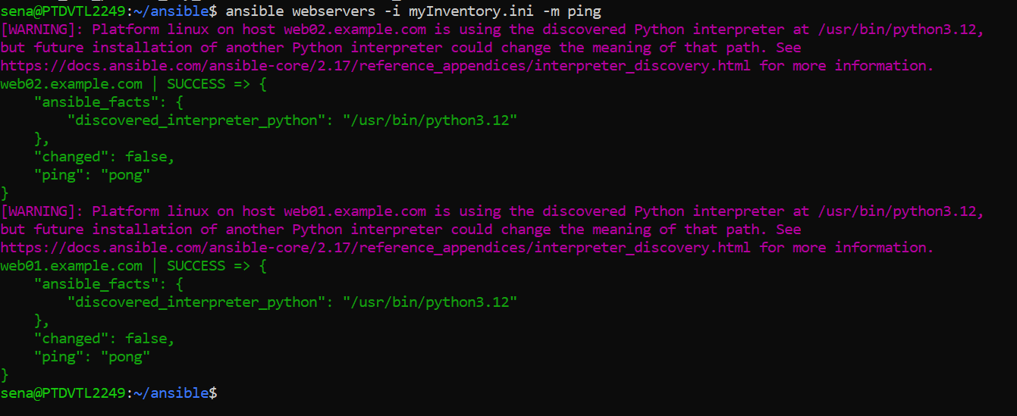
Inventory INI format
ansible webservers -i myInventory.ini -m ping

Slide 11
Inventory YML format
all:
vars:
ansible_user: sena
ansible_ssh_private_key_file: /home/sena/.ssh/id_ed25519.pub
children:
webservers:
hosts:
web01.example.com:
ansible_host: 127.0.0.1
web02.example.com:
ansible_host: localhost
vars:
http_port: 80
dbservers:
hosts:
db01.example.com:
ansible_host: 192.168.1.20
db02.example.com:
ansible_host: 192.168.1.21
vars:
db_port: 3306

Slide 12
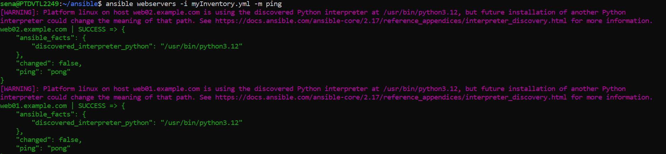
Inventory YML format
sena@PTDVTL2249:~/ansible$ ansible webservers -i myInventory.yml -m ping

Slide 13
2 – Variables
Local Playbook
Group
Host
Global
External
Enviroment

Slide 14
Local Playbook Variables
sena@PTDVTL2249:~/02-variables$ cat myInventory.ini
[serverGroup1]
server1 ansible_host=localhost
---
- name: Demonstrate different types of variables in Ansible
hosts: all
gather_facts: false
vars:
# Scalar (String) variable
app_name: "MyApp"
hello_message: "Hello World from Playbook"
# Scalar (Number) variable
max_connections: 100
# Boolean variable
is_production: true
# List variable
server_list:
- web01
- web02
- db01
# Dictionary variable
database_config:
host: "db01"
port: 3306
user: "admin"
password: "secret"
tasks:
- name: Display the string variable (app_name)
debug:
msg: "{{ hello_message }}. The application name is {{ app_name }}"
- name: Display the number variable (max_connections)
debug:
msg: "The maximum number of connections is {{ max_connections }}"
- name: Display the boolean variable (is_production)
debug:
msg: "Is this a production environment? {{ is_production }}"
- name: Display the list variable (server_list)
debug:
msg: "The list of servers is {{ server_list }}"
- name: Display the dictionary variable (database_config)
debug:
msg: "Database config: Host={{ database_config.host }}, Port={{ database_config.port }}, User={{ database_config.user }}, Password={{ database_config.password }}"

Slide 15
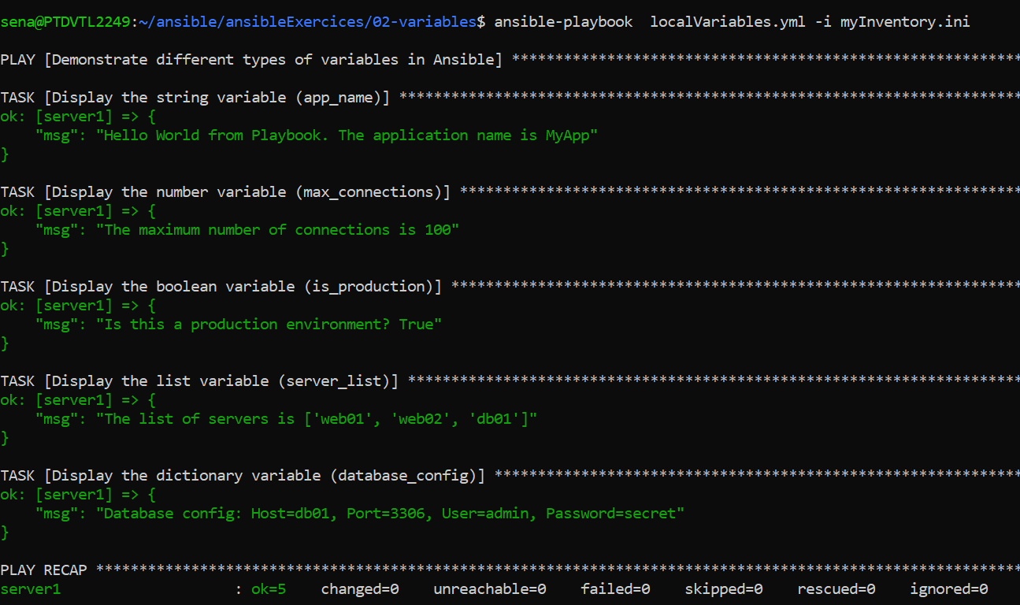
Local Playbook Variables
sena@PTDVTL2249:~/02-variables$ ansible-playbook localVariables.yml -i myInventory.ini

Slide 16
Group Variables
sena@PTDVTL2249:~/02-variables$ cat group_vars/serverGroup1.yml
hello_message: "Hello World from Group 1"
sena@PTDVTL2249:~/02-variables$ cat groupVariables.yml
---
- name: Hello World with Group Variables
hosts: serverGroup1
tasks:
- name: Show a Group Variable
debug:
msg: "{{ hello_message }}"

Slide 17
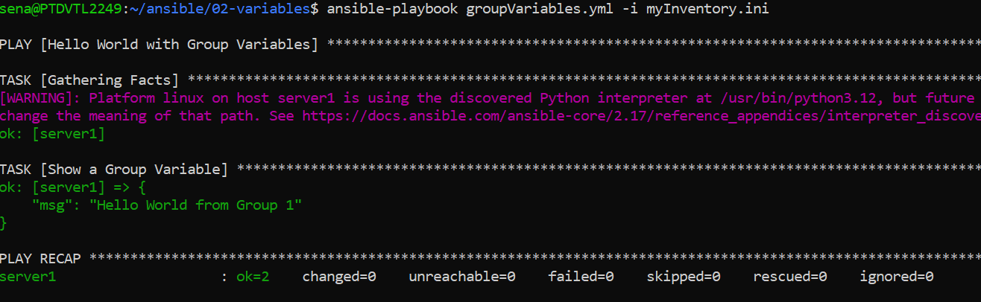
Group Variables
sena@PTDVTL2249:~/02-variables$ ansible-playbook hostVariables.yml -i myInventory.ini

Slide 18
Host Variables
sena@PTDVTL2249:~/02-variables$ cat host_vars/server1.yml
hello_message: "Hello World from Server1"
sena@PTDVTL2249:~/02-variables$ cat hostVariables.yml
---
- name: Exemplo de Hello World com variáveis de Host
hosts: server1
tasks:
- name: Exibir mensagem de Hello World
debug:
msg: "{{ hello_message }}"

Slide 19
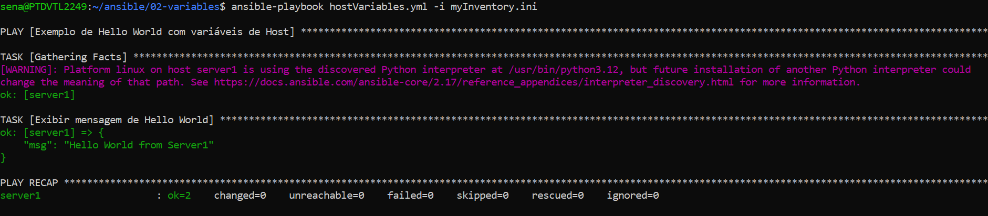
Host Variables
sena@PTDVTL2249:~/02-variables$ ansible-playbook hostVariables.yml -i myInventory.ini
Challenge: Now that we have the hello_message defined in 3 places (locally, group_vars and host_vars) execute the two previous playbooks (groupVariables.yml and localVariables.yml).
Any changes?

Slide 20
Global Variables
sena@PTDVTL2249:~/02-variables/group_vars$ cat all.yml
all_message: "Hello all Groups”
sena@PTDVTL2249:~/ansible/02-variables$ cat globalVariables.yml
---
- name: Example with global variables
hosts: localhost
tasks:
- name: Exibir mensagem global
debug:
msg: "{{ all_message }}"

Slide 21
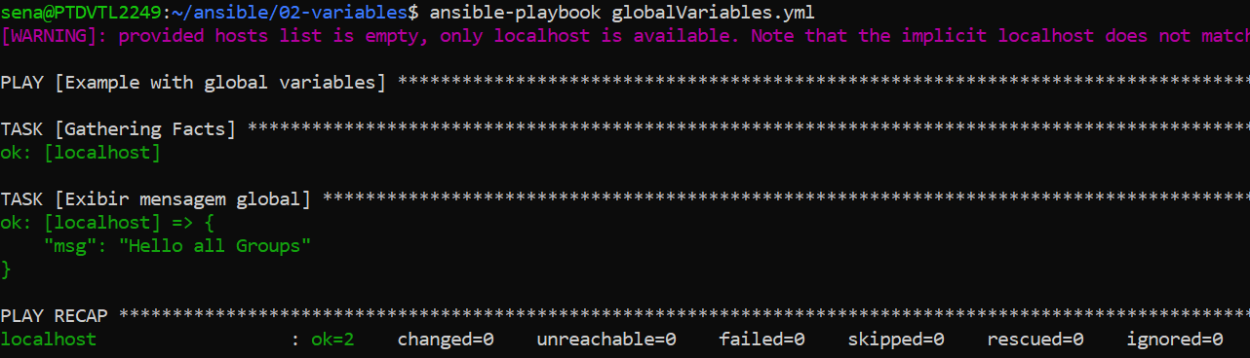
Global Variables
ansible-playbook globalVariables.yml

Slide 22
External Variables
sena@PTDVTL2249:~/ansible/02-variables$ cat vars_files/hello_vars.yml
hello_message: "Hello World from External File"
sena@PTDVTL2249:~/02-variables$ cat externalVariables.yml
---
- name: Example with external file variables
hosts: localhost
vars_files:
- vars_files/hello_vars.yml
tasks:
- name: Exibir mensagem de Hello World
debug:
msg: "{{ hello_message }}"

Slide 23
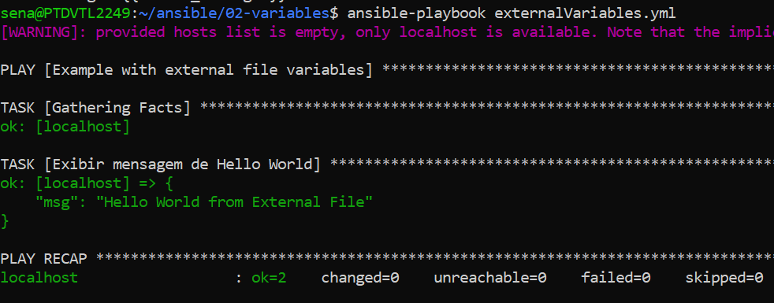
External Variables

Slide 24
Enviroment Variables
sena@PTDVTL2249:~/02-variables$ export HELLO_MESSAGE="Hello World from Environment"
sena@PTDVTL2249:~/02-variables$ cat enviromentVariables.yml
---
- name: Exemplo de Hello World com variáveis de ambiente
hosts: localhost
tasks:
- name: Exibir mensagem de Hello World usando variável de ambiente
debug:
msg: "{{ lookup('env', 'HELLO_MESSAGE') }}"

Slide 25
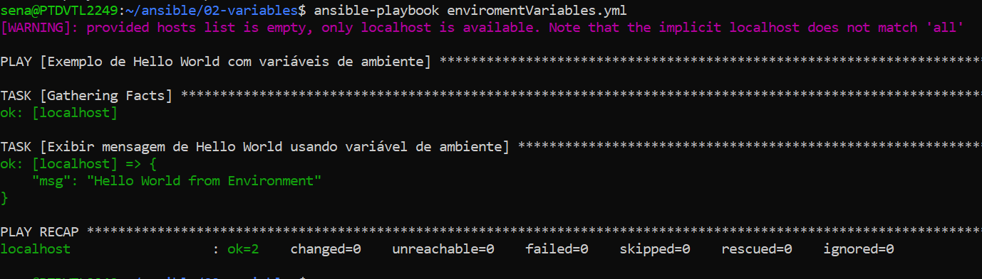
Enviroment Variables
sena@PTDVTL2249:~/ansible/02-variables$ ansible-playbook enviromentVariables.yml

Slide 26
3 – PlayBooks
Install/Stop Apache
Templates
Conditonals and Loops
Roles
Other Modules (Copy, LineInFile, Shell)

Slide 27
Install Apache
---
- name: Install httpd (Apache) on Ubuntu/Debian
hosts: localhost
become: yes
vars:
serviceName: "apache2"
tasks:
- name: Install Apache HTTP server
apt:
name: "{{ serviceName }}"
state: present
update_cache: yes
- name: Iniciar e habilitar o serviço Apache
service:
name: "{{ serviceName }}"
state: started
enabled: yes

Slide 28
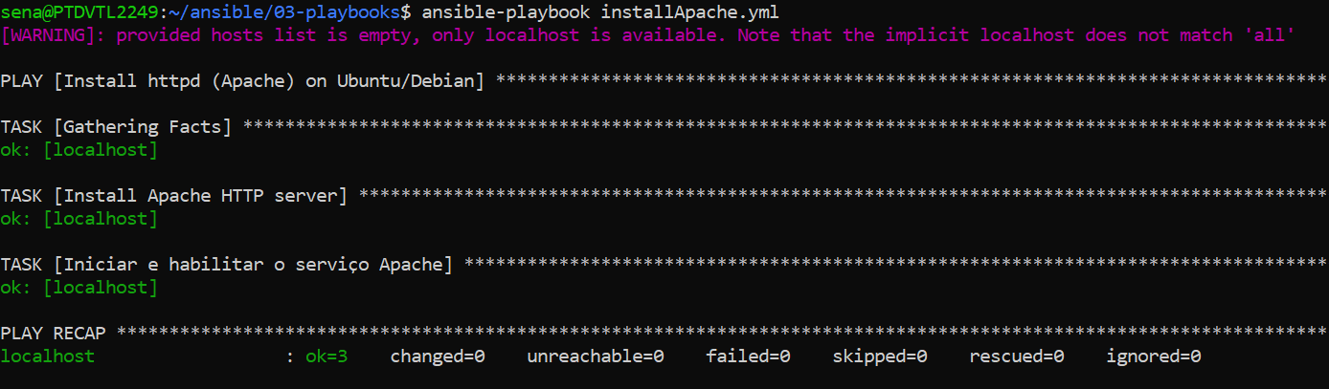
Install Apache
sena@PTDVTL2249:~/03-playbooks$ ansible-playbook installApache.yml

Slide 29
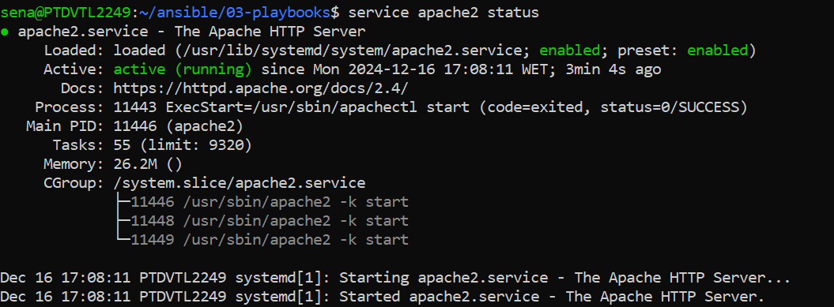
Install Apache
sena@PTDVTL2249:~/03-playbooks$ service apache2 status

Slide 30
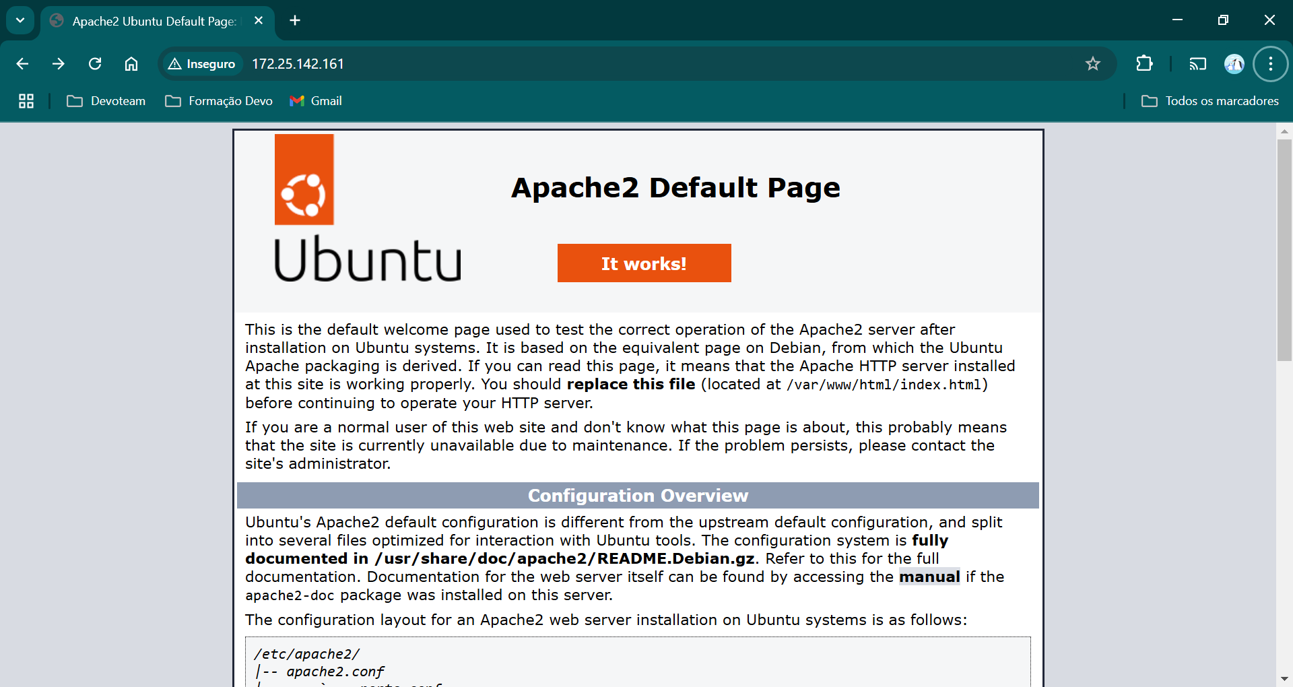
Install Apache

Slide 31
Stop Apache
---
- name: Install httpd (Apache) on Ubuntu/Debian
hosts: localhost
become: yes
vars:
serviceName: "apache2"
tasks:
- name: Stop Apache
service:
name: "{{ serviceName }}"
state: stopped
enabled: yes

Slide 32
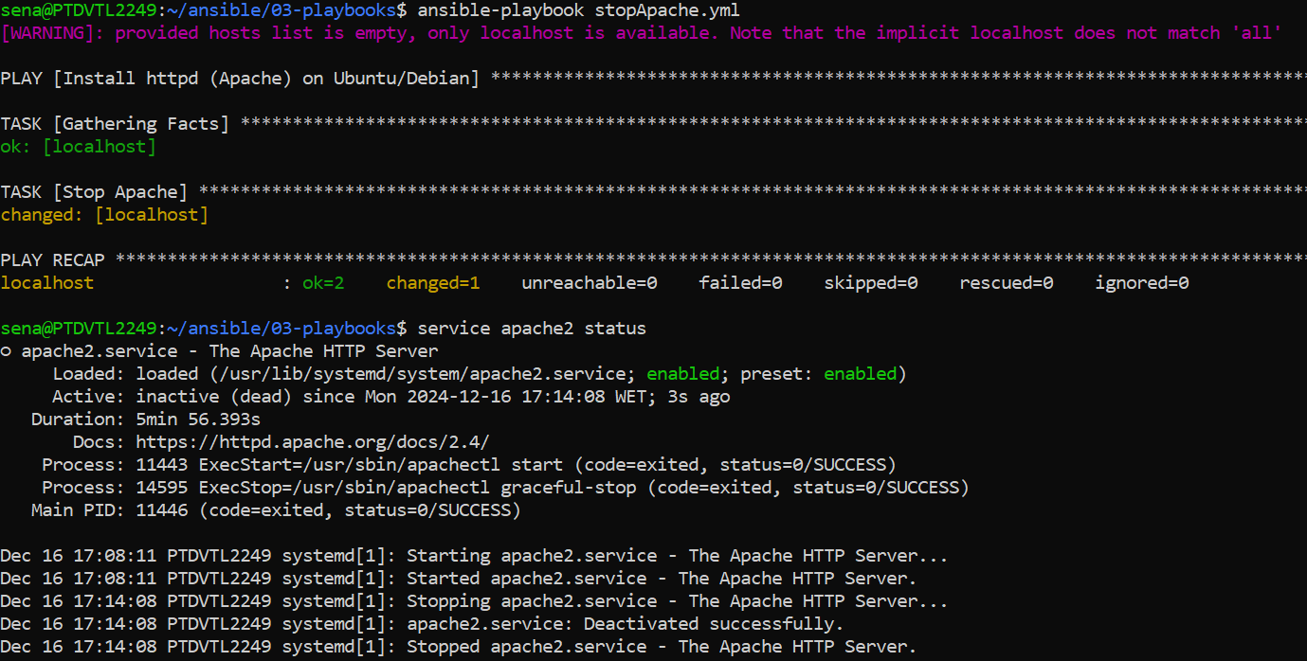
Stop Apache

Slide 33
Using Templates
0. sudo cp /etc/apache2/apache2.conf /etc/apache2/apache2.conf.backup
1. Create a template called httpd.conf.j2 in ./templates/
sena@PTDVTL2249:~/03-playbooks/templates$ cat apache2.conf.j2
# Apache Configuration
ServerRoot /etc/apache2
Listen 8080
# Server settings
ServerAdmin webmaster@localhost
ServerName {{ apache_server_name }}
# Document Root
DocumentRoot {{ apache_document_root }}
# Directory Settings
<Directory />
Options FollowSymLinks
AllowOverride None
Require all denied
</Directory>
<Directory "{{ apache_document_root }}">
AllowOverride All
Require all granted
</Directory>
# Other configurations...
DefaultRuntimeDir ${APACHE_RUN_DIR}
PidFile ${APACHE_PID_FILE}
Timeout 300
KeepAlive On
MaxKeepAliveRequests 100
KeepAliveTimeout 5
User ${APACHE_RUN_USER}
Group ${APACHE_RUN_GROUP}
HostnameLookups Off
ErrorLog ${APACHE_LOG_DIR}/error.log
LogLevel warn
IncludeOptional mods-enabled/*.load
IncludeOptional mods-enabled/*.conf
Include ports.conf
<Directory /usr/share>
AllowOverride None
Require all granted
</Directory>
<Directory /var/www/>
Options Indexes FollowSymLinks
AllowOverride None
Require all granted
</Directory>
AccessFileName .htaccess
<FilesMatch "^\.ht">
Require all denied
</FilesMatch>
LogFormat "%v:%p %h %l %u %t \"%r\" %>s %O \"%{Referer}i\" \"%{User-Agent}i\"" vhost_combined
LogFormat "%h %l %u %t \"%r\" %>s %O \"%{Referer}i\" \"%{User-Agent}i\"" combined
LogFormat "%h %l %u %t \"%r\" %>s %O" common
LogFormat "%{Referer}i -> %U" referer
LogFormat "%{User-agent}i" agent
IncludeOptional conf-enabled/*.conf
IncludeOptional sites-enabled/*.conf

Slide 34
Using Templates and Handlers
---
- name: Modify Apache2 Configuration
hosts: localhost
become: yes
vars:
apache_server_name: "www.example.com"
apache_document_root: "/var/www/html"
tasks:
- name: Deploy apache2.conf using template
template:
src: apache2.conf.j2 # The Jinja2 template file
dest: /etc/apache2/apache2.conf # The target location for the file
owner: root
group: root
mode: '0644'
notify:
- restart apache2
handlers:
- name: restart apache
service:
name: apache2
state: restarted

Slide 35
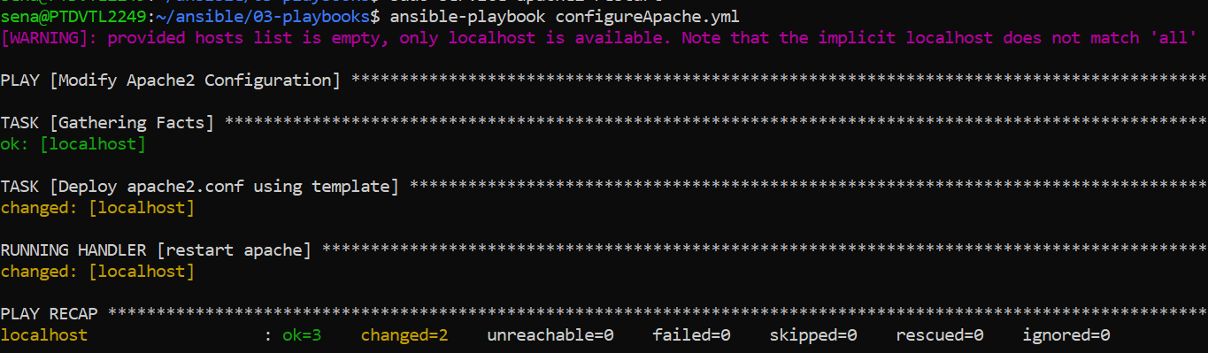
Using Templates and Handlers

Slide 36
Conditionals and Loops
sena@PTDVTL2249:~/03-playbooks$ cat installApache.yml
---
- name: Install httpd (Apache) on Ubuntu/Debian
hosts: localhost
become: yes
vars:
serviceName: "apache2"
tasks:
- name: Install Apache HTTP server
apt:
name: "{{ serviceName }}"
state: present
update_cache: yes
- name: Iniciar e habilitar o serviço Apache
service:
name: "{{ serviceName }}"
state: started
enabled: yes

Slide 37
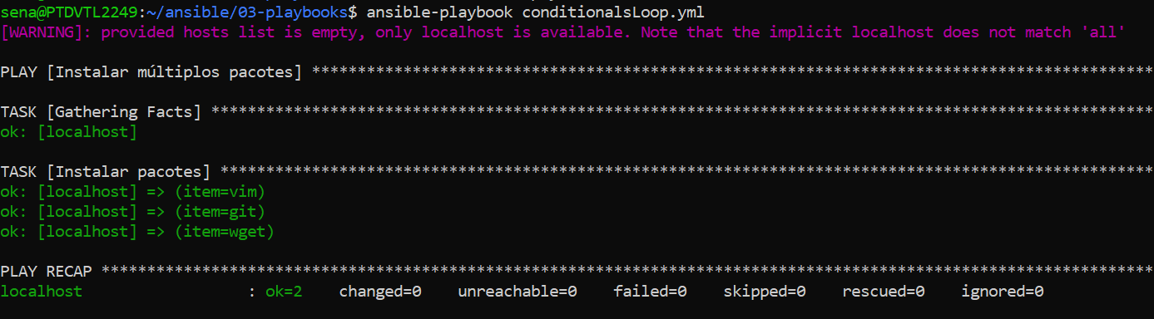
Conditionals and Loops

Slide 38
Roles
sena@PTDVTL2249:~/03-playbooks$ cat ./roles/apache/tasks/main.yml
---
- name: Install Apache
apt:
name: apache2
state: present
- name: Iniciar e habilitar o serviço Apache
service:
name: apache2
state: started
enabled: yes

Slide 39
Roles
sena@PTDVTL2249:~/03-playbooks$ cat roleApache.yml
---
- name: Setup Apache
hosts: localhost
become: yes
roles:
- apache

Slide 40
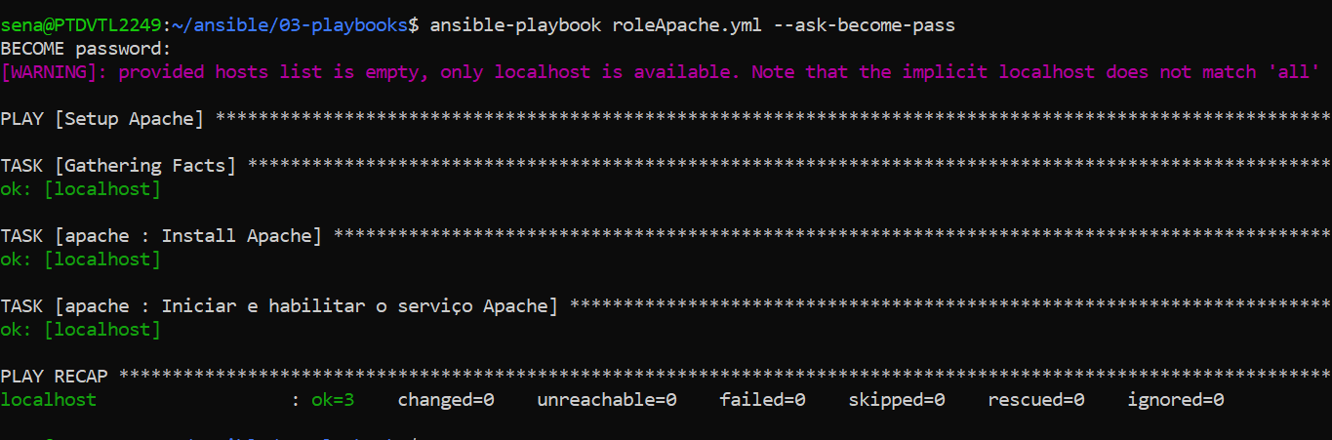
Roles

Slide 41
Copy
---
- name: Copy a file to a remote server
hosts: localhost
gather_facts: false
tasks:
- name: Copy a local file to the remote server
copy:
src: /home/sena/ansible/ansibleExercices/03-playbooks/copyFile.yml # Path to the file on the local machine
dest: /home/sena/ansible/ansibleExercices/03-playbooks/copyFile.yml.backup # Path where the file will be copied on the remote server
owner: sena # Set file owner (optional)
group: sena # Set file group (optional)
mode: '0644' # Set file permissions (optional)
- name: Set current date variable
set_fact:
current_date: "{{ lookup('pipe', 'date --iso-8601=seconds') }}"
- name: Add the current date at the beginning of the destination file
lineinfile:
path: /home/sena/ansible/ansibleExercices/03-playbooks/copyFile.yml.backup # Destination file
line: "# File backup date: {{ current_date }}" # Line to add
insertbefore: BOF # Insert at the beginning of the file
create: no

Slide 42
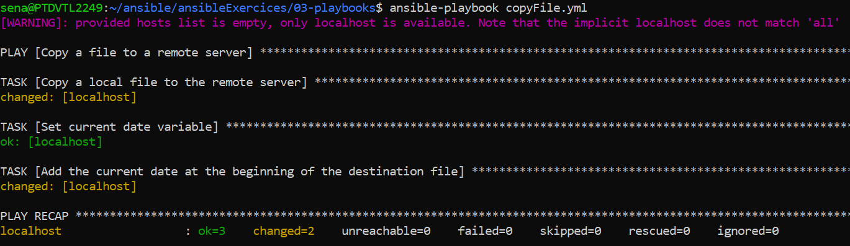
Copy

Slide 43
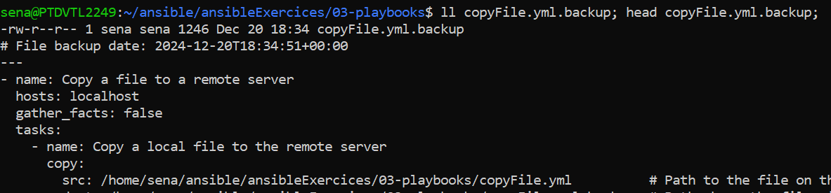
Copy

Slide 44
Shell Module
sena@PTDVTL2249:~/ansibleExercices/03-playbooks$ cat shell.yml
---
- name: Run a shell command on a remote server
hosts: localhost
gather_facts: false
tasks:
- name: Run a shell command to list files
shell: "ls -l /home/sena/ansible/ansibleExercices/03-playbooks"
register: result
- name: Display the result of the shell command
debug:
msg: "The output of the command is: {{ result.stdout }}"

Slide 45
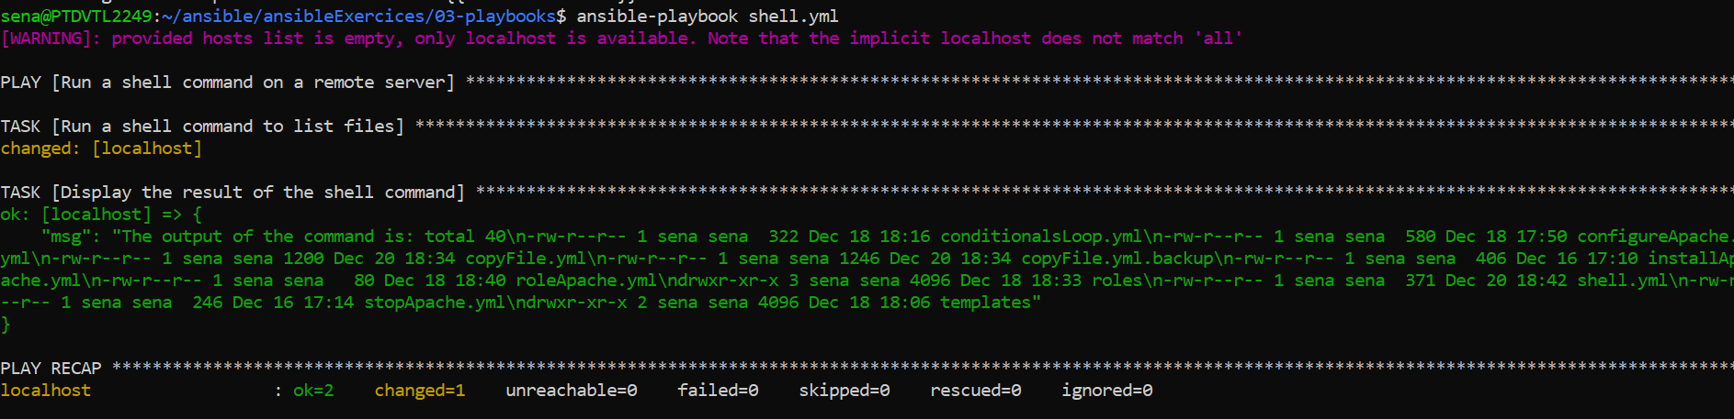
Shell Module

