Slide 1
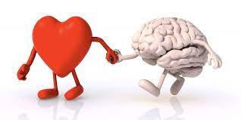
Exercise and it’s effect on cardiovascular system & Brain

Slide 2
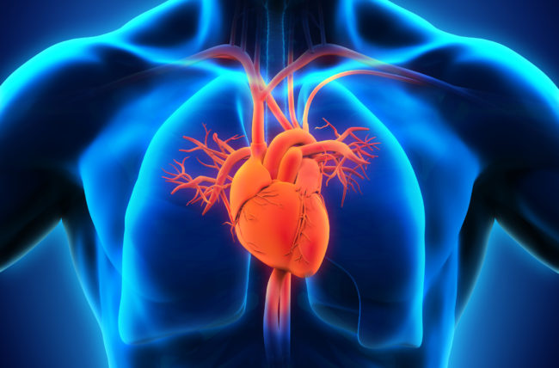
Heart benefits from exercise
Lower blood pressure
Improve blood flow
Lower cholesterol
Decrease risk of heart disease, stroke and diabetes
Reduce the incidence of heart arrhythmia, like atrial fibrillation (AFib)
C#, Asp.NET MVC
Entity Framework
JQuery

Slide 3


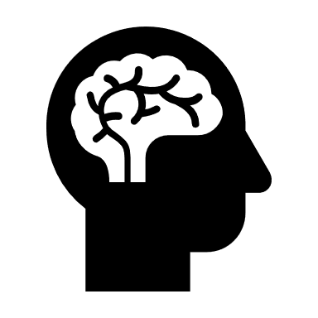






Weight control
Metabolism
The Benefits Of Cardiovascular Fitness
Reduced Disease Risk
Your State Of Mind
Improves Sleep

Slide 4
Some of the Cardiovascular diseases
Abnormal heart rhythms or arrhythmias
Heart attack and failure
Congenital heart disease
Coronary artery disease
Deep vein thrombosis

Slide 5

Exercise and it’s effect on brain
Exercise Boosts Memory
Relief from depression
Exercise Increases Concentration
Delays aging
Exercise Improves Mental Health
Improved concentration
Reduction of the effects of stress and anxiety
Exercise affects the brain in many ways

Slide 6



Exercise and Learning
Exercise increases neuronal connections
It strengthens the cerebellum
It fuels brain with oxygen
Causes nerve cells multiply - nerve connections are strengthened

Slide 7

Video Time

Slide 8
How many people in the world workout, exercise daily and eat healthy?
How many of You doing workout, exercise daily?
More than 1 in 4 people across the world don't get enough exercise
32%
23%
Ref: https://www.usatoday.com/story/news/nation-now/2018/09/05/adults-worldwide-not-exercising-study-who/1199978002/

Slide 9










Thank You

