Slide 1
Simple Home Security
Shomesec

Slide 2
Why?
2,000,000 home burglaries are reported each year in the United States.
About 30 percent of all burglaries are through an open or unlocked window or door.
Nearly 66 percent of all burglaries are residential (home) break-ins.
Renters are just as likely to be the victims of property crime as homeowners.
Homes without security systems are up to 300% more likely to be broken into.

Slide 3
Why?
As of 2010, there were an estimated eighteen million home security systems installed in the US.
About 60% of convicted burglars say the presence of an alarm would cause them to seek a different home to burglarize.
The average amount of stolen property from a burglarized home totals $2,316.5 In contrast, you can get a home security system for as little as twenty dollars per month.
Some homeowners insurance providers offer discounts up to 20% when homeowners install home security systems.

Slide 4
HOW?
Make it cheap (under $500 w/ no subscription fees)
Wireless Arduino / Raspberry PI controlled network
RF transmitting sensors
Prototype will use Arduino for controlling sensors

Slide 5
HOW?
System armed by keypad
Text or email when a sensor trips and system is armed
Or can be set to notify the police

Slide 6
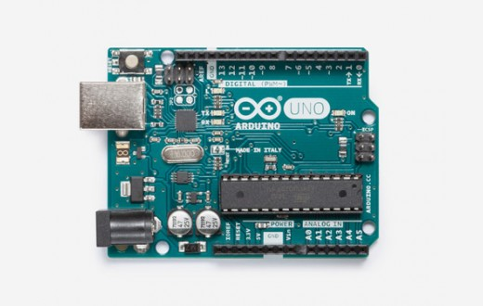
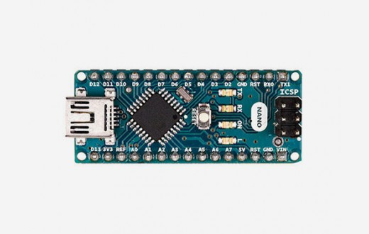
Arduinos – simple and cheap

Slide 7
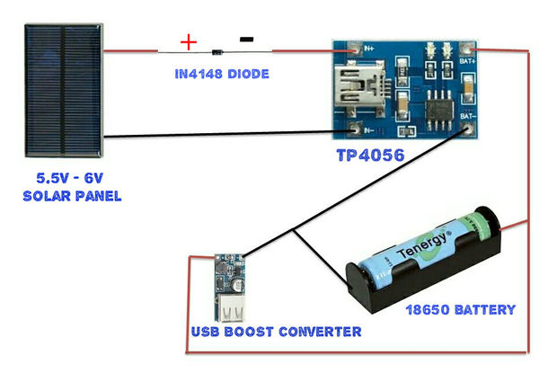
Solar power circuit

Slide 8
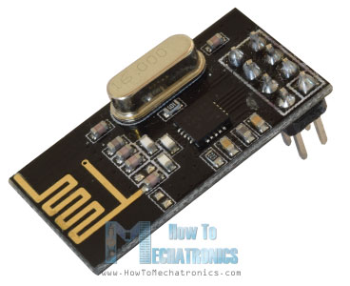
RF Transceiver – cheap data transfer

Slide 9
Window Sensors
Window

Slide 10
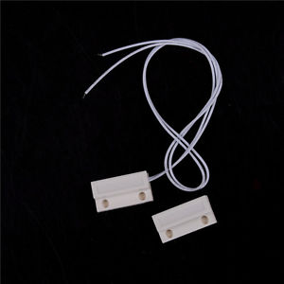
Door Sensors

Slide 11
Other thoughts
Control some of the simple stuff
Motion sensing lights
Speaker to alarm on break in
Light to flash on break in

Slide 12
Why is funding needed?
Is this even possible?
Testing, testing, testing
Prototype the networking
Prototype the solar inverter

Slide 13
references
[1] http://www.safeguardtheworld.com/statistics.html
[2] https://www.safewise.com/resources/security-stats-facts

