Slide 1
Containers
Len Bass
Notes:
This is the slide title. The title of the lecture topic goes in:
<Lecture Title Here>
The lecturer should put their name in:
<Presenter’s Name Here>

Slide 2
Logistics
You will have to install Docker on your laptop – either in native mode or using Docker Toolbox. On my laptop, native mode does not have enough memory so I use Docker Toolbox.
Make sure Hello World works (from the installation instructions).
Make sure you have access to the internet since you will be downloading software.
© Len Bass 2015

Slide 3
Outline
Introduction to containers
Hands on Docker
What’s left?
© Len Bass 2015

Slide 4
Goal of containers
Want to package executable such that it
  Is isolated from other executables
  Is lightweight in terms of loading and transferring
© Len Bass 2015

Slide 5
Isolation
Process
Isolate address space
No isolation for files or networks
Lightweight
Virtual Machine
Isolate address space
isolate files and networks
Heavyweight
© Len Bass 2015

Slide 6
Containers
Process
Isolate address space
No isolation for files or networks
Lightweight
Container
Isolate address space
isolate files and networks
Lightweight
Virtual Machine
Isolate address space
isolate files and networks
Heavyweight
© Len Bass 2015

Slide 7
Trade offs
Virtual machine gives you all the freedom you have with bare metal
  Choice of operating system
  Total control over networking arrangement and file structures
Container is constrained in terms of operating systems available
  Currently just Linux but soon Windows and OSX
  Provides limited networking options
  Provides limited file structuring options
© Len Bass 2015

Slide 8
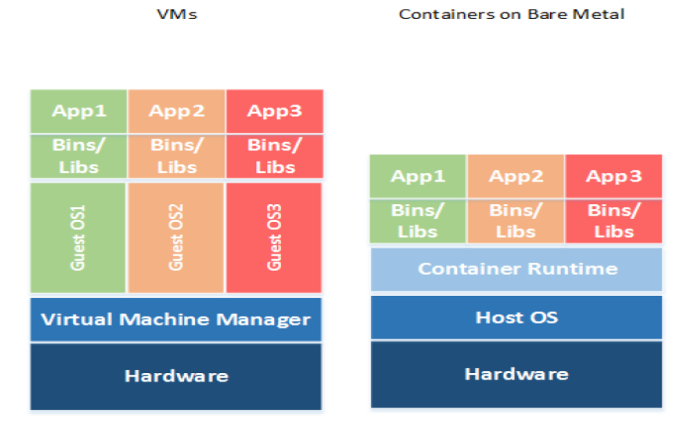
VMs and Containers
copyright 2015 Len Bass

Slide 9
VMS vs containers
VMs are virtualized hardware.
  Each VM can run its own OS.
  All OSs and apps use same instruction set
  VM manager is hypervisor
  Each VM has its own IP address
Containers are virtualized operating system.
  Each container can use Its own binaries and libraries
  All apps use same OS
  Container manager is, for example, “Docker Engine”
  Each container has its own IP address
© Len Bass 2015

Slide 10
Portability
Containers are portable across platforms as long as the container runtime is the same.
This allows a container to be moved from one environment to another.
© Len Bass 2015

Slide 11
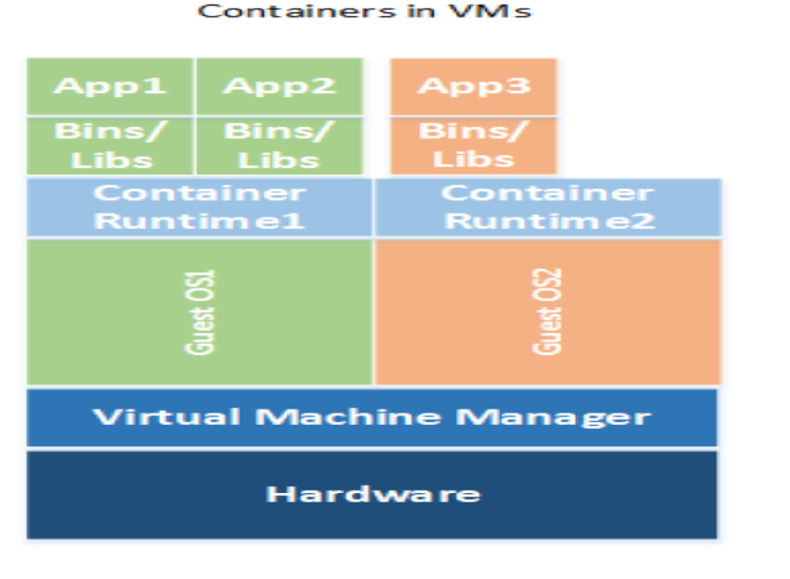
VMs and containers can be combined
© Len Bass 2015

Slide 12
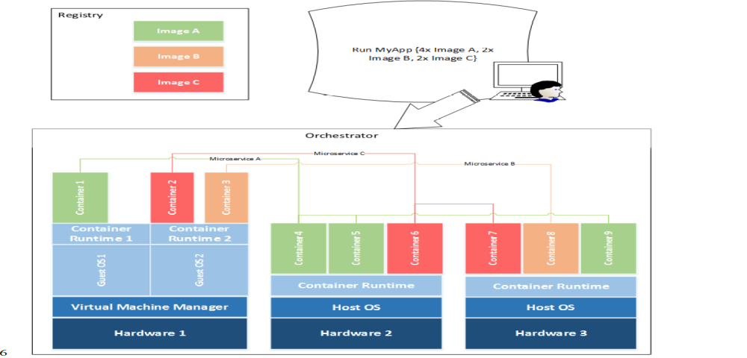
Container component interactions
© Len Bass 2015

Slide 13
Outline
Introduction to containers
Hands on Docker
What’s left?
© Len Bass 2015

Slide 14
Hands on portion
If you have loaded Docker Toolbox, you have a copy of VirtualBox
Open VirtualBox
Select “default
Select “settings/network”
Expand “Advanced” and select “port forwarding”
Forward 8080 on host to 8080 on VM.
© Len Bass 2015

Slide 15
docker pull ubuntu
Execute “docker pull Ubuntu”
This loads an image from the docker library
The image contains bare copy of ubuntu
© Len Bass 2015

Slide 16
docker images
Execute “docker images”
This generates a list of images known to Docker on your machine
You should see Hello World and ubuntu
© Len Bass 2015

Slide 17
docker run –i –t ubuntu
Execute docker run –i –t ubuntu
This executes an image. An executing image is called a “container”.
You are now inside the container.
Execute “ls”.
  A directory structure is set up but only a bare bones OS has been loaded
© Len Bass 2015

Slide 18
Install software on container
  Execute
    apt-get update
    apt-get install wget
    apt-get install nodejs
    apt-get install npm
    <cntl d>
This installs the software you will use during this session and exits the container
© Len Bass 2015

Slide 19
docker ps –a
Execute “docker ps –a”
This generates a list of all of the containers that have been run
© Len Bass 2015

Slide 20
Output from docker ps -a
CONTAINER ID IMAGE COMMAND CREATED STATUS PORTS NAMES
174268c64fbd ubuntu "/bin/bash" 7 minutes ago Exited (0) About a minute ago sharp_mcnulty
54ae910238b3 hello-world "/hello" 53 minutes ago Exited (0) 53 minutes ago practical_euler
© Len Bass 2015

Slide 21
docker commit sharp_mcnulty cseet
Note that the ubuntu container has a name of “sharp_mcnulty” (on my machine). It will be different on yours.
“docker commit sharp_mcnulty cseet” creates an image with the name cseet
© Len Bass 2015

Slide 22
Execute “docker images”
REPOSITORY TAG IMAGE ID CREATED SIZE
cseet latest a70567971230 13 seconds ago 456 MB
ubuntu latest 0ef2e08ed3fa 8 days ago 130 MB
hello-world latest 48b5124b2768 7 weeks ago 1.84 k
© Len Bass 2015

Slide 23
Execute “docker run –i –t cseet”
You are back inside a container. Load application:
wget https://raw.githubusercontent.com/cmudevops/ipshow.js/master/initialization_script
wget https://raw.githubusercontent.com/cmudevops/ipshow.js/master/ipshow.js
© Len Bass 2015

Slide 24
Exit the container - <cntl d>
© Len Bass 2015

Slide 25
List containers
$docker ps -a
CONTAINER ID IMAGE COMMAND CREATED STATUS PORTS NAMES
9c4b32145fa3 cseet "/bin/bash" 2 minutes ago Exited (0) 8 seconds ago reverent_lewin
174268c64fbd ubuntu "/bin/bash" 30 minutes ago Exited (0) 24 minutes ago sharp_mcnulty
54ae910238b3 hello-world "/hello" About an hour ago Exited (0) About an hour ago practical_euler
© Len Bass 2015

Slide 26
Make an image called ipshow
docker commit reverent_lewin ipshow
$ docker images
REPOSITORY TAG IMAGE ID CREATED SIZE
ipshow latest 8f7afedea65d 6 seconds ago 456 MB
cseet latest a70567971230 11 minutes ago 456 MB
<none> <none> b348af319cbc 21 minutes ago 456 MB
ubuntu latest 0ef2e08ed3fa 8 days ago 130 MB
hello-world latest 48b5124b2768 7 weeks ago 1.84 k
© Len Bass 2015

Slide 27
Execute app
docker run –i –t –p 0.0.0.0:8080:8080 ipshow /bin/bash /initialization_script
In browser: localhost:8080
You should see three ip addresses in the browser:
  Ip address of local host
  127.0.0.1 (conventially this is local host)
  Ip address of container
© Len Bass 2015

Slide 28
What have we seen
Distinction between docker images and containers
Creating a docker image in layers
Provisioning the docker image from the internet
Executing pre-built app
© Len Bass 2015

Slide 29
End of hands on – back to theory
Docker Higher Education Guide
https://docs.google.com/document/d/1meLrrov1vWE7dzyy0RxbKxDLmmqzx0IA4NG3wSFsg7Q/edit
© Len Bass 2015

Slide 30
Layers
A Docker container image is structured in terms of “layers”.
Process for building image
  Start with base image
  Load software desired
  Commit base image+software to form new image
  New image can then be base for more software
Image is what is transferred
© Len Bass 2015

Slide 31
Loading of software
OS is ~ 1GB(yte)
Fast network is ~ 1Gb(it) rated
Since there are 8 bits per byte, transferring an OS should take 8 seconds.
But a 1Gb rated network is ~35Mb in practice
This means loading an OS is >30 seconds
Consequently, sharing an OS saves >30 seconds per instance. Sharing other software saves more
*http://www.tomshardware.com/reviews/gigabit-etherne-bandwidth,2321-3.html
© Len Bass 2015

Slide 32
Exploiting layers
When an image is updated, only update new layers
Unchanged layers do not need to be updated
Consequently, less software is transferred and an update is faster.
© Len Bass 2015

Slide 33
Outline
Introduction to containers
Hands on Docker
What’s left?
© Len Bass 2015

Slide 34
What is left?
Scripting
Sharing of images
Scaling of images
  AWS container service
  Lambda
© Len Bass 2015

Slide 35
Scripting
Creating an image by hand is tedious and error prone
You can create a script to do this (Dockerfile).
© Len Bass 2015

Slide 36
Sharing image
Multiple team members may wish to share images
Images can be in production, under development or under test
Docker Hub is a repository where images can be stored and shared.
  Each image is tagged to allow versioning
  Any image can be “pulled” to any host (with appropriate credentials)
  Tagging as “latest” allows updates to be propagated. Pull <image name>:latest gets the last image checked into repository with that name.
© Len Bass 2015

Slide 37
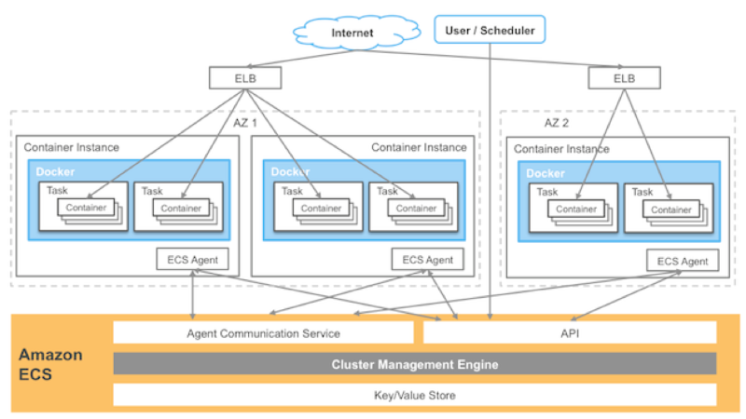
AWS EC2 container management
© Len Bass 2015

Slide 38
AWS Lambda
AWS also has a facility called “Lambda” that consists of preloaded OS + execution engines. Exists for
  Java
  Node.js
  Python
  C#
AWS maintains pool of partially loaded containers that only require app specific layer.
  Load in micro secs.
  Only one request per Lambda instance
© Len Bass 2015

Slide 39
Summary
A container is a lightweight virtual machine that provides address space, network, file isolation
Docker allows building images in layers and deployment of a new version just requires deploying layers that have changed.
Containers can be managed either on VMs through autoscaling or on preallocated pool for short duration, quick loading
Development workflow is supported through an image repository.
© Len Bass 2015

