Slide 1
The Art and Economics of Enterprise R&D Decision Making
David Rosen & Edward Pershwitz Huawei USA, R&D Competence Center DevOps Enterprise Summit, October 2015
Notes:
More Information:
Hello and welcome listening 《Huawei Telepresence and Videoconferencing Solutions》

Slide 2







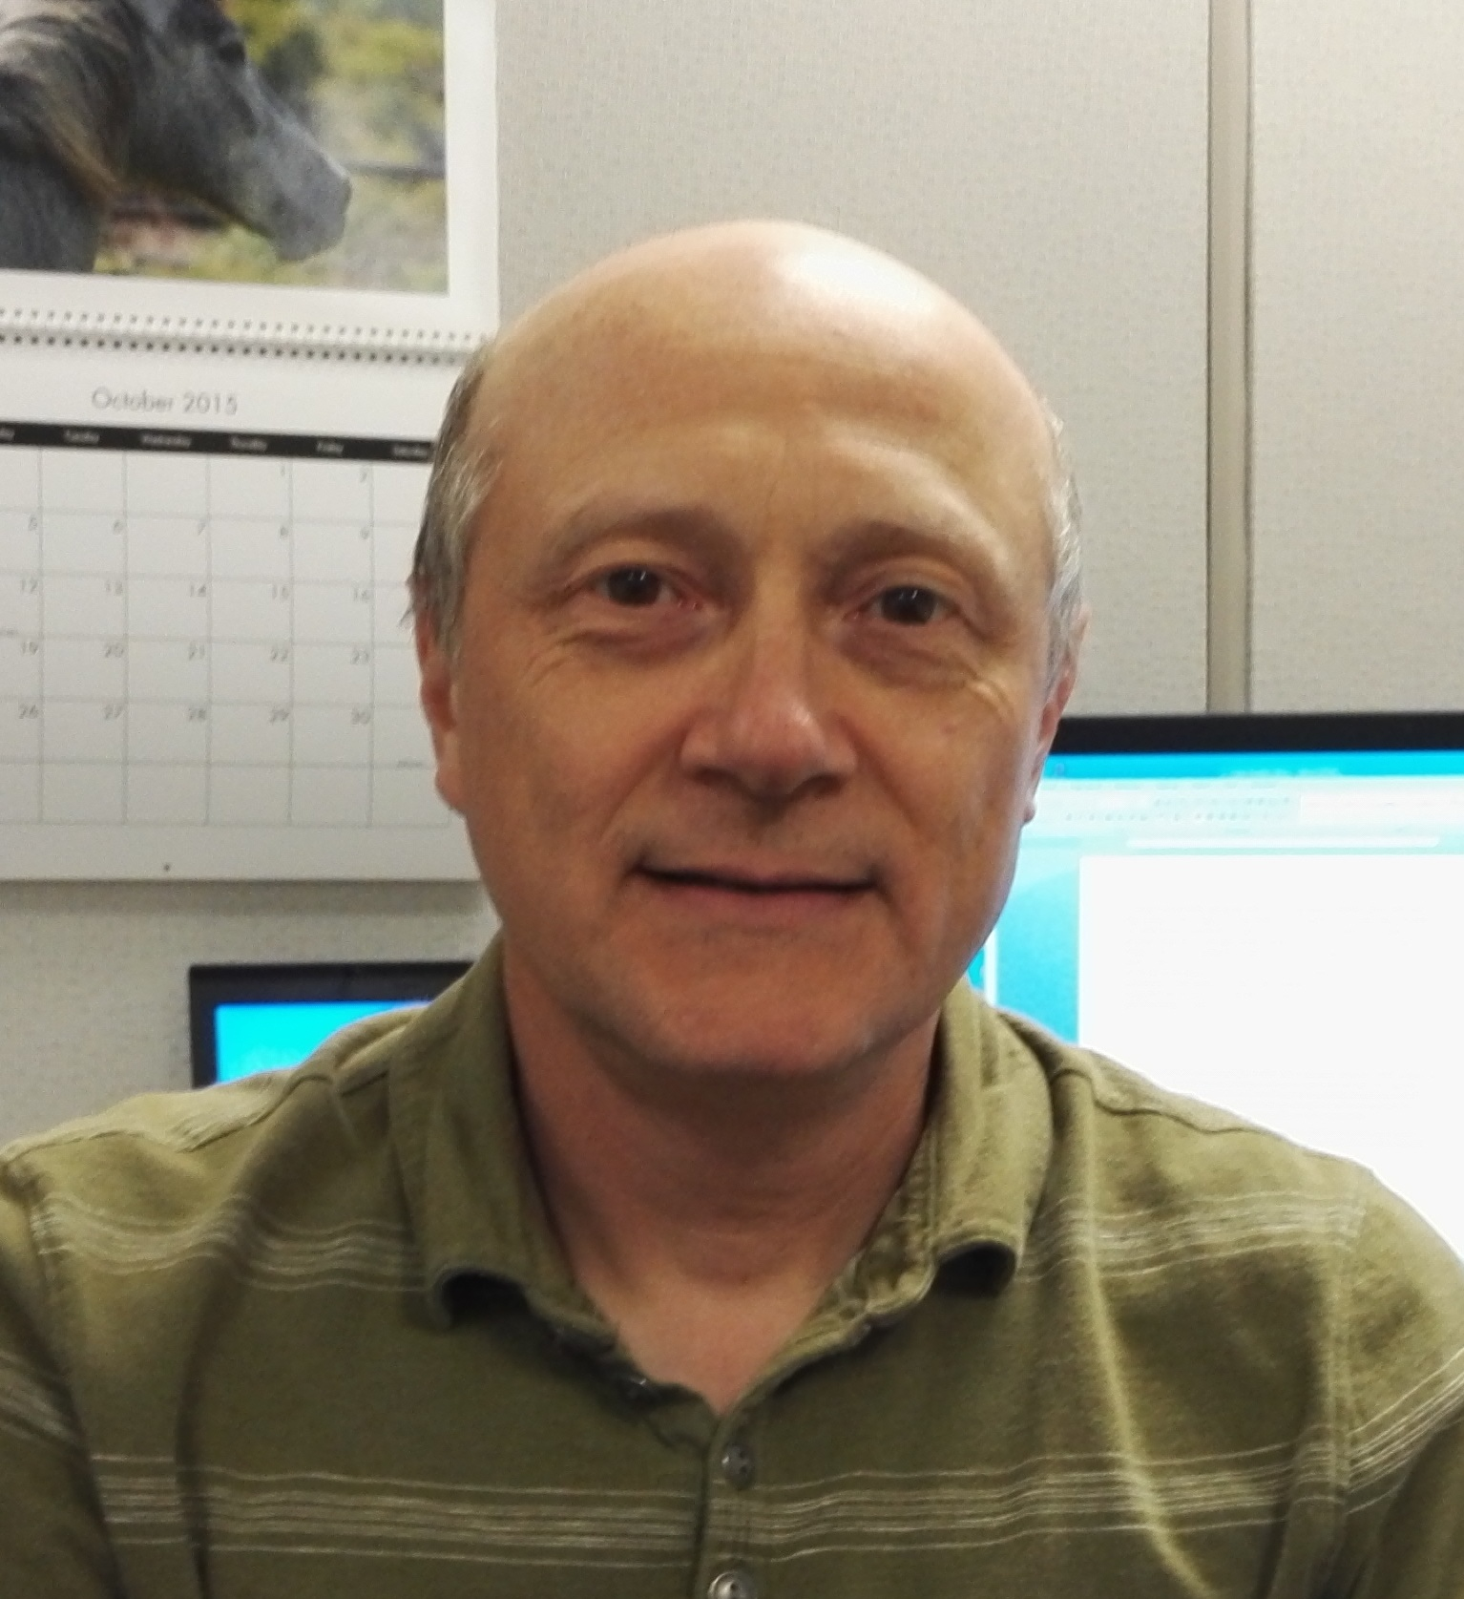



David Rosen
Joined Huawei USA September 2014, as Principal R&D Technology Strategist Now leading the US-based Huawei RDCC R&D Technology Strategy team
Broad experience from Developer Tools and Ecosystems, Continuous Delivery, DevOps, Agile markets
Business Development, Product Management, Technical Sales, Engineering Management, Software Development
Edward Pershwitz
Joined Huawei USA in August 2013 as Principal R&D Tools Infrastructure Architect Lead for the America RDCC R&D Tools Architecture team
30 years of extensive software design/architecture, solution architecture, and automation experience
Vision, Introduction and implementation of cost-effective innovative solutions
Notes:
Key Messages:
Huawei is a global leader of ICT solutions. Continuously innovating based on customer needs, we are committed to enhancing customer experiences and creating maximum value for telecom carriers, enterprises, and consumers. Our telecom network equipment, IT products and solutions, and smart devices are used in 170 countries and regions. Huawei ranked 285th on the Global Fortune 500 in 2014.
We invest over 10% of our annual sales revenue into R&D and more than 45% of our 150,000 employees engage in R&D. We have built 16 R&D centers worldwide and 31 joint innovation centers with customers.
**********************************
Slide Owner: Wang Jie (00286887), Corporate Marketing Dept
Latest update: May, 2015
Recommended target audience: governments, media, partners and customers not so familiar with Huawei
**********************************
More information

Slide 3
Huawei at a Glance
14
Regions
285
Ranking in
the Fortune
Global 500
~170,000
Employees
170+
Countries
A Global
Leader of ICT
Solutions
16
R&D centers
76,000
R&D employees
31
Joint
innovation
centers
Notes:
Key Messages:
Huawei is a global leader of ICT solutions. Continuously innovating based on customer needs, we are committed to enhancing customer experiences and creating maximum value for telecom carriers, enterprises, and consumers. Our telecom network equipment, IT products and solutions, and smart devices are used in 170 countries and regions. Huawei ranked 285th on the Global Fortune 500 in 2014.
We invest over 10% of our annual sales revenue into R&D and more than 45% of our 150,000 employees engage in R&D. We have built 16 R&D centers worldwide and 31 joint innovation centers with customers.
**********************************
Slide Owner: Wang Jie (00286887), Corporate Marketing Dept
Latest update: May, 2015
Recommended target audience: governments, media, partners and customers not so familiar with Huawei
**********************************
More information

Slide 4
Achieved Effective Growth with CAGR of 14% over the Last Five Years
Sales Revenue
Operating Profit
USD Billion
5.5
46.5
39.5
4.8
4.8
32.4
35.4
27.6
3.3
21.5
3.0
3.3
2009
2010
2011
2012
2013
2014
2009
2010
2011
2012
2013
2014
CNY is the company's functional currency. The USD figures are converted based on the exchange rate at the end of the corresponding year.
Notes:
Key Messages:
In 2014, the ICT industry grew tremendously as 4G was rolled out worldwide. Technological innovations accelerated in the areas of cloud computing, Big Data,and IoT, with smart devices connecting the lives of more people. Having seized these opportunities, we continued to focus on our pipe strategy, streamlined management, and maintained effective growth. As a result, our sales revenue reached USD 46.5 billion in 2014, an increase of over 20% year-on-year. The operating profit reached USD5.5 billion, a year on year increase of 12%.
**********************************
Slide Owner: Wang Jie (00286887), Corporate Marketing Dept
Latest update: May, 2015
Recommended target audience: governments, media, partners and customers not so familiar with Huawei
**********************************
More information:
The reporting entity is Huawei Holdings Co., Ltd.
CNY is the company's functional currency
Huawei is not a public company. Nevertheless, we release our annual report every year with financial data audited by KPMG
USD: CNY exchange rates at the end of the corresponding year:
2009: 6.8255
2010: 6.6070
2011: 6.2949
2012: 6.2285
2013: 6.0569
2014: 6.1958

Slide 5
Focusing on Information Generation, Transmission, Processing, and Storage to Provide ICT Solutions and Services for Three Customer Groups
Serving hundreds of
millions of consumers
Serving global carriers
Focusing on valued industries
Consumer Business
A brand loved by consumers
Carrier Business
Customers' best strategic partner
Enterprise Business
Enterprises' best innovation partner
ICT Product and Solution Provider
Information Generation
Information Transmission
Information Processing and Storage
Smartphones
MBB & home devices
Wearable devices
Vehicle telematics
Mobile network
Fixed network
Telecom software and core network
Enterprise network
M2M connection management platform
Data center infrastructure
Big Data analytic platform
Cloud services
Professional services
Notes:
Key Messages:
Focusing on information generation, transmission, processing and storage, Huawei provides end-to-end innovative ICT solutions and products for carriers, enterprises and consumers. In the age of ICT convergence, this “front shop, back factory" model ensures synergy advantages of solutions while providing flexible and differentiated services based on different requirements of our customer groups.
**********************************
Slide Owner: Wang Jie (00057737), Corporate Branding & Communications Dept, Global Marketing Dept
Latest update: May, 2015
**********************************
More information:
智能手机
MBB终端&家庭终端
可穿戴式终端
车载终端

Slide 6


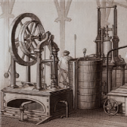


ICT Enables the Fourth Industrial Revolution – Intelligentization
Intelligentization
App
App
App
5G
Cloud
IoT
Big Data
Everything is connected
Mechanization
Electrification
Automation
Everything is intelligent
Following mechanization, electrification, and automation, we have reached the doorstep of the fourth industrial revolution – Intelligentization. Intelligence is embedded into everything including business processes.
ICT technologies such as mobility, cloud, Big Data, and IoT form the foundation of intelligentization.
Notes:
Key Messages:
Society has gone through three transformations, including mechanization, electrification, and automation. At present, ICT is driving a new industrial revolution where everything will become smart. Hundreds of billions of connected machines—from production equipment to household appliances—will possess smart functionality.
5G, cloud computing, the Internet of Things, and Big Data are core ICT technologies that support this new "smart" industrial revolution. Massive amounts of data generated by smart equipment will be collected, transmitted, and processed by ICT infrastructure before being presented to end users.
Like the three revolutions before it, the new “smart” industrial revolution will greatly improve productivity and the quality of life for all.
**********************************
Slide Owner: Liyongqing (89633), WU KEVIN XUHAO (206473), Market Insight Dept
Latest update: May, 2015
Recommended target audience: all
**********************************
More Information

Slide 7
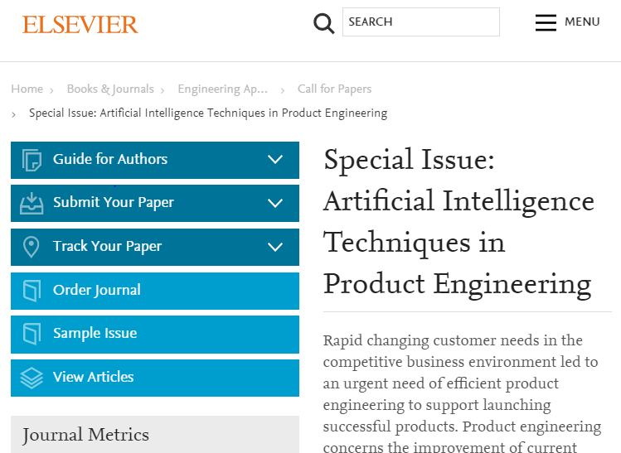
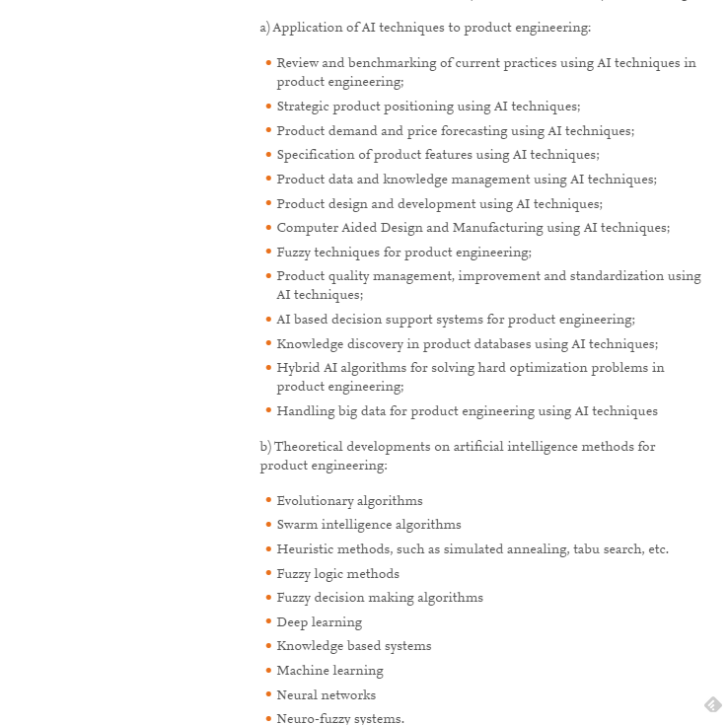
Intelligentization for Product Engineering - Hot Emerging Topic!

Slide 8
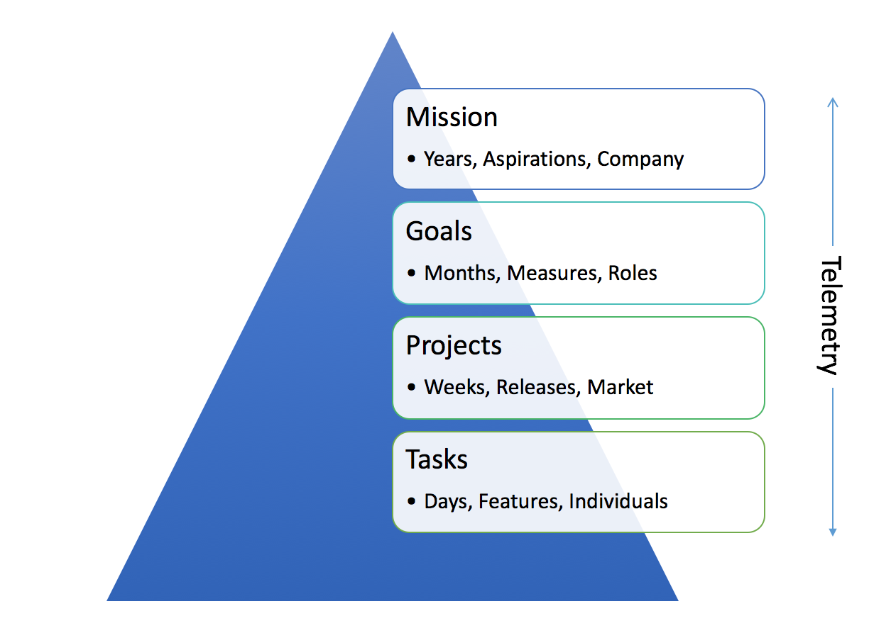
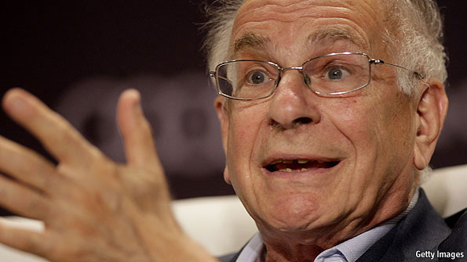

Decision Making Components and Types
Two types of R&D/Product Decisions:
Management: What should be done, and Why?
Engineering: How should it be done, and Why?
Inputs to a decision:
Cognitive System - Heuristics
Environment
Technology
Daniel Kahneman

Slide 9
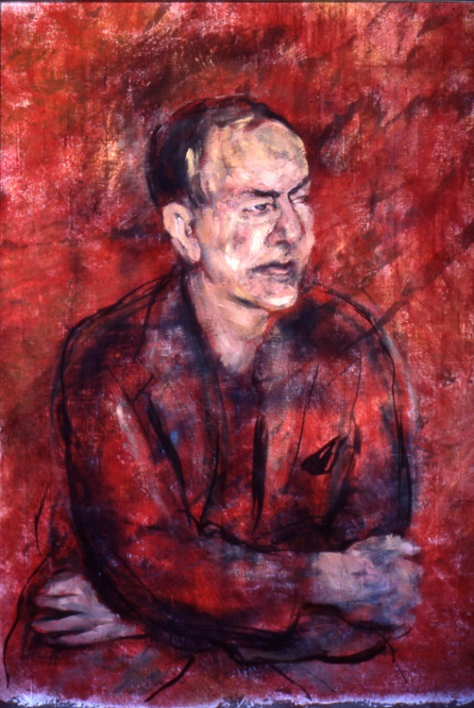
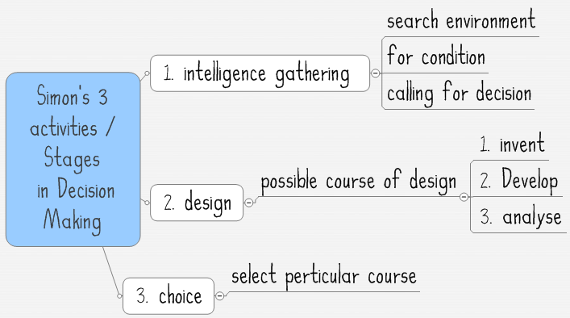
Herb Simon - Grandfather of Business Decision Making
Bounded Rationality
The task of rational decision making is to select the alternative that results in the more preferred set of all possible consequences. Correctness of decision is measured by:
the adequacy of achieving the desired objective
the efficiency with which the result was obtained.
The task of choice was divided into three required steps:
Identifying and listing all the alternatives
Determining all consequences resulting from each of the alternatives
Comparing the accuracy and efficiency of each of these sets of consequences
“information acts as a constraint on decision”
"Herbert simon red complete" by Richard Rappaport. Licensed under CC BY 3.0 via Commons
"Simons 3 stages in Decision Making" by MrunaltPatel - Licensed under CC BY 3.0 via Commons

Slide 10
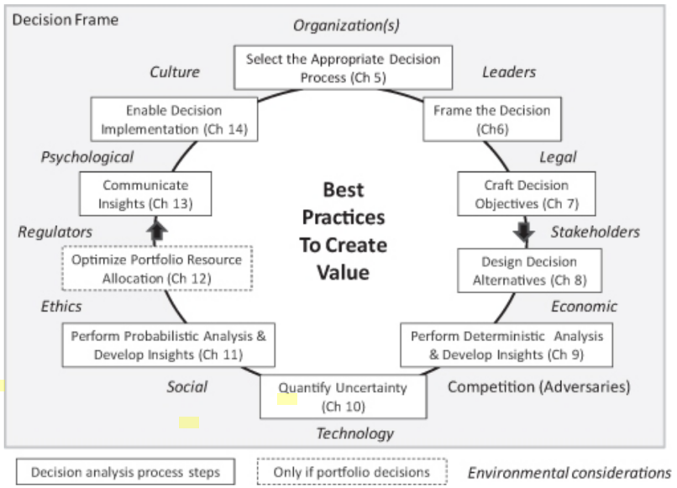
Economics of Enterprise Decision Making
Anecdotal Value of Decision Analysis:
Chevron: $B/y in savings with marginal cost of execution/training
Eastman Kodak: In review of 37 projects, saved $5M-$10M/project

Slide 11
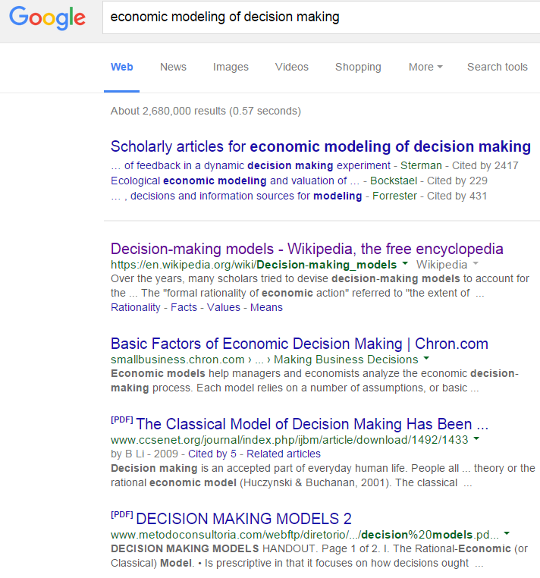
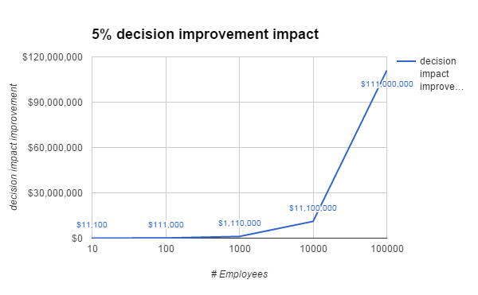
Modeling Economics of R&D Decision Making is a Complex Task!
10% management @ 6 decisions/day @ $10k avg impact
90% engineers @ 18 decisions/day @ $1k avg impact

Slide 12
The QCD Model: Qualitative/Quantitative Customer-Driven Development
Professor Jan Bosch, Chalmers University, Sweden:
Combines qualitative feedback with quantitative customer observation.
Requirements are treated as hypotheses.
Hypotheses are continuously validated with customers and products in the field.
Allows for continuous prioritization of feature content.

Slide 13
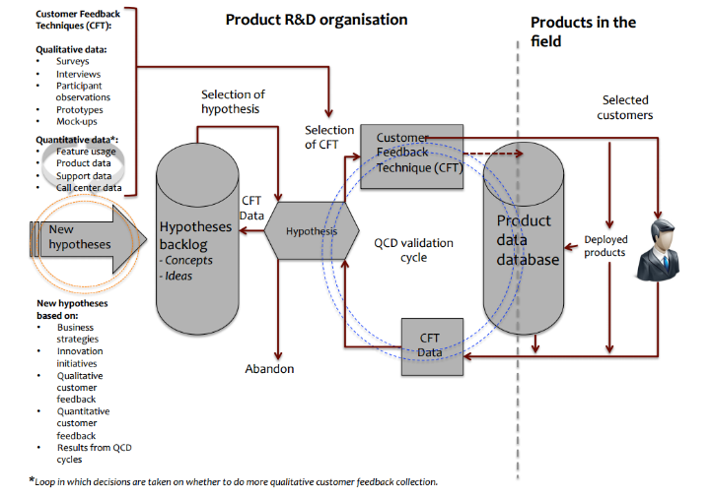
QCD: Continuously Evaluate What is Important for R&D
Hypothesis of what will add value to the user and the product or the system are selected from the Hypotheses Backlog in the case of the mobile – internet model by the architects, product managers, and app developers, among others.
A Customer Feedback Technique (CFT) is selected using the expert system.
Go out to deployed products and/or customers with the hypothesis to determine its validity and prioritization using the CFT and related data.
The CFT data is returned from the internal organization or external customer and deposited in the Product Data database.
The information from the Product Data DB is provided to the expert cognitive system.
Based on the findings a cognitive expert system adds the hypothesis to the backlog based on its priority (higher or lower) to the R&D organization or if no value remove it from the list
Allows for continuous prioritization of hypotheses to know what is important to R&D
Cognitive Expert System

Slide 14
Intelligent Delivery Pipeline
First there was continuous integration...
Then continuous delivery...
Then continuous deployment...
Then DevOps….
Now what?
Development
Quality Assurance
Staging
Production
Continuous Integration
Continuous Delivery
Code
Build
Unit Test
Functional Test
Integration Test
Performance Test
Acceptance Test
Continuous monitoring
Expanding the notion of delivery pipeline to intelligent, adaptive, risk-driven delivery pipeline.

Slide 15
Intelligent Delivery Pipeline
Intelligence comes from turning feedback data into decision making
Example: What does it mean for a test to fail?
D&D
What modules did it hit (code coverage data)
When did it pass last time? What changes happen to code/environment/test itself? (historical data)
Is the failure consistent or intermittent? Is code coverage consistent or varying?
What clues can be given to the developer fixing the bug?
QA
How often does this test break the code?
Is the failure consistent or intermittent? Is code coverage consistent or varying?
How can this data be used for building a strategy for which tests to run given time constraints?

Slide 16
Intelligent Delivery Pipeline
Adaptive: The model capable of self-adjustment based on expert system recommendations
The expert system keeps creating new knowledge from feedback data
Example: Is 80% code coverage enough?
When can we say that the code is sufficiently tested based on AT/field problem reports (evidence-based)?
How does this correlate with branch coverage data?
How does this correlate to static analysis data?
How does this correlate with architecture erosion metrics?
How does this correlate with test selection strategy?
How does this change the definition of “done” given a particular R&D model (quality requirements)?
Does the test selection strategy need to be adjusted?
Delivery pipeline workflow(s) automatically or semi-automatically adapt to new knowledge

Slide 17
Intelligent Delivery Pipeline
Risk-driven: The R&D model adjusts based on risks assigned to decision factors
Product Type:
Mobile App
Mission-critical Infrastructure
Release Cycle:
Daily/Weekly
> 1 year
SW Complexity:
Small/Independent
Large/Interdependent
HW Complexity:
COTS
New proprietary complex
Available skills:
Experienced team /
Existing technology
New team / New technology
Quality/Availability:
Experimental /
Best Effort
0 defects / 5 9’s availability
Outage Response:
Incremental release
Emergency recovery
Risk factor assignment is based on expert opinion. Eventually it should be evidence-based also.

Slide 18


Human Intelligence
Human intelligence is still important…. ugh
Applications are deployed to application servers or on the cloud. Why? Because of on-demand environments that are created for the application execution. These environments provide resources and support a comprehensive set of services the application can use instead of implementing its own.
Expanding this notion to deploying human intelligence to an on-demand environment specifically supporting the user’s role within the R&D process. A comprehensive service layer is custom-tailored to each step of the user’s workflow.
In a sense human intelligence is deployed to the intelligent product delivery pipeline with every tool necessary to interact with the rest of it within a dynamically modeled business process.

Slide 19
Technology and Frameworks
Integration Platform for R&D Services, Workflows, Resources, and Data
Evidence-based R&D Expert System
Big Data Platform and Services
Centralized Service Framework
Workflow Framework
Standardized R&D Tool Chain Service layer with support for custom extensions
Ecosystem open to stakeholder contributions
Shared Data Center Environment
Tiered Resource Management
Fully Automated Execution Environment
User-Centric, Integrated UI Framework
R&D
Model

Slide 20
Current Focus
A single platform supporting all BUs across Huawei; generic support for common functionality with mechanisms for custom extensions
Standardized service layer providing a high degree of reuse; implementation decoupled from contracts for ease of evolution; reduced maintenance
Business practices are workflow-driven; user-task-based/automated/hybrid workflows are customized to individual BU needs
Best practices are captured in sharable models
User interface integrates multiple tools on dynamically defined desktops per role; one UI to learn; user-centric rather than application-centric paradigm
Required functionality is sliced into well-defined individual services that can be recombined to create customized work environments for specific roles; work environments are modeled as a part of business process modeling
Daily activity/collaboration data is captured and analyzed; the accumulated knowledge base becomes the basis for an expert system
Workflow-based automation of the product development/verification/packaging/delivery/support lifecycle
Support for sharing of Lab resources: tiered resource management; lab as a service; standardized data center; high degree of parallelization/equipment utilization/monitoring

Slide 21
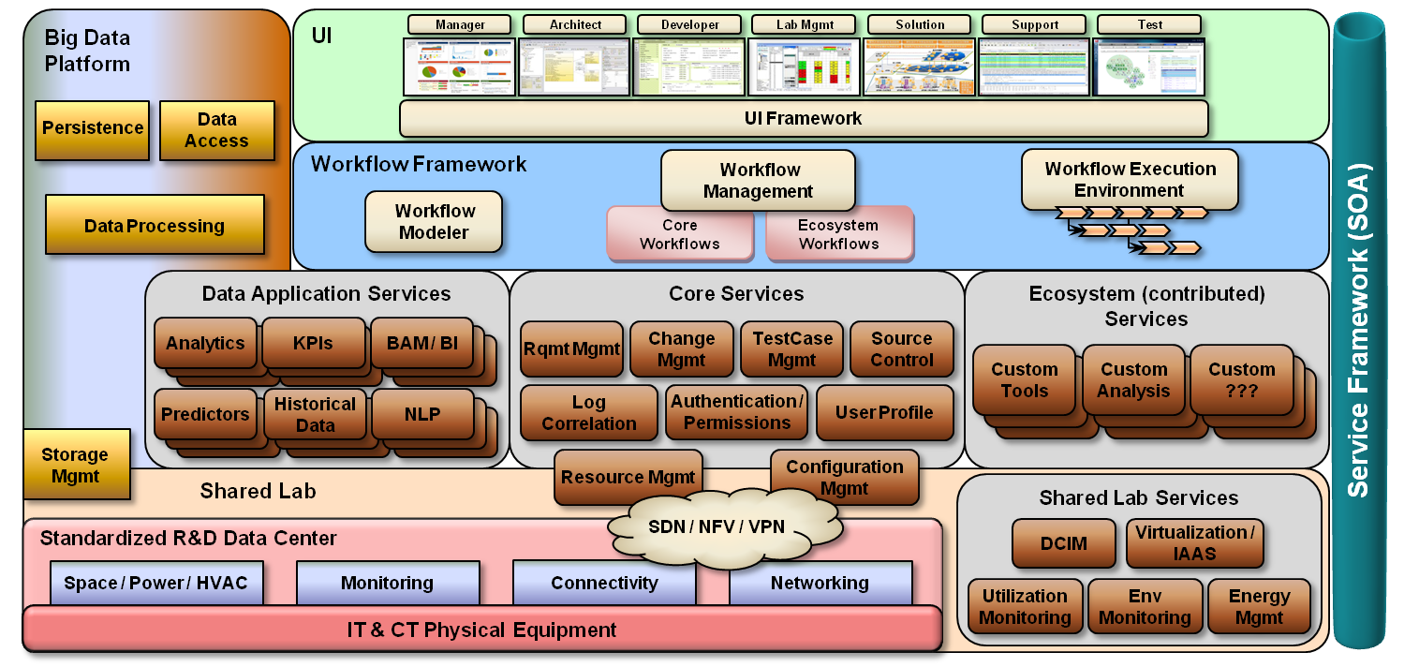
R&D Ecosystem

Slide 22
Conclusion - Top Takeaways:
Effectiveness and efficiency of R&D decision making set up for disruption
Data, Data, Data ⇒ Expert System (Machine Intelligence + Cognitive Computing) ⇒ Guidance
We believe intelligence needs to be embedded as part of the end-to-end development and delivery pipeline
R&D Ecosystem as a container for human intelligence, maximizing productivity and creativity
We certainly don’t have all the answers, but are actively investing in, and researching this emerging area
Sound Interesting? Come talk to us to explore how we can work together!

