Slide 1
ITIL. You keep using that word.
I don’t think it means what you think it means.
Kaimar Karu
Head of Product Strategy
and Development, AXELOS
@kaimarkaru

Slide 2
何不食肉糜？
APPRECIATE THE CONTEXT
@kaimarkaru
Notes:
From: Emperor Hui of Jin

Slide 3





APPRECIATE THE JOURNEY
@kaimarkaru

Slide 4
PROCESS MANAGEMENT
@kaimarkaru

Slide 5


CUSTOMER VALUE
?
@kaimarkaru

Slide 6

LACK OF COLLABORATION
No!
@kaimarkaru

Slide 7
COMMON ANTI-PATTERNS
By-the-book ITIL ‘implementations’
Ideal world process documentation
Expensive ‘Level 5’ maturity projects
‘Watermelon’ SLAs
CAB used as ‘Change Approval Board’
Search for the silver bullet
@kaimarkaru

Slide 8
DEFINING SERVICES
„A means of delivering value to customers by facilitating outcomes customers want to achieve without the ownership of specific costs and risks.“
@kaimarkaru

Slide 9
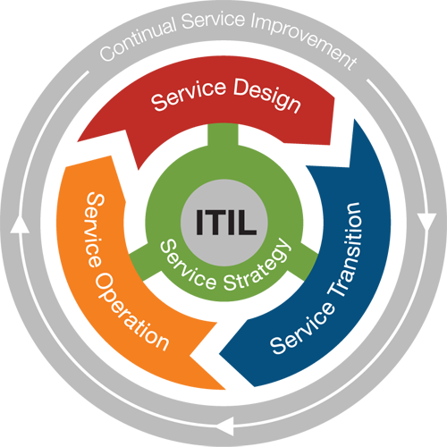
THE FLOW OF SERVICE MANAGEMENT
Strategy: who are the customers and what services they require to solve their problems
Design: how should the services look and feel like, and what capabilities are needed to provide them
Transition: how to develop, test, integrate, and release services
Operation: how to support live services, and how to provide a great customer and user experience
@kaimarkaru

Slide 10








SERVICE MANAGEMENT
$
@kaimarkaru

Slide 11
SERVICE MANAGEMENT AND DEVOPS (TRAD.)
Service Management
Delivering value rapidly and continually
Continual Service Improvement
Service Strategy
Service Design
Service Transition
Service Operation
Software Development
Product Strategy
Product Architecture
Prioritize and Develop
Build and Test
Deploy
Continuous Integration
Continuous Deployment
More harm than good
@kaimarkaru
Considered to be missing

Slide 12
ITIL AND THE THREE WAYS OF DEVOPS
Service Strategy
Service Transition
Business Relationship Management
Demand Management
Service Portfolio Management
Service Level Management
Availability Management
Capacity Management
Change Management
Release & Deployment Management
Configuration Management
Incident Management
Problem Management
Request Fulfilment
Service Design
Service Operation
Flow
Feedback
Experimentation and learning
@kaimarkaru

Slide 13
CONTINUAL SERVICE IMPROVEMENT: THE THIRD WAY
ID
Date raised
Size (small, medium, large)
Timescale (short-, medium-, long-term)
Description
Priority
KPI metric
Justification
Raised by
To be actioned by
Date required by
What is the vision?
Where are we now?
How to keep the momentum going
Where do we want to be?
How do we get there?
Did we get there?
@kaimarkaru

Slide 14
OPERATIONS AS A PLATFORM
Security
Continual Service Improvement
Service Strategy
Service Design
Service Transition
Service Operation
PLATFORM SERVICES
Product Strategy
Product Architecture
Prioritize and Develop
Build and Test
Deploy
Continuous Integration
Continuous Deployment
Quality
@kaimarkaru

Slide 15

ITIL GUIDING PRINCIPLE #1
FOCUS ON VALUE
All activities must deliver customer value
The customer determines what is of value
Not all ‘improvements’ deliver value
$
@kaimarkaru

Slide 16

ITIL GUIDING PRINCIPLE #2
DESIGN FOR EXPERIENCE
Understand the interactions
Walk a mile in your customer’s shoes
Empathy is the key
@kaimarkaru

Slide 17

ITIL GUIDING PRINCIPLE #3
START WHERE YOU ARE
Understand the vision and the direction
Seek out the value in what you have
Leverage what already exists
@kaimarkaru

Slide 18

ITIL GUIDING PRINCIPLE #4
WORK HOLISTICALLY
Organizations are complex systems
Value is co-created through interactions
Local optimization != value
@kaimarkaru

Slide 19

ITIL GUIDING PRINCIPLE #5
PROGRESS ITERATIVELY
Avoid ‘big bang’ change initiatives
Keep each improvement manageable
Keep delivering value, continually
@kaimarkaru

Slide 20

ITIL GUIDING PRINCIPLE #6
OBSERVE DIRECTLY
Understanding context is important
Direct observations trump reports
Going to the source kills assumptions
@kaimarkaru

Slide 21

ITIL GUIDING PRINCIPLE #7
BE TRANSPARENT
The unknown is scary
Missing information is replaced by myths
Transparency creates supporters
@kaimarkaru

Slide 22

ITIL GUIDING PRINCIPLE #8
COLLABORATE
Understand the end-to-end flow
Work with your customers and users
Manage your stakeholders
@kaimarkaru

Slide 23

ITIL GUIDING PRINCIPLE #9
KEEP IT SIMPLE
Minimum Valuable Process
Minimum Valuable Procedure
Minimum Valuable Reporting
@kaimarkaru

Slide 24




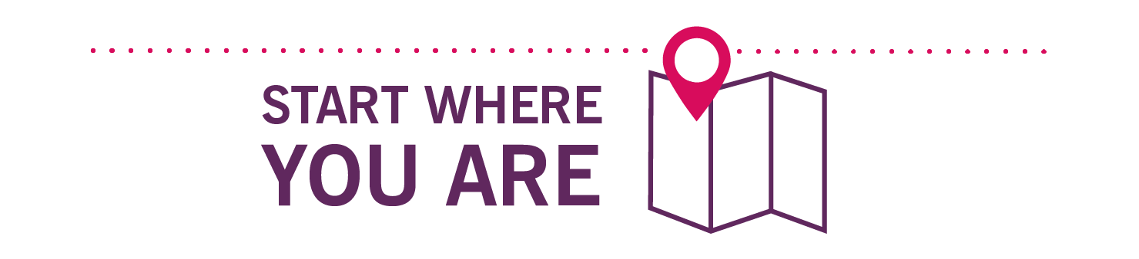
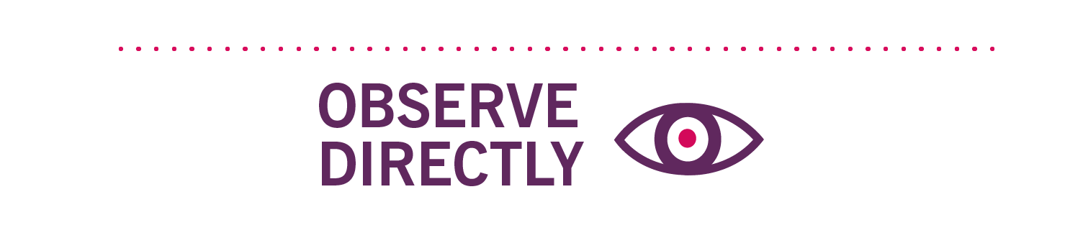



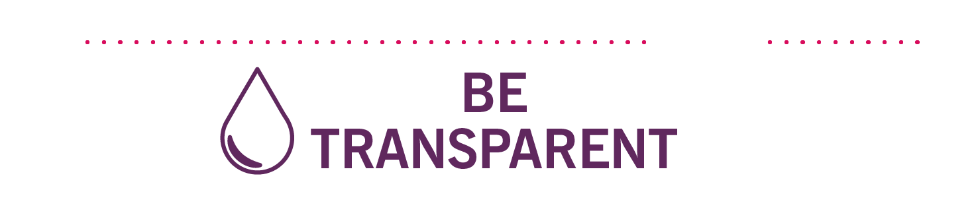
ITIL GUIDING PRINCIPLES
@kaimarkaru

Slide 25
Thank you!
@kaimarkaru
WWW.AXELOS.COM

