Slide 1

Notes:
*looks good

Slide 2


Notes:
EC logo

Slide 3
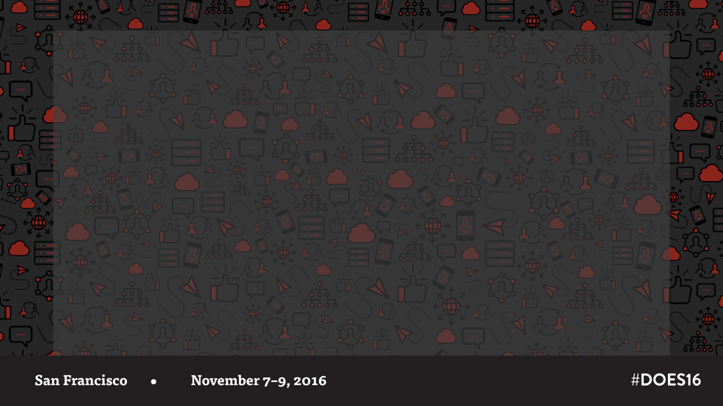
Wi-Fi
Network: devopsenterprise
Password: does2016
As a courtesy to your fellow attendees, please limit your
usage to 2 devices. Please refrain from live streaming
the event on site. Thank you!

Slide 4
Registration Yosemite
Monday, November 7 | 7:00 a.m.–5:00 p.m.
Tuesday, November 8 | 7:30 a.m.–5:00 p.m.
Wednesday, November 9 | 7:30 a.m.–5:00 p.m.
Notes:
Expo Hall photo
*Add Yosemite Ballroom in red like with other room names below Registration

Slide 5

Founding Partner
Notes:
EC logo

Slide 6
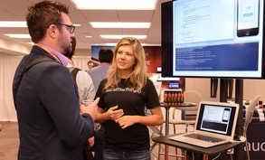
Expo Hall Hours
Monday | 11:30 a.m.–4:00 p.m.
Tuesday | 10:00 a.m.–4:00 p.m. & 5:30 p.m.–7:30 p.m.
Wednesday | 10:30 a.m.–3:30 p.m.
Notes:
Expo Hall photo

Slide 7
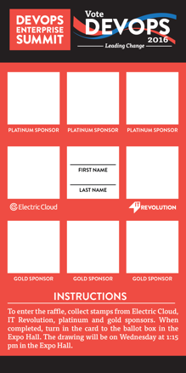
Ballot Game
Collect stamps from Electric Cloud, IT Revolution, and Gold & Platinum sponsors.
Enter to win prizes
iPad Pro, Amazon Echo, BEATS headphones, & more!
Drawing*
Wednesday, November 9, 1:15 p.m. in the Expo Hall
*must be present to win
Notes:
Image of ballot game
*Must be present to win fine print at the bottom.
The prizes area feels super cluttered. What are the three coolest ones and then just put & more! Afterward
Or we could replicate this slide with same headline, put “Thank you to our sponsors who donated awesome prizes!” With their logo lockup (and the ballot in the same place).

Slide 8
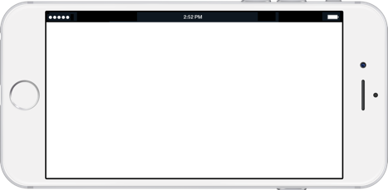

Download the app!
bit.ly/DOES16app
Notes:
*Added link

Slide 9
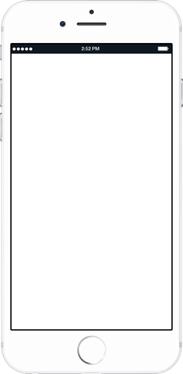



Search “DevOps Enterprise Summit” on the iOS App Store or Google Play Store

Slide 10





Platinum Sponsors
Notes:
Alphabetical order logo lockup

Slide 11

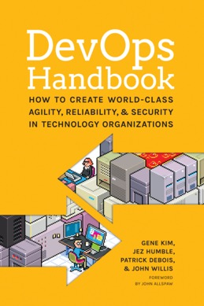
DevOps Handbook is Here!
5+ years in the making
23 chapters
48 case studies
98,124 words
48 images
503 endnotes
192 footnotes
Notes:
DevOps Handbook cover image

Slide 12
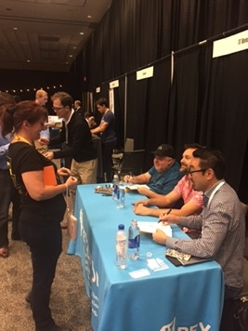

DevOps Handbook
Get your copy compliments of
Book signing during the Vote DevOps Happy Hour at the XebiaLabs booth!
Notes:
DevOps Handbook signing photo
*

Slide 13
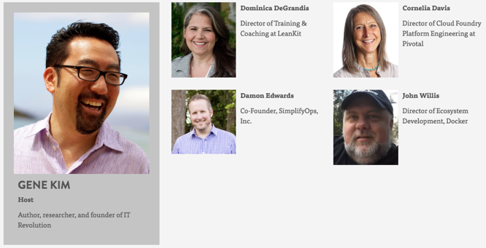
Programming Committee

Slide 14
















Gold Sponsors
Notes:
Alphabetical order logo lockup

Slide 15
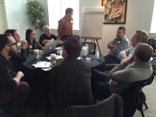
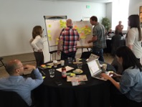
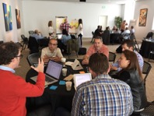
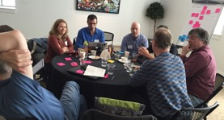
DevOps Enterprise Forum
Leading Change | Organization Design Modern Technology Practices | Compliance and Security
Notes:
Tile these images somehow.

Slide 16
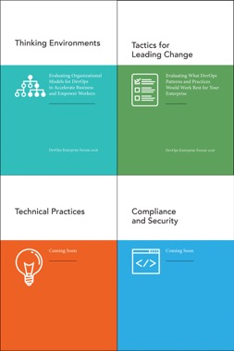
DevOps Enterprise Forum
Download the eBooks
bit.ly/devopsforum
Notes:
Tiled covers of the Forum guidance
*There will be a new image for this year’s papers, but this will do as a placeholder!

Slide 17
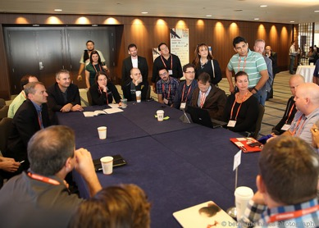
DevOps Workshops Imperial A
Leading Change
Organizational Design
Modern Technical Practices
Security & Compliance
2 Unstructured Open Workshops
Notes:
DevOps Workshop photo

Slide 18













Silver Sponsors
Notes:
Alphabetical order logo lockup

Slide 19




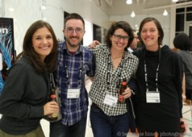
Calling All DOES Alumni
Did you attend DOES 2014, 2015, London 2016?
Stop by the IT Revolution booth and pick up your alumni pins!
Notes:
Alumni photo
Images of pins

Slide 20




Media Partners
Notes:
Alphabetical order logo lockup

Slide 21


Slide decks and videos will be available following the conference.
slideshare.net/ITRevolution
bit.ly/itrevvideos
PLEASE REFRAIN FROM RECORDING SESSIONS.

Slide 22
Code of Conduct
Listen | Share | Respect | Speak Up
If you have any issues, email help@itrevolution.net

Slide 23
Code of Conduct
DevOps Enterprise Summit is dedicated to providing a harassment-free conference experience for everyone, regardless of gender, sexual orientation, disability, physical appearance, body size, race, or religion. All participants shall conduct themselves at all times in accordance with highest standards of decorum and good taste.

Slide 24


Partners
Notes:
Partner logos omit Syft
*omit syft logo pls

Slide 25
Session Evaluations
We want to hear from you!
Open the app.
Locate your chosen session.
Click “Session Evaluation.”
Be sure to click “Finish.”
It only takes a few seconds!

Slide 26

Notes:
*tried to drag and drop the Axelos slide in here and it changed the way it looks! I think it looks better than what they sent over but . . .

Slide 27
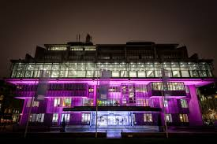

See you in 2017
DOES17
June 5 & 6, 2017
QEII Centre, London
November 13–15, 2017
Hilton Union Square,
San Francisco
Notes:
QEII and Union Square photos

