Slide 1
Shaping the Future of Travel with DevOps and Cloud
Alice Albano
Damien Profeta

Slide 2
Agenda
Amadeus - Who are we?
A bit of history
Benefits, Challenges and opportunities
Technical changes
Key takeaways
Questions

Slide 3
Amadeus - Who are we?
1.
© Amadeus IT Group and its affiliates and subsidiaries

Slide 4
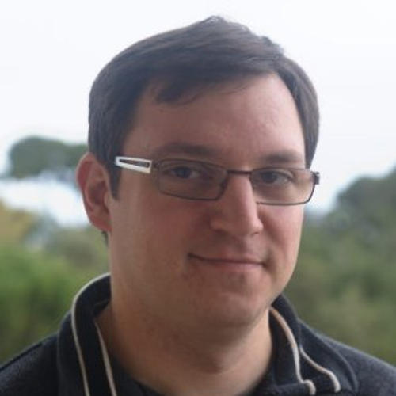
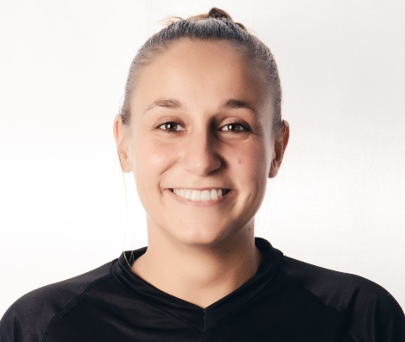
Who are we
Damien Profeta
Expert Software Engineer
Alice Albano
Alice Albano
Software Engineer

Slide 5
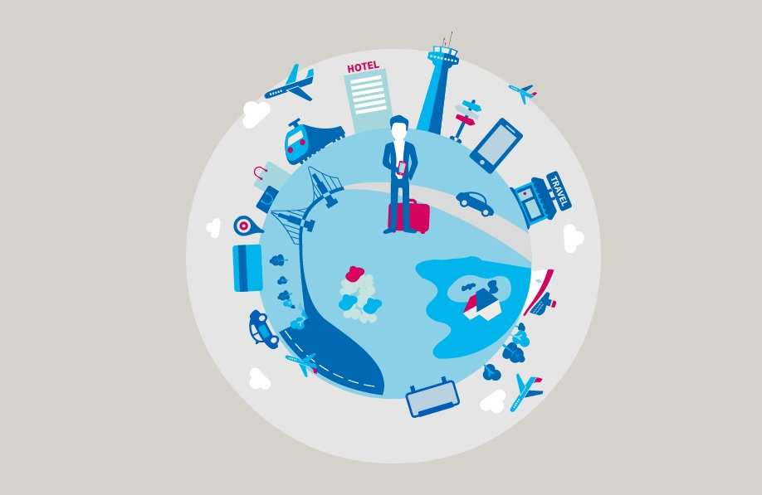
Amadeus - Who are we?
Leading provider
of technology solutions and services
for the entire travel ecosystem
Notes:
airlines, airports and ground handlers, car rental agencies, corporations, cruise and ferry operators, hotels and event venues, insurance providers, travel sellers, tourism boards, travelers themselves and more

Slide 6


Amadeus - Who are we?
From searching for a destination to booking a trip, Amadeus enables travel all over the world
15.000+ professionals
190+ countries

Slide 7
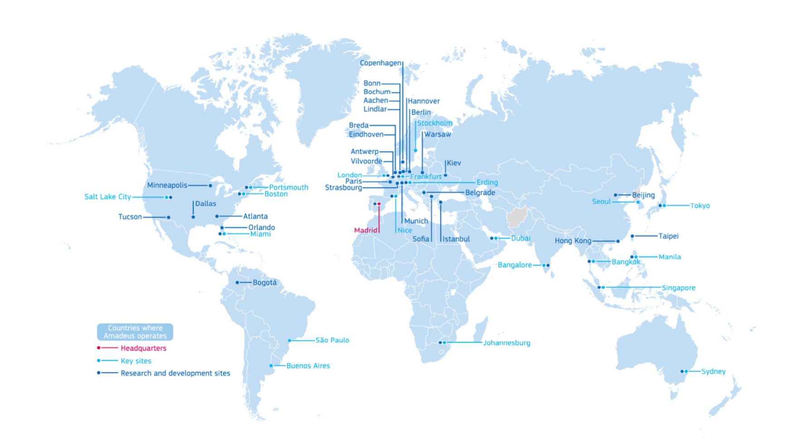
Amadeus - Who are we?
Amadeus’ presence in the world

Slide 8
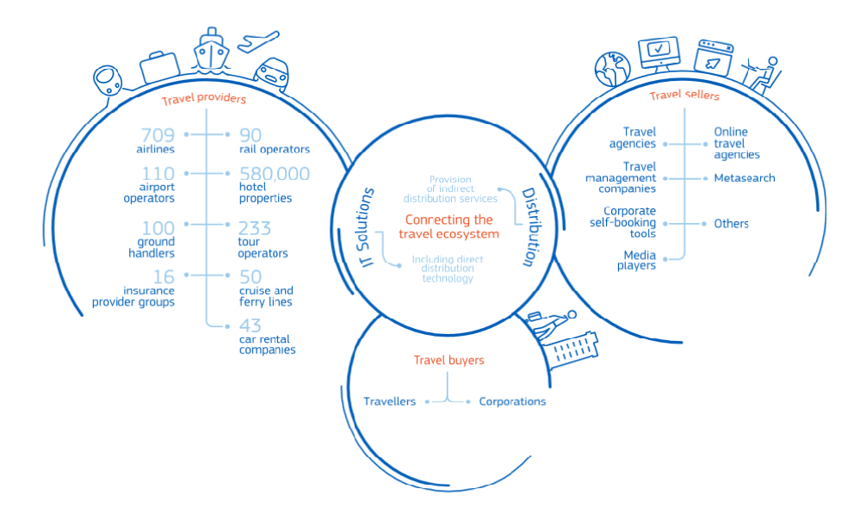
Amadeus - Who are we?
Amadeus at the heart of travel

Slide 9



Amadeus - Who are we?
Amadeus business lines
_Distribution
Enable transactions between travel providers, travel sellers and travellers
_Airline IT
Sales
Analytics
Inventory
Revenue management
_Diversification into new areas
Airports
Hotels
Railways
Notes:
Distribution:
real-time search, pricing, booking, ticketing

Slide 10


Amadeus - Who are we?
Some figures
How many servers do we run?
Hint: Google runs probably over 2M servers
How many incoming transactions per second?
Hint: Google Search represents 60k TPS
How many lines of code do we maintain?
Hint: Facebook represents 60M of lines of code
How many jobs do we maintain?
7K
70K
700K
3K
30K
130K
12M
120M
220M
3K
30K
300K
Notes:
Conclusion: compared to the giants of the Internet, we develop and run applications which are significantly larger and more complex, for a comparable volume of transactions, operated at a much lower scale.
Note: Google is now said to have 2B lines of code

Slide 11
A bit of history …
2.
© Amadeus IT Group and its affiliates and subsidiaries

Slide 12
A bit of history
TPF & G-OPS
Transaction Processing Facility by IBM
Global-Operations
DevOps
Amadeus Cloud Services
ACS & DevOps
Global-Operations
Open Back-End
OBE & G-OPS
Notes:
1991: Creation of WWW

Slide 13
1990: The past
TPF & G-OPS
Transaction Processing Facility by IBM
Global-Operations
DevOps
Amadeus Cloud Services
ACS & DevOps
Global-Operations
Open Back-End
OBE & G-OPS
Notes:
1991: Creation of WWW

Slide 14
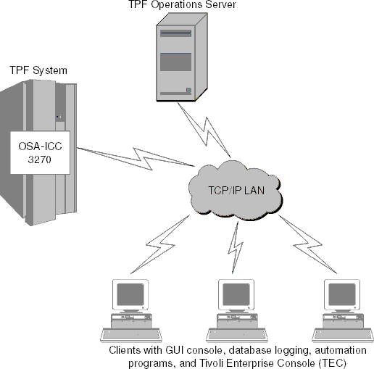
1990: The past
TPF & Global-Operations
TPF for high-performance reservations systems:
High-rate transaction processing
Live update
Developers
Application managers
Delivery
Secure data
Dev of new functionalities
Independent testing
Ensure high-performance 24/7
Manage servers, storage and networks
Software
Changes/activations
Jobs
Standards compliancy
Notes:
Ops:
Set standards to ensure that customer and traveler data is secured and that customers receive the service they need
Ensure compliance to standards across the company
Build and manage the server systems, data storage units and communication networks
Ensure that continuous high-performance services are delivered to customers 24/7

Slide 15
1990: The past
Challenges
A lot has happened since TPF
The internet
Forecast of huge increase of availability traffic
Bad look-to-book ratio
Complementary workloads and processes
Job scheduling
Aging of TPF technology
Maintenance & operating costs
Difficulty to hire new people

Slide 16
2000: The present
TPF & G-OPS
Transaction Processing Facility by IBM
Global-Operations
OBE & G-OPS
Open Back-End
Global-Operations
ACS & DevOps
Amadeus Cloud Services
DevOps
Notes:
2001: Creation of Wikipedia

Slide 17
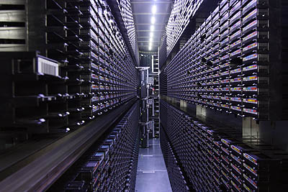
2000: The present
Open Back-End & Global-Operations
Based on open standards or systems:
TCP/IP, Unix, SQL
Some open-source software
But closed applicative stack
Portable software (as far as possible)
Service Oriented Architecture (SOA)
Redundant
Same operational model:
Dev + Application Manager

Slide 18
2000: The present
Challenges
Not enough if you don’t change the operating model
High-available datacenters
Cope with traffic growth
Redundancy
Closer to the client
Legal reason
Human approvals to load in PRD
One load per week in PRD and tested for a whole week
Hardware availability
Getting a new machine might take time
Own made stack prevented us from reusing open-source software
Notes:
Too much power/cooling needed for 1 data center

Slide 19
2000: The present
Goals
Flexible locations
mix of private data centers and public cloud
Optimize the efficiency via progressive automation
Highly scalable hardware
Adaptation to international and industry standards
Notes:
Flexible locations for many reason:
Closer to the client
Too much power/cooling needed for 1 data center
Legal constraint

Slide 20
2015: The future
TPF & G-OPS
Transaction Processing Facility by IBM
Global-Operations
OBE & G-OPS
Open Back-End
Global-Operations
ACS & DevOps
Amadeus Cloud Services
DevOps
Notes:
We wanted to have devops model but to do that we need to have a cloud infrastructure (Iaas/Paas)

Slide 21
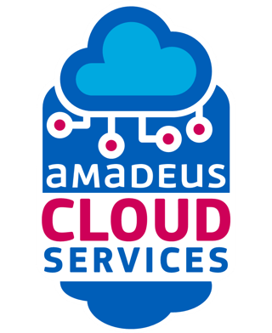
2015: The future
ACS & DevOps
Thanks to DevOps philosophy and cloud technology
developed jointly by our R&D and Global Operations teams to easily deploy applications in any location using automation

Slide 22
Benefits Challenges and Opportunities
3.
© Amadeus IT Group and its affiliates and subsidiaries

Slide 23
DevOps philosophy
Benefits
Technical
Ease local dev
Cultural
More productive teams
Business
Faster time to market
Operational
Continuous build, integration and deployment of software and jobs
Higher engagement
Operate everywhere
Standardization
Automatic recovery
Improved communication and collaboration
More time and interest in innovating
Product ownership

Slide 24
DevOps philosophy
Challenges
Culture change
Operations and developers interactions
What about other teams?
Integration
Maintenance
Support
Tooling change and standardization
Different base platform (Windows, Linux, c++, java, c)
Different source code (clearcase, cvs, mercurial, git)
Notes:
In a few team, developer can’t log on production platform.

Slide 25
DevOps philosophy
Challenges
Eating your own dog food
Improved automation
Improved monitoring
Issue not reported and workarounds
Lack of global ownership in case of incidents
Higher recovery time
Worst communication with customers
Very strict APIs management

Slide 26
Current infrastructure
Challenges
DevOps approach would be too complex and expensive:
Lack of infrastructure automation
Extensive knowledge of underlying hardware and network
Time spent in operating the platform would be too high
Cloud-based architectures come in handy

Slide 27
Cloud-based architectures
Opportunities
Separation and abstraction of the application, platform and infrastructure layers
Flexible management of computing resources
Multi tenancy
Quota limits
Use of standardized, low-cost, low-consumption hardware
Redundancy, Scalability and Isolation
Intrinsic tolerance to system failure
Open source community
Notes:
- Use of standardized, low-cost, low-consumption hardware
Autonomous rack vs data center build
-Support by major IT players via the open source community

Slide 28
Technical changes
4.
© Amadeus IT Group and its affiliates and subsidiaries

Slide 29

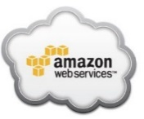
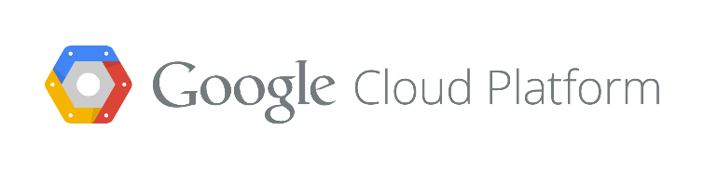
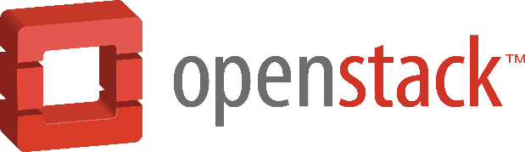
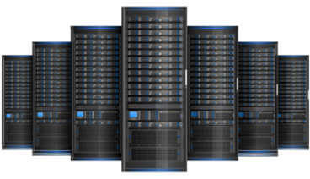

Architecture
App
Any kind of Amadeus application
PaaS
IaaS
HW

Slide 30
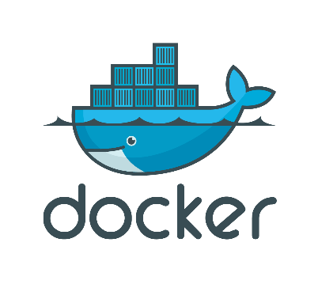
Architecture
Layers
“image”:
To build, ship and run applications on any Linux platform
Unified packaging format (for any type of application)
“container”:
Process isolation

Slide 31
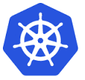
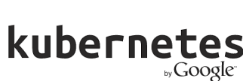
Architecture
Layers
“image”:
To build, ship and run applications on any Linux platform
Unified packaging format (for any type of application)
“container”:
Process isolation
Orchestration of containers
Scheduling
Lifecycle
Health
Monitoring
Cluster management
Scaling

Slide 32

Architecture
Layers
“image”:
To build, ship and run applications on any Linux platform
Unified packaging format (for any type of application)
“container”:
Process isolation
Orchestration of containers
Scheduling
Lifecycle
Health
Monitoring
Cluster management
Scaling
Development Platform
Built upon Kubernetes
Continuous integration and continuous delivery: some new notions like deployment and build
Web console

Slide 33
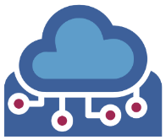

Architecture
Layers
“image”:
To build, ship and run applications on any Linux platform
Unified packaging format (for any type of application)
“container”:
Process isolation
Orchestration of containers
Scheduling
Lifecycle
Health
Monitoring
Cluster management
Scaling
Development Platform
Built upon Kubernetes
Continuous integration and continuous delivery: some new notions like deployment and build
Web console
Amadeus specialization of Openshift:
ESB
Control-M
Databases
Job-as-code
Thousand of jobs in parallel
Hundreds of thousand of defined jobs

Slide 34
Key takeaways
5.
© Amadeus IT Group and its affiliates and subsidiaries

Slide 35
Key takeaways
Technology and organizational model go hand in hand
Change is the mark of success
Operational model is a key factor

Slide 36

Questions?
amadeus.com amadeus.com/blog
You can follow us on:
AmadeusITgroup

Slide 37
Thank you!
amadeus.com amadeus.com/blog
You can follow us on:
AmadeusITgroup

Slide 38
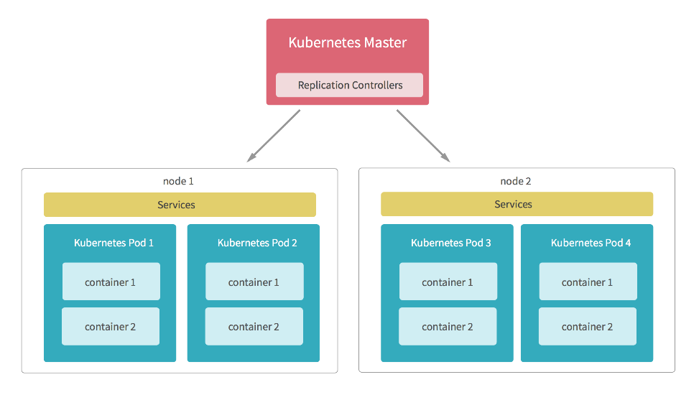
Kubernetes
Kubernetes Master
It controls the overall cluster and runs the API for the cluster.
Nodes
A Node is a physical server (or a VM) inside the cluster.
Pods
A pod is the basic building block in Kubernetes. Inside a pod, you can run one or multiple containers.
Each container shares the allocated CPU, memory, volumes and other resources to a pod.
Replication Controller
It watches the cluster and ensures that a given number of pods are running in the cluster all the time, launching new pods and remove existing ones when needed.
Services
Since pods can be added and removed, services act as a dynamic load balancer for a set of pods.

